Slide 1

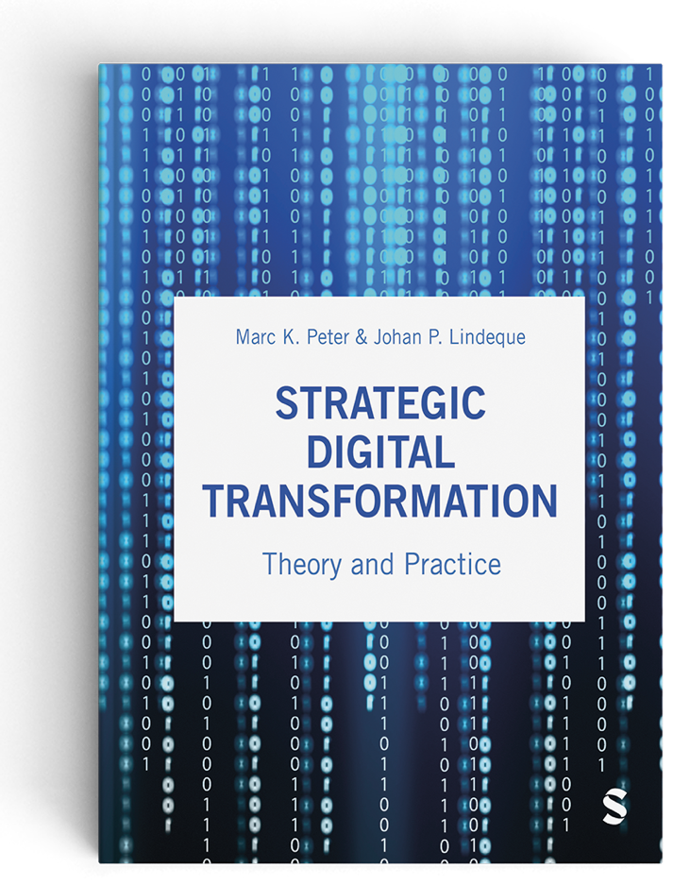
Strategic Digital Transformation
Full Slide Deck
Chapters 01 to 12
© Marc K. Peter & Johan P. Lindeque (2026): Strategic Digital Transformation. Theory and Practice. Sage Publications, London/UK
1

Slide 2
01 Strategic Digital Transformation: Background and Terminology
Chapter 01 of 12
© Marc K. Peter & Johan P. Lindeque (2026): Strategic Digital Transformation. Theory and Practice. Sage Publications, London/UK
2

Slide 3
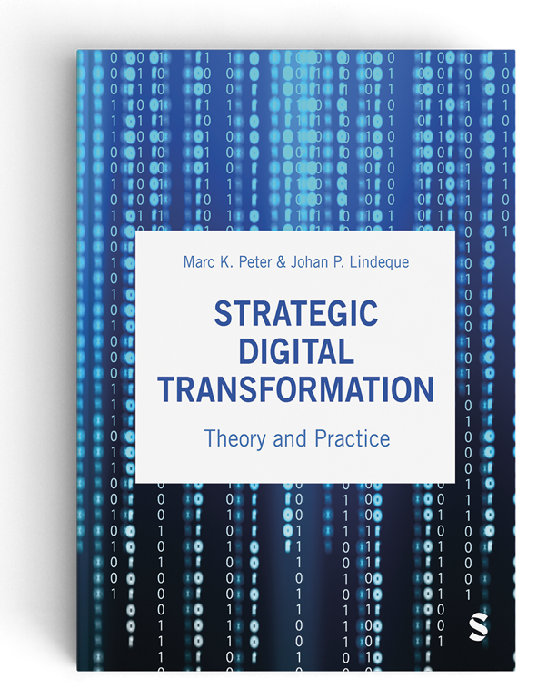


Digital Transformation Textbook
This cutting-edge textbook takes a unique approach to digital transformation which aligns theory and practice and is supported by the authors’ own research with over 4,000 organisations. Covering key topics such as emerging technologies, AI, cybersecurity, customer orientation, operational excellence, marketing automation, innovation and leadership and culture, it offers a learning experience which prepares students for the practical realisation of digital transformation for competitive advantage.
With individual and group exercises and case studies from a range of organisations, Strategic Digital Transformation prepares students to apply the knowledge and experience gained from the book in their future careers. It is suitable for undergraduate and postgraduate digital transformation and digital business courses.
We wish you lots of success and hope that
you will benefit from this textbook!
This cutting-edge textbook takes a unique approach to digital transformation which aligns theory and practice and is supported by the authors’ own research with over 4,000 organisations. Covering key topics such as emerging technologies, AI, cybersecurity, customer orientation, operational excellence, marketing automation, innovation and leadership and culture, it offers a learning experience which prepares students for the practical realisation of digital transformation for competitive advantage.
With individual and group exercises and case studies from a range of organisations, Strategic Digital Transformation prepares students to apply the knowledge and experience gained from the book in their future careers. It is suitable for undergraduate and postgraduate digital transformation and digital business courses.
Marc K. Peter & Johan P. Lindeque
Strategic Digital Transformation
Theory and Practice
2026, 408 pages
Sage Publications, London/UK
www.strategic-digital-transformation.com
Prof. Dr. Marc K. Peter
Dr. Johan P. Lindeque

Slide 4

Foreword
Modern advancements in the economy are characterised by a series of transformative industrial revolutions over the past three hundred years, each driven by groundbreaking technological innovations that reshaped societies, industries, businesses, and the way we live and work. The first industrial revolution, which began in the late 18th century, was driven by the mechanisation of production through steam power and the advent of factories. This era saw a dramatic increase in productivity and the rise of urban centres, fundamentally altering the social and economic landscape. The second industrial revolution in the late 19th and early 20th centuries introduced mass production and assembly lines, powered by electricity. Innovations such as the telegraph, telephone, and internal combustion engine further accelerated industrial growth and global connectivity, resulting in consumer markets.
The third industrial revolution, starting in the mid-20th century, brought automation and the digitalisation of manufacturing processes. The development of computers and the internet revolutionised industries, enabling unprecedented levels of precision and efficiency. This era laid the groundwork for the interconnected world we live in today. We are currently in the midst of the fourth industrial revolution, characterised by the fusion of digital and physical dimensions, creating smart factories and shipping digital societies. As we stand on the brink of the fifth industrial revolution, the focus shifts towards human-machine symbiosis, ethical AI, and sustainable practices. This emerging era emphasises the integration of advanced technologies with human capabilities, fostering collaboration between humans and robots, and prioritising ecological sustainability and social well-being.
In this rapidly evolving landscape, strategic digital transformation is not just an option but a necessity for organisations to remain competitive and relevant. It involves a holistic renewal of business models, processes, and organisational structures, leveraging digital technologies to create new value and drive innovation. This new textbook describes the components and provides a toolkit for strategic digital transformation, which requires a clear vision, a comprehensive digital strategy, a robust implementation plan and a commitment to continuous learning and adaptation.
Organisations that embrace this transformation will be better positioned to navigate the complexities of the digital age, capitalise on new opportunities, and contribute to a more sustainable and inclusive future. It is an exciting time to be part of this journey, and I am confident that the insights and strategies presented in this textbook will provide valuable guidance for young leaders and innovators seeking to thrive in the digital era.
Alois Zwinggi
Managing Director, World Economic Forum
www.weforum.org
© World Economic Forum/Pascal Bitz (Flickr, 2023)

Slide 5














Case Study Collection
Each book chapter has an opening case and suggested case work,
and additional cases are available online as separate documents.
Visit www.strategic-digital-transformation.com for:
  Slide decks for each case (case summaries and illustrations).
  Videos from case organisations (case introductions, promotional clips and interviews).
  The Digital Transformation Toolkit with workshop templates and checklists.
The authors would like to express their gratitude to all participating organisations
and to the contributors (authors and interview partners) of the case studies:

Slide 6
Book Structure
PART 1
FOUNDATIONS
OF DIGITAL
TRANSFORMATION
Chapter 01: Strategic Digital Transformation: Background and Terminology
Chapter 02: Business Strategy in the Digital Age
Chapter 03: Digital Transformation
in Context: Innovation
and Sustainability
PART 2
STRATEGIC ACTION FIELDS (SAF) OF
DIGITAL TRANSFORMATION
Chapter 04: SAF Customer Centricity
Chapter 05: SAF New Digital Technologies
Chapter 06: SAF Data and the Cloud
Chapter 07: SAF New Strategies and Business Models
Chapter 08: SAF Operational Excellence / Process Management
Chapter 09: SAF Digital Leadership and Culture
Chapter 10: SAF Digital Marketing
PART 3
DIGITAL TRANSFORMATION IN PRACTICE
Chapter 11: Success Factors and Metrics for Digital Transformation Implementation
Chapter 12: Transformation in Practice - Digital Transformation Toolkit
PART 4
DIGITAL TRANSFORMATION CASE STUDIES
BRUGG Lifting
City of Lucerne
Switzerland Tourism
Valuu (PostFinance)
With many other case studies (including videos and interviews) available online.

Slide 7
Learning Goals Chapter 01
Be able to understand how technological innovation drove (and is still driving) industrial revolutions impacting businesses, organisations and society.
Be able to identify and critically evaluate how technological innovation includes both opportunities and challenges.
Be able to explain the difference between digitisation, digitalisation and strategic digital transformation.
Be able to explain why different digital maturity levels are observed across individual (business) organisations and countries for national context.
Be able to critically assess why strategic digital transformation is relevant to businesses (and other organisations) for business strategy development.

Slide 8

Opening Case: The Astonishing UK Red Flag Act of 1865

Slide 9
Opening Case: The Astonishing UK Red Flag Act of 1865
was officially known as the Locomotive Act of 1865 (Great Britain, 1869)
aimed to regulate the use of mechanically propelled vehicles on public highways during the late 19th century
is particularly notable for its stringent restrictions on the operation of road locomotives to limit the disruption of the existing transportation infrastructure
was influenced by various factors, including the interests of the railway industry and those who relied on horse-drawn transportation
played a crucial role in shaping the early development of the automotive industry in the UK as it was difficult for investors and entrepreneurs to experiment with early vehicle designs
highlighted need for regulatory framework to manage the introduction of new technologies

Slide 10
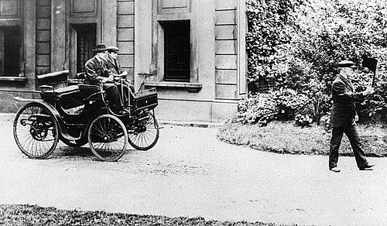
Opening Case: The Astonishing UK Red Flag Act of 1865
Requirements of the Act:
  Any vehicle had to be preceded by a person walking at least 60 yards (55 meters) ahead, carrying a red flag or lantern to warn others of the vehicle's approach
  Very low speed limits for these vehicles: 4 miles per hour (6.4 km/h) in rural areas and just 2 miles per hour (3.2 km/h) in urban areas to prevent accidents and damage to the roads
  Vehicles be manned by a crew of three: a driver, a stoker, and the person carrying the red flag
Discourage of widespread adoption of road locomotives
  Limited practicality and efficiency
  Added operational cost and complexity, reduced convenience

Slide 11
The UK Red Flag Act of 1865 (Great Britain, 1869, sections 3/4) stipulated the following:
  ... while any locomotive is in motion, (one person) shall precede such locomotive on foot by not less than sixty yards, and shall carry a red flag constantly displayed, and shall warn the riders and drivers of horses of the approach of such locomotives, and shall signal the driver thereof when it shall be necessary to stop, and shall assist horses, and carriages drawn by horses, passing the same.
  ... any person in charge of any such locomotive shall provide two efficient lights to be affixed conspicuously, one at each side on the front of the same, between the hours of one hour after sunset and one hour before sunrise.
  ... it shall not be lawful to drive any such locomotive along any turnpike road or public highway at a greater speed than four miles an hour, or through any city, town, or village at a greater speed than two miles an hour; and any person acting contrary thereto shall for every such offence, on summary conviction thereof, forfeit any sum not exceeding ten pounds.

Slide 12
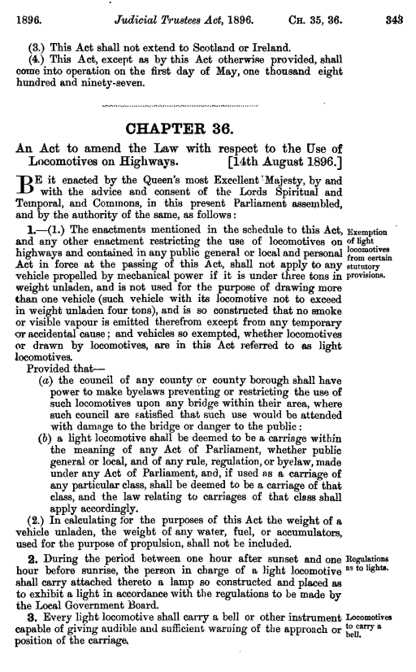
Locomotives on Highways Act of 1896
repealed many of the provisions of the 1895 act, which were recognized as overly restrictive
raised speed limit to 14 miles per hour (22.5 km/h)
removed requirement for a person to walk in front of the vehicle
marked the beginning of a more favourable regulatory environment, which lead to the widespread adoption and transformation of the motor transportation in the UK
enabled investors and manufacturers to experiment with new designs
made motor vehicles more practical and appealing for wider range of uses

Slide 13
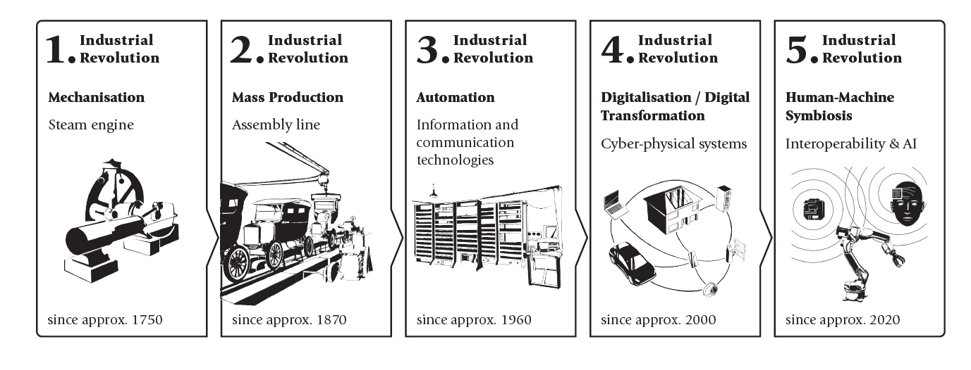
1.0 Technology Innovation and Industrial Revolutions
Industrial revolutions are all driven by innovation in technology
Each affected the lives of citizens and consumers in terms of education, occupation, health and safety.

Slide 14
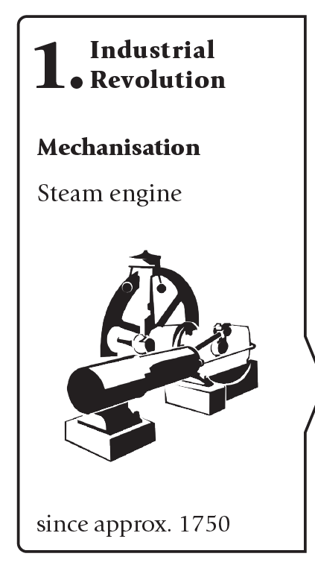
1.1.1 First Industrial Revolution: Mechanisation
Until the eighteenth century, society was dominated by agriculture – tools and muscle power
Major developments: steamship, or later the steam powered locomotive
Greatest increase in productivity in the history of humankind
Coal mining was accelerated and intensified to obtain the needed energy
Importance of banks increased to take out loans for necessary investments
Corporations and joint-stock organisations emerged
Challenging situation faced by workers led to social problems and political upheavals

Slide 15
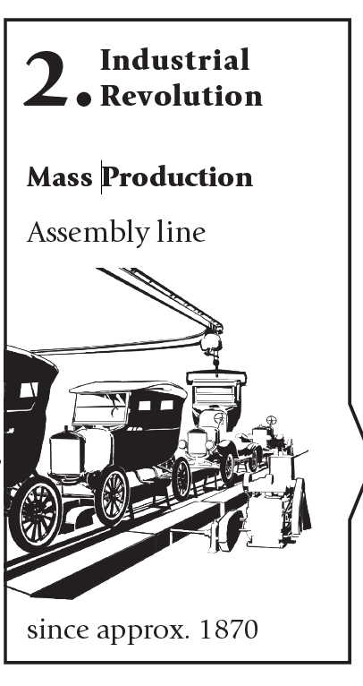
1.1.2 Second Industrial Revolution: Mass Production
New discoveries and inventions: electricity (refrigerators, electric motors, light bulbs) which led to a boom in the growth infrastructure (cities, transport)
In Europe, development focused on electrical engineering and the chemical industries
In the USA, car production experienced a boom due to the invention of assembly-line production (Henry Ford)
  Previously: entire car was assembled at one station, Now: individual stations for each individual sub-step
  Focus on efficiency and mass production
First step towards the globalisation of economic and societal activities (aviation, shipping, telecommunication)
Corresponding management principle is called Taylorism

Slide 16
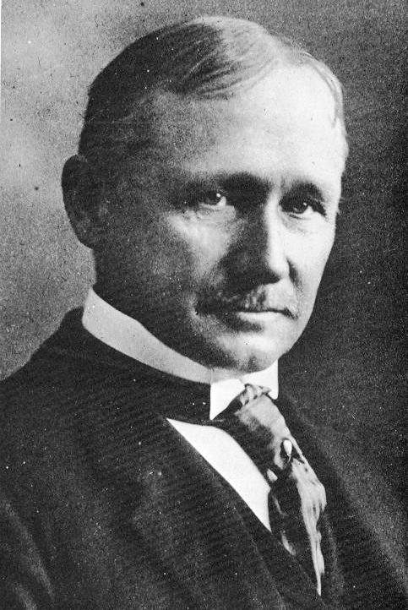
Frederick Taylor’s scientific management (developed in the early 20th century)
is a management theory that emphasises efficiency and productivity through systematic study and optimisation of work processes
Key principles:
  Standardisation: ensure consistency and efficiency
  Time and Motion Studies: analysing time and movements to eliminate unnecessary actions
  Specialisation: assigning workers specific tasks based on skills
  Incentives: performance-based incentives to increase motivation
  Management Control: planning, organizing, supervising work
Critique: Workers were treated as a “resource”, neglecting their social and psychological needs
Grönroos (1994) argues that this approach is becoming obsolete in the face of increasing service competition and changing customer expectations

Slide 17
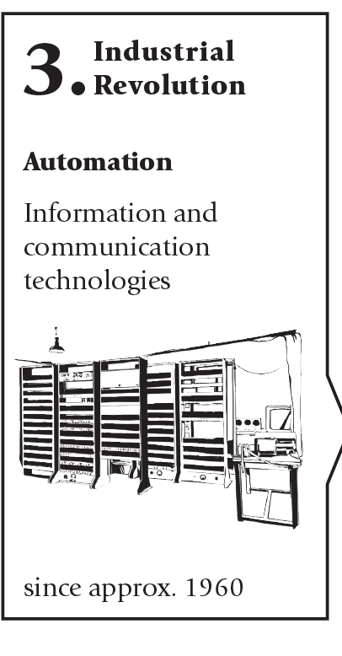
1.1.3 Third Industrial Revolution: Automation
began in the 1970s
Major developments: big calculating machines, programmable logic controllers and (personal) computers
made partial automation and digitisation possible
First large IT organisations were incorporated
For the first time, digital data was being collected and stored
Specific areas of work were taken over by computers or robots
In later decades, shift away from sellers’ markets to buyers’ markets due to an oversupply of products
Organisations with technological innovations achieved a competitive advantage over other firms

Slide 18
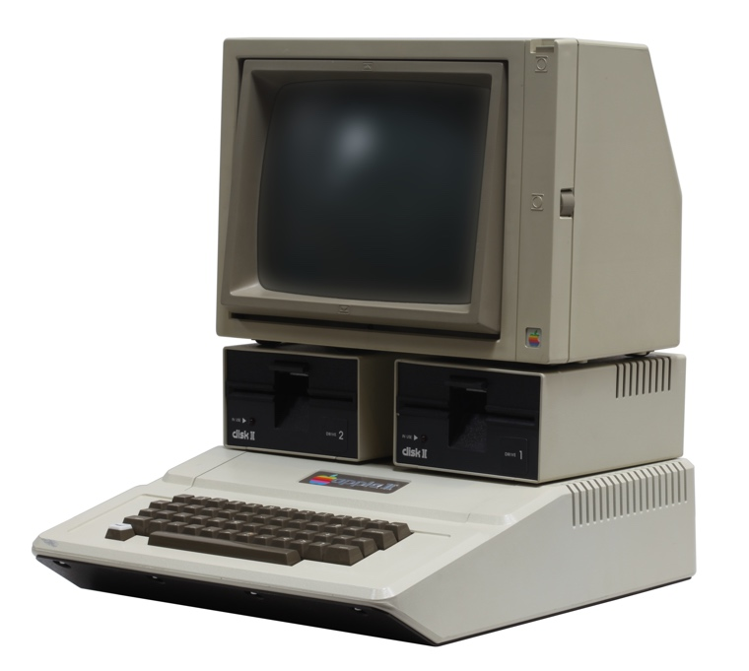
Market entry of computers in consumers’ homes
Development of microprocessors which made it possible to create smaller, more affordable computers.
Initially, primarily of interest to hobbyists as it required to assemble and programme them
Introduction of Apple II in 1977 – focus on user-friendliness and accessibility, aesthetics and ease of use
UK: Sinclair’s ZX80 and ZX81, USA: Commodore’s VIC-20 and Commodore 64
Evolution of home computers was a complex process influenced by technological advancements, hobbyist enthusiasm and strategic marketing (home computer perceived as a multi-functional device for work and play)

Slide 19
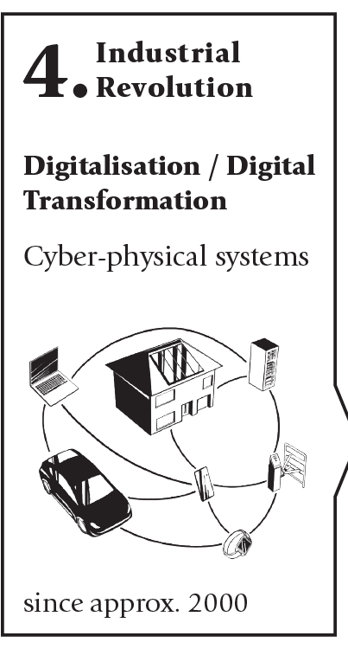
1.1.4 Fourth Industrial Revolution: Digitalisation and Digital Transformation
Still in the middle of this revolution which emerged in around 2000
Characterised by its use of the internet in everyday life and industry (= Internet of Things (IoT)).
Extended network connections, independent communication between machines and real-time information to cyber-physical (production) systems and to intelligent factory (Industrial Internet of Things (IIoT)).
Inherent data generation capacity is a unique feature of all digital technologies, leading to the emergence of the data economy
Managers need to identify and implement new digital tools (apps, platforms) that enable networking and collaboration
Networking of everything is at the heart of the fourth industrial revolution

Slide 20
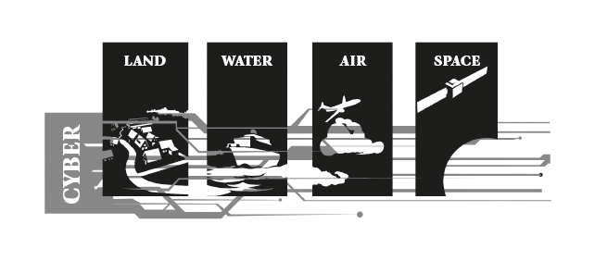
Cyber-physical Systems (CPS)
Concept emerged in the early 2000s
represent a transformative approach to integrating digital technologies with the physical world
are designed to monitor, coordinate, control, and integrate physical processes across the dimensions of land, water, air and space
Components: embedded systems, sensors, actuators and communication networks
address complex challenges related to reliability, real-time performance, security, and interoperability
must be able to operate autonomously, adapt to changing conditions, and ensure the safety and efficiency of operations
offer the potential to revolutionise how we interact with and control the physical world through sophisticated, interconnected and digital systems

Slide 21
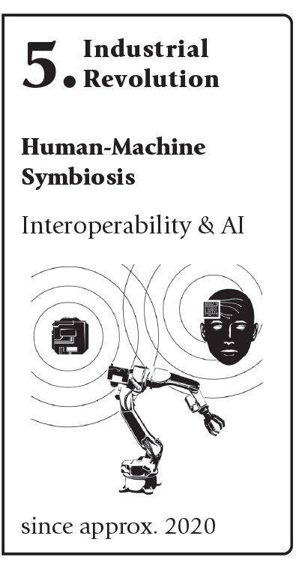
1.1.5 Fifth Industrial Revolution: Human-Machine Symbiosis
aims to continue to leverage advancements of the fourth industrial revolution (cloud data storage, computing power and new interoperability) – Digital transformation at its core
emphasises on an evolving view towards the Industrial Internet of Things (IIoT)
  optimises the human-machine symbiosis (collaborative robots or cobots),
  fosters interoperability, the ability to connect various systems and devices to work together
  implements ethical artificial intelligence models (which, in turn, triggered legal and ethical considerations), and
  focuses on sustainable actions, ecological transformation
“Society 5.0”: New work (reduced working hours, state-sponsored unconditional basic income) and well-being

Slide 22
1.2 Challenges and Opportunities of the Digital Age
Challenges within organisations:
    Dependence on the internet and electricity: protection needed against destruction by natural forces, accidents and human error, cyberattacks, sabotage and misuse using knowledge, capital and resources
    Complexity and digital skills: machine complexity stirs the danger of a totalitarian surveillance state consisting of largely autonomous (cyber-physical) computer systems
    Influence on society: human workers are increasingly replaced by AI and robots in monotonous work but also intellectual work
    Adapt quickly to the new requirements
Society runs the risk of excluding people and widening the digital gap
Educational measures must be taken in order to guarantee equal opportunities

Slide 23
1.2 Challenges and Opportunities of the Digital Age
Opportunities of digital transformation
Customer-driven new business or revenue models | The digitalisation of everything and the market-driven need for new (partly mobile and always available) applications, as well as the resulting opportunities for new business opportunities, are creating innovative business models. These include, for example: Subscription models: monthly fee instead of individual transactions. Peer-to-peer models: customers sell directly without the involvement of intermediaries. Freemium models: the basic version is made available to a wide audience free of charge.
Increased effectiveness and efficiency | One advantage of digital transformation is increased effectiveness and efficiency through digitisation. It also creates opportunities for individuals and small businesses that were previously reserved exclusively for large organisations, for example, the broad and automated communication and distribution of information.
Internationalisation | Digital transformation also plays an essential role in the internationalisation of organisations. As communication and logistics are simplified, it is easier for an organisation to expand internationally following digital transformation.
Challenges of digital transformation
New leadership values and corporate culture | The use of new technologies changes corporate and work processes and, in turn, leadership behaviour and organisational values. The transformation has a direct influence on the culture and – if not planned and considered – can be a risk to the organisation’s principles and values.
Cybersecurity | Increased digitalisation requires investments in the IT infrastructure. Everything is networked with everything else. With cloud-based systems, data is theoretically accessible to everyone, at all times and from everywhere. This increases the complexity and the risks of losing data or being attacked. Cybersecurity becomes increasingly important.
Changes in job profiles and redundancies | Jobs that coordinate or execute individual work or production processes are partly replaced by machines or software. At the same time, tasks and requirement profiles resulting from digital transformation require new (digital) skills. This change is demanding and may lead to job losses.

Slide 24

Flexible working arrangements and working from home
COVID-19 pandemic: home offices and working from home (WFH)
Underscored the critical role of digital transformation in enabling remote work and maintaining business continuity
Flexible working arrangements as a strategic move:
  Enhances employee morale, retention, motivation and commitment
  Opens up opportunities to tap into a broader talent pool, as geographical constraints become less relevant
  Reduced need for physical office space, lower utility costs, and decreased expenditure on commuting allowances, lower carbon emissions

Slide 25
1.2 Challenges and Opportunities of the Digital Age
Strategic DT can be particularly worthwhile for smaller businesses. SMEs
  can benefit from new technologies
  can implement digital solutions (in most cases) much quicker than large organisations
  do not generate quite as much data as large organisations, which makes data quicker and easier to handle
But…
  Transition is associated with major investments in infrastructure and further employee training
  Sufficient attention must also be paid to data and IT security in order to avoid failures

Slide 26








1.3 Digitisation, Digitalisation and Strategic Digital Transformation
Since the early 2000s digital transformation has been the central theme for business strategy development and implementation
Buzzword not only used by consulting firms, but also in board meetings and management teams
Customers can efficiently compare and purchase products and services
New business models merged in the form of new organisations (Alibaba, Baidu, Tencent and Xiaomi in China; and Amazon, Apple, Google and Meta in the USA)

Slide 27
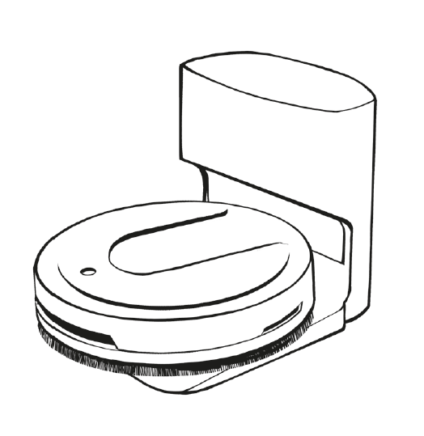
Robot vacuum cleaners: a digital example of the new challenges for organisations
First robot vacuum cleaners were developed at the beginning of the twenty-first century
Examples of differences of traditional vacuum cleaners compared to robots
  Variety of sensors to detect objects and measure spaces, which collect data in an app
  The data obtained is transferred via the internet to a cloud, evaluated using algorithms/AI , which allows efficiency improvements to the product, but also helps to create customer profiles
  The findings help market further products and services by word of mouth and via digital channels.
  Talented employees are needed, whom the organisation can attract with competitive working conditions and a modern working environment
Digital age has become diverse and complex – challenge for leaders of the strategic digital transformation of a business

Slide 28
Digital Transformation Definitions
Definition | Source
"Our working definition of digital business strategy is simply that of organizational strategy formulated and executed by leveraging digital resources to create differential value." | Bharadwaj et al., 2013, 472
"Whatever the end state of digital transformation turns out to be, reaching it is not simply about technology. (...) Digital maturity is the product of strategy, culture and leadership." | Kane et al., 2015, 15
“A managerial perspective of digital transformation (...) is thus two-sided, including the adoption of digital technologies in managerial work and the use of digital technologies that operational employees utilize in their work, associated with the changing nature of the work to be completed.” | Kraft et al., 2022, 474
"... digital transformation (...) is driven by work that takes an internal perspective, i.e. a resource-based view, as well as an external perspective, i.e. one of structural change, and a change in the way value is/can be created as a result. | Kraus et al., 2022, 11
“... digital transformation (can be described) as a process where digital technologies create disruptions triggering strategic responses from organizations that seek to alter their value creation paths while managing the structural changes and organizational barriers that affect the positive and negative outcomes of this process.” | Vial, 2021, 118
"... digital transformation is an ongoing process of using new digital technologies in everyday organizational life, which recognizes agility as the core mechanism for the strategic renewal of an organization's (1) business model, (2) collaborative approach, and eventually the (3) culture." | Warner & Wäger, 2019, 326

Slide 29
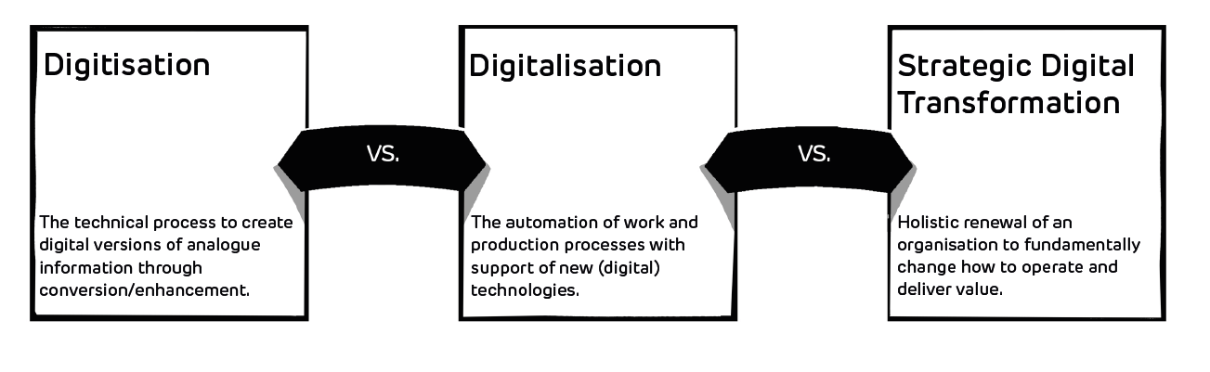
Definitions of the concepts

Slide 30
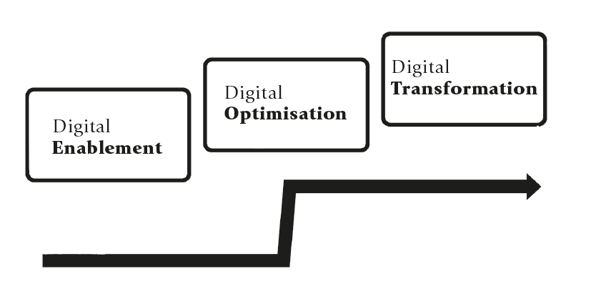
Digital Maturity Levels
Digital enablement (digitisation): creating digital versions of analogue information
  Example: paperless office or the use of online platforms for meetings.
Digital optimisation (digitalisation): improve tasks and processes with technology
  Example: automation of important buiness processes
  Questions about the appropriate technologies, the necessary skills of the employees, the investments, the cultural change and the risks that are being taken
Strategic digital transformation: holistic renewal of the organisation (technologies and business models, new markets)
  Increased investments and risks

Slide 31
Strategy – not technology – drive digital transformation and maturity
Study from 2015 with 4,800 study participants, published in the American MIT Sloan Management Review, found that only 15% of organisations with low digital maturity had a digital strategy
80% of digitally mature organisations had a digital strategy
existence of a digital strategy is therefore related to the progress of digital transformation
Organisations with low digital maturity tend to focus on individual technologies
Digitally mature organisations are much more customer-focused, efficient and innovative, they also find it easier to attract motivated employees
→ employees primarily want to work for digitally progressive organisations

Slide 32
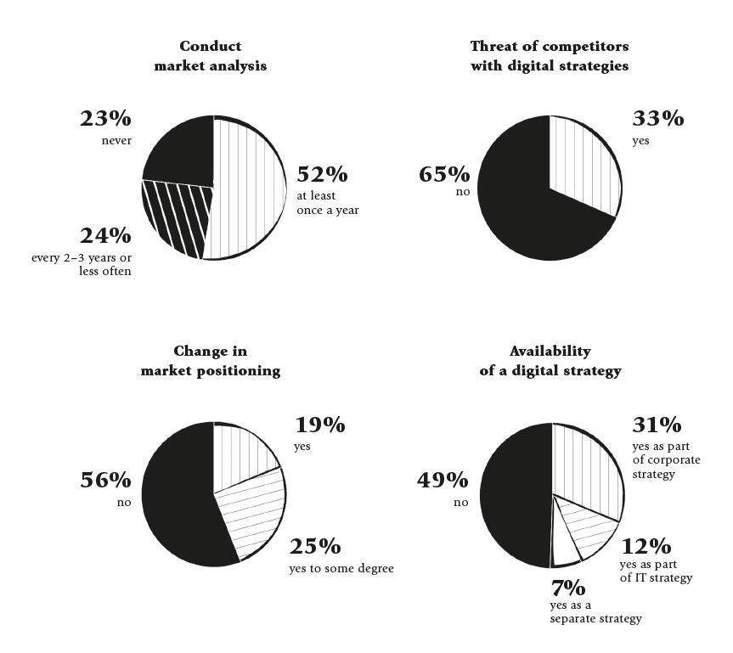
1.4 The Case for Strategic Digital Transformation
Need for a higher degree of strategy planning and implementation in the digital age
Businesses (especially SMEs) often don’t have an analysis of their market and new technology, or a digital roadmap/plan
The progress of digitalisation efforts in SMEs is estimated to be at 56%
The degree of satisfaction with digital transformation is significantly higher among SMEs (81% are satisfied or very satisfied)

Slide 33
An international comparison of digital transformation maturity
IMD’s world digital competitiveness ranking (2023): based on knowledge, technology and future readiness
  Leaders: USA (100%), the Netherlands (98.1%), Singapore (97.4%), Denmark (96.9%) and Switzerland (96.2%); Middle: Japan (75.4%) and Thailand (70.5%); Lower third: India (57.7%), Mexico (51.3%) and Brazil (49.7%)
Dell Technologies’ Digital Transformation Index (2020): based on a survey of 4300 executives of mid-sized to large enterprises
  India (64/100), Mexico (61), Brazil (60), European countries (52 to 60 each), the USA (58), China (58), the UK (54 each), Japan in seventeenth place (38)
EU publication of the European Investment Bank:
  EU firms adopt some technologies fast (advanced, robotics, digital/online platforms, 3D printing and AR/ VR) and lag behind the USA in other technologies (Internet of Things, drones)
  Scandinavian countries are leading the index, with many Eastern European countries being at the end of the list

Slide 34
Results of international comparison of digital transformation maturity
Show differences in the digital maturity of nations (IMD and EU reports) versus the executives’ views of organisations (Dell report)
Important factors to determine digital maturity: technology, data, legislation, cybersecurity, the customer experience, as well as digital skills and culture
Developed countries (and organisations in these countries) seem to have a higher digital maturity than developing countries (and organisations in these countries)

Slide 35
Drivers for the digital transformation
Drivers named by Tangwaragorn et al. (2024):
  Organisational drivers such as culture, human capital, governance and research & development (R&D) and the need for an organisational, digital strategy.
  Operational and management drivers such as improvements in processes and operations, new products and services, and digital business opportunities.
  Technological drivers such as new digital technology, cybersecurity measures, data analytics and strategic data management.
  Environmental and contextual drivers such as government/legal frameworks, collaboration and value creation in the ecosystem, digital literary, and market factors such as economic indicators, labour market dynamics and digital competition.
Collectively form a comprehensive framework for understanding and implementing strategic digital transformation

Slide 36
1.5 Conclusion
The UK Red Flag Act of 1865 highlights the need for a regulatory framework to manage technological advancements, and to strategically respond to new technology and regulation
Each industrial revolution is characterised by significant technological advancements that transformed production processes, societal structures, and economic landscapes
For strategy development, organisations should understand the differences between digitisation (digital enablement), digitalisation (digital optimisation), and strategic digital transformation
Organisations should assess the need, urgency and relevance of these digital maturity levels in the context of current future competition.

Slide 37
Case Studies
You will find a collection of case studies for Strategic Digital Transformation in the appendix and additional cases online at www.strategic-digital-transformation.com.
Step 1: Selection of a case organization
Read the Swiss retail bank case “Valuu: a corporate start-up for digital business model innovation” (sections ‘Background’ and ‘The launch’), or
Select any other major retail bank in your country, or
Identify any other organisation in your country which is well documented (e.g., has a website and social media presence), and which can form the basis for future course work in Chapters 02 to 12 based on the Digital Transformation Toolkit present in Chapter 12.
For options 2 and 3 (if you chose to select another case organisation than Valuu), you should document the following:
Name of the organisation including information about their website and social media profiles.
Organisational facts and figures (e.g., financial metrics, number of employees, products and services, geographical reach; as well as its office, production and distribution locations).
Industry information with challenges and opportunities.

Slide 38
Case Studies
You will find a collection of case studies for Strategic Digital Transformation in the appendix and additional cases online at www.strategic-digital-transformation.com.
Step 2: Case questions linked to this chapter
Describe how each industrial revolution has transformed the business and identify the technology that was the trigger point which led to the need for a new strategy, new skills and new resources (see Chapter 1.0 and Figure 1.2).
Select a new digital technology (e.g., the cloud, sensors as part of the Internet of Things, or AI) and describe the opportunities and challenges of this technology for the business (see also Box 1.4).
Describe how the organisation could utilise technology for 1) digitisation, 2) digitalisation and 3) strategic digital transformation (see Chapter 1.3 and Figure 1.5).
Describe why this organisation would require a holistic, strategic digital transformation, and define the internal and external areas/functions (e.g., processes, marketing, new products and services) in which the organisation should pursue digital transformation.

Slide 39
Exercises
Discuss the following questions in your class, in your group or assignment:
Based on the opening case (UK Red Flag Act of 1865), describe how society today might react to further advancements in AI (artificial intelligence) with new laws, impacting business strategy and operations.
Identify an established industry / sector that you think has been transformed by technologies and explain how each industrial revolution has transformed the business and identify the technology that was the trigger point which led to the need for a new business strategy.
Identify an established large company and describe how they did (or could) utilise technology for 1) digitisation, 2) digitalisation and 3) strategic digital transformation.
Forming two small groups (2-4 students in each group), assign a pro and contra position to each group and debate the degree to which strategic digital transformation is required, or if digitalisation would be sufficient to compete in the digital age.
Select 2-3 countries and use the United Nations' (2025) Digital Development Compass on https://digitaldevelopmentcompass.undp.org to review the nations' digital readiness. Discuss the reasons and drivers for their digital maturity level.

Slide 40
Further Reading List
Gradillas, M., & Thomas, L. D. (2025). Distinguishing digitization and digitalization: A systematic review and conceptual framework. Journal of Product Innovation Management, 42(1), 112-143.
Peter, M. K., Kraft, C., & Lindeque, J. (2020). Strategic action fields of digital transformation: An exploration of the strategic action fields of Swiss SMEs and large enterprises. Journal of Strategy and Management, 13(1), 160-180.
Tangwaragorn, P., Charoenruk, N., Viriyasitavat, W., Tangmanee, C., Kanawattanachai, P., Hoonsopon, D., Pungpapong, V., Pattanapanyasat, R.-P., Boonpatcharanon, S., & Rhuwadhana, P. (2024). Analyzing key drivers of digital transformation: A review and framework. Journal of Industrial Information Integration, 42, 100680.
Vial, G. (2021). Understanding digital transformation: A review and a research agenda. Managing digital transformation, Journal of Strategic Information Systems, 13-66.

Slide 41
References
Acemoglu, D. and Restrepo, P. (2019). Automation and New Tasks: How Technology Displaces and Reinstates Labor. Journal of Economic Perspectives, 33(2), www.aeaweb.org/articles?id=10.1257/jep.33.2.3.
Arsić, M. (2020). Impact of digitalisation on economic growth, productivity and employment. Economic Themes, 58(4), 431-457.
Atack, J., Bateman, F., & Margo, R. A. (2008). Steam power, establishment size, and labor productivity growth in nineteenth century American manufacturing. Explorations in Economic History, 45(2), 185-198.
Bharadwaj, A., El Sawy, O. A., Pavlou, P. A., & Venkatraman, N. V. (2013). Digital business strategy: toward a next generation of insights. MIS Quarterly, 471-482.
Burns, T., Cosgrove, J., & Doyle, F. (2019). A review of Interoperability Standards for Industry 4.0. Procedia Manufacturing, 38, 646-653.
Dell Technologies (2020). Digital Transformation Index 2020: Vanson Bourne Research Findings & Methodology. Dell Technologies, https://www.delltechnologies.com/asset/no-no/solutions/business-solutions/briefs-summaries/dt-index-2020-executive-summary.pdf.
European Investment Bank (2023). Digitalisation in Europe 2022–2023: Evidence from the EIB Investment Survey. European Investment Bank, www.eib.org/economics.
Ford, D. (1980). The development of buyer‐seller relationships in industrial markets. European Journal of Marketing, 14(5/6), 339-353.
Gradillas, M., & Thomas, L. D. (2025). Distinguishing digitization and digitalization: A systematic review and conceptual framework. Journal of Product Innovation Management, 42(1), 112-143.
Great Britain (1869). The statutes of the United Kingdom of Great Britain and Ireland [1807-1868/69]. His Majesty's statute and law printers, p. 183, https://archive.org/details/statutesunitedk30britgoog/page/182/mode/2up (accessed 2 March 2025).
Grönroos, C. (1994). From scientific management to service management: a management perspective for the age of service competition. International Journal of Service Industry Management, 5(1), 5-20.
Gunes, V., Peter, S., Givargis, T., & Vahid, F. (2014). A survey on concepts, applications, and challenges in cyber-physical systems. KSII Transactions on Internet and Information Systems (TIIS), 8(12), 4242-4268.
Haddon, L. (1988). The home computer: the making of a consumer electronic. Science as Culture, 1(2), 7-51.
Hoc, J. M. (2000). From human–machine interaction to human–machine cooperation. Ergonomics, 43(7), 833-843.
IMD (2023). IMD World Digital Competitiveness Ranking 2023. IMD, www.imd.org/centers/world-competitiveness-center/rankings/world-digital-competitiveness.
Kane, G.C., Palmer, D., Phillips, A.N, Kiron, D. and Buckley, N. (2015). Strategy, not Technology, Drives Digital Transformation: Becoming a Digitally Mature Enterprise. MIT Sloan Management Review and Deloitte University Press.
Kraft, C., Lindeque, J. P., & Peter, M. K. (2022). The digital transformation of Swiss small and medium-sized enterprises: insights from digital tool adoption. Journal of Strategy and Management, 15(3), 468-494.
Kraus, S., Durst, S., Ferreira, J. J., Veiga, P., Kailer, N., & Weinmann, A. (2022). Digital transformation in business and management research: An overview of the current status quo. International Journal of Information Management, 63, 102466.
Kyprianou, Emilio (n.d.). The Red Flag Act. The Open University Law School, https://law-school.open.ac.uk/blog/red-flag-act (accessed 2 March 2025).
Marwedel, P. (2021). Embedded system design: embedded systems foundations of cyber-physical systems, and the internet of things (p. 433). Springer Nature.
Mouazen, A. M., Hernández-Lara, A. B., Chahine, J., & Halawi, A. (2025). Triple bottom line sustainability and Innovation 5.0 management through the lens of Industry 5.0, Society 5.0 and Digitized Value Chain 5.0. European Journal of Innovation Management.
Omrani, N., Rejeb, N., Maalaoui, A., Dabić, M., & Kraus, S. (2022). Drivers of digital transformation in SMEs. IEEE Transactions on Engineering Management, 71, 5030-5043.
Peter, M.K. (Hrsg.) (2017). KMU-Transformation: Als KMU die Digitale Transformation erfolgreich umsetzen. Forschungsresultate und Praxisleitfaden. FHNW Hochschule für Wirtschaft, Olten/Schweiz, www.kmu-transformation.ch.
Peter, M.K. (Hrsg.) (2021). Strategieentwicklung im digitalen Zeitalter: Planung und Umsetzung der Digitalen Transformation. FHNW Hochschule für Wirtschaft und Strategylab, Olten/Schweiz, www.strategische-transformation.ch.
Peter, M.K. (2023). Digitaler Masterplan für KMU. So gelingt die digitale Transformation in Ihrem Unternehmen. Verlag Beobachter Edition & Handelszeitung. Zürich/Schweiz, www.digitaler-masterplan.ch.
Peter, M.K. (2024). The Digital Transformation Canvas. Develop and implement your digital strategy. FT Publishing/Pearson, London/UK, www.the-digital-transformation-canvas.com.

Slide 42
References
Peter, M. K., Kraft, C., & Lindeque, J. (2020). Strategic action fields of digital transformation: An exploration of the strategic action fields of Swiss SMEs and large enterprises. Journal of Strategy and Management, 13(1), 160-180.
Peter, M. K., Wuersch, L., Neher, A., Lindeque, J. P., & Mändli Lerch, K. (2024a). The workplace of the future: the COVID-19 pandemic and working from home in Swiss small businesses. Journal of Strategy and Management, 17(4), 707-729.
Peter, M. K., Wuersch, L., Wong, A., & Neher, A. (2024b). Digital transformation of work: Swiss MSEs working from home behaviour during COVID-19–pioneers leading the pack. European Business Review, 36(2), 249-270.
Prassida, G. F., & Asfari, U. (2022). A conceptual model for the acceptance of collaborative robots in industry 5.0. Procedia Computer Science, 197, 61-67.
Sharma, A., & Singh, B. J. (2020). Evolution of industrial revolutions: A review. International Journal of Innovative Technology and Exploring Engineering, 9(11), 66-73.
Tangwaragorn, P., Charoenruk, N., Viriyasitavat, W., Tangmanee, C., Kanawattanachai, P., Hoonsopon, D., Pungpapong, V., Pattanapanyasat, R.-P., Boonpatcharanon, S., & Rhuwadhana, P. (2024). Analyzing key drivers of digital transformation: A review and framework. Journal of Industrial Information Integration, 42, 100680.
Taylor, F.W. (1911): The Principles of Scientific Management: first published in 1911. ‎ Ocean of Minds Media House, River Denys.
United Nations (2025). Digital Development Compass. United Nations Development Programme, https://digitaldevelopmentcompass.undp.org/ (accessed on 2 March 2025).
Vial, G. (2021). Understanding digital transformation: A review and a research agenda. Managing digital transformation, Journal of Strategic Information Systems, 13-66.
Warner, K. S., & Wäger, M. (2019). Building dynamic capabilities for digital transformation: An ongoing process of strategic renewal. Long Range Planning, 52(3), 326-349.
Wilson, J. M. (2014). Henry Ford vs. assembly line balancing. International Journal of Production Research, 52(3), 757-765.
Xu, M., David, J. M., & Kim, S. H. (2018). The fourth industrial revolution: Opportunities and challenges. International Journal of Financial Research, 9(2), 90-95.

Slide 43
Case Study Collection
Each book chapter has an opening case and suggested case work,
and additional cases are available online as separate documents.
The authors would like to express their gratitude to all participating organisations
and to the contributors (authors and interview partners) of the case studies:

Slide 44
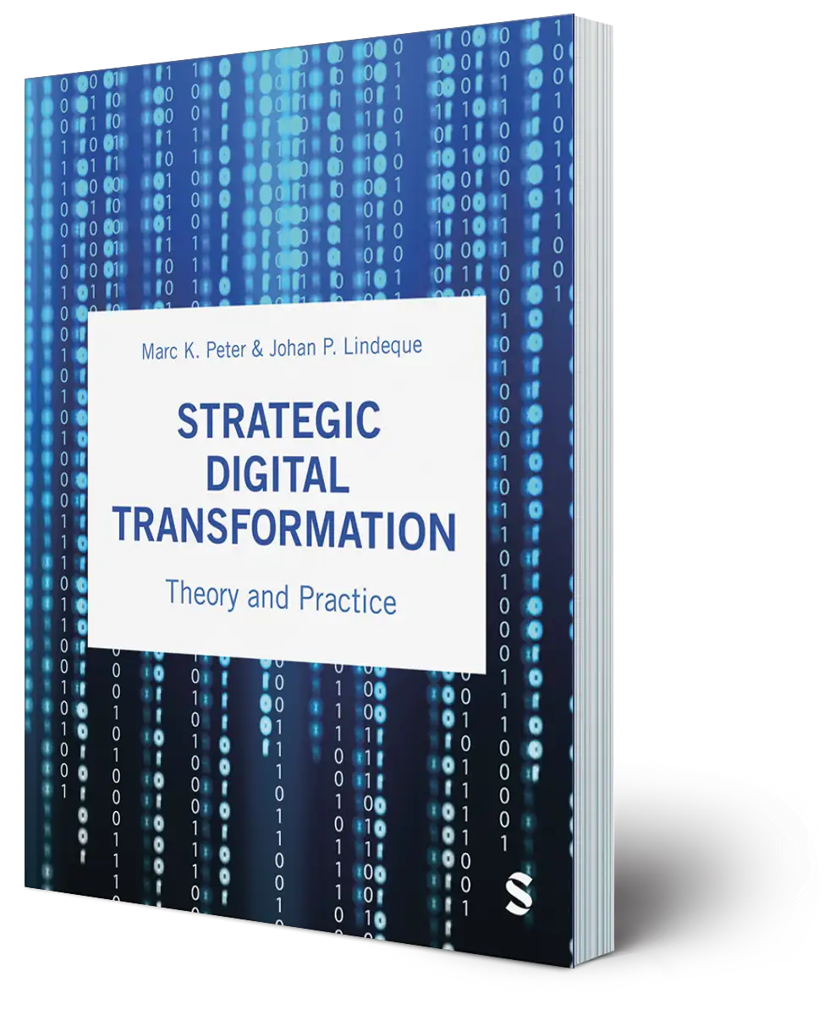
Digital Transformation Textbook
Visit www.strategic-digital-transformation.com
for case studies, videos and workshop templates.
Prof. Dr. Marc K. Peter
Dr. Johan P. Lindeque

Slide 45
02 Business Strategy in the Digital Age
Chapter 02 of 12
© Marc K. Peter & Johan P. Lindeque (2026): Strategic Digital Transformation. Theory and Practice. Sage Publications, London/UK
45

Slide 46
Digital Transformation Textbook
This cutting-edge textbook takes a unique approach to digital transformation which aligns theory and practice and is supported by the authors’ own research with over 4,000 organisations. Covering key topics such as emerging technologies, AI, cybersecurity, customer orientation, operational excellence, marketing automation, innovation and leadership and culture, it offers a learning experience which prepares students for the practical realisation of digital transformation for competitive advantage.
With individual and group exercises and case studies from a range of organisations, Strategic Digital Transformation prepares students to apply the knowledge and experience gained from the book in their future careers. It is suitable for undergraduate and postgraduate digital transformation and digital business courses.
We wish you lots of success and hope that
you will benefit from this textbook!
This cutting-edge textbook takes a unique approach to digital transformation which aligns theory and practice and is supported by the authors’ own research with over 4,000 organisations. Covering key topics such as emerging technologies, AI, cybersecurity, customer orientation, operational excellence, marketing automation, innovation and leadership and culture, it offers a learning experience which prepares students for the practical realisation of digital transformation for competitive advantage.
With individual and group exercises and case studies from a range of organisations, Strategic Digital Transformation prepares students to apply the knowledge and experience gained from the book in their future careers. It is suitable for undergraduate and postgraduate digital transformation and digital business courses.
Marc K. Peter & Johan P. Lindeque
Strategic Digital Transformation
Theory and Practice
2026, 408 pages
Sage Publications, London/UK
www.strategic-digital-transformation.com
Prof. Dr. Marc K. Peter
Dr. Johan P. Lindeque

Slide 47
Foreword
Modern advancements in the economy are characterised by a series of transformative industrial revolutions over the past three hundred years, each driven by groundbreaking technological innovations that reshaped societies, industries, businesses, and the way we live and work. The first industrial revolution, which began in the late 18th century, was driven by the mechanisation of production through steam power and the advent of factories. This era saw a dramatic increase in productivity and the rise of urban centres, fundamentally altering the social and economic landscape. The second industrial revolution in the late 19th and early 20th centuries introduced mass production and assembly lines, powered by electricity. Innovations such as the telegraph, telephone, and internal combustion engine further accelerated industrial growth and global connectivity, resulting in consumer markets.
The third industrial revolution, starting in the mid-20th century, brought automation and the digitalisation of manufacturing processes. The development of computers and the internet revolutionised industries, enabling unprecedented levels of precision and efficiency. This era laid the groundwork for the interconnected world we live in today. We are currently in the midst of the fourth industrial revolution, characterised by the fusion of digital and physical dimensions, creating smart factories and shipping digital societies. As we stand on the brink of the fifth industrial revolution, the focus shifts towards human-machine symbiosis, ethical AI, and sustainable practices. This emerging era emphasises the integration of advanced technologies with human capabilities, fostering collaboration between humans and robots, and prioritising ecological sustainability and social well-being.
In this rapidly evolving landscape, strategic digital transformation is not just an option but a necessity for organisations to remain competitive and relevant. It involves a holistic renewal of business models, processes, and organisational structures, leveraging digital technologies to create new value and drive innovation. This new textbook describes the components and provides a toolkit for strategic digital transformation, which requires a clear vision, a comprehensive digital strategy, a robust implementation plan and a commitment to continuous learning and adaptation.
Organisations that embrace this transformation will be better positioned to navigate the complexities of the digital age, capitalise on new opportunities, and contribute to a more sustainable and inclusive future. It is an exciting time to be part of this journey, and I am confident that the insights and strategies presented in this textbook will provide valuable guidance for young leaders and innovators seeking to thrive in the digital era.
Alois Zwinggi
Managing Director, World Economic Forum
www.weforum.org
© World Economic Forum/Pascal Bitz (Flickr, 2023)

Slide 48
Case Study Collection
Each book chapter has an opening case and suggested case work,
and additional cases are available online as separate documents.
Visit www.strategic-digital-transformation.com for:
  Slide decks for each case (case summaries and illustrations).
  Videos from case organisations (case introductions, promotional clips and interviews).
  The Digital Transformation Toolkit with workshop templates and checklists.
The authors would like to express their gratitude to all participating organisations
and to the contributors (authors and interview partners) of the case studies:

Slide 49
Book Structure
PART 1
FOUNDATIONS
OF DIGITAL
TRANSFORMATION
Chapter 01: Strategic Digital Transformation: Background and Terminology
Chapter 02: Business Strategy in the Digital Age
Chapter 03: Digital Transformation
in Context: Innovation
and Sustainability
PART 2
STRATEGIC ACTION FIELDS (SAF) OF
DIGITAL TRANSFORMATION
Chapter 04: SAF Customer Centricity
Chapter 05: SAF New Digital Technologies
Chapter 06: SAF Data and the Cloud
Chapter 07: SAF New Strategies and Business Models
Chapter 08: SAF Operational Excellence / Process Management
Chapter 09: SAF Digital Leadership and Culture
Chapter 10: SAF Digital Marketing
PART 3
DIGITAL TRANSFORMATION IN PRACTICE
Chapter 11: Success Factors and Metrics for Digital Transformation Implementation
Chapter 12: Transformation in Practice - Digital Transformation Toolkit
PART 4
DIGITAL TRANSFORMATION CASE STUDIES
BRUGG Lifting
City of Lucerne
Switzerland Tourism
Valuu (PostFinance)
With many other case studies (including videos and interviews) available online.

Slide 50
Learning Goals Chapter 02
Be able to explain how the digital age is shifting the sources of firm strategic competitive advantage.
Be able to explain how established theories of firm strategic competitive advantage apply in the digital age.
Be able to critically evaluate the potential of digitisation, digitalisation and digital transformation to allow firms to achieve sustained competitive advantage.
Be able to explain the appropriate approach to the formulation of firm strategies in the digital age.
Be able to critically assess the enablers and inhibitors of the formulation of firm strategies in the digital age.

Slide 51
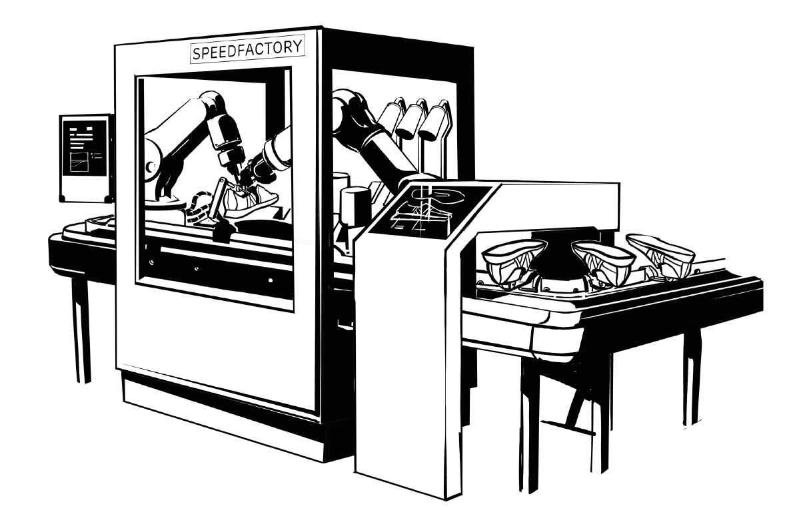
Opening Case: Success Story: Adidas Storefactory and Speedfactory Concepts

Slide 52

Opening Case: Success Story: Adidas Storefactory and Speedfactory Concepts
Adidas designs, produces and markets athletic and sports lifestyle products and is headquartered in Herzogenaurach, Germany.
Adidas invested in experiments with new production approaches, building on the cyber-physical systems of Industry 4.0 with
  Storefactory pop-up store in Berlin from 2016-2017
  Speedfactories located in Ansbach, Germany and Atlanta, USA between 2015 and 2020
Responded to societal trends around personalization and sustainability with the projects
In order to enable short production times, flexibility and responsiveness to consumer demand, the technology and insights were transferred to Asian suppliers, while Speedfactories closed in 2020.

Slide 53
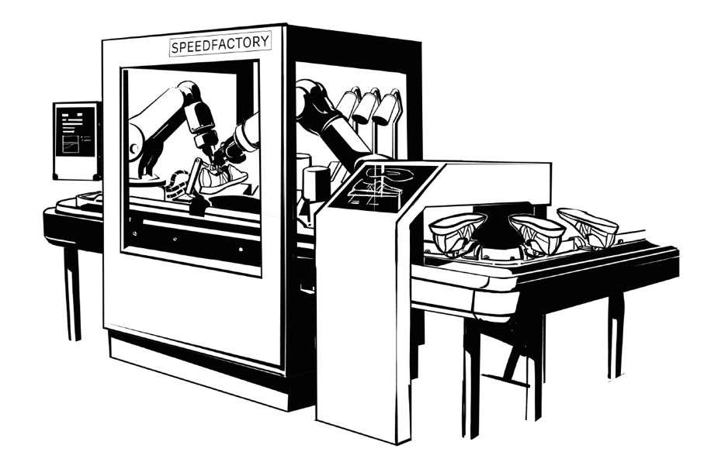
Opening Case: Adidas Storefactory concept
allows customers to undergo a body scan by projection technology and kinetic motion sensors
uses design station to design a woolen sweater that was then produced in the store
enabled up to 10 pullovers a day to be designed and produced in around 4 hours and at a cost of about EUR 200.
employs all of the digital technologies associated with a cyber-physical system and Industry 4.0
enables instore experience of the brand and association of advanced manufacturing and technology experimentation with the consumer brand
allows Adidas to gather data about customer preferences and willingness-to-pay for mass customized products and services

Slide 54
Opening Case: Adidas Speedfactory experiment
was a larger scale experiment in highly automated manufacturing with mass customization to test the arguments for digital technologies and manufacturing with Industry 4.0 logics
was enabled by an internal incubator unit independent of the parent firm called Future Team
employed digital technologies like 3-D printing, robotics and computerized knitting machines
aligned machines and humans in advanced machine-human cyber-physical systems of production
created awareness through marketing campaign along the project including designs with “running influencers”
Stimulated debate about automation and employment, Critics wondered if it was nothing more than a marketing campaign

Slide 55
2.0 Introduction
Digital Transformation is a strategic undertaking that improves the ability of firms to create and capture value in the digital age, by leveraging the integration of digital technologies as a central consideration of business strategizing.
This definition draws attention to digital strategy formulation and implementation to explain firm performance.
Chapter 02
  explores how established theories of strategic competitive advantage apply to strategy formulation in the digital age
  addresses the practical implementation of these explanations with the ACT Method proposed in Chapter 12
This practice-oriented strategizing across seven strategic action fields (SAFs) is covered in Chapter 04 to 10, the implementation in Chapter 11

Slide 56
2.1 Strategies as Theories of Competitive Success
Firm strategies are theories of how to compete successfully,
All firm strategies are formulated and implemented within the context of the sociotechnical system of a firm
Firm performances is the primary outcome of successful firm strategies
Research has identified a number of interconnected alternative theories which explain firm performance to different degrees
Internal explanations
important resources, capabilities and dynamic capabilities
External competitive environment
corporate decisions on entering specific industries and strategic positioning relative to competitors in an industry

Slide 57

2.2 Assessing Firm Performance
Typically using accounting and finance measures, newly also including the impact of firms on stakeholders and their role in value creation
Stakeholders are “any group or individual who can affect or is affected by the achievement of the organization’s objectives”
External stakeholders increasingly important, as they provide resources and capabilities not owned or directly controlled by firms, but needed by them
In the digital age information and network effects are increasingly determining firm performance for both traditional and digital businesses.

Slide 58
2.2 Assessing Firm Performance
Perceived legitimacy of stakeholders’ interest is reflected by a balanced scorecard of organizational performance and organizational effectiveness
  Performance: measurable quantitative indicators (focus on financial, product market and shareholder return performance)
  Effectiveness: focus on internal performance outcomes related to more efficient operations and broader internal and external performance assessments beyond economic value creation
  Both can be assessed at a point in time or over time, as a single firm or in comparison to other firms, and in terms of expectations of internal and external stakeholders

Slide 59
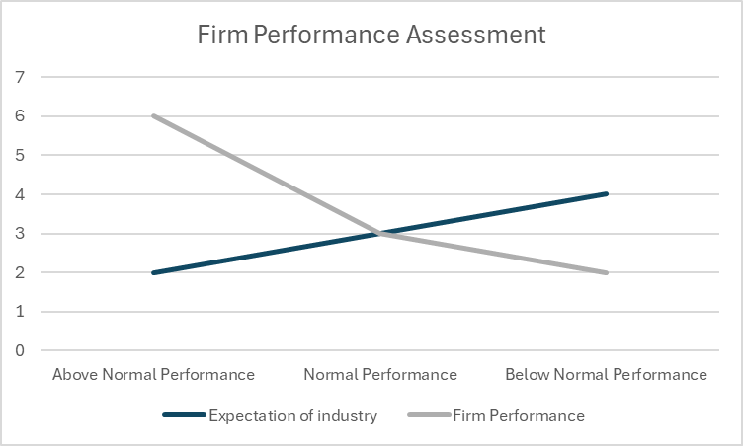
Comparative Firm Performance Assessment
Economic performance assessments compare performance outcomes to expectations for firm performance for a given industry, competitor or strategic groups
The logic can be extended to between strategic group comparisons or include competitive, environmental, societal, and digital performance measures.
  Above Normal Performance: Performance exceeds expectations for the industry and that of members of firm’s strategic group
  Normal Performance: Performance meets expectations for the industry and is comparable to members of firm’s strategic group
  Below Normal Performance: Performance is below expectations for the industry and members of firm’s strategic group

Slide 60
2.2.1 Economic Performance
Assessed in terms of organizational performance and effectiveness
Focused on effectiveness and efficiency with which the firm creates and captures economic value
Primary stakeholders here are operative and managerial firm employees, customers, suppliers and distributors, and shareholders.
Created economic value
Perceived benefit derived from product or services of each individual customer = Willingness-to-pay for each customer
High economic performance
Pricing strategy optimally reflects customer willingness-to-pay
Effectiveness and efficiency of value creation and delivery

Slide 61
2.2.1 Economic Performance
Lower direct and indirect costs for developing, producing and delivering a product or service to customers, all other things being equal, the higher the profit
On individual product purchase level (transition): total net profit = total number of sales (volume of transactions) x net profit per unit sold
These values vary by product or service which makes it complex to calculate in a firm overall
Digital Transformation affects the willingness-to-pay, frequency of purchase (volume), the cost structures of firms as a whole and of individual products or services
Careful assessment of the potential for digital technologies using these measures allows firms to create and capture economic value

Slide 62
Organizational Performance Measures (exemplary indicators)
General | Financial Performance | Product Market Performance | Shareholder Return
Firm Survival | Profit Growth | Revenue / Sales Growth | Total Shareholder Return
 | Profit Margin | Growing Market Share | Dividend Payments
 | Return on Assets | Customer Satisfaction / Net Promotor Score | Stock / Share Price Increases
 | Return on Investments | Improving Profitability of Existing Customers
 |  | Gain Profitable of New Customers

Slide 63
Organizational Effectiveness Measures (exemplary indicators)
Operative Performance | People Performance
Reducing Costs | Culture and Values
Improving Product and Service Quality | Employee Satisfaction
 | Employee Retention Rates

Slide 64
2.2.2 Natural Environmental Performance
Digital Transformation has negative and positive impacts on the natural environmental sustainability.
“Wicked problem” nature of the pursuit of sustainability goals: Digital technologies contribute to enabling solutions thereby encouraging again problems to solve and so on.
Currently the potential for digital transformation to contribute to natural environmental sustainability is significantly interesting and addressed in Chapter 03.
Problem/ solution: Digitization
Solution for sustainability:
Reduced paper in office
Unintended consequence:
Higher use of ICT equipment
New problem:
Greater e-waste

Slide 65
Natural Environmental Performance Measures in the Digital Age
Enabling sustainability of other economic actors
Reduced resource consumption
Carbon Emissions
Energy Use and Heat Pollution
E-Waste
Impact on natural habitats

Slide 66







2.2.3 Societal Performance
Impact of the digital age on economic and societal activities changes the way in which economies function and people live their lives, addressed in detail in Chapter 03.
Technologies are value neutral, so the use of the technologies determine positive or negative impacts.
Digital Transformation can impact local communities, employees and customers as the primary societal stakeholders in terms of the societal performance measures in the digital age:
Employment
Education
Access to food & water
Physical & mental health
Lifestyles
Equality & inclusion
Safety & crime prevention

Slide 67
2.3 Digital Transformation and Firm Performance
Impact of digital strategies on firm performance can be assessed in four impacts on the value creation and capturing: (1) scope, (2) scale, (3) speed, and (4) sources of value creation and capture
Digital transformation, digital strategy and digital technologies
  need to be understood by stakeholders
  change, how the scope of business activities is understood internally and externally
  enable and require a different approach to thinking about the internal and external scale of activities
  speed up the pace of traditional and newer business activities
  allow new sources of value creation and capture

Slide 68
Dimensions of Digital Technologies Impact on Firm Performance
Performance indicators are discussed in relation to digital strategy formulation in Chapter 11.
Scope | (2) Scale | (3) Speed of Business Activities | (4) New Sources of Value Creation
Cross Functional and Process Silo Activities | Rapid Digital Scaling Up and Down | Speed of Product Launches | Increased Value from Information
Digitization of Products and Services | Network Effects for Rapid Scaling | Speed of Decision-making | Multisided Business Models
Digitization of Information and Knowledge | Scale through Information Abundance | Speed of Supply Chain Orchestration | Coordinated Business Models in Networks
Participants in Dynamic Ecosystems | Scale through Networks and Alliances | Speed of Network Formation and Adaptation | Control of Digital Industry Architecture

Slide 69
2.4 Firm Embeddedness
Traditionally firms are described as
  being members of an industry or
  embedded in the technological landscape and the flows of information and goods and services in a given industry.
In the digital age the firm embeddedness extends to embeddedness in ecosystems that may incorporate multiple different industries, which are called socio-technical systems.
Traditionally
Digital age
Industry
Industry
Industry
Firm
Firm
Industry

Slide 70
2.4.1 Socio-Technical Systems
Socio-technical systems (STS) perspective
  includes social (human) and technology (non-human) aspects into a system that pursue a common goal.
  is reflected in every proceeding industrial revolution (see Chapter 01).
  emphasizes that when technology is adopted, behavioural consequences of the adoption need to be considered, otherwise sociological challenges are likely to emerge.
Current early stage of the digital age is featured by emerging digital socio-technical systems within which organizations and people rapidly adopt digital technologies to achieve business goals.
Different socio-technical systems can be embedded in, overlapping with, dependent on or independent of each other.
Depending on the firm, a firm can be embedded in one or more such socio-technical systems (horizontal or vertical integration).

Slide 71
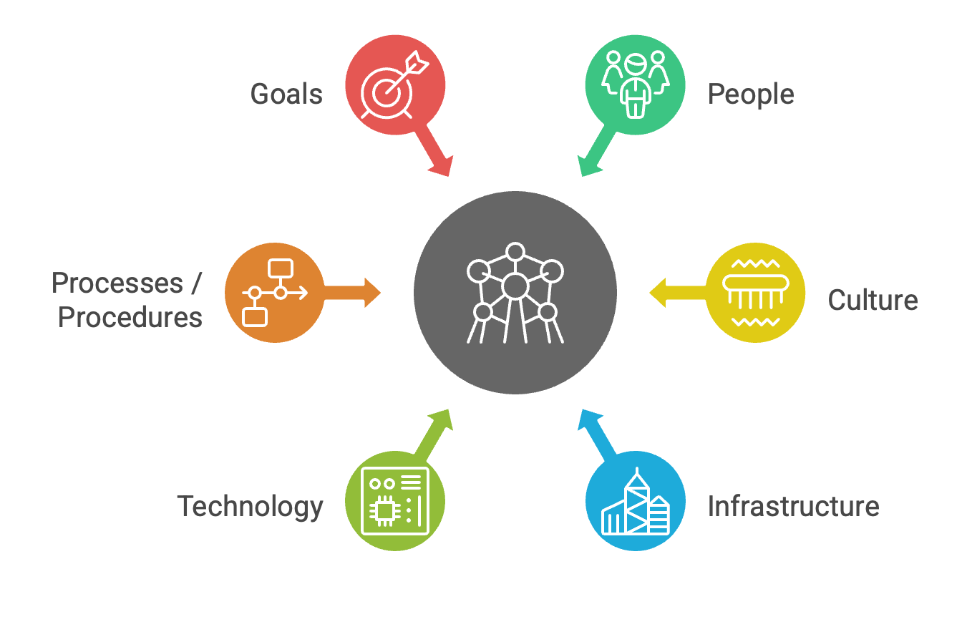
Six Dimensions of Cyber-Physical Systems

Slide 72
2.4.1 Socio-Technical Systems
Over the last 50 years in 5 phases of technology development (see Industrial revolutions in Chapter 01), move from physical systems to advanced cyber-physical systems with significant human-technology interaction in complex networks.
Technologies moved from information and communication to networking and now also controlling and sensing technologies.
The complexity of the networks within and across socio-technical systems increased to diverse human-human, human-technology and technology-technology networks, featured by increasing automation.
Humans have taken over the role of supporting machines to get work done which leads to symbiotic cyber-physical systems where humans and machines are mutually dependent on each other to achieve common goals.
Digital transformation does not necessarily lead to cyber-physical systems ,but some firms have begun to experiment with them (see opening case of Adidas)

Slide 73
2.4.1 Socio-Technical Systems
‘Cyber Physical Systems (CPS) are smart networked systems with embedded sensors, processors and actuators that are designed to sense and interact with the physical world (including the human users), and support real-time, guaranteed performance in safety-critical applications. In CPS systems, the joint behaviour of the “cyber” and “physical” elements of the system is critical - computing, control, sensing and networking can be deeply integrated into every component, and the actions of components and systems must be safe and interoperable.’
Networking and Information Technology Research and Development
Program of the United States Government (NITRD; 2015)

Slide 74
2.4.2 Strategic Action Fields of Digital Transformation
Firms integrate themselves into different socio-technical systems for specific activities and goals which can be grouped into strategic action fields.
Perceived attractiveness of digital technologies, benefit and legitimacy to firm performance influence which strategic action fields are chosen by the individual firm and therefore how the digital transformation is done
Strategic action fields (SAF)
  emphasize the social aspects of the digital transformation process
  focus attention on managerial sense-making and related legitimation processes
  may include all or only subsystems of a broader socio-technical system, dependent on the technology relevance and the perceived attractiveness of different activities (applications) that a technology enables

Slide 75
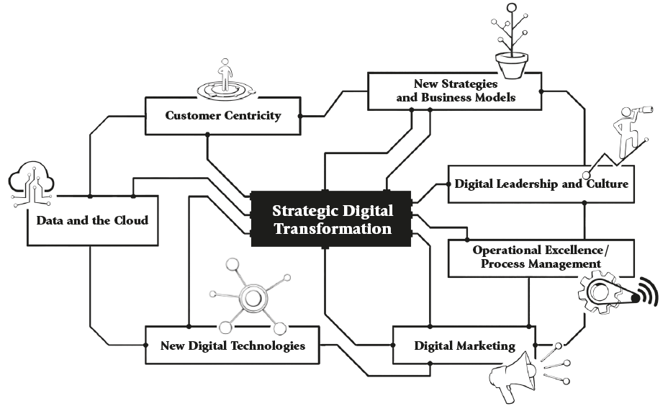
The Seven Strategic Action Fields of Digital Transformation
  Chapter 04 to 10 cover all seven strategic action fields
  For public sector / government organisations, SAF 4 “New strategies and business models” is changed to “digital e-government strategies” and SAF 7 “Digital Marketing” is changed to “digital communication”

Slide 76
2.5 Theories of (Sustainable) Competitive Advantage
All these strategic theories have the goal to achieve a competitive advantage, better a sustained competitive advantage
  Competitive advantage: above normal performance in the short term
  Sustained competitive advantage: above normal performance in the medium or long term
Performance assessments can include economic (competitive), natural environment and societal performance.
System theory view of performance: three levels of analysis (firms, strategic groups and industries) can all interact with each other and within a complex system that collectively influences firms’ fates.
Firm performance
Firm
Strategic groups
Industries

Slide 77
2.5.1 Ownership and Control Over Resources
Resource-based explanations exist in the strategic management literature since the 1950s
Resources are defined as “all assets, capabilities, organizational processes, firm attributes, information, knowledge etc. controlled by a firm that enable the firm to conceive of and implement strategies to improve its efficiency and effectiveness”
Resource-based theory (Barney, 1991) has two main assumptions and four necessary conditions for a sustained competitive advantage:
  Firms do not all have access to the same quality of resources.
  High value creating resources are not transferable.
Resources must be valuable (opportunities used, threats neutralized), rare, difficult to imitate (especially interesting in the digital transformation as social complexity contributes to this point), limited or have no strategically equivalent substitute resources.

Slide 78
2.5.2 Capabilities
Capability of resource management and organization processes leads to sustained competitive advantage
Core competence theory (Prahalad & Hamel, 1990)
  First to introduce a capabilities-based explanation for sustained competitive advantage
  Answer to one of the main critiques of resource-based theory (1991), value creation process is not explained
  Core competencies were defined as the “the collective learning in the organization, especially how to coordinate diverse production skills and integrate multiple streams of technology”
  Core competences allow the firm to product a core product which can be integrated into diverse final products.
  Has the same four conditions as the resource-based view: valuable – adding value proposition to customers, difficult to imitate, unique, limited)

Slide 79
2.5.3 Dynamic Capabilities
Dynamic capabilities extended resource- and capability-based thinking
Dynamic capabilities “are the organizational and strategic routines by which firms achieve new resource configurations as markets emerge, collide, split, evolve, and die”
Four conditions are not necessarily met: valuable and rare, but doubts about inimitability and non-substitutability
Dynamic capabilities do not automatically lead to sustained competitive advantage.
Dynamic capabilities contribute to organizing and managing resources and capabilities to achieve sustained competitive advantage.
Sustained competitive advantage
Dynamic Capabilities
Routines for new, adapted resource configuration
Capabilities
ability to manage and organize resources
Resources
Tangible and intangible assets

Slide 80
2.5.4 Industry Dynamics
Industry characteristics influence firm performance.
Firms are open systems that take in inputs to product products and services to be outputted for purchase in markets.
Industry-based explanations also adopted open systems to explain industry effects on firm performance.
Model of industry attractiveness (Porter, 1979):
  synthesizes decades of economic and strategic management theorizing about industry attractiveness and related firm performance
  has a structure-conduct-performance (SCP) school of thought: industry characteristics (structure) determine firm behaviour (conduct) and thereby determine firm performance.
  allows firms to deduce strategic implications for all market structures
  arguably leaves managers out that play a critical role as their decision-making can change industry structure and firm conduct.

Slide 81
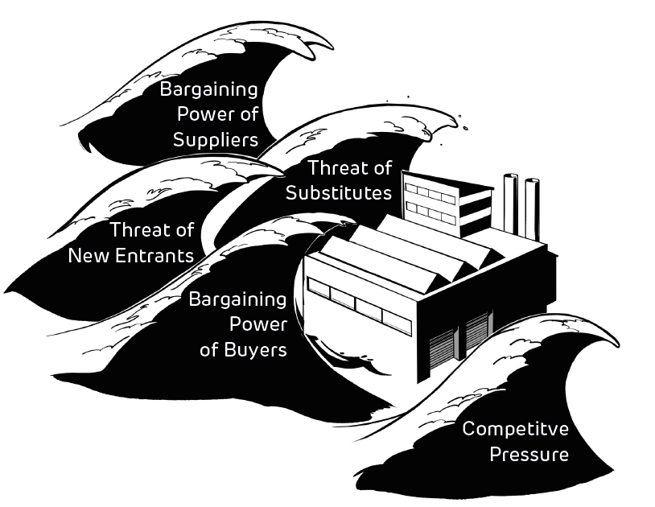
Industry Dynamics and Competitive Performance (Five Forces Model)

Slide 82
2.5.4 Industry Dynamics
Porter’s (1979) Five Forces Model
  provides an extremely valuable framework for organizing managers analysis and sense-making of their environment
  Optimum in the models is:
    Minimized bargain power of suppliers and customers
    Limiting risk of new entrants or substitutes
    alignment with complementary products to raise switching costs for customers and limiting the degree of competition

Slide 83
Underlying Mechanisms for Five Forces Model
Underlying mechanisms are affected by digital transformation which may change industry attractiveness for incumbents and new entrants.
Competitive Intensity (Jockeying for Position) | Buyer (Customer) and Supplier Power | Barriers Reducing Threat of New Entrants | Substitute Products or Services | Complementary Products or Services
Degree of Standardization or Differentiation | Risk of value chain integration / disintermediation | Cost Disadvantages Not Associated with Firm Size (e.g. learning curve) | (Changes in) Relative Price-Performance Trade-off | (Changes in) Relative Price-Performance Trade-off
Concentration of Competing Firms | Product Standardization or Differentiation | Access to Distribution Channels
Industry Growth | Substitutes | Capital Requirements
Cost Structures of Competitors | Criticality of Product or Services | Product Differentiation
Industry Capacity | Switching Costs | Economies of Scale
Exit Barriers | Industry Mutual Dependencies | Government Policy / Regulation
 | Concentration

Slide 84
2.5.5 Strategic Groups
Definition: “occurring subsets of firms that are more homogeneous in actions than is found across industry incumbents in general”
Firm performance differs across strategic groups in an industry
Categorization into strategic groups relies on identifying similarities or differences in
  Strategic orientation of firms for value creation
  Firms’ scope of operations
  Scale of resource deployment
Short et al. (2007) stated that firm effects have the strongest effect on firm performance, followed by industry and then strategic group membership.
Porter (1991) acknowledges strategic groups as a reference group for managers’ decision-making and therefore expects that strategic groups are most likely to be active in the same strategic action fields.

Slide 85
2.6 “Generic” Strategies for Value Creation
are clear and distinct value propositions to customers of firms.
show different configurations of internal resource- and capability-based theories with the four assumptions, and external market position-based theories.
“Strategic positioning means performing different activities from rivals’ or performing similar activities in different ways.”
in the digital age, need to integrate digital technologies into resources and capabilities.
determine together with the ability to capture a meaningful proportion of the created value in net profit the firm performance.

Slide 86
2.6 “Generic” Strategies for Value Creation: Strategy typologies
Operational excellence (Treacy and Wiersma): the ability to manage costs so that reliable middle market products can be offered at the best price
Cost focus strategy (Porter): outstanding customer service, operational efficiency and product or service quality control
Cost leadership strategy (Porter): focused on efficiency through cost reduction, control and minimization for highly competitive pricing
Product leadership strategy (Treacy and Wiersma): product or service innovation defining the state of the art in a particular product category
Differentiation focus strategy: specialty products or services at high price market segments
Differentiation strategy (Porter): mass market premium pricing strategy with strong brand identification
Customer Intimacy (Treacy and Wiersma): differentiation strategy that is based on direct and personalized long-term customer relationship building

Slide 87

Key Idea: Customer Segmentation Analysis
To develop a value proposition customers need to be segmented.
Value proposition is tailored to address the needs and preferences of customers in a specific segment to increase the customers’ willingness-to-pay.
Several approaches to develop an understanding of customer segments
  Previously published research
  Qualitative primary research (e.g. workshops or focus groups): importance of a diverse stakeholder representation
  Quantitative primary research (e.g. surveying customers): pre-phase of focus groups to develop survey instrument
  Mixed method design of the approaches

Slide 88
2.7 Digital Business Strategy Formulation
Digital business strategies are “organizational strategy formulated and executed by leveraging digital resources to create differential value”
Requires an assessment of
  Resource-based performance
  Structure-conduct-performance (Five Forces Model)
  Established generic value creation strategies

Slide 89
2.7.1 Digital Technologies and Strategy Formulation
need an assessment of product-market position and choice about generic value creation strategy
require a fit between internal resources and capabilities and the external competitive positioning for competitive success
include an assumption of an open system and dynamic interaction between actors in an industry / socio-technical system.
require a position of a firm in the socio-technical system through an assessment of optimal scope of digital technologies, development of digital transformation capability and digital governance
require choices about the IT infrastructure needed, information systems processes and related human skills.

Slide 90
Digital Technology Resources and Capabilities in Cyber-Physical Systems
Digital Technology Capability
Information Technology (IT) Infrastructure Resources
Computing Technology (CPT) Infrastructure Resources
Communication Technology (CT) Infrastructure Resources
Connectivity Technology (CNT) Infrastructure Resources
Control Technology (CNTR) Infrastructure Resources
Human IT Resources
Human CPT Resources
Human CT Resources
Human CNT Resources
Human CNTR Resources
IT-enabled Intangible Resources
CPT- enabled Intangible Resources
CT-enabled Intangible Resources
CNT-enabled Intangible Resources
CNTR-enabled Intangible Resources

Slide 91
2.7.1 Digital Technologies and Strategy Formulation
Competitive strategizing and digital technology strategy need to be merged to an integrated co-evolving digital strategy
Digital technologies
  are fundamentally dependent on interacting with the broader ecosystem to create intended value for the competitive strategy
  raise question of digital scale of the business
  allow businesses to rapidly scale up or down which can change competitive dynamics in an industry
  can accelerate product / service launches and strategic decision-making
Digital strategizing needs to consider the value creation potential in information abundance and new business models.

Slide 92
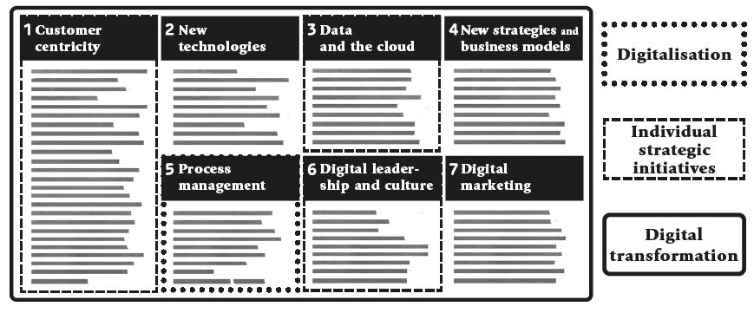
2.7.2 Implementing Digital Strategies to Create and Capture Value
Firms need to capture and create value through the integration of digital technologies and leverage the associated information (Chapter 1.3, seven action fields in Section 2.4.2)
Digital technologies alone in a resource-based view cannot lead to sustained competitive advantage.
Firms’ dynamic capabilities to reconfigure non-digital and digital resource into capabilities can lead to sustained competitive advantage, if they are different to those of the competitors or help unique market positional strategies.

Slide 93
2.8 Conclusion
Digital Transformation is bringing fundamental changes in the way firms create and capture value.
Digital strategies challenge managers to think about how digital technologies change the resources and capabilities of their firms and how the activities of the generic chosen strategies are changed by this process.
Competitive forces that firm is subject to are changing.
Firms need to ensure that their activities still fit the generic value creation strategies and the market positional strategies that are pursued.

Slide 94
Case Studies
You will find a collection of case studies for Strategic Digital Transformation in the appendix and additional cases online at www.strategic-digital-transformation.com.
Step 1: Selection of a case organization
Take your assigned or self-selected focal case study from week 1 (Chapter 1) or one of the cases provided with this text to complete the following tasks / answer the questions posed below.
Step 2: Case questions linked to this chapter
Explain to what degree the case study shows evidence of the focal firm responding to changes in the sociotechnical systems in which the firm is embedded (see Chapter 2.4.1).
Identify the stakeholders of the focal firm in the case and justify their selection.
Justify a set of metrics, e.g. key performance indicators (KPIs) based on the case study, that includes KPIs that account for the diverse stakeholders of the firm (see Boxes 2.2 to 2.5 for performance measures).

Slide 95
Case Studies
You will find a collection of case studies for Strategic Digital Transformation in the appendix and additional cases online at www.strategic-digital-transformation.com.
Explain which of the seven strategic action fields of digital transformation are relevant in the case study (see Box 2.8).
Discuss the degree to which you believe the firm in the case study is likely to be able to achieve sustained competitive advantage, from both an internal resource / capabilities-based, and external market positioning strategy perspective.
Given the value proposition in the case study, which other firms can you find online that would be members of the strategic group (i.e., which are strategically relevant) of the firm?
How similar do you consider the generic (digital) business strategies of the firms in the strategic group?

Slide 96
Exercises
Discuss the following questions in your class, in your group or assignment:
What are the six dimensions of cyber-physical systems (see Box 2.7) that allowed Adidas to implement their Storefactory and Speedfactory concepts? (see opening case)?
Identify an established industry / sector that you think has been transformed by digital technologies and explain how you believe the digital age has shifted the sources of firm strategic competitive advantage as a result.
Identify a firm of your choice that has achieved significant success by relying on digital technologies and discuss how well the success is explained by established theories of firm strategic competitive advantage.
Forming two small groups (2-4 students in each group), assign a pro and contra position to each group and debate the degree to which digital transformation allows firms to achieve sustained competitive advantage.
Identify a firm that is largely or entirely analogue in the way it serves its customers and formulate a strategy for the firm that is adequate for competing in the digital age.
Critically assess the enablers and inhibitors of the formulation of the firm strategy for the digital age developed in Exercise 5.

Slide 97
Further Reading List
Bharadwaj, A., El Sawy, O.A., Pavlou, P. A., & Venkatraman, N.V. (2013). Digital business strategy: toward a next generation of insights. MIS Quarterly, 37(2), 471-482.
Peter, M. K., Kraft, C., & Lindeque, J. (2020). Strategic action fields of digital transformation: An exploration of the strategic action fields of Swiss SMEs and large enterprises. Journal of Strategy and Management, 13(1), 160-180.
Porter, M.E. (1979). How Competitive Forces Shape Strategy. Harvard Business Review, Marc-April, 137-145.
Richard, P. J., Devinney, T. M., Yip, G. S., & Johnson, G. (2009). Measuring organizational performance: Towards methodological best practice. Journal of Management, 35(3), 718-804.

Slide 98
References
Adidas (2019) adidas deploys Speedfactory technology at Asian suppliers by end of 2019. Adidas Press Release. Last Accessed on 08 March 2024 from https://www.adidas-group.com/en/media/news-archive/press-releases/2019/adidas-deploys-speedfactory-technology-at-asian-suppliers-by-end-2019
Akan, O., Allen, R. S., Helms, M. M., & Spralls III, S. A. (2006). Critical tactics for implementing Porter's generic strategies. Journal of business strategy, 27(1), 43-53.
Baía, E. P., & Ferreira, J. J. (2024). Dynamic capabilities and performance: how has the relationship been assessed? Journal of Management & Organization, 30(1), 188-217.
Barjak, F., Lindeque, J., Koch, J., & Soland, M. (2022). Segmenting household electricity customers with quantitative and qualitative approaches. Renewable and Sustainable Energy Reviews, 157, 112014.
Barney, J. (1991). Firm resources and sustained competitive advantage. Journal of Management, 17 (1), 99–120.
Barney, J. B. (2001). Resource-based theories of competitive advantage: A ten-year retrospective on the resource-based view. Journal of Management, 27(6), 643-650.
Barney, J. B. (2020). Measuring firm performance in a way that is consistent with strategic management theory. Academy of Management Discoveries, 6(1), 5-7.
Bharadwaj, A. S. (2000). A resource-based perspective on information technology capability and firm performance: an empirical investigation. MIS Quarterly, 24(1), 169-196.
Bharadwaj, A., El Sawy, O.A., Pavlou, P. A., & Venkatraman, N.V. (2013). Digital business strategy: toward a next generation of insights. MIS Quarterly, 37(2), 471-482.
Eisenhardt, K. M., & Martin, J. A. (2000). Dynamic capabilities: what are they?. Strategic Management Journal, 21(10‐11), 1105-1121.
Freeman, R. E. (1984). Strategic Management: A Stakeholder Approach. Boston: Pitman.
Henderson, J. C., & Venkatraman, N. (1999). Strategic alignment: a model for organizational transformation via information technology. IBM Systems Journal, 38(2&3), 472-484.
Kaplinsky, R., & Morris, M. (2000). A handbook for value chain research (Vol. 113). Brighton: University of Sussex, Institute of Development Studies.
Kim, E., Nam, D. I., & Stimpert, J. L. (2004). The applicability of Porter’s generic strategies in the digital age: assumptions, conjectures, and suggestions. Journal of Management, 30(5), 569-589.
Kraft, C., Lindeque, J. P., & Peter, M. K. (2022). The digital transformation of Swiss small and medium-sized enterprises: insights from digital tool adoption. Journal of Strategy and Management, 15(3), 468-494.
Lindeque, J., & Samuel, O. (2022). The societal case for small business social responsibility: A review of the evidence of societal impact types and their relevance to stakeholders. In The Impact of Corporate Social Responsibility (pp. 44-69). New York: Routledge.
McGahan, A. M., & Porter, M. E. (1997). How much does industry matter, really?. Strategic Management Journal, 18(S1), 15-30.
Menz, M., Kunisch, S., Birkinshaw, J., Collis, D. J., Foss, N. J., Hoskisson, R. E., & Prescott, J. E. (2021). Corporate Strategy and the Theory of the Firm in the Digital Age. Journal of Management Studies, 58(7), 1695-1720.
Müller, F. (2017). "Knit for You": Wie Adidas mit einem Pop-up-Store die Zukunft einläutet. Horizont, Available from https://www.horizont.net/marketing/nachrichten/Knit-for-You-Wie-Adidas-mit-einem-Pop-up-Store-die-Zukunft-einlaeutet-156393
Networking and Information Technology Research and Development Program of the United States Government (NITRD; 2015). Cyber Physical Systems Vision Statement. Available from: https://www.nitrd.gov/nitrdgroups/images/6/6a/Cyber_Physical_Systems_(CPS)_Vision_Statement.pdf
Newbert, S. L. (2007). Empirical research on the resource‐based view of the firm: an assessment and suggestions for future research. Strategic Management Journal, 28(2), 121-146.
Panagiotou, G. (2006). The impact of managerial cognitions on the structure‐conduct‐performance (SCP) paradigm: A strategic group perspective. Management Decision, 44(3), 423-441.
Peter, M. K., Kraft, C., & Lindeque, J. (2020). Strategic Action Fields of Digital Transformation: An exploration of the strategic action fields of Swiss SMEs and large enterprises. Journal of Strategy and Management, 13(1), 160-180.
Peter, M.K. (Hrsg.) (2017). KMU-Transformation: Als KMU die Digitale Transformation erfolgreich umsetzen. Forschungsresultate und Praxisleitfaden. FHNW Hochschule für Wirtschaft, Olten/Schweiz, www.kmu-transformation.ch.
Peter, M.K. (Hrsg.) (2021). Strategieentwicklung im digitalen Zeitalter: Planung und Umsetzung der Digitalen Transformation. FHNW Hochschule für Wirtschaft und Strategylab, Olten/Schweiz, www.strategische-transformation.ch.
Peter, M.K. (2023). Digitaler Masterplan für KMU. So gelingt die digitale Transformation in Ihrem Unternehmen. Verlag Beobachter Edition & Handelszeitung. Zürich/Schweiz, www.digitaler-masterplan.ch.
Peter, M.K. (2024). The Digital Transformation Canvas. Develop and implement your digital strategy. FT Publishing/Pearson, London/UK, www.the-digital-transformation-canvas.com.

Slide 99
References
Piepponen, A., Ritala, P., Keränen, J., & Maijanen, P. (2022). Digital transformation of the value proposition: A single case study in the media industry. Journal of Business Research, 150, 311-325.
Porter, M. E. (1985). Competitive Advantage. The Free Press. New York.
Porter, M.E. (1979). How Competitive Forces Shape Strategy. Harvard Business Review, Marc-April, 137-145.
Porter, M.E. (1991). Towards a Dynamic Theory of Strategy. Strategic Management Journal, 12, 95-117.
Porter, M.E. (1996). What is Strategy? Harvard Business Review, November-December, 61-78.
Prahalad, C. K., & Hamel, G. (1990). The core competence of the corporation. Harvard Business Review, 68(3), 79-91.
Rêgo, B. S., Jayantilal, S., Ferreira, J. J., & Carayannis, E. G. (2021). Digital transformation and strategic management: A systematic review of the literature. Journal of the Knowledge Economy, 1-28.
Richard, P. J., Devinney, T. M., Yip, G. S., & Johnson, G. (2009). Measuring organizational performance: Towards methodological best practice. Journal of Management, 35(3), 718-804.
Short, J. C., Ketchen Jr, D. J., Palmer, T. B., & Hult, G. T. M. (2007). Firm, strategic group, and industry influences on performance. Strategic Management Journal, 28(2), 147-167.
Sony, M., & Naik, S. (2020). Industry 4.0 integration with socio-technical systems theory: A systematic review and proposed theoretical model. Technology in Society, 61, 101248.
Szalkowski, G. A., & Johansen, C. (2023). Defining and measuring the effects of digital technologies on social sustainability: A systematic literature review. Sustainable Development, early view online.
Taylor, S. A., Hunter, G. L., Zadeh, A. H., Delpechitre, D., & Lim, J. H. (2020). Value propositions in a digitally transformed world. Industrial Marketing Management, 87, 256-263.
Teece, D. J., Pisano, G., & Shuen, A. (1997). Dynamic capabilities and strategic management. Strategic Management Journal, 18(7), 509-533.
Treacy, M., & Wiersema, F. (1995). The Discipline of Market Leaders. Reading, MA: Persus Books.
Verhoef, P. C., Broekhuizen, T., Bart, Y., Bhattacharya, A., Dong, J. Q., Fabian, N., & Haenlein, M. (2021). Digital transformation: A multidisciplinary reflection and research agenda. Journal of Business Research, 122, 889-901.
Volberda, H. W., Khanagha, S., Baden-Fuller, C., Mihalache, O. R., & Birkinshaw, J. (2021). Strategizing in a digital world: Overcoming cognitive barriers, reconfiguring routines and introducing new organizational forms. Long Range Planning, 54(5), 102110.
von Kutzschenbach, M., & Daub, C. H. (2020). Digital transformation for sustainability: A necessary technical and mental revolution. In New Trends in Business Information Systems and Technology: Digital Innovation and Digital Business Transformation (pp. 179-192). Cham: Springer International Publishing.
Warner, K. S., & Wäger, M. (2019). Building dynamic capabilities for digital transformation: An ongoing process of strategic renewal. Long Range Planning, 52(3), 326-349.
Wernerfelt, B. (1984). A resource‐based view of the firm. Strategic Management Journal, 5(2), 171-180.
Wiener, A. (2017). Inside Adidas’ Robot-Powered, On-Demand Sneaker Factory. Wired. Last Accessed on 08 March 2024 from https://www.wired.com/story/inside-speedfactory-adidas-robot-powered-sneaker-factory

Slide 100
Case Study Collection
Each book chapter has an opening case and suggested case work,
and additional cases are available online as separate documents.
The authors would like to express their gratitude to all participating organisations
and to the contributors (authors and interview partners) of the case studies:

Slide 101
Digital Transformation Textbook
Visit www.strategic-digital-transformation.com
for case studies, videos and workshop templates.
Prof. Dr. Marc K. Peter
Dr. Johan P. Lindeque

Slide 102
03 Digital Transformation in Context: Innovation and Sustainability
Chapter 03 of 12
© Marc K. Peter & Johan P. Lindeque (2026): Strategic Digital Transformation. Theory and Practice. Sage Publications, London/UK
102

Slide 103
Digital Transformation Textbook
This cutting-edge textbook takes a unique approach to digital transformation which aligns theory and practice and is supported by the authors’ own research with over 4,000 organisations. Covering key topics such as emerging technologies, AI, cybersecurity, customer orientation, operational excellence, marketing automation, innovation and leadership and culture, it offers a learning experience which prepares students for the practical realisation of digital transformation for competitive advantage.
With individual and group exercises and case studies from a range of organisations, Strategic Digital Transformation prepares students to apply the knowledge and experience gained from the book in their future careers. It is suitable for undergraduate and postgraduate digital transformation and digital business courses.
We wish you lots of success and hope that
you will benefit from this textbook!
This cutting-edge textbook takes a unique approach to digital transformation which aligns theory and practice and is supported by the authors’ own research with over 4,000 organisations. Covering key topics such as emerging technologies, AI, cybersecurity, customer orientation, operational excellence, marketing automation, innovation and leadership and culture, it offers a learning experience which prepares students for the practical realisation of digital transformation for competitive advantage.
With individual and group exercises and case studies from a range of organisations, Strategic Digital Transformation prepares students to apply the knowledge and experience gained from the book in their future careers. It is suitable for undergraduate and postgraduate digital transformation and digital business courses.
Marc K. Peter & Johan P. Lindeque
Strategic Digital Transformation
Theory and Practice
2026, 408 pages
Sage Publications, London/UK
www.strategic-digital-transformation.com
Prof. Dr. Marc K. Peter
Dr. Johan P. Lindeque

Slide 104
Foreword
Modern advancements in the economy are characterised by a series of transformative industrial revolutions over the past three hundred years, each driven by groundbreaking technological innovations that reshaped societies, industries, businesses, and the way we live and work. The first industrial revolution, which began in the late 18th century, was driven by the mechanisation of production through steam power and the advent of factories. This era saw a dramatic increase in productivity and the rise of urban centres, fundamentally altering the social and economic landscape. The second industrial revolution in the late 19th and early 20th centuries introduced mass production and assembly lines, powered by electricity. Innovations such as the telegraph, telephone, and internal combustion engine further accelerated industrial growth and global connectivity, resulting in consumer markets.
The third industrial revolution, starting in the mid-20th century, brought automation and the digitalisation of manufacturing processes. The development of computers and the internet revolutionised industries, enabling unprecedented levels of precision and efficiency. This era laid the groundwork for the interconnected world we live in today. We are currently in the midst of the fourth industrial revolution, characterised by the fusion of digital and physical dimensions, creating smart factories and shipping digital societies. As we stand on the brink of the fifth industrial revolution, the focus shifts towards human-machine symbiosis, ethical AI, and sustainable practices. This emerging era emphasises the integration of advanced technologies with human capabilities, fostering collaboration between humans and robots, and prioritising ecological sustainability and social well-being.
In this rapidly evolving landscape, strategic digital transformation is not just an option but a necessity for organisations to remain competitive and relevant. It involves a holistic renewal of business models, processes, and organisational structures, leveraging digital technologies to create new value and drive innovation. This new textbook describes the components and provides a toolkit for strategic digital transformation, which requires a clear vision, a comprehensive digital strategy, a robust implementation plan and a commitment to continuous learning and adaptation.
Organisations that embrace this transformation will be better positioned to navigate the complexities of the digital age, capitalise on new opportunities, and contribute to a more sustainable and inclusive future. It is an exciting time to be part of this journey, and I am confident that the insights and strategies presented in this textbook will provide valuable guidance for young leaders and innovators seeking to thrive in the digital era.
Alois Zwinggi
Managing Director, World Economic Forum
www.weforum.org
© World Economic Forum/Pascal Bitz (Flickr, 2023)

Slide 105
Case Study Collection
Each book chapter has an opening case and suggested case work,
and additional cases are available online as separate documents.
Visit www.strategic-digital-transformation.com for:
  Slide decks for each case (case summaries and illustrations).
  Videos from case organisations (case introductions, promotional clips and interviews).
  The Digital Transformation Toolkit with workshop templates and checklists.
The authors would like to express their gratitude to all participating organisations
and to the contributors (authors and interview partners) of the case studies:

Slide 106
Book Structure
PART 1
FOUNDATIONS
OF DIGITAL
TRANSFORMATION
Chapter 01: Strategic Digital Transformation: Background and Terminology
Chapter 02: Business Strategy in the Digital Age
Chapter 03: Digital Transformation
in Context: Innovation
and Sustainability
PART 2
STRATEGIC ACTION FIELDS (SAF) OF
DIGITAL TRANSFORMATION
Chapter 04: SAF Customer Centricity
Chapter 05: SAF New Digital Technologies
Chapter 06: SAF Data and the Cloud
Chapter 07: SAF New Strategies and Business Models
Chapter 08: SAF Operational Excellence / Process Management
Chapter 09: SAF Digital Leadership and Culture
Chapter 10: SAF Digital Marketing
PART 3
DIGITAL TRANSFORMATION IN PRACTICE
Chapter 11: Success Factors and Metrics for Digital Transformation Implementation
Chapter 12: Transformation in Practice - Digital Transformation Toolkit
PART 4
DIGITAL TRANSFORMATION CASE STUDIES
BRUGG Lifting
City of Lucerne
Switzerland Tourism
Valuu (PostFinance)
With many other case studies (including videos and interviews) available online.

Slide 107
Learning Goals Chapter 03
Be able to explain the importance of innovation as the shared enabling activity for economic value creation and the realization of a more sustainable future.
Be able to explain the inherent tensions in the pursuit of societal, economic and natural environmental sustainability.
Be able to understand how a systems design approach can allow opportunities for digital transformation to contribute to realizing the economic and societal sustainability transitions.
Be able to critically evaluate the opportunities and risks associated with a sustainable digital transformation of firms, the economy and society.

Slide 108
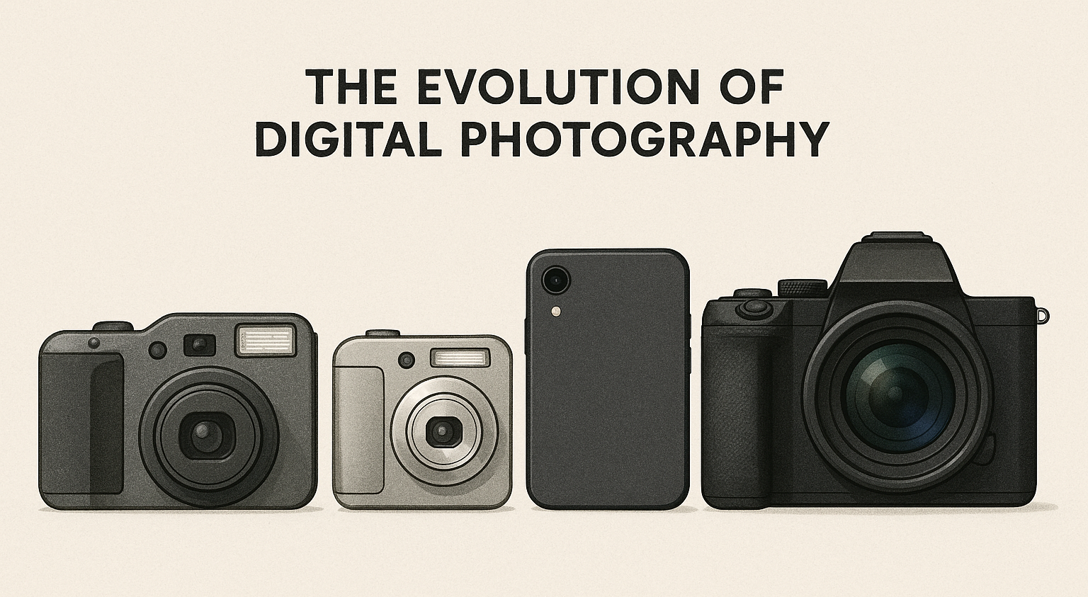
Opening Case: The Transition of Digital Photography
Source: https://copilot.microsoft.com/

Slide 109
Opening Case: The Transition of Digital Photography
Transition from traditional analogue to digital photography is one of the most visible digital transformations of business and society in the last 30 years.
The strategic responses of the two firms Eastman Kodak (Kodak) and Fujifilm (Fuji) has been discussed academically a lot.
  Fujifilm: responded with organizational ambidexterity, balancing the established competencies with the new potential of digital technologies.
  Kodak originally invented the digital camera but was not able to transition traditional core competence with the innovative technologies and was later threatened by new entrants.
The sustainability perspective has been under explored, but shows “wicked problems” (dilemmas and contradictions in all sustainability transitions):
  Analogue photography requires significant equipment and chemicals, which were not needed after the transition.
  Digital photography requires rare minerals and potentially unsustainable processes for printing photos

Slide 110
3.0 Introduction
Chapter 02 showed how firms can think strategically about digital transformation to create value with focus on economic value creation and competitive advantage.
Integration of digital technologies and the digital transformation for economic value creation can realize efficiency and effectiveness gains
This chapter focuses on the relationship between digital and sustainable transformations of firms
Innovation of how the value is created through digital transformation can enable a transition to a sustainable future.

Slide 111
3.1 Innovation and Value Creation
Innovation is implicit to the theories of strategic value creation in Chapter 02.
National innovation system and institutions governing national markets need to establish necessary conditions for innovation by firms.
Interpersonal relationship and employee communication is required to develop innovative firm level dynamic capabilities that lead to competitive advantage in the marketplace.
Firms can then sense/ identify the need for change and actually change with contribution of employees and create value that is aligned with the external environment.
Innovation can be understood as an adaptation response to perceived opportunities and risks in a dynamic external environment.
According to the Oslo Manual, there are four firm level innovations.

Slide 112
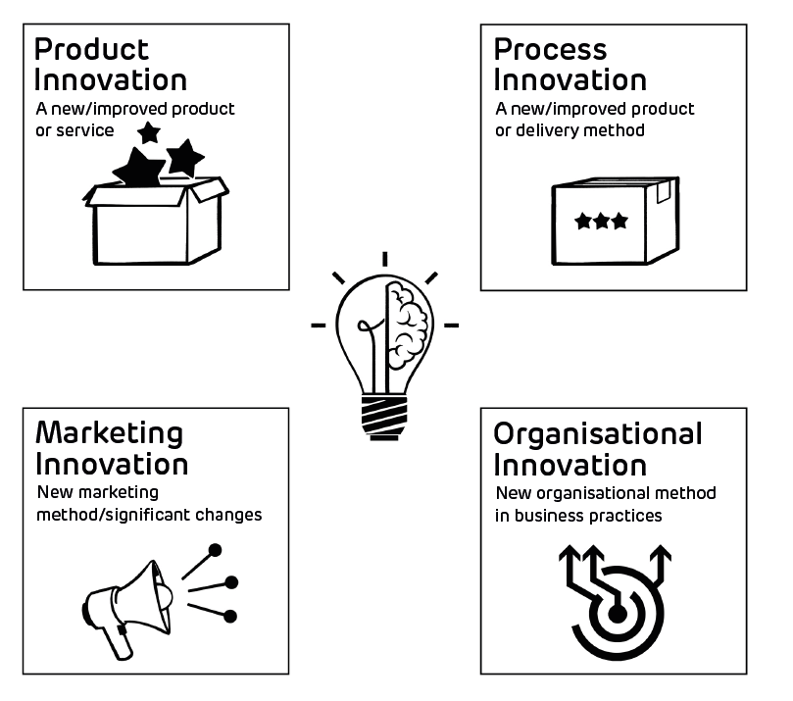
Full Oslo Manual Definitions of Innovation
Overview of the four main types of innovation according to the Oslo Manual

Slide 113
3.1 Innovation and Value Creation
Ambidextrous organizations are able to effectively manage the tension between exploration (sensing new opportunities) and exploitation (of existing competitive advantage by increasing efficiency and effectiveness)
Five conditions that facilitate organizational ambidexterity:
  1. There is a clearly articulated strategic intent that justifies ambidexterity;
  2. A shared strategic vision and set of firm values that promote a common identity, but enable different cultures of value creation to co-exist in a firm
  3. A senior management team that explicitly owns the ambidextrous strategy, seen in common responsibility, rewards and shared and consistent communication
  4. Separate business units with aligned architectures and targeted integration
  5. A leadership style that is able to facilitate the ambidexterity of the firm through effective conflict resolution and resource allocation to exploitative and exploratory activities.

Slide 114
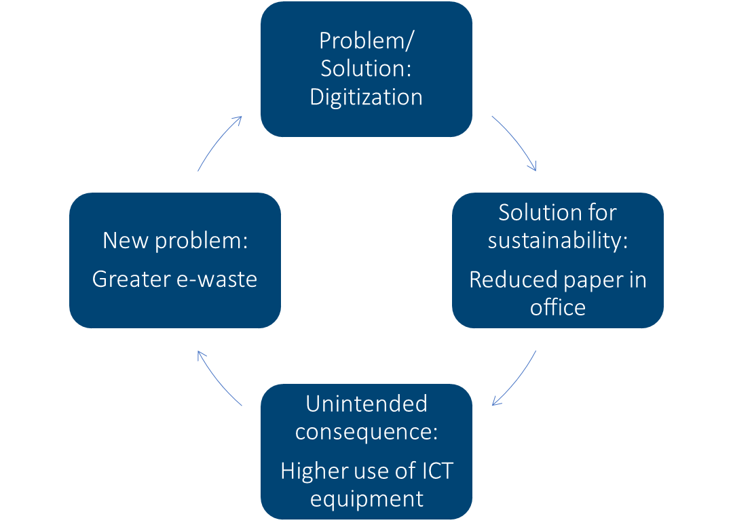
3.2 System Dynamics of Technology and Sustainability Transition Management
Firms are bounded open socio-technical systems and take (non--renewable resources, combine them with (digital) technologies, employees and processes to transform these resources into outputs with customer value while producing waste outputs.
Digital transformation can contribute to all parts of sustainability.
Two systems dynamic approaches that co-evolute and relate to firm innovation and strategic value
  Digital transformation as transformation of socio-technical systems
  Sustainability transitions
“Limits to Growth” by Meadows et al. (1972) introduced the later called concept of “wicked problems” that digital transformation contributes to sustainability by solving the focal problem and at the same time leading to unintended negative outcomes that need new efforts to solve their impact on sustainability.

Slide 115
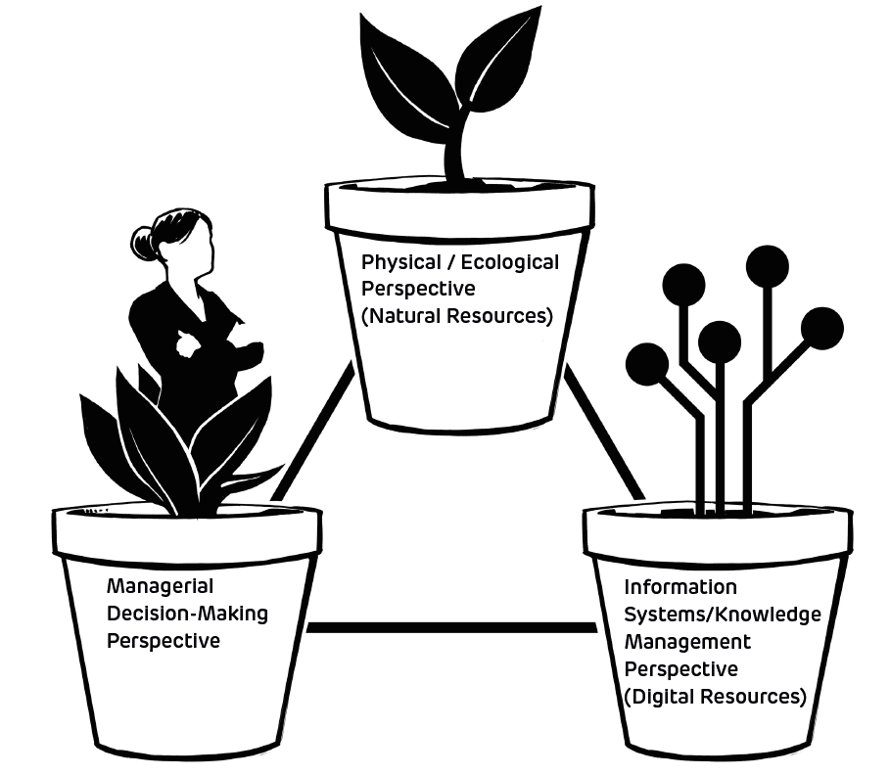
Elements of a System Dynamics Analysis
System Dynamics
  was developed by Forrester (1961) and later extended.
  analysis uses complex models to allow (1) predictive modelling, (2) development of holistic frameworks for feedback mechanisms, and/or (3) to facilitate stakeholder engagement through participatory modelling.
  “provides a set of conceptual and quantitative methods that can be used to represent, explore and simulate the complex feedback and non-linear interactions among system elements, management actions, and performance measures”
Goal: capture complexity and uncertainty while making it accessible and allowing decision-making.

Slide 116
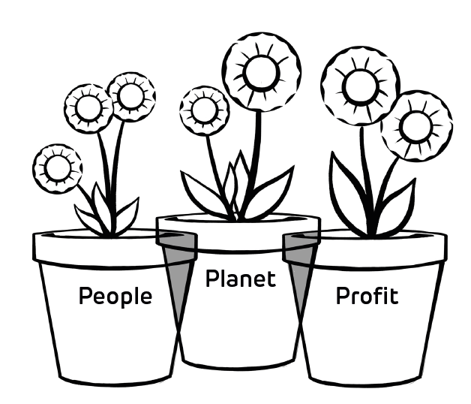
3.3 Digital Sustainability
Sustainability transition has seen a complex societal change take place over multiple decades.
Increasing emphasis on creating natural environmental, societal and economic value.
Different definitions and frameworks:
  Brundtland (see next slide): foundational and institutionally legitimized definition of sustainable development with emphasis on intergenerational responsibilities, recognizes the importance of technology and social organization
  Triple Bottom Line (TBL): sustainability in terms of economic / profit, social/ people and the natural environment.
Digital technologies have the chance to shift the limits of the natural environment to meet present and future human needs.

Slide 117
Brundtland Definition of Sustainability
“Sustainable development is development that meets the needs of the present without compromising the ability of future generations to meet their own needs”
Two key concepts:
  the concept of 'needs', in particular the essential needs of the world's poor, to which overriding priority should be given; and
  the idea of limitations imposed by the state of technology and social organization on the environment's ability to meet present and future needs.”
    World Commission on Environment and Development (WCED, 1987, 37)

Slide 118
3.3 Digital Sustainability
Digital technologies contribute to sustainable innovation.
Digital Sustainability refers to “organizational activities that seek to advance the sustainable development goals through creative deployment of technologies that create, use, transmit, or source electronic data.”
Digital technologies and digital transformation contributes to “improvements or transformations in products, services, technologies and organizational processes, which not only aid companies in maintaining competitive advantage to sustain their business [economic performance] but also significantly improve their social and environmental performance”
Definition of digital sustainability is clearly aligned with triple bottom line framework and Brundtland definition of sustainability
From a strategic perspective it is needed to clearly articulate a strategic intent for ambidexterity to balance exploitation and exploration during a transformation process.

Slide 119
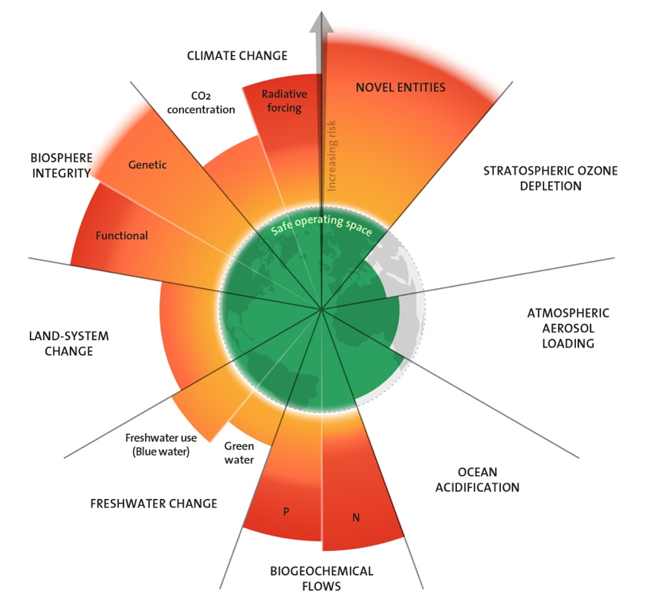
Environmental Sustainability and Planetary Boundaries Framework
recognizes humans as the primary driver to change to earth systems (the fundamental systems that support life on earth, economic and social activities of humans)
identifies nine boundaries as thresholds for human activity on earth:
  “the global biogeochemical cycles of nitrogen, phosphorus, carbon, and water; the major physical circulation systems of the planet (the climate, stratosphere, ocean systems);
  biophysical features of Earth that contribute to the resilience of its self-regulatory capacity (marine and terrestrial biodiversity, land systems);
  two critical features associated with anthropogenic global change (aerosol loading and chemical pollution).”
DT (potentially) impacts firms to operate within the boundaries by changing consummation and value creation.
Azote for Stockholm Resilience Centre, based on analysis in Richardson et al., 2023

Slide 120
Sustainability – A Emerging Success Factor for Digital Transformation
Sustainability concept:
  a resource should only be used to the extent that it is able to regenerate (from the forestry in 1713).
  fulfilling our current need for resources without compromising the possible needs of future generations.
Three equally important criteria for decision-making: (1) economically efficient, (2) socially just, (3) ecologically viable
Corporate social responsibility (CSR) describes organisations’ responsibility for the impact of their activities on society and the environment.
Every organisation should develop a sustainability/ CSR strategy.
Sustainable business practices lead to greater resilience on all levels of the business which has advantages for organisations, e.g. fair wages stabilise the organisation’s workforce.
Sustainability can become a fourth success metric for digital transformation.

Slide 121
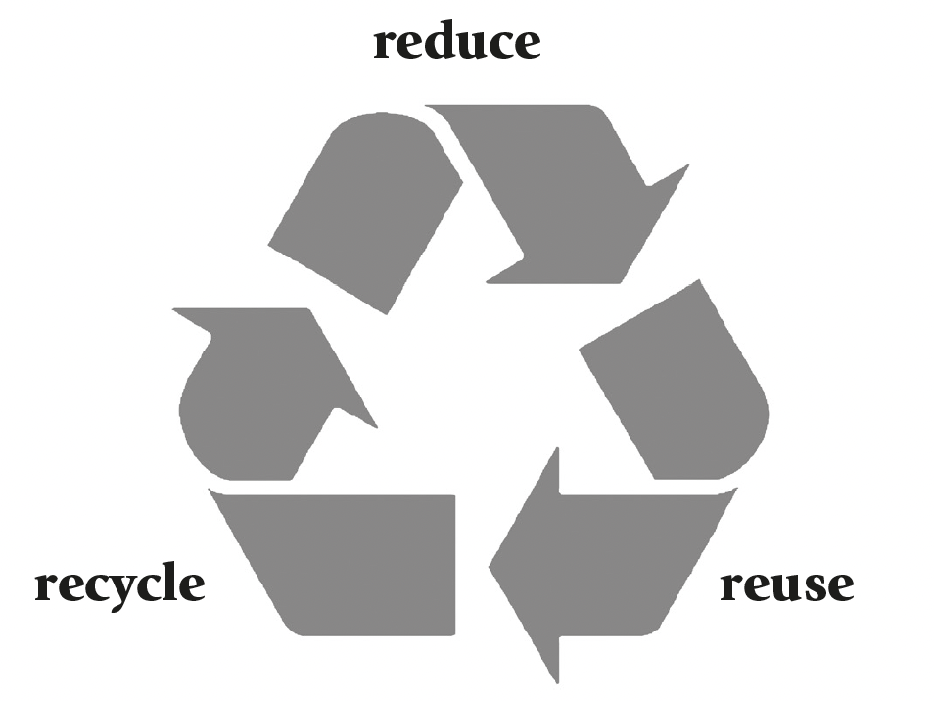
Sustainability – A Emerging Success Factor for Digital Transformation
3Rs of sustainability are the core of the circular economy:
shared and used for as long as possible (reused), so less products are produced (reduce) and this reduces the number of materials recycled (recycle)

Slide 122

Key Idea: United Nations Sustainable Development Goals
https://www.un.org/sustainabledevelopment/wp-content/uploads/2023/09/E_SDG_Guidelines_Sep20238.pdf
169 targets in 17 Sustainable Development Goals (SDGs) developed by the United Nations (UN) 2030 Agenda for Sustainable Development
Focus on people and peace (social sustainability), the planet (sustainability of the natural environment) and prosperity (economic sustainability)
Key reference framework for global efforts to realize a more sustainable future.
Digital transformation is critical for most of the SDGs.
Potential for positive contribution from businesses to the SDGs reflects the “wicked problem”.

Slide 123
Triple Bottom Line Approach to Sustainability
Positive parts | Major critiques
Widely adopted and very accessible framework | Based on an unrealistic assumption of the possibility for win-win outcomes for firm-level sustainability
Well aligned with global political initiatives and firm level approaches | No sufficient acknowledgement of the tensions between the pursuit of economic, social and environmental sustainability
Allows a broader view in terms of socio-technical and earth systems | Assesses incremental change on firm level (weak sustainability), but only systemic change (strong sustainability) can lead to the needed sustainability outcomes.

Slide 124
3.4 Digital Sustainability and System Dynamics: Identifying Opportunities for Impact
Great interest in the relationship between digital transformation and sustainability
Potential of digital technologies to enable a transition to a fundamentally more sustainable way of value creation and consummation is seen as a significant opportunity for more sustainable development
  if firms seek to take a lead in transforming their socio-technical systems.
  requires explicit strategic intent to align the digital and sustainability transitions.
  requires individual firms and their wider socio-technical systems to understand the socio-ecological systems that interact with the socio-technical systems creating economic value.
After understanding the systems and mapping their interactions, it is possible for firms to purposefully digitally transform the value creation activities within the respective system.

Slide 125
3.4 Digital Sustainability and System Dynamics: Identifying Opportunities for Impact
Broader discussions on the potential need for a new paradigm in strategic management to answer question of what should be the primary foundation of how civil society, business and the state should be organized.
One side for a reform in the interest of realizing “an opportunity to pursue a complementary direction of modelling that incorporates natural constraints into a multi-level and multi-stakeholder representation of firm-level decision making”
Others side raise concerns about a fundamental shift away from “the critical problems of allocating scarce resources to high-valued ends, building and sustaining organizations and institutions that coordinate tasks, jobs, and complex interactions, and encourage entrepreneurship and innovation that drives economic growth and improvements in the standard of living”
Approach of textbook: understand strategic digital transformation as co-evolution and an integral part of the competitive strategy, while seeking and taking advantage of opportunities for a more sustainable future.

Slide 126
Firm Specific Assessment of the Potential for a Sustainable Digital Transformation
Underlying thesis: individual firms can contribute to a more sustainable future by changing the ways to more sustainable ways of value creation
Systems perspective: approach requires
  assessment of the firm’s use and contribution to different stocks and how the firm changes the rate of use of or contribution to (flows) different stocks across the three dimensions of the TBL
  knowing the specific foci needed for a firm
  understanding the current and desired future interactions of a firm with employees and customers
  understanding how the firm exploits and impact the natural environment
Following slides show the first high-level attempt at formulating the questions that need to be asked to pursue a sustainable digital transformation in a firm
  Mini-Challenge: If you pick a specific firm, could you reformulate these generic questions to be tailored to the sustainable digital transformation of that firm?

Slide 127
Firm Specific Assessment of the Potential for a Sustainable Digital Transformation
Opportunities for Digital Transformation to Contribute to a Sustainable Natural Environment (Planet dimension)
Focus on digital transformation that reduces the need to exploit non-renewable stocks of natural resources in the earth systems in economic value creation activities
Focus on digital transformation that increases the potential to exploit renewable stocks of natural resources in the earth systems in economic value creation activities
Focus on digital transformation that reduces the rate at which non-renewable stocks of natural resources in the earth systems are exploited in economic value creation activities
Focus on digital transformation that increases the rate at which renewable stocks of natural resources in the earth systems are exploited in economic value creation activities
Focus on digital transformation that reduces the degree to which / avoids economic value creation activities that result in undesirable / harmful stocks in the earth systems (e.g. pollution)
Focus on digital transformation that reduces the rate at which unavoidable undesirable / harmful stocks in the earth systems (e.g. pollution) are created.

Slide 128
Firm Specific Assessment of the Potential for a Sustainable Digital Transformation
Opportunities for Digital Transformation to Contribute to a Sustainable Economy
(Profit dimension)
Focus on digital transformation that contributes to desirable stocks of sustainability enabling capital for economic value creation activities
Focus on digital transformation that increases the rate at which desirable stocks of sustainability enabling capital for economic value creation activities is accumulated
Focus on digital transformation that decreases the rate at which / avoids undesirable stocks of unsustainable capital for economic value creation activities is accumulated
Focus on digital transformation that enables business processes that increase the sustainability of the use of capital stocks

Slide 129
Firm Specific Assessment of the Potential for a Sustainable Digital Transformation
Opportunities for Digital Transformation to Contribute to a Sustainable Society
(People dimension)
Focus on digital transformation that that contributes to desirable social stocks delivered by economic value creation activities
Focus on digital transformation that reduce undesirable social stocks delivered by economic value creation activities
Focus on digital transformation that increases the rates of increases in desirable social stocks delivered by economic value creation activities
Focus on digital transformation that decreases the rates of increases in undesirable social stocks delivered by economic value creation activities

Slide 130
3.5 Conclusion
Innovation in value creation is crucial for achieving a sustainable future through digital transformation.
Interpersonal relationships and communication within firms is important for fostering innovation
Firms are viewed as socio-technical systems that interact with natural resources and society.
Digital transformation can contribute to sustainability by changing how firms create value
System dynamics approaches help understand complex interactions and the potential for digital transformation to support sustainability transitions.
Digital sustainability aligns with the triple bottom line framework, the Brundtland definition of sustainability and the UN SDGs.
Firms need to align their digital and sustainability strategies and understand their interactions with socio-ecological systems.

Slide 131
Case Studies
You will find a collection of case studies for Strategic Digital Transformation in the appendix and additional cases online at www.strategic-digital-transformation.com.
Step 1: Selection of a case organization
Take your assigned or self-selected focal case study from week 1 (Chapter 1) or one of the cases provided with this text to complete the following tasks / answer the questions posed below.
Step 2: Case questions linked to this chapter
Describe the types of innovation that can be observed in the case study (see Box 3.1).
Describe how the innovation in the focal firm of the case study enables economic value creation and / or the realization of a more sustainable future for the firm (profit dimension), society (people dimension) and the natural environment (planet dimension) (see Chapter 3.3).
Describe the primary flows and stocks in the internal systems of the firm and the external systems the firm is embedded. How do these systems interact?

Slide 132
Case Studies
You will find a collection of case studies for Strategic Digital Transformation in the appendix and additional cases online at www.strategic-digital-transformation.com.
Discuss the degree to which the case study shows evidence of the active management of inherent tensions in the pursuit of societal (people dimension), economic (profit dimension) and natural environmental (planet dimension) sustainability (see Chapter 3.3).
Explain the degree to which a systems design approach can be observed in the case study and if this is effectively leveraged to allow opportunities for digital transformation to contribute to the economical and societal sustainability transitions to be realised.
Discuss the opportunities and risks associated with a sustainable digital transformation of the economy and society in the case study.

Slide 133
Exercises
Discuss the following questions in your class, in your group or assignment:
How did digital photography impact and contribute to economic value creation and / or the realization of a more sustainable future for the firm (profit dimension), society (people dimension) and the natural environment (planet dimension) (see also Box 3.8 in light of the opening case "The Transition to Digital Photography")?
How should managers enable innovation projects to effectively achieve digital and sustainability goals?
How should managers respond to the inherent tensions in the pursuit of societal, economic and natural environmental sustainability when undertaking the digital transformation of a firm?
Forming two small groups (2-4 students in each group), assign a pro and contra position to each group and debate the degree to which sustainability is important and critical for society and businesses (group 1), or overrated and not that important (group 2).

Slide 134
Exercises
Critically evaluate the opportunities and risks associated with a sustainable digital transformation of the economy and society.
Discuss the degree to which it is possible for individual firms that are pursuing digital transformation, and seeking to do so in a sustainable manner, to contribute to realising global sustainability goals associated with the United Nations Sustainable Development Goals (SDG) (see Box 3.6).

Slide 135
Further Reading List
Furman, J. L., Porter, M. E., & Stern, S. (2002). The determinants of national innovative capacity. Research Policy, 31(6), 899-933.
O'Reilly III, C. A., & Tushman, M. L. (2011). Organizational ambidexterity in action: How managers explore and exploit. California Management Review, 53(4), 5-22.
Salvato, C., & Vassolo, R. (2018). The sources of dynamism in dynamic capabilities. Strategic Management Journal, 39(6), 1728-1752.

Slide 136
References
Bansal, P., Durand, R., Kreutzer, M., Kunisch, S. and McGahan, A. M. (2024). Time to renew our strategy paradigm: Environmental crises have revealed cracks in strategy's foundations. Journal of Management Studies, early view.
Christensen, C. (1997). The Innovator’s Dilemma: When New Technologies Cause Great Firms to Fail. Harvard Business School Press.
Dzator, J., Acheampong, A. O., Appiah-Otoo, I., & Dzator, M. (2023). Leveraging digital technology for development: Does ICT contribute to poverty reduction? Telecommunications Policy, 47(4), 102524.
Elkington J. (1997). Cannibals with Forks: Triple Bottom Line of 21st Century Business. Capstone: Oxford.
Elsawah, S., Pierce, S. A., Hamilton, S. H., Van Delden, H., Haase, D., Elmahdi, A., & Jakeman, A. J. (2017). An overview of the system dynamics process for integrated modelling of socio-ecological systems: Lessons on good modelling practice from five case studies. Environmental Modelling & Software, 93, 127-145.
Forrester, J. (1961). Industrial Dynamics. Productivity Press, Portland.
Forrester, J. (1969). Urban Dynamics. MIT Press, Cambridge.
Foss, N.J. and Klein, P.G. (2024), Do we Need a ‘New Strategy Paradigm’? No. Journal of Management Studies, early view.
Fujifilm (2024) Fujifilm Files Patent Infringement Lawsuit Against Eastman Kodak Company. Accessed on 08 May 2024 from https://www.fujifilm.com/us/en/news/graphic-arts-and-printing/fujifilm-files-patent-infringement-lawsuit-against-eastman-kodak-co
Furman, J. L., Porter, M. E., & Stern, S. (2002). The determinants of national innovative capacity. Research Policy, 31(6), 899-933.
George, G., Merrill, R. K., & Schillebeeckx, S. J. (2021). Digital sustainability and entrepreneurship: How digital innovations are helping tackle climate change and sustainable development. Entrepreneurship Theory and Practice, 45(5), 999-1027.
Giraldo, S., la Rotta, D., Nieto-Londoño, C., Vásquez, R. E., & Escudero-Atehortúa, A. (2021). Digital transformation of energy companies: A colombian case study. Energies, 14(9), 2523.
Ho, J. C., & Chen, H. (2018). Managing the disruptive and sustaining the disrupted: The case of Kodak and Fujifilm in the face of digital disruption. Review of Policy Research, 35(3), 352-371.
Isil, O., & Hernke, M. T. (2017). The triple bottom line: A critical review from a transdisciplinary perspective. Business Strategy and the Environment, 26(8), 1235-1251.
Kraus, S., Schiavone, F., Pluzhnikova, A., & Invernizzi, A. C. (2021). Digital transformation in healthcare: Analyzing the current state-of-research. Journal of Business Research, 123, 557-567.
Kumar, A., Paul, M., & Upadhyay, P. (2021). From Physical Food Security to Digital Food Security. Delivering value through blockchain. Scandinavian Journal of Information Systems, 33(2), Article 5.
Lan, L. & Zhou, Z. (2024). Complementary or substitutive effects? The duality of digitalization and ESG on firm’s innovation. Technology in Society, 102567.
Lehrer, M., & Delaunay, C. (2009). Multinational Enterprises and the Promotion of Civil Society: The Challenge for 21st Century Capitalism. California Management Review, 51(4), 126-147.
Li, L. (2022). Digital transformation and sustainable performance: The moderating role of market turbulence. Industrial Marketing Management, 104, 28-37.
Liu, R., Gailhofer, P., Gensch, C.-O., Köhler, A., & Wolff, F. (2019). Impacts of the digital transformation on the environment and sustainability. Issue Paper under Task 3 from the “Service contract on future EU environment policy”. Öko-Institut e.V., Berlin, 20/12/2019.
Loorbach, D., & Wijsman, K. (2013). Business transition management: exploring a new role for business in sustainability transitions. Journal of Cleaner Production, 45, April, 20-28.
Lu, H. T., Li, X., & Yuen, K. F. (2023). Digital transformation as an enabler of sustainability innovation and performance–Information processing and innovation ambidexterity perspectives. Technological Forecasting and Social Change, 196, 122860.
Lucas Jr, H. C., & Goh, J. M. (2009). Disruptive technology: How Kodak missed the digital photography revolution. The Journal of Strategic Information Systems, 18(1), 46-55.
Meadows, D., Meadows, D., Randers, J., 1972. The Limits to Growth. Universe Books, New York.
National Oceanic and Atmospheric Administration (NOAA; 2024) Information and Activities for Earth Science Students and Teachers. NOAA Earth System Research Laboratories (ESRL). Accessed 07 May 2024 from https://gml.noaa.gov/outreach/info_activities
O'Reilly III, C. A., & Tushman, M. L. (2011). Organizational ambidexterity in action: How managers explore and exploit. California Management Review, 53(4), 5-22.
OECD (2005). Oslo Manual: Guidelines for Collecting and Interpreting Innovation Data, 3rd Edition, The Measurement of Scientific and Technological Activities, OECD Publishing, Paris, https://www.oecd.org/en/publications/oslo-manual_9789264013100-en.html.

Slide 137
References
Pappas, I.O., Mikalef, P., Dwivedi, Y.K., Jaccheri, L., Krogstie, J., 2023. Responsible digital transformation for a sustainable society. Information Systems Frontiers, 25(3), 945-953.
Peter, M.K. (2024). The Digital Transformation Canvas. Develop and implement your digital strategy. FT Publishing/Pearson, London/UK, www.the-digital-transformation-canvas.com.
Porter, M. E., & Kramer, M. R. (2011). Creating Shared Value. Harvard Business Review, 1(2), 62-77.
Richardson, K., Steffen, W., Lucht, W., Bendtsen, J., Cornell, S. E., Donges, J. F., ... & Rockström, J. (2023). Earth beyond six of nine planetary boundaries. Science Advances, 9(37), eadh2458.
Rittel, H. W., & Webber, M. M. (1973). Dilemmas in a general theory of planning. Policy Sciences, 4(2), 155-169.
Rockström, J., Steffen, W., Noone, K., Persson, Å., Chapin, F. S., Lambin, E., Lenton, T. M., Scheffer, M., Folke, C., Schellnhuber, H. J., Nykvist, B., de Wit, C. A., Hughes, T., van der Leeuw, S., Rodhe, H., Sörlin, S., Snyder, P. K., Costanza, R., Svedin, U., … Foley, J. (2009). Planetary Boundaries: Exploring the Safe Operating Space for Humanity. Ecology and Society, 14(2), Article 32.
Salvato, C., & Vassolo, R. (2018). The sources of dynamism in dynamic capabilities. Strategic Management Journal, 39(6), 1728-1752.
Schmithüsen, F.J. (2013) ‘Three hundred years of applied sustainability in forestry’. Unasylva, 64(240).
Sharma, G., Greco, A., Grewatsch, S., & Bansal, P. (2022). Cocreating forward: How researchers and managers can address problems together. Academy of Management Learning & Education, 21(3), 350-368.
Sony, M., Naik, S., 2020. Industry 4.0 integration with socio-technical systems theory: A sys-tematic review and proposed theoretical model. Technology in Society, 61, 101248.
Subramaniam, Y., & Masron, T. A. (2024). Digital technologies, poverty and microfinance in developing countries. Journal of Strategy and Management, early online view.
Tajvidi, R., & Karami, A. (2021). The effect of social media on firm performance. Computers in Human Behavior, 115, 105174.
United Nations (UN, 2024) Transforming our world: the 2030 Agenda for Sustainable Development. Accessed from https://sdgs.un.org/2030agenda on 29 April 2024.
Urth HQ (2024) Is Analogue or Digital Photography More Environmentally Friendly? Accessed on 08 May 2024 from https://magazine.urth.co/articles/analogue-versus-digital-photography-eco-friendly
Vaezinejad, S., Kouhizadeh, M., Schniederjans, D., & Sarkis, J. (2024). Digital Technologies and the Circular Economy: A Theoretical Perspective. Available at SSRN 4748938.
Wolstenholme, E.F. (2003). Towards the definition and use of a core set of archetypal structures in system dynamics. System Dynamics Review, 19(1), 7-26.
World Commission on Environment and Development (WCED; 1987) Our Common Future, Oxford and New York : Oxford University Press.
Zhang W, Zhao S, Wan X, Yao Y (2021) Study on the effect of digital economy on high-quality economic development in China. PLOS ONE, 16(9), e0257365.

Slide 138
Case Study Collection
Each book chapter has an opening case and suggested case work,
and additional cases are available online as separate documents.
The authors would like to express their gratitude to all participating organisations
and to the contributors (authors and interview partners) of the case studies:

Slide 139
Digital Transformation Textbook
Visit www.strategic-digital-transformation.com
for case studies, videos and workshop templates.
Prof. Dr. Marc K. Peter
Dr. Johan P. Lindeque

Slide 140
04 Strategic Action Field of Customer Centricity
Chapter 04 of 12
© Marc K. Peter & Johan P. Lindeque (2026): Strategic Digital Transformation. Theory and Practice. Sage Publications, London/UK
140

Slide 141
Digital Transformation Textbook
This cutting-edge textbook takes a unique approach to digital transformation which aligns theory and practice and is supported by the authors’ own research with over 4,000 organisations. Covering key topics such as emerging technologies, AI, cybersecurity, customer orientation, operational excellence, marketing automation, innovation and leadership and culture, it offers a learning experience which prepares students for the practical realisation of digital transformation for competitive advantage.
With individual and group exercises and case studies from a range of organisations, Strategic Digital Transformation prepares students to apply the knowledge and experience gained from the book in their future careers. It is suitable for undergraduate and postgraduate digital transformation and digital business courses.
We wish you lots of success and hope that
you will benefit from this textbook!
This cutting-edge textbook takes a unique approach to digital transformation which aligns theory and practice and is supported by the authors’ own research with over 4,000 organisations. Covering key topics such as emerging technologies, AI, cybersecurity, customer orientation, operational excellence, marketing automation, innovation and leadership and culture, it offers a learning experience which prepares students for the practical realisation of digital transformation for competitive advantage.
With individual and group exercises and case studies from a range of organisations, Strategic Digital Transformation prepares students to apply the knowledge and experience gained from the book in their future careers. It is suitable for undergraduate and postgraduate digital transformation and digital business courses.
Marc K. Peter & Johan P. Lindeque
Strategic Digital Transformation
Theory and Practice
2026, 408 pages
Sage Publications, London/UK
www.strategic-digital-transformation.com
Prof. Dr. Marc K. Peter
Dr. Johan P. Lindeque

Slide 142
Foreword
Modern advancements in the economy are characterised by a series of transformative industrial revolutions over the past three hundred years, each driven by groundbreaking technological innovations that reshaped societies, industries, businesses, and the way we live and work. The first industrial revolution, which began in the late 18th century, was driven by the mechanisation of production through steam power and the advent of factories. This era saw a dramatic increase in productivity and the rise of urban centres, fundamentally altering the social and economic landscape. The second industrial revolution in the late 19th and early 20th centuries introduced mass production and assembly lines, powered by electricity. Innovations such as the telegraph, telephone, and internal combustion engine further accelerated industrial growth and global connectivity, resulting in consumer markets.
The third industrial revolution, starting in the mid-20th century, brought automation and the digitalisation of manufacturing processes. The development of computers and the internet revolutionised industries, enabling unprecedented levels of precision and efficiency. This era laid the groundwork for the interconnected world we live in today. We are currently in the midst of the fourth industrial revolution, characterised by the fusion of digital and physical dimensions, creating smart factories and shipping digital societies. As we stand on the brink of the fifth industrial revolution, the focus shifts towards human-machine symbiosis, ethical AI, and sustainable practices. This emerging era emphasises the integration of advanced technologies with human capabilities, fostering collaboration between humans and robots, and prioritising ecological sustainability and social well-being.
In this rapidly evolving landscape, strategic digital transformation is not just an option but a necessity for organisations to remain competitive and relevant. It involves a holistic renewal of business models, processes, and organisational structures, leveraging digital technologies to create new value and drive innovation. This new textbook describes the components and provides a toolkit for strategic digital transformation, which requires a clear vision, a comprehensive digital strategy, a robust implementation plan and a commitment to continuous learning and adaptation.
Organisations that embrace this transformation will be better positioned to navigate the complexities of the digital age, capitalise on new opportunities, and contribute to a more sustainable and inclusive future. It is an exciting time to be part of this journey, and I am confident that the insights and strategies presented in this textbook will provide valuable guidance for young leaders and innovators seeking to thrive in the digital era.
Alois Zwinggi
Managing Director, World Economic Forum
www.weforum.org
© World Economic Forum/Pascal Bitz (Flickr, 2023)

Slide 143
Case Study Collection
Each book chapter has an opening case and suggested case work,
and additional cases are available online as separate documents.
Visit www.strategic-digital-transformation.com for:
  Slide decks for each case (case summaries and illustrations).
  Videos from case organisations (case introductions, promotional clips and interviews).
  The Digital Transformation Toolkit with workshop templates and checklists.
The authors would like to express their gratitude to all participating organisations
and to the contributors (authors and interview partners) of the case studies:

Slide 144
Book Structure
PART 1
FOUNDATIONS
OF DIGITAL
TRANSFORMATION
Chapter 01: Strategic Digital Transformation: Background and Terminology
Chapter 02: Business Strategy in the Digital Age
Chapter 03: Digital Transformation
in Context: Innovation
and Sustainability
PART 2
STRATEGIC ACTION FIELDS (SAF) OF
DIGITAL TRANSFORMATION
Chapter 04: SAF Customer Centricity
Chapter 05: SAF New Digital Technologies
Chapter 06: SAF Data and the Cloud
Chapter 07: SAF New Strategies and Business Models
Chapter 08: SAF Operational Excellence / Process Management
Chapter 09: SAF Digital Leadership and Culture
Chapter 10: SAF Digital Marketing
PART 3
DIGITAL TRANSFORMATION IN PRACTICE
Chapter 11: Success Factors and Metrics for Digital Transformation Implementation
Chapter 12: Transformation in Practice - Digital Transformation Toolkit
PART 4
DIGITAL TRANSFORMATION CASE STUDIES
BRUGG Lifting
City of Lucerne
Switzerland Tourism
Valuu (PostFinance)
With many other case studies (including videos and interviews) available online.

Slide 145
Learning Goals Chapter 04
Be able to explain the importance of customer centricity for firms in the digital age.
Be able to explain how digital technologies are uniquely suited to realising customer centricity.
Be able to critically evaluate both the opportunities and challenges of customer centric strategies for firms in the digital age.
Be able to critically evaluate the suitability of a customer centric value creation strategy for firms in the digital age.
Be able to critically evaluate how well a firm is leveraging digital technologies to realise a customer centric value creation strategy.
Be able to develop a digital technology enabled customer centric value creation strategy for firms in the digital age.

Slide 146
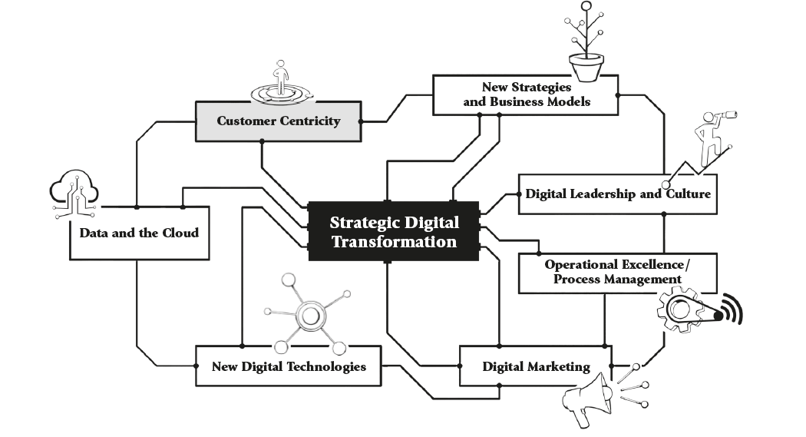
Strategic Action Fields

Slide 147
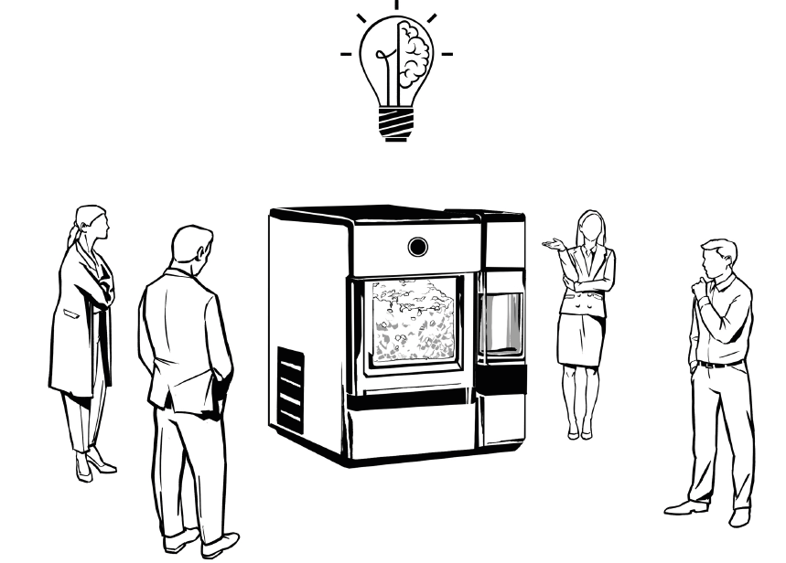
Opening Case: General Electric’s Co-Creation Strategy
for the Opal™ Nugget Ice Maker

Slide 148
Opening Case: General Electric’s Co-Creation Strategy
for the Opal™ Nugget Ice Maker
GE Appliances leveraged its FirstBuild™ (2024) co-creation community to design “a residential ice maker that would appeal to nugget ice enthusiasts”.
Customer surveys showed a strong preference for nugget ice.
Then FirstBuild™
  developed Opal to offer an affordable nugget ice maker in 2015.
  made it available in 2016 on the crowdfunding platform Indiegogo to gauge market acceptance.
  started with a first micro-factory on the University of Louisville campus and an online forum.
  extended to centres of excellence in India, Kentucky and China by 2018.
  is now “a global co-creation community backed by GE Appliances, a Haier company, [which] has already engaged thousands of makers in person and online to invent a new world of appliances.”

Slide 149
Opening Case: General Electric’s Co-Creation Strategy
for the Opal™ Nugget Ice Maker
Integration of customers into the design processes
  represents a unique approach to customer centricity.
  ensures that the preferences and jobs to be done of customers are designed into the product from the very start of product development and the associated value proposition.
Active scanning of the market and relationship
building with key customers allows firms
to anticipate and respond to customer needs.

Slide 150
4.0 Introduction
Digital technologies and digital transformation have created new opportunities for engaging and understanding customers.
Adopting a customer centric approach with digital technologies creates value, allows improvements in customer experiences and for tailored products and services.
Customer centricity is a key strategic action in digital transformation.
Two different approaches to customer centricity which need digital technologies to be applied differently:
  Customer intimacy (Treacy and Wiersma, 1995): long-term personalised relationship building in niche customer segments
  Differentiation strategy (Porter, 1985): brand-based customer relationship building for larger customer segments

Slide 151
4.1 Customer Centricity (First SAF)
A strategy that seeks to “fundamentally align a company’s products and services with the wants and needs of its most valuable customers”.
Goal: develop a long-term customer relationship, personalized or general
Digital transformation: potential by generating and using customer data
Critique:
  Not a competitive advantage, but necessary to maintain parity with competitors
  Questionable practicality and effectiveness, less performance indicators
  Often not fully implemented due to expectation that a single stakeholder is the sole focus or multiple stakeholders with “balanced centricity”.
  Complex customer needs and relationship price, quality, perceived value
  Implementation of CRM required, capturing and analysis of customer data to make decisions and implement activities.
  Regulatory control to protect customer and privacy difficult

Slide 152
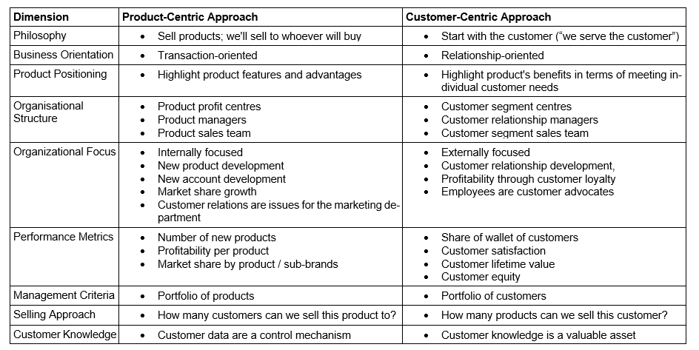
4.1 Customer Centricity

Slide 153
4.2 Customer Centricity and Different Customer Types
Appropriateness of customer centric firm strategy
  Conditions under which customer centricity would lead to a competitive advantage in B2C and B2B markets for different products or services
  Price, quality, value proposition and realisation
  Possibility to realise a long-term relational approach to serving customers
Spontaneously: B2C luxury consumer goods have a customer centric approach, but they use a product-based approach driving the value proposition and realisation.
Instead: Large volume retail sector with loyalty schemes use data on purchasing patterns over time to help understand the needs, wants and preferences, allowing customer loyalty.
Difficult to make assumptions about implementation of customer centricity
Digital Transformation: potential for a more customer centric approach

Slide 154
4.3 Customer Centricity, Digital Technologies, and the Data Economy
Increasing digital transformation, increasing customer centricity as digital technologies facilitate capturing customer needs and preferences that were previously prohibitively complex and expensive.
Digital technologies are highly scalable from small group collaboration for innovation projects to large datasets about consumer behaviour.
Digital technologies enable needs and wants to be addressed, by offering products and services that more closely reflect customer preferences.
Growing data economy: “a global ecosystem where data is gathered, organized, and exchanged to create economic value”.
  Change in economic value creation
  Opens risks, opportunities and challenges, that need to be understood and responded to.
  Key digital technologies: hyper-connectivity, capturing and storage of data, analytical techniques (IoT, Big Data, AI, Cloud Solutions)

Slide 155
Artificial Intelligence and Customer Centricity
AI and data collection on wants, needs and preferences allow customer centricity in the retail industry.
The use of AI on large datasets allows to “customize their offerings, create personalized shopping experiences, and make the purchase process simpler and more convenient”.
Key opportunities of AI:
Better identification of customers
Individualised product recommendations
More seamless shopping experience

Slide 156
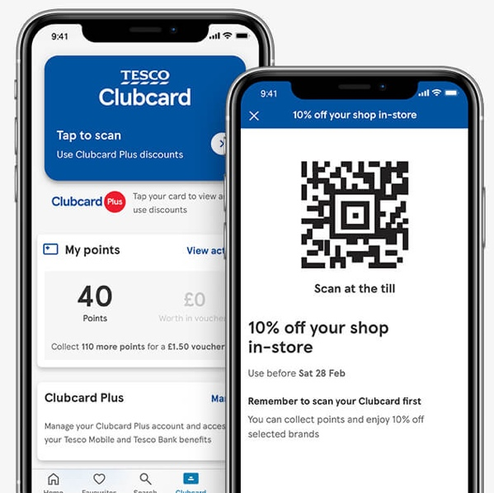
The Central Role of Information Systems in Tesco’s Customer Loyalty
Loyalty scheme Tesco Clubcard by Tesco, major UK-based retailer
  Customers get points for scanning card when purchasing, allowing customer purchases to be associated with specific customers over time
  Customers are offered rewards for staying loyal
Loyalty scheme as customer centric approach how “business in partnership with, and with the consent of their customers [, can] be loyal to their customers, by continually enhancing the value that they offer to those customers”.
Marketing research focuses on types of loyalty realised, design of rewards for participation by customers
Practically greatest value: exploitation of resulting data and integration of insights into CRM strategy (business development, promotions, recruitment, new services, channel migration strategies, relationship building)
https://www.tesco.com/clubcard/clubcard-plus?srsltid=AfmBOorTEJH7f37XQPeiY-ctqrcYKi7riX69dlKNb61hkEgm-tXB72P7

Slide 157
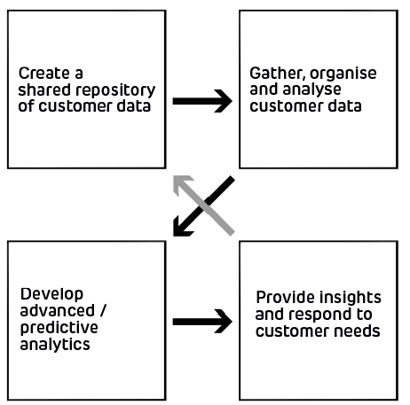
4.3 Customer Centricity, Digital Technologies, and the Data Economy
Firms that adopt a firm level customer centric approach follow a four-phase process, with the phases building on each other and following in order
Communal collaboration: shared central repository of all gathered, standardized and organized customer data from all touchpoints under the control of a neutral entity (like IT).
Serial coordination: how data analytics and diverse analytical activities are organised and coordinated, may require a reorganisation and staff development
Symbiotic coordination: understand past behaviours for making decisions and realise predictive analytics (models to predict customer behaviour and experiment with interventions to influence customer behaviour)
Integral coordination: bringing the customer understanding into the day-to-day operations

Slide 158
4.3 Customer Centricity, Digital Technologies, and the Data Economy
Increasing data intensity, increases concerns about data security, privacy concerns and implications for society
Firms need to comply with the appropriate national and regional legal frameworks for collecting, sharing and exploiting consumers data
  Secure storage required for personal and sensitive data to ensure confidentiality of the data and protection from cyber attacks
  Access needs to be well managed, so unauthorised access by staff and external cybercriminals is prevented
  E.g. Article 8 of the EU Charter of Fundamental Rights for a digital society, the General Data Protection Regulation (GDPR)
Firms need to understand how participation in data economy may infringe on individuals’ right to privacy and autonomy

Slide 159
4.4 Customer Centricity and the Customer Journey
Digital technologies shift customer journey to first multi-channel and increasingly to omni-channel strategies
  Expanded channels through which customers can interact with a firm
  Further degree of complexity
  Channels become interchangeable and seamlessly available
  Require firms to develop new data resources like a shared data pool
  Increasing loss of control through firm embeddedness in value creating ecosystem with not-owned touchpoints
  Increased customer experience, customer loyalty and satisfaction
Customer centricity is the design and management of the customer experience along the customer journey, including sensory (sense), affective (feel), cognitive (think), physical (behavioural), and social-identity (relational) customer experiences
Achievable if firms proceed through four phases for developing a data centric approach

Slide 160
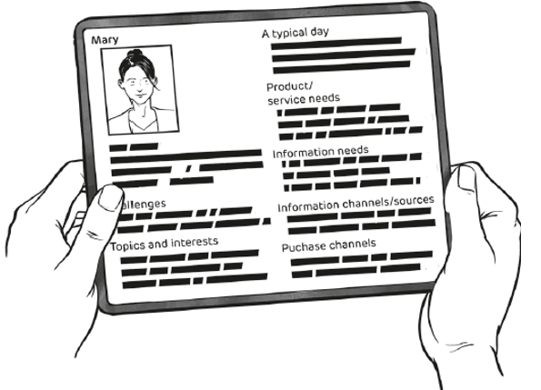
Customer Personas
“a semi-fictional representation of [an] ideal customer based on market research and real data about […] existing customers”
allow focus on specific customer segments in terms of needs, wants and preferences
Value of customer personas lies in the ability of a firm to empathise with, understand the lives of customers and understand die customer journey from their perspective
With many different types of customers, it makes sense to develop a number of personas.

Slide 161
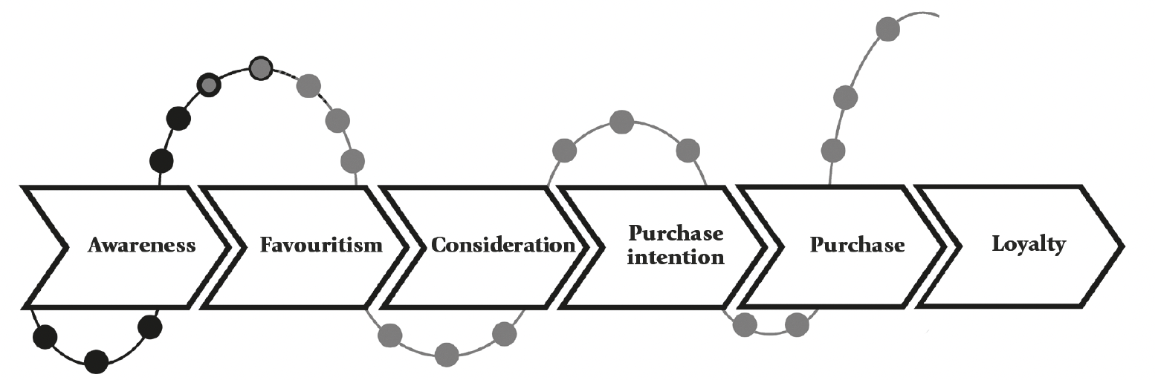
4.4.1 Omni-channel Customer Centricity Along the Customer Journey
Customer Journey is divided in three different phases.
Each completion of the customer journey contributes to the experience and the next purchasing process.
Management of touchpoints (omni-channel management) becomes crucial.
“Omni-channel management [can then be defined] as the synergistic management of numerous available channels and customer touchpoints, in such a way that the customer experience across channels and the performance over channels is optimized.”

Slide 162
4.4.2 Prepurchase Phase of Customer Journey
Activities are likely to take place over a mix of analogue and digital channels in an omni-channel approach.
Awareness
of a need or want
Consideration
of products or services that could address the need or want
Considering alternatives
Customer searches for offers in the marketplace
Preference
of a specific product or service
Purchase intention
emerges

Slide 163

Open Innovation and Co-creation with Customers
Digital technologies allow a more open approach to product or service innovation processes where customers and other stakeholders can be integrated or even co-create.
Through a dialogue with customers, firms understand their needs, wants and preferences better, which allows for a more effective and efficient product development process.
Critical to these processes is an open dialogue and mutual respect
Opening case of this chapter showed such a co-creation process

Slide 164
4.4.3 Purchase Phase of Customer Journey
Decision
choosing a specific product or service
Development of purchase intention
may or may not develop an intention to purchase that chosen offering
Ordering
product or service
Payment
of product or service

Slide 165
Social Media and Online Monitoring of / Listening to Customer Engagement
Social media as important source of insights (reviews, comments) about products and services for customers in the prepurchase phase
Firms can monitor social media platforms inhouse or purchase data from specialised firms
  provide a sense of the ratio of positive, neutral and negative sentiments
  see, where stakeholders are active on social media
  Monitor comments to improve customer experience
Each platform has unique characteristics which allow unique insights in social media monitoring/ listening
Similar to the analysis with the Net Promoter Score (Slide 28)

Slide 166
4.4.4 Post-purchase Phase of Customer Journey
Usage
Consume or use purchased product
Engagement
may engage with the firm
Communication
may talk about satisfied experience
Service requests
may activate a service request to address deficiencies

Slide 167
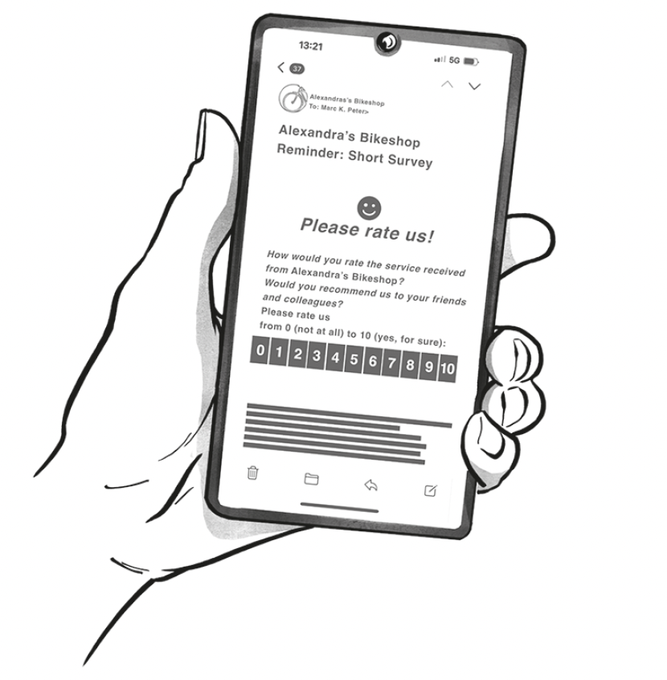
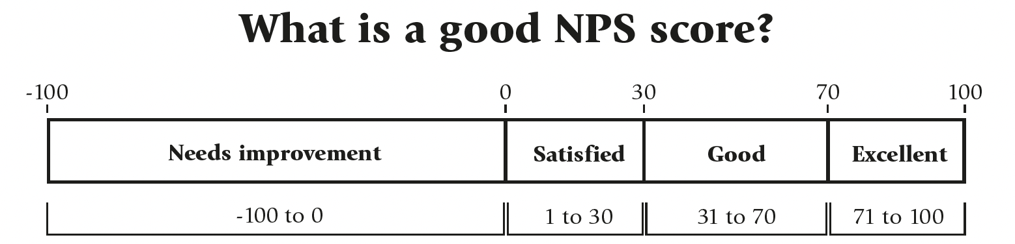
Net Promoter Score (NPS)

Slide 168
Net Promoter Score (NPS)
Aim: establish the satisfaction/ loyalty of customer to brand after the purchase
How: One rating question with a 10-point Likert scale (0 = not at all likely / 10 = extremely likely to recommend), often followed by open question received via email
Evaluation in 3 categories:
  0-6 Points Detractors: bad customer experience, stop purchasing, risk for bad reviews, deeper insights into reasons to improve customer experience
  7-8 Points Indifferent Customers: satisfied with experience, will not necessarily recommend the firm, receive less attention from firms
  9-10 Points Promoters: excellent customer experience, highly likely to recommend firm
NPS = % of promoters - % of detractors
Critique: simplicity, risk to be biased by cultural influences to give higher ratings

Slide 169
4.5 Enablers and Challenges for Customer Centricity Organisations
Organisational agility: accept risk and adopt a learning approach, requires flexibility and a timely responsiveness
Direct, two-way communication with customers: to not lose touch with customers
Integration of customers in the value creation processes: monitor customer trends and developments
Organisational culture focused on serving the customers: Breakdown pyramid structures, hire for fit with this culture, make customers a shared responsibility in all functions through incentive systems
Organisational traps to overcome with digital tools for insights and leadership for culture:
  Product focalisation, rigid organisational boundaries, “fixed-pie” mindset
  Cultures of fear and judgement
  Overwhelming customers with offerings
  Short-run performance measurement, instead of a long-term strategy

Slide 170
4.6 Customer Centricity and Competitive Advantage
Customer Centricity = source of sustained competitive advantage leading to improved firm performance by creating long-term value for customers, allowing firm to capture value through improved financial performance
Fundamental transformation enabled by digital technologies needed to reflect dynamic capabilities, capabilities and resource-based views for customer centricity
Result: entirely new ways of operating and decision-making, customer experience in the centre of value creation
Customer centricity might be the full realisation of Treacy and Wiersemas’s (1993) customer intimacy strategic discipline for competing
Positional strategic approach: Customer Centricity is choosing most profitable customer segments to serve by developing new products or existing offerings

Slide 171
4.7 Customer Centricity and Sustainability
Digitally enabled customer centricity contributes to realising a more sustainable future by responding to customer consumption behaviour more effectively
  Thinking about consumption of goods and services and how this affects economic, environmental and social sustainability
  Act of consuming is affected by and effects the consumptive behaviour of customers due to the importance of individual and collective customer attitudes, values and expectations
  Digital technologies allow different consumption by digitising elements or whole product and by offering innovative products with respect to sustainability concerns
  Digital technologies enable effective communication of product-market fit with preferences

Slide 172
4.8 Conclusion
Customer centricity allows for more effective relationship-building with customers
Customer centricity and co-creation are two methods to drive digital innovation
Need for firms to understand and meet customer needs and expectations in the fourth/ fifth industrial revolutions
Digital transformation enables to gather and analyse customer data, meanwhile associated with privacy and security concerns
Trend for an ever-greater digital transformation of customer journey to an omni-channel journey and a customer centric approach
Enablers and challenges for customer centric strategies: organisational agility, employee empowerment, customer-focused culture
First SAF is a source for potential competitive advantage with the use of customer data in strategic and operational systems and processes

Slide 173
Case Studies
You will find a collection of case studies for Strategic Digital Transformation in the appendix and additional cases online at www.strategic-digital-transformation.com.
Step 1: Selection of a case organization
Students can complete the following tasks either based on the focal case study, or work on the recommended case study for this chapter (Switzerland Tourism – cross-media campaign "The ride of a lifetime") and answer below questions.
Step 2: Case questions linked to this chapter
How well does the marketing strategy of Switzerland Tourism reflect a customer-centric approach?
Develop a customer persona (see Box 4.3) based on a summarised persona description of a typical segment which would/might visit Switzerland.
Develop the customer journey (see Chapter 4.4) for the campaign until a tourist would visit Switzerland: what steps will the tourist take, and what channels will be used to obtain information, and communicate with businesses (e.g., travel agency, airport, train)?
How is the digitally enabled customer journey reflected in the multi-channel marketing campaign (see also Chapter 4.4.1)?

Slide 174
Case Studies
You will find a collection of case studies for Strategic Digital Transformation in the appendix and additional cases online at www.strategic-digital-transformation.com.
Evaluate the choice to integrate world-famous personalities Roger Federer and Trevor Noah into the campaign: in your opinion does this speak to a customer-centric mindset at Switzerland Tourism?
How do you think digitally enabled customer centricity could be further enhanced in the customer experience of tourists that become aware of Switzerland as a destination after watching the campaign?
Additional cases with student questions for the strategic digital action field of Customer Centricity are covered in:
• Autodesk Asia-Pacific – customer lifecycle management
and marketing automation (available online).
• Action fields of digital transformation at Synchrony Financial (USA)
(available online).

Slide 175
Case Studies
You will find a collection of case studies for Strategic Digital Transformation in the appendix and additional cases online at www.strategic-digital-transformation.com.
Step 1: Selection of a case organization
Read the Swiss retail bank case “Valuu: a corporate start-up for digital business model innovation” (sections ‘Background’ and ‘The launch’), or
Select any other major retail bank in your country, or
Identify any other organisation in your country which is well documented (e.g., has a website and social media presence), and which can form the basis for future course work in Chapters 02 to 12 based on the Digital Transformation Toolkit present in Chapter 12.
For options 2 and 3 (if you chose to select another case organisation than Valuu), you should document the following:
Name of the organisation including information about their website and social media profiles.
Organisational facts and figures (e.g., financial metrics, number of employees, products and services, geographical reach; as well as its office, production and distribution locations).
Industry information with challenges and opportunities.

Slide 176
Case Studies
You will find a collection of case studies for Strategic Digital Transformation in the appendix and additional cases online at www.strategic-digital-transformation.com.
Step 2: Case questions linked to this chapter
Describe how each industrial revolution has transformed the business and identify the technology that was the trigger point which led to the need for a new strategy, new skills and new resources (see Chapter 1.0 and Figure 1.2).
Select a new digital technology (e.g., the cloud, sensors as part of the Internet of Things, or AI) and describe the opportunities and challenges of this technology for the business (see also Box 1.4).
Describe how the organisation could utilise technology for 1) digitisation, 2) digitalisation and 3) strategic digital transformation (see Chapter 1.3 and Figure 1.5).
Describe why this organisation would require a holistic, strategic digital transformation, and define the internal and external areas/functions (e.g., processes, marketing, new products and services) in which the organisation should pursue digital transformation.

Slide 177
Exercises
Discuss the following questions in your class, in your group or assignment:
Review the opening case (General Electric’s Opal Nugget Ice Maker) in light of a product vs. customer centric approach (see Table 4.1): how would General Electric's approach be different under each strategy?
Select a small or medium-sized firm of your choice (its recommended that it has a narrow product focus for this exercise) and analyse the potential of the firm to leverage digital technologies to implement a more customer-centric approach to value creation.
Forming two small groups (2-4 students in each group), assign a pro and contra position to each group and debate the degree to which product vs. customer centric approaches (see Table 4.1) are more successful.
Analyse and discuss how data needs to be managed (see Figure 4.4) in order for a firm to benefit from data for customer-centric strategies (select a concrete industry / business to discuss your points)).
Based on above industry/business in exercise 4, elaborate the implications and risks towards data security, privacy concerns and implications for society.

Slide 178
Exercises
For the selected industry/business in exercise 4, map the customer journey and align it to customer touchpoint to identify all channels that should be managed (omni channel management).
Explain why customer centricity and competitive advantages for firms are linked. Provide at least 3 concrete examples.

Slide 179
Further Reading List
Boston Consulting Group (2022). Delivering Government Services Like a Digital Native, https://www.bcg.com/publications/2022/delivering-customer-centric-digital-government-services
Boston Consulting Group (2023). Building Customer Experience for the Future https://www.bcg.com/publications/2023/building-customer-experience-for-the-future
Gummesson, E. (2008). Customer centricity: reality or a wild goose chase? European Business Review, 20(4), 315-330.
Latinovic, Z., & Chatterjee, S. C. (2019). Customer centricity in the digital age. Sloan Management Review, 60(4), 0_1-0_2.
Läubli, D. & Sänger, F. (2024). Building the future: Focusing on digitalization and sustainability, https://www.mckinsey.com/industries/retail/our-insights/building-the-future-focusing-on-digitalization-and-sustainability
Sankur, A., Duncan, E., Cilento, G., & Fuchs, S. (2024). True customer-centricity: An operating model for competitive advantage, https://www.mckinsey.com/industries/industrials-and-electronics/our-insights/true-customer-centricity-an-operating-model-for-competitive-advantage

Slide 180
References
Dalsace, F., Bonnet, D., & Lange, K. (2025). Customer centricity: Digital and leadership to the rescue. Business Horizons, in press.
Fader, P. S., & Winer, R. S. (2012). Introduction to the special issue on the emergence and impact of user-generated content. Marketing Science, 31(3), 369-371.
FirstBuildTM. (2024) Home Page. Last Accessed 26.07.2024 from https://firstbuild.com/
GE Appliances. (2018). FirstBuild™ by GE Appliances Expands Innovation Model Overseas. Last Accessed 26.07.2024 from https://pressroom.geappliances.com/news/firstbuildTM-by-ge-appliances-expands-innovation-model-overseas
General Electric. (2015) First Nugget Ice Maker for Home Use Launches. Last Accessed 26.07.2024 from https://www.ge.com/news/press-releases/first-nugget-ice-maker-home-use-launches
General Electric. (2024). GE Profile™ Opal™ Nugget Ice Maker + Side Tank and Bluetooth. Last accessed on 26.07.2024 from https://www.geappliances.com/appliance/GE-Profile-Opal-Nugget-Ice-Maker-Side-Tank-and-Bluetooth-OPAL01GEPKT
Gulati, R., & Oldroyd, J. B. (2005). The quest for customer focus. Harvard Business Review, 83(4), 92-101.
Gummesson, E. (2008a). Extending the service-dominant logic: from customer centricity to balanced centricity. Journal of the Academy of Marketing Science, 36, 15-17.
Gummesson, E. (2008b). Customer centricity: reality or a wild goose chase? European Business Review, 20(4), 315-330.
Habel, J., Kassemeier, R., Alavi, S., Haaf, P., Schmitz, C., & Wieseke, J. (2020). When do customers perceive customer centricity? The role of a firm’s and salespeople’s customer orientation. Journal of Personal Selling & Sales Management, 40(1), 25-42.
Hayes, Ó., & Kelliher, F. (2022). The emergence of B2B omni-channel marketing in the digital era: a systematic literature review. Journal of Business & Industrial Marketing, 37(11), 2156-2168.
Hemel, C. V. D., & Rademakers, M. F. (2016). Building customer-centric organizations: Shaping factors and barriers. Journal of Creating Value, 2(2), 211-230.
Indiegogo. (2024) Home Page. Last accessed on 26.07.2024 from https://www.indiegogo.com
Ivanov, I.I. (2019). Chasing the Crowd: Digital Transformations and the Digital Driven System Design Paradigm. In: Shishkov, B. (eds) Business Modeling and Software Design. BMSD 2019. Lecture Notes in Business Information Processing, vol 356. Springer, Cham.
Kusinitz, Sam (2014). “The Definition of a Buyer Persona [in Under 100 Words],” Hubspot, (March 8), [available at http://blog.hubspot.com/marketing/buyer-persona-definition-under-100-sr].
Latinovic, Z., & Chatterjee, S. C. (2019). Customer centricity in the digital age. Sloan Management Review, 60(4), 0_1-0_2.
Lemon, K. N., & Verhoef, P. C. (2016). Understanding customer experience throughout the customer journey. Journal of Marketing, 80(6), 69-96.
Peter, M.K. (Hrsg.) (2017). KMU-Transformation: Als KMU die Digitale Transformation erfolgreich umsetzen. Forschungsresultate und Praxisleitfaden. FHNW Hochschule für Wirtschaft, Olten/Schweiz, www.kmu-transformation.ch.
Peter, M.K. (Hrsg.) (2021). Strategieentwicklung im digitalen Zeitalter: Planung und Umsetzung der Digitalen Transformation. FHNW Hochschule für Wirtschaft und Strategylab, Olten/Schweiz, www.strategische-transformation.ch.
Peter, M.K. (2023). Digitaler Masterplan für KMU. So gelingt die digitale Transformation in Ihrem Unternehmen. Verlag Beobachter Edition & Handelszeitung. Zürich/Schweiz, www.digitaler-masterplan.ch.
Peter, M.K. (2024). The Digital Transformation Canvas. Develop and implement your digital strategy. FT Publishing/Pearson, London/UK, www.the-digital-transformation-canvas.com.
Peter, M. K., Kraft, C., & Lindeque, J. (2020). Strategic action fields of digital transformation: An exploration of the strategic action fields of Swiss SMEs and large enterprises. Journal of Strategy and Management, 13(1), 160-180.
Rowley, J. (2007). Reconceptualising the strategic role of loyalty schemes. Journal of Consumer Marketing, 24(6), 366-374.
Schweidel, D. A., & Moe, W. W. (2014). Listening in on social media A joint model of sentiment and venue format choice. Journal of Marketing Research, 51(4), 387-402.
Sestino, A., Kahlawi, A., & De Mauro, A. (2025). Decoding the data economy: a literature review of its impact on business, society and digital transformation. European Journal of Innovation Management, 28(2), 298-323.
Sheth, J. N., Sethia, N. K., & Srinivas, S. (2011). Mindful consumption: A customer-centric approach to sustainability. Journal of the Academy of Marketing Science, 39, 21-39.
Shah, D., Rust, R. T., Parasuraman, A., Staelin, R., & Day, G. S. (2006). The path to customer centricity. Journal of Service Research, 9(2), 113-124.
Treacy, M., & Wiersema, F. (1995). The Discipline of Market Leaders. Reading, MA: Persus Books.
Verhoef, P. C., Kannan, P. K., & Inman, J. J. (2015). From multi-channel retailing to omni-channel retailing: introduction to the special issue on multi-channel retailing. Journal of Retailing, 91(2), 174-181.

Slide 181
Case Study Collection
Each book chapter has an opening case and suggested case work,
and additional cases are available online as separate documents.
The authors would like to express their gratitude to all participating organisations
and to the contributors (authors and interview partners) of the case studies:

Slide 182
Digital Transformation Textbook
Visit www.strategic-digital-transformation.com
for case studies, videos and workshop templates.
Prof. Dr. Marc K. Peter
Dr. Johan P. Lindeque

Slide 183
05 Strategic Action Field of New Digital Technologies
Chapter 05 of 12
© Marc K. Peter & Johan P. Lindeque (2026): Strategic Digital Transformation. Theory and Practice. Sage Publications, London/UK
183

Slide 184
Digital Transformation Textbook
This cutting-edge textbook takes a unique approach to digital transformation which aligns theory and practice and is supported by the authors’ own research with over 4,000 organisations. Covering key topics such as emerging technologies, AI, cybersecurity, customer orientation, operational excellence, marketing automation, innovation and leadership and culture, it offers a learning experience which prepares students for the practical realisation of digital transformation for competitive advantage.
With individual and group exercises and case studies from a range of organisations, Strategic Digital Transformation prepares students to apply the knowledge and experience gained from the book in their future careers. It is suitable for undergraduate and postgraduate digital transformation and digital business courses.
We wish you lots of success and hope that
you will benefit from this textbook!
This cutting-edge textbook takes a unique approach to digital transformation which aligns theory and practice and is supported by the authors’ own research with over 4,000 organisations. Covering key topics such as emerging technologies, AI, cybersecurity, customer orientation, operational excellence, marketing automation, innovation and leadership and culture, it offers a learning experience which prepares students for the practical realisation of digital transformation for competitive advantage.
With individual and group exercises and case studies from a range of organisations, Strategic Digital Transformation prepares students to apply the knowledge and experience gained from the book in their future careers. It is suitable for undergraduate and postgraduate digital transformation and digital business courses.
Marc K. Peter & Johan P. Lindeque
Strategic Digital Transformation
Theory and Practice
2026, 408 pages
Sage Publications, London/UK
www.strategic-digital-transformation.com
Prof. Dr. Marc K. Peter
Dr. Johan P. Lindeque

Slide 185
Foreword
Modern advancements in the economy are characterised by a series of transformative industrial revolutions over the past three hundred years, each driven by groundbreaking technological innovations that reshaped societies, industries, businesses, and the way we live and work. The first industrial revolution, which began in the late 18th century, was driven by the mechanisation of production through steam power and the advent of factories. This era saw a dramatic increase in productivity and the rise of urban centres, fundamentally altering the social and economic landscape. The second industrial revolution in the late 19th and early 20th centuries introduced mass production and assembly lines, powered by electricity. Innovations such as the telegraph, telephone, and internal combustion engine further accelerated industrial growth and global connectivity, resulting in consumer markets.
The third industrial revolution, starting in the mid-20th century, brought automation and the digitalisation of manufacturing processes. The development of computers and the internet revolutionised industries, enabling unprecedented levels of precision and efficiency. This era laid the groundwork for the interconnected world we live in today. We are currently in the midst of the fourth industrial revolution, characterised by the fusion of digital and physical dimensions, creating smart factories and shipping digital societies. As we stand on the brink of the fifth industrial revolution, the focus shifts towards human-machine symbiosis, ethical AI, and sustainable practices. This emerging era emphasises the integration of advanced technologies with human capabilities, fostering collaboration between humans and robots, and prioritising ecological sustainability and social well-being.
In this rapidly evolving landscape, strategic digital transformation is not just an option but a necessity for organisations to remain competitive and relevant. It involves a holistic renewal of business models, processes, and organisational structures, leveraging digital technologies to create new value and drive innovation. This new textbook describes the components and provides a toolkit for strategic digital transformation, which requires a clear vision, a comprehensive digital strategy, a robust implementation plan and a commitment to continuous learning and adaptation.
Organisations that embrace this transformation will be better positioned to navigate the complexities of the digital age, capitalise on new opportunities, and contribute to a more sustainable and inclusive future. It is an exciting time to be part of this journey, and I am confident that the insights and strategies presented in this textbook will provide valuable guidance for young leaders and innovators seeking to thrive in the digital era.
Alois Zwinggi
Managing Director, World Economic Forum
www.weforum.org
© World Economic Forum/Pascal Bitz (Flickr, 2023)

Slide 186
Case Study Collection
Each book chapter has an opening case and suggested case work,
and additional cases are available online as separate documents.
Visit www.strategic-digital-transformation.com for:
  Slide decks for each case (case summaries and illustrations).
  Videos from case organisations (case introductions, promotional clips and interviews).
  The Digital Transformation Toolkit with workshop templates and checklists.
The authors would like to express their gratitude to all participating organisations
and to the contributors (authors and interview partners) of the case studies:

Slide 187
Book Structure
PART 1
FOUNDATIONS
OF DIGITAL
TRANSFORMATION
Chapter 01: Strategic Digital Transformation: Background and Terminology
Chapter 02: Business Strategy in the Digital Age
Chapter 03: Digital Transformation
in Context: Innovation
and Sustainability
PART 2
STRATEGIC ACTION FIELDS (SAF) OF
DIGITAL TRANSFORMATION
Chapter 04: SAF Customer Centricity
Chapter 05: SAF New Digital Technologies
Chapter 06: SAF Data and the Cloud
Chapter 07: SAF New Strategies and Business Models
Chapter 08: SAF Operational Excellence / Process Management
Chapter 09: SAF Digital Leadership and Culture
Chapter 10: SAF Digital Marketing
PART 3
DIGITAL TRANSFORMATION IN PRACTICE
Chapter 11: Success Factors and Metrics for Digital Transformation Implementation
Chapter 12: Transformation in Practice - Digital Transformation Toolkit
PART 4
DIGITAL TRANSFORMATION CASE STUDIES
BRUGG Lifting
City of Lucerne
Switzerland Tourism
Valuu (PostFinance)
With many other case studies (including videos and interviews) available online.

Slide 188
Learning Goals Chapter 05
Be able to identify the main types of digital technologies.
Be able to explain why technologies are adopted and accepted by firms and employees.
Be able to explain how different digital technologies create value in terms of underlying value drivers.
Be able to explain how digital technologies contribute to the competitive advantage of firms.
Be able to explain how digital technologies support greater sustainability.
Evaluate the opportunities and risks associated with the adoption and use of digital technologies.

Slide 189
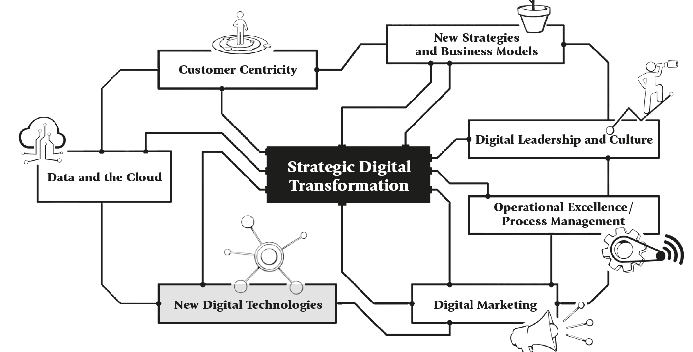
Strategic Action Fields

Slide 190
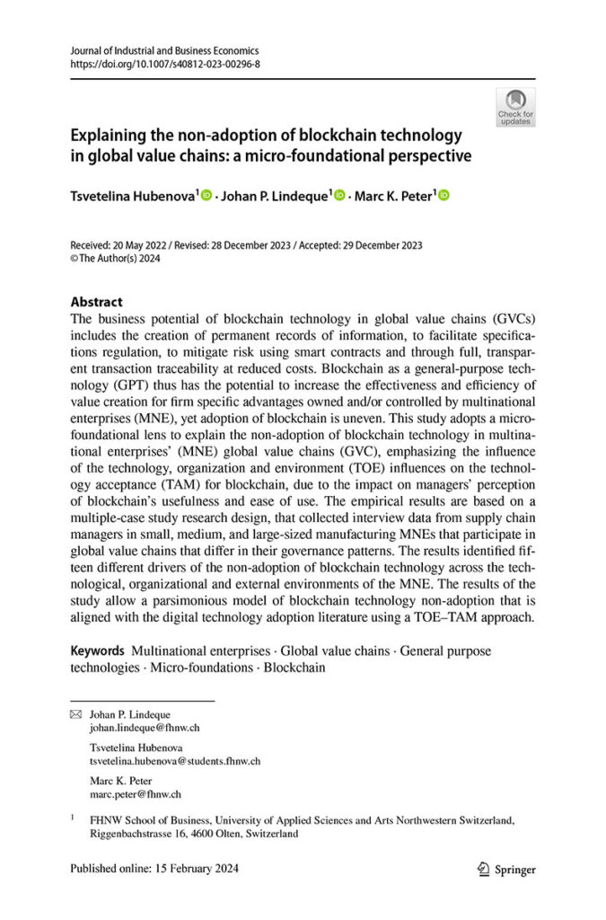
Opening Case: The Surprising Case of Blockchain Technology Non-Adoption in Supply Chains
Blockchain technology has received significant attention, also as enabling technology for digital currencies like Bitcoin.
Different approaches to blockchain technology, which differ in the degree to which they are centralised or decentralised and their degree of privacy.
Blockchain technologies consists of different blocks which include a timestamp, transaction data and the cryptographic hash of the preceding block (retroactive modification impossible).
Blocks are interconnected and with each transaction or activity a new set of record is added.

Slide 191
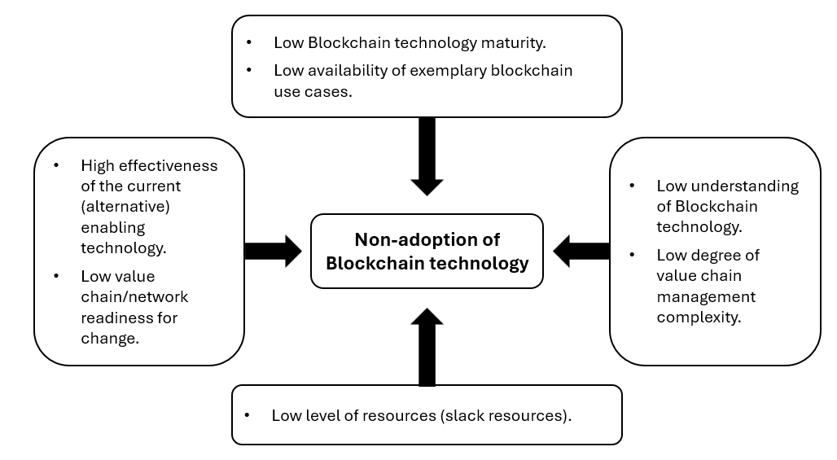
Opening Case: The Surprising Case of Blockchain Technology Non-Adoption in Supply Chains
Blockchain technology enhances transparency, traceability, efficiency and information security
Interesting for finance, banking, insurance, logistics and transportation and supply chain management
Supply chain managers are not entirely convinced for the following reasons

Slide 192
5.0 Introduction
Computer, information, communication, sensing and controlling technologies are being integrated in response to digital transformation
Technologies are novel and require managers to make decisions about adoption and use of technologies
Chapter introduces widely adopted models for explaining firm level and employee level technology adoption and acceptance decisions
Selection of important contemporary digital technologies are presented and discussed, including two important themes of AI as part of the fifth industrial revolution
Chapter concludes with assessment of the impact of new technologies on firm competitive performance and sustainability
Cybersecurity risks seen as a success factor in the digital age are covered in this Chapter

Slide 193

Definition of New Digital Technologies
Central digital technologies in the digital transformation of firms include computing, information, communication, connectivity, sensing and controlling technologies.
Digital technology is considered new when it conforms to the Oslo Manual definition of an innovation (by organisation for economic co-operation and development (OECD)): allows product, process, marketing and/ or organizational innovations.
Existing technology may be new in a novel domain in application
  e.g. blockchain technology was new with cryptocurrencies, then focus moved to other domains, so it is again considered a new innovation in smart contracts or record keeping.
https://www.coe.int/de/web/cultural-routes/oecd

Slide 194
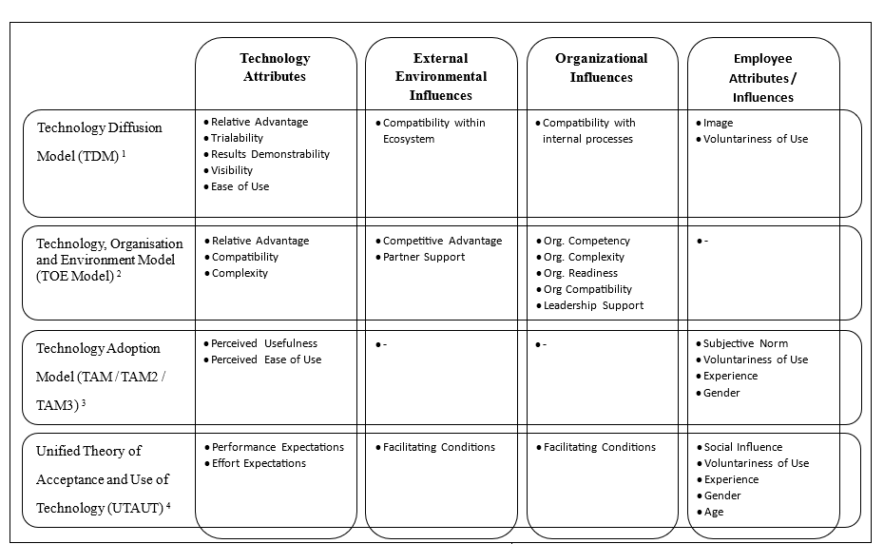
5.1 Technology Adoption Decisions: Four widely adopted theories and models
In all these models, perceptions of technology users, managers and technology adoption decision-makers play a critical role

Slide 195
5.1.1 Technology Diffusion Model (TDM) by Moore & Benbasat (1991)
The higher the eight defined attributes of technology innovations are, the more quickly a technology will defuse:
  Relative Advantage: is perceived as being better
  Compatibility: is perceived as being consistent with the existing values, needs, and past experiences of potential adopters
  Trialability: may be experimented with before adoption
  Result Demonstrability: more advantages of an innovation can be demonstrated and are observable
  Visibility: adoption and acceptance of an innovation by others can be observed
  Ease of Use: is perceived as easy or difficult to use
  Image: is perceived to enhance one's image or status in one's social system
  Voluntariness of Use: is perceived as being voluntary, or of free will

Slide 196
5.1.2 Technology, Organisation and Environment Model (TOE)
Widespread approach for explaining digital technology adoption by organisations
Holistic approach that is free of industry or firm-size effects, critiqued for being too general and having unclear constructs
Very useful for categorising the factors that determine technology adoption
  Technology: The attributes of the technology being considered for adoption;
  Organisation: Internal facilitating conditions
  Environment: External facilitating conditions
Needs to be integrated for operationalisation of categories, using the perceived usefulness (PU) or perceived ease of use (PEOU) factors from the technology acceptance model:
  Technology: complexity, compatibility with processes, relative advantage
  Organisation: competences, complexity, readiness and compatibility
  Environment: competitive advantage, partner support

Slide 197
5.1.3 Technology Acceptance Model (TAM)
Often integrated with TOE: factors that determine PU and PEOU
Explains technology acceptance and usage
The greater the perceived usefulness and the perceived ease of use, the higher the expected attitudinal and behavioural intentions (subjective norm to decision-maker) to use the technology
  Perceived Usefulness: “the degree to which a person believes that using a particular system would enhance his or her job performance”
  Perceived Ease of Use: “the degree to which a person believes that using a particular system would be free of effort”
  Subjective Norm: “the person’s perception that most people who are important to him thin he should or should not perform the [behaviour] in question"

Slide 198
Technology Adoption Under Conditions of Uncertainty
Common assumption of models and theories is that while subjective, it is still possible to assess the advantages of adopting a novel technology.
Under conditions of high levels of uncertainty, managers will take a comparative approach to make technology adoption decisions.
Different mechanisms of isomorphic state: conformity in technology adoption decisions across business organization and employees
Mechanisms can act at different times along the decision-making process and can be leveraged by advocates for a given technology like consulting firms and technology producers.
Mimetic
copy decisions of others
Normative
Base decisions on professional legitimised norms
Coercive
coerced by an authoritative entity which regulates industry
Competitive
technology seen as underlying driver of competitive advantage of a high performing firm

Slide 199
5.1.4 Unified Theory of Acceptance and Use of Technology (UTAUT)
Developed in an extensive empirical study by Venkatesh et al. (2003)
Integrated MM, TPD/DTPB, TPB, TAM, MPCU, IDT and SCT
Final result of four main determinants for technology acceptance
  High Performance Expectations: “the degree to which an individual believes that using the system will help him or her to attain gains in job performance”
  Low Effort Expectations: “the degree of ease associated with the use of the system”
  Social Influence: “the degree to which an individual perceives that important others believe he or she should use the new system”
  Facilitating Conditions: “defined as the degree to which an individual believes that an organizational and technical infrastructure exists to support use of the system”.
  Four moderating effects: Gender, age, experience and perceived voluntariness of use of a technology

Slide 200
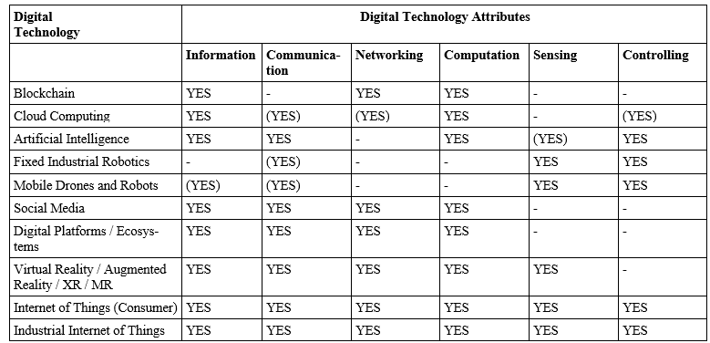
5.2 Digital Technologies
Each technology listed below should be
  discussed in terms of digital technology attributes
  linked to managerial and/ or operational work
  assessed using the degree of human-technology network and to which degree the technology is assisting humans or vice versa.

Slide 201
5.2.1 Blockchain Technology (see Opening Case)
Based on distributed ledger technology (DLT) that enables information to be recorded, stored by multiple networked entities to create a transparent, immutable and irreversible record of information
Multiple approaches for implementation:
  centralised or decentralised,
  permissioned (private):
    private: only permission enables to access network, transact and see transaction information
    consortium: semi-decentralized, managers decide what is public or private
    hybrid: transactions can be verified privately or publicly
  permissionless (public): can be accessed by anyone, blocks are publicly visible
  consensus mechanism used:
    Public: Proof-of-Work, Proof-of-Stake, Delegated Proof-of-Stake
    Private: Byzantine Fault Tolerance (pBFT), Istanbul BFT, federated BFT

Slide 202

5.2.2 Cloud Computing
Ideal case: “clouds are pools of endless computing resources with unlimited performance that, provide endless amounts of resources at any time and automatically scale the performance of the system up and down as needed”
Attractive to firms because of flexibility, lower investment, operating and maintenance costs, improved organizational resilience, improved rescalability, on demand consumption of services.
Most well-known provider: Amazon Web Services with storage (Amazon S3), CPU capacity (Amazon EC2) or databases (SimpleDB)
Decision on cloud solution type:
  Private: hosted on server of company, only used by members of firm
  Public: computing, computer resources […] to the public” via a cloud service provider, reducing security and control for users
  Community: specific group of users that share common goals or missions
  Hybrid: combination of all other, dependent on interoperability and management of complexity
https://de.wikipedia.org/wiki/Amazon_Web_Services

Slide 203
5.2.2 Cloud Computing
Four architectures:
  Hardware as a Service (HaaS): cloud provider rent out hardware to be installed, configured and maintained by cloud user via internet
  Infrastructure as a Service (IaaS): similar to HaaS, virtual machines are rented out, free to choose operating system and software stack
  Platform as a Service (PaaS): fully configured and managed computing platform, ready to run custom software developed by the user
  Software as a Service (SaaS):highest abstraction level, ready-to-use online applications deployed in the cloud, hidden from the user, managed by provider, user only needs to use them
Raise significant concerns about trust in service providers, security of data, service guarantees, location of data, data protection regulations, cybersecurity, risk of lock in with a provider

Slide 204
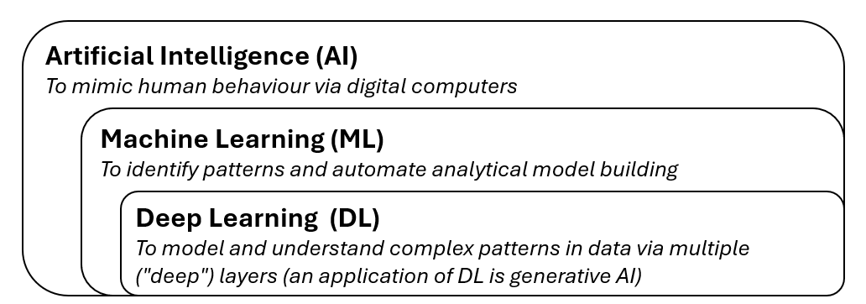
5.2.3 Artificial Intelligence
refers to simulation of human intelligence in machines (reasoning, learning, problem-solving, perception and language understanding)
AI systems classified in narrow AI (specific tasks) and general AI (any task)
Two levels of AI in terms of their level of complexity and learning capabilities:
  ML: development of algorithms and statistical models by identifying patterns and relationships in data.
  DL: subset of ML, inspired by function of the human brain, requires large amounts of data and computational power for training, can achieve remarkable accuracy and performance, applications: generative AI, image and speech recognition, natural language processing

Slide 205

Alan Turing and the Dawn of AI
In his seminal paper “Computing Machinery and Intelligence” from 1950, Alan Turing proposed the question “Can machines play the imitation game?”
This game involves an interrogator who must distinguish between a human and machine based on their responses to questions.
If the machine’s responses are indistinguishable from the human’s, it can be said to “think”.
For him, computers are discrete-state machines capable of performing any operation a human computer could given sufficient storage and speed.
https://www.manhattanrarebooks.com/pages/books/1842/alan-turing/computing-machinery-and-intelligence-in-mind?soldItem=true

Slide 206
The Future of AI and its Impact to Humanity
Grace et al. (2024) did a large-scale survey conducted among 2778 AI researchers to find out predictions regarding the future of AI.
50% chance of AI systems achieving significant milestones by 2028 .
10% chance of AI outperforming humans in all tasks by 2027, 50% chance by 2047.
Full automation of all human occupations is expected to reach a 10% probability by 2037 and 50% by 2116.
68% believe good outcomes are more likely than bad outcomes, 51% give at least a 10% chance to AI leading to catastrophic outcomes.
Identified AI-related scenarios: spread of false information, authoritarian population control, increased inequality
Lack of consensus whether faster or slower AI progress would be better for humanity.
Broad agreement that research aimed to minimize potential risks is priority.

Slide 207
The European Union’s AI Act
aims to regulate AI to ensure safety, transparency and human oversight.
started on 1 August 2024, will be mostly fully applicable in August 2026.
Four risk categories identified:
  Unacceptable Risk: prohibited AI systems that pose significant threats like social
  scoring or manipulative techniques
  High Risk: stringent requirements for systems in critical infrastructure and industries, robust risk management and other assessments needed.
  Limited Risk: meet transparency obligations by informing users that they interact with
  AI like chatbots or deepfakes
  Minimal Risk: most applications, are largely unregulated.
Majority of obligations on high-risk AI systems and focus general-purpose AI (GPAI) models
GPAI need technical documentation, usage instructions, summaries of training data, (evaluations, adversarial testing, report incidents for systemic risk models).

Slide 208
5.2.4 Robotics (Fixed and Mobile)
Critical to many industrial automation processes as an integral element of Industry 4.0
Traditionally: physical and fixed in position robots that perform activities usually done by humans, rely on sensing and controlling, collaborate with humans.
Robots can take any physical form required to complete tasks (in the physical world or cyberspace)
New topics like collaborative robots (cobots), autonomous robots and human-robot interactions.
AI robots: semi-autonomous, physical or virtual form, complete tasks previously done by humans, combine automation, learning and decision-making without experiencing emotions

Slide 209
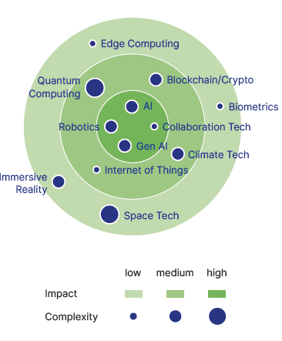
Technology Radar
Tool that supports the identification, observation and evaluation of relevant and outdated technologies.
provides information about technology trends critical for planning research and development activities of the firm.
allows comparison of trends to actual technology portfolio of the business to allow new initiatives.
Steps to create a technology radar:
  Identify relevant technology or application areas.
  Collect information about relevant technology and application areas.
  Evaluate these technologies and applications.
  Visualize and communicate the results in the radar.

Slide 210









5.2.5 Social Media
Web 2.0 enabled set of internet- and mobile-enabled applications that allow users to build communities, interact and communicate, with the purpose of sharing, exchanging and consuming user generated content
Individuals and organisations join platforms to form social networks, communicate one-to-one and one-to-many at low cost.
Enabler of business activity like building reputation, enabling transactions, developing customer relationships and building brands
Dominant platforms: LinkedIn, X (formerly Twitter), Facebook, TikTok, WeChat, Instagram, Pinterest and YouTube.
Social media companies get large amounts of data from user generated content creation and consumption highly valuable for advertising services.
Organisations use social media platforms for reputation building, value stream for advertising revenue, communication with stakeholders, user generated reviews.

Slide 211
5.2.6 Digital Platforms and Ecosystems
Social media as a special case of a broader category
Organizational form that is most strongly associated with the digital age
Enabled by a socio-technical system of pervasive connectivity and data generation, computers and mobile devices, the internet, increasingly sensor technologies, the community of user as actors on the platform or in the ecosystem, computing, cloud services and recently AI.
Development relies on connectivity, re-programmable functionality and re-purposable digital devices, and data generation, capture and analysis.
Resulting distributed socio-technical systems allow an unprecedented capacity for identifying, monitoring, controlling agents or assets in a given ecosystem
Common characteristics: generation of economies of scale, scope, and network effects, leading to monopolistic positions
Value sources: provision of matching services, low search costs, enabling market expansion and facilitation of innovation, human behaviour

Slide 212
5.2.7 Extended, Virtual, Augmented and Mixed Reality
Extented relaty (EX) is umbrella term for all real and virtual combined digital environments and interactions by computer technology like VR, AR and MR.
Conceptualised in the 1960s, commercialised in the 1980s, new products since.
Recently extensive interest in AR
VR
seeks to immerse user in a modelled digital world
Applications: gaming, training, design, education, learning
AR
Combine real world and virtual objects that interact in real-time
Applications: architecture, maintenance, entertainment, education, medicine and psychological treatments
MR
Blends elements of AR, VR
Interaction with that world in real-time
enabled by computing, display and sensory technologies
Physical and digital objects co-exist and interact in real time.

Slide 213
5.2.8 (Industrial) Internet of Things
refers to a computing concept that describes the ever-increasing connectivity of common devices to the internet.
Idea is to “deploy billions or even trillions of smart objects capable of sensing the surrounding environment, transmit and process acquired data, and then feedback to the environment”.
aim to improve connection between physical and digital worlds in an integrated cyber-physical system, allowing exchange of information, enabling digital systems to sense via and control devices in the physical world.
IoT: focus on everyday lives, human-centred system, needs flexibility to integrate wide variety of devices
IIoT: machine-to-machine (M2M) and industrial communication technologies with automation applications, machine-oriented, highly reliable integration and connectivity required, potential to increase efficiency and sustainability

Slide 214
Long Range Wide Area Network (LoRaWAN)
enables energy-efficient (battery time of up to 10 years per sensor) data transmission over long distances between devices/sensors, cloud and IoT
Specifically designed for IoT and IIoT
Possibiltiy to manage hundreds of sensors in a network and process large amounts of sensor data
used to continuously monitor a large area with multiple sensors, e.g. temperature, pollution levels or humidity.
Also see the “BRUGG Lifting and its Industrial Internet of Things (IIoT) asset management solution ‘PVS’” case in the case study collection (appendix).

Slide 215
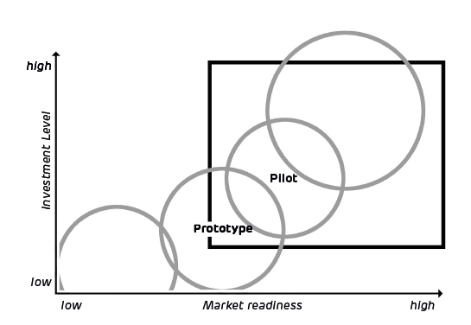
5.3 Methods of Developing and Testing Digital Technology Solutions
Most common methods in business practice:
  Proof of concept (POC): technical implementation of an idea to check feasibility, limited functionalities developed
  Prototype: technically developed solution with a limited range of functions, sufficiently developed for validating original idea for finalising requirements for pilot
  Pilot: technical solution tested in a limited circle and use cases, not made available externally, test feasibility and effectiveness, limited scope and duration
  MVP: technical product to test idea in the market with selected customers, get customer feedback quickly to further develop in iterations, fits basic needs of customer which could be enough for achieving market success
Approaches chosen by various factors like scope, maturity and market readiness of innovation and available budgets/ funding

Slide 216
5.4 New Digital Technologies and Cybersecurity
Digital technologies, increasing online use raise concerns about cybersecurity
Cybersecurity: guard against evolution of cyber threats to citizens, consumers, firms and governments
Types of cyber threats:
  Technical: attack to normal functioning of a device (malware, ransomware)
  Social: exploit human errors to gain access to sensitive information (phishing, spam attacks)
Firms need to assess both organizational and employee cybersecurity readiness to counter cyber threats as individuals play central role.
  Improving capability of employees to identify and know how to respond to a cyber threat.
  Developing awareness, confidence and attitudes (affected by subjective norms of employees social groups) that lead to undertaking protective behaviours.

Slide 217
Verizon’s Data Breach Investigations Report (DBIR)
Provides a comprehensive analysis of the current cyber threat landscape:
  Attack vectors: mainly phishing, exploitation of vulnerabilities, use of stolen credentials, ransomware and Denial of Service (DoS)
  Emerging threats: new, innovative attacks, variations of traditional methods, e.g. exploitation of zero-day vulnerabilities.
  68% of breaches involved a non-malicious human element falling victim to a social engineering attack or making an error.
  62% of financially motivated incidents involved ransomware or extortion, with a median loss of $46,000 per breach.
  15% of breaches involved a third-party hosting partner infrastructures or data custodians.
  14% of breaches involved the exploitation of vulnerabilities as an initial access step.
  Robust security measures needed: regular updates and patches, employee training, implementation of multi-factor authentication

Slide 218
5.5 New Digital Technologies and Competitive Advantage
Studies on impact of digital technologies on firm performance mainly focus on relationship digital technology adoption and innovation activities (service and product innovations)
Mixed results for relationship:
  Blichfeldt & Faullant (2021): find evidence
  Usai et al. (2021): no direct effect,
    adoption increased efficiency but competitive advantage was firm’s unique knowledge independent from underlying technology
    Reasons: imitability and general purpose nature of most digital technologies

Slide 219
5.6 New Digital Technologies and Sustainability
Assessment of impact of individual technologies on sustainability in isolation not possible
Careful assessment needed for the impact of technologies on rate of desirable and undesirable flows and stocks
Ambiguous picture of the sustainability of digital technologies:
  More often featured by simultaneous intended and realized outcomes, different in degrees
  Associated unintended positive and negative consequences

Slide 220
5.7 Conclusion
Opening case demonstrated concerns of blockchain technology: maturity, lack of use cases, resources constraints.
Four key models to explain how perceptions of users and decision-makers influence adoption and diffusion of new technologies: Technology Diffusion Model (TDM), Technology, Organization, and Environment Model (TOE), Technology Acceptance Model (TAM), Unified Theory of Acceptance and Use of Technology (UTAUT)
Models can also be applied to specific digital technologies (blockchain, cloud computing, AI, robotics, social media, digital platforms, XR, IoT) to understand, remove barriers and identify future strategic opportunities.
Technology radar, development and testing of digital technology solutions provide meaningful tools and methods to evaluate and build new product and services.
Careful consideration and strategic planning needed in adopting new technologies to ensure they align with a firm's goals and ecosystem.

Slide 221
Case Studies
You will find a collection of case studies for Strategic Digital Transformation in the appendix and additional cases online at www.strategic-digital-transformation.com.
Step 1: Selection of a case organization
Students can complete the following tasks either based on the focal case study, or work on the recommended case study for this chapter (BRUGG Lifting and its Industrial Internet of Things (IIoT) asset management solution ‘PVS’) and answer below questions.
Step 2: Case questions linked to this chapter
What are the challenges when developing solutions/products based on new technologies (i.e. technologies that an organisation previously did not use)?
What are the challenges when introducing a new technology to the market?
What are the benefits of a POC (proof of concept) test installation on a customer’s site / in the customer’s work environment (see Chapter 5.3)?
What is the link between new digital technologies and cybersecurity (see Chapter 5.4). Why does cybersecurity need to be considered in light of new digital technology?

Slide 222
Case Studies
You will find a collection of case studies for Strategic Digital Transformation in the appendix and additional cases online at www.strategic-digital-transformation.com.
Why and how can new (digital) technology support the competitiveness of an organisation with existing products and services (see Chapter 5.5)?
Why is the definition of a business model important for new technology-based solutions/products?
Why do organisations need to balance technology versus go-to-market (sales and marketing) investments?
Additional cases with student questions for the strategic digital action field of New Digital Technologies are covered in:
• IT portfolio management and corporate knowledge – Colloquial enterprise architecture
management (available online).
• Action fields of digital transformation at Synchrony Financial (USA) (available online).
• CRM and Sales Automation at Transgourmet Switzerland (available online).
• From Limited Budget to Limitless Potential: The Digital Journey of OSHE@UTMKL (available online).
• Valuu: a corporate start-up for digital business model innovation (available in the Appendix).

Slide 223
Exercises
Discuss the following questions in your class, in your group or assignment:
Analyse and discuss the opening case (The Surprising Case of Blockchain Technology Non-Adoption in Supply Chains) in light of the four technology adoption theories (TDM, TOE, TAM and UTAUT) as presented in Table 5.1. Why was Blockchain adoption so low?
What are the success factors for digital technology innovation to create value and a firm's competitive advantage? Identify and describe at least three success factors.
Based on a selected industry/business, select a technology (see for instance the digital technologies as presented in Table 5.2), and describe how you could test and develop them with a POC, prototype, pilot or MVP (see Figure 5.6).
How will AI impact businesses in the future? Discuss both opportunities and risks associated with AI based on the selected industry/business in exercise 3.
Forming two small groups (2-4 students in each group), assign a pro and contra position to each group and debate whether AI has more positive or negative benefits for society and businesses in the long-run (reference Turing's 1950 statements in Box 5.3).

Slide 224
Exercises
For your selected industry/business in exercise 3, identify and evaluate the most prominent digital technologies on a technology radar (see Box 5.6).
Identify and describe the cybersecurity risks impacting organisations? How can cybercriminals attack a firm's IT system, steal or manipulate data, or blackmail the organisation (ask for ransomware)? For each identified risk, describe how the business can protect itself from the threats/risks.

Slide 225
Further Reading List
Moore, G. C., & Benbasat, I. (1991). Development of an instrument to measure the perceptions of adopting an information technology innovation. Information Systems Research, 2(3), 192-222.
Verizon (2024): 2024 Data Breach Investigations Report (DBIR). Verizon, May, https://www.verizon.com/business/resources/Te3/reports/2024-dbir-data-breach-investigations-report.pdf.
Wingenter, T., & Peter, M.K. (2025). Digital Technology Radar 2025, Digital-Technology-Radar.net, https://digital-technology-radar.net/ (accessed on 6 March 2025). The following fact sheets are available online:
  Artificial Intelligence (AI)
  Generative AI (Gen AI)
  Biometrics
  Blockchain and Crypto
  Climate Tech
  Collaboration Tech
  Robotics
  Edge Computing
  Immersive Reality (VR, AR, XR)
  Internet of Things (IoT)
  Quantum Computing
  Space Tech

Slide 226
References
Ambrozio, S., Lindeque, J.P., & Peter, M.K. (2025). Navigating Uncertainty: Isomorphic Pressures in Cloud Computing Adoption, in: Moussa, M., & McMurray, A. (Eds.): Palgrave Handbook of Breakthrough Technologies in Contemporary Organisations. Singapore: Springer Nature (in print).
Bains, P. (2022). Blockchain consensus mechanisms: A primer for supervisors. International Monetary Fund, January 2022.
Blichfeldt, H., & Faullant, R. (2021). Performance effects of digital technology adoption and product & service innovation–A process-industry perspective. Technovation, 105, 102275.
Bohnsack, R., Bidmon, C. M., & Pinkse, J. (2022). Sustainability in the digital age: Intended and unintended consequences of digital technologies for sustainable development. Business Strategy and the Environment, 31(2), 599-602.
Chatterjee, S., Rana, N. P., Dwivedi, Y. K., & Baabdullah, A. M. (2021). Understanding AI adoption in manufacturing and production firms using an integrated TAM–TOE model. Technological Forecasting and Social Change, 170, 120880.
Cipresso, P., Giglioli, I. A. C., Raya, M. A., & Riva, G. (2018). The past, present, and future of virtual and augmented reality research: a network and cluster analysis of the literature. Frontiers in Psychology, 9, 309500.
Davis, F. D. (1989). Perceived usefulness, perceived ease of use, and user acceptance of information technology. MIS Quarterly, 319-340.
Davis, F. D., & Venkatesh, V. (1996). A critical assessment of potential measurement biases in the technology acceptance model: three experiments. International Journal of Human-Computer Studies, 45(1), 19-45.
Duggan, K. and Leurs, B. (2018): 'Proof of Concept, Prototype, Pilot, MVP – What’s in a Name? Four Methods for Testing and Developing Solutions', Nesta, London/UK, https://www.nesta.org.uk/blog/proof-of-concept-prototype-pilot-mvp-whats-in-a-name/.
Egwutuoha, I. P., Schragl, D., & Calvo, R. (2013). A brief review of cloud computing, challenges and potential solutions. Parallel & Cloud Computing, 2(1), 7-14.
European Union (2025): AI Act, https://digital-strategy.ec.europa.eu/en/policies/regulatory-framework-ai, last update 18 February 2025.
Gangwar, H., Date, H., & Ramaswamy, R. (2015). Understanding determinants of cloud computing adoption using an integrated TAM–TOE model. Journal of Enterprise Information Management, 28(1), 107–130.
Gangwar, H., Date, H., & Raoot, A. D. (2014). Review on IT adoption: Insights from recent technologies. Journal of Enterprise Information Management, 27(4), 488–502.
Garrett, G.A. (2019). Introduction, in Garrett, G.A. (ed.) Cybersecurity in the Digital Age: Tools, Techniques, & Best Practices. Wolters Kluwer.
Gawer, A. (2022). Digital platforms and ecosystems: remarks on the dominant organizational forms of the digital age. Innovation, 24(1), 110-124.
Grace, K., Stewart, H., Sandkühler, J. F., Thomas, S., Weinstein-Raun, B., & Brauner, J. (2024). Thousands of AI authors on the future of AI. arXiv preprint arXiv:2401.02843.
Hubenova, T., Lindeque, J. P., & Peter, M. K. (2024). Explaining the non-adoption of blockchain technology in global value chains: a micro-foundational perspective. Journal of Industrial and Business Economics, 1-33.
Kapoor, K. K., Tamilmani, K., Rana, N. P., Patil, P., Dwivedi, Y. K., & Nerur, S. (2018). Advances in social media research: Past, present and future. Information Systems Frontiers, 20, 531-558.
Martens, M., De Wolf, R., & De Marez, L. (2019). Investigating and comparing the predictors of the intention towards taking security measures against malware, scams and cybercrime in general. Computers in Human Behavior, 92, 139-150.
Moore, G. C., & Benbasat, I. (1991). Development of an instrument to measure the perceptions of adopting an information technology innovation. Information Systems Research, 2(3), 192-222.
Moosavi, J., Naeni, L. M., Fathollahi-Fard, A. M., & Fiore, U. (2021). Blockchain in supply chain management: a review, bibliometric, and network analysis. Environmental Science and Pollution Research, 2021, 1–15.
Ngai, E. W., Tao, S. S., & Moon, K. K. (2015). Social media research: Theories, constructs, and conceptual frameworks. International Journal of Information Management, 35(1), 33-44.
OECD (2005). Oslo Manual: Guidelines for Collecting and Interpreting Innovation Data, 3rd Edition, The Measurement of Scientific and Technological Activities, OECD Publishing, Paris, https://www.oecd.org/en/publications/oslo-manual_9789264013100-en.html.
Peter, M.K. (Hrsg.) (2017). KMU-Transformation: Als KMU die Digitale Transformation erfolgreich umsetzen. Forschungsresultate und Praxisleitfaden. FHNW Hochschule für Wirtschaft, Olten/Schweiz, www.kmu-transformation.ch.
Peter, M.K. (Hrsg.) (2021). Strategieentwicklung im digitalen Zeitalter: Planung und Umsetzung der Digitalen Transformation. FHNW Hochschule für Wirtschaft und Strategylab, Olten/Schweiz, www.strategische-transformation.ch.
Peter, M.K. (2023). Digitaler Masterplan für KMU. So gelingt die digitale Transformation in Ihrem Unternehmen. Verlag Beobachter Edition & Handelszeitung. Zürich/Schweiz, www.digitaler-masterplan.ch.
Peter, M.K. (2024). The Digital Transformation Canvas. Develop and implement your digital strategy. FT Publishing/Pearson, London/UK, www.the-digital-transformation-canvas.com.
Peter, M. K., Kraft, C., & Lindeque, J. (2020). Strategic Action Fields of Digital Transformation: An exploration of the strategic action fields of Swiss SMEs and large enterprises. Journal of Strategy and Management, 13(1), 160-180.

Slide 227
References
Rajasekaran, A. S., Azees, M., & Al-Turjman, F. (2022). A comprehensive survey on blockchain technology. Sustainable Energy Technologies and Assessments, 52(PA), 102039
Rogers, E. M. (1983). Diffusion of Innovations. 3rd ed. The Free Press, New York.
Sisinni, E., Saifullah, A., Han, S., Jennehag, U., & Gidlund, M. (2018). Industrial internet of things: Challenges, opportunities, and directions. IEEE Transactions on Industrial Informatics, 14(11), 4724-4734.
Sarker, I. H. (2021). Deep learning: a comprehensive overview on techniques, taxonomy, applications and research directions. SN Computer Science, 2(6), 1-20.
Tóth, Z., Caruana, R., Gruber, T., & Loebbecke, C. (2022). The dawn of the AI robots: towards a new framework of AI robot accountability. Journal of Business Ethics, 178(4), 895-916.
Turing, A.M. (1950). Computing Machinery and Intelligence. Mind 49: 433-460.
Usai, A., Fiano, F., Petruzzelli, A. M., Paoloni, P., Briamonte, M. F., & Orlando, B. (2021). Unveiling the impact of the adoption of digital technologies on firms’ innovation performance. Journal of Business Research, 133, 327-336.
Venkatesh, V., & Bala, H. (2008). Technology acceptance model 3 and a research agenda on interventions. Decision Sciences, 39(2), 273-315.
Venkatesh, V., & Davis, F. D. (2000). A theoretical extension of the technology acceptance model: Four longitudinal field studies. Management Science, 46, 186–204.
Venkatesh, V., Morris, M. G., Davis, G. B., & Davis, F. D. (2003). User acceptance of information technology: Toward a unified view. MIS Quarterly, 27(3), 425-478.
Venkatesh, V., Thong, J. Y., & Xu, X. (2016). Unified theory of acceptance and use of technology: A synthesis and the road ahead. Journal of the Association for Information Systems, 17(5), 328-376.
Verizon (2024): 2024 Data Breach Investigations Report (DBIR). Verizon, May, https://www.verizon.com/business/resources/Te3/reports/2024-dbir-data-breach-investigations-report.pdf.
Wingenter, T., & Peter, M.K. (2025). Digital Technology Radar 2025, Digital-Technology-Radar.net, https://digital-technology-radar.net/ (accessed on 6 March 2025).
Witschel, H. F., Pande, C., Martin, A., Laurenzi, E., & Hinkelmann, K. (2020). Visualization of patterns for hybrid learning and reasoning with human involvement. In New Trends in Business Information Systems and Technology: Digital Innovation and Digital Business Transformation (pp. 193-204). Cham: Springer International Publishing.
Yli-Huumo, J., Ko, D., Choi, S., Park, S., & Smolander, K. (2016). Where is current research on blockchain technology? - a systematic review. PloS One, 11(10), e0163477.

Slide 228
Case Study Collection
Each book chapter has an opening case and suggested case work,
and additional cases are available online as separate documents.
The authors would like to express their gratitude to all participating organisations
and to the contributors (authors and interview partners) of the case studies:

Slide 229
Digital Transformation Textbook
Visit www.strategic-digital-transformation.com
for case studies, videos and workshop templates.
Prof. Dr. Marc K. Peter
Dr. Johan P. Lindeque

Slide 230
06 Strategic Action Field of Data and the Cloud
Chapter 06 of 12
© Marc K. Peter & Johan P. Lindeque (2026): Strategic Digital Transformation. Theory and Practice. Sage Publications, London/UK
230

Slide 231
Digital Transformation Textbook
This cutting-edge textbook takes a unique approach to digital transformation which aligns theory and practice and is supported by the authors’ own research with over 4,000 organisations. Covering key topics such as emerging technologies, AI, cybersecurity, customer orientation, operational excellence, marketing automation, innovation and leadership and culture, it offers a learning experience which prepares students for the practical realisation of digital transformation for competitive advantage.
With individual and group exercises and case studies from a range of organisations, Strategic Digital Transformation prepares students to apply the knowledge and experience gained from the book in their future careers. It is suitable for undergraduate and postgraduate digital transformation and digital business courses.
We wish you lots of success and hope that
you will benefit from this textbook!
This cutting-edge textbook takes a unique approach to digital transformation which aligns theory and practice and is supported by the authors’ own research with over 4,000 organisations. Covering key topics such as emerging technologies, AI, cybersecurity, customer orientation, operational excellence, marketing automation, innovation and leadership and culture, it offers a learning experience which prepares students for the practical realisation of digital transformation for competitive advantage.
With individual and group exercises and case studies from a range of organisations, Strategic Digital Transformation prepares students to apply the knowledge and experience gained from the book in their future careers. It is suitable for undergraduate and postgraduate digital transformation and digital business courses.
Marc K. Peter & Johan P. Lindeque
Strategic Digital Transformation
Theory and Practice
2026, 408 pages
Sage Publications, London/UK
www.strategic-digital-transformation.com
Prof. Dr. Marc K. Peter
Dr. Johan P. Lindeque

Slide 232
Foreword
Modern advancements in the economy are characterised by a series of transformative industrial revolutions over the past three hundred years, each driven by groundbreaking technological innovations that reshaped societies, industries, businesses, and the way we live and work. The first industrial revolution, which began in the late 18th century, was driven by the mechanisation of production through steam power and the advent of factories. This era saw a dramatic increase in productivity and the rise of urban centres, fundamentally altering the social and economic landscape. The second industrial revolution in the late 19th and early 20th centuries introduced mass production and assembly lines, powered by electricity. Innovations such as the telegraph, telephone, and internal combustion engine further accelerated industrial growth and global connectivity, resulting in consumer markets.
The third industrial revolution, starting in the mid-20th century, brought automation and the digitalisation of manufacturing processes. The development of computers and the internet revolutionised industries, enabling unprecedented levels of precision and efficiency. This era laid the groundwork for the interconnected world we live in today. We are currently in the midst of the fourth industrial revolution, characterised by the fusion of digital and physical dimensions, creating smart factories and shipping digital societies. As we stand on the brink of the fifth industrial revolution, the focus shifts towards human-machine symbiosis, ethical AI, and sustainable practices. This emerging era emphasises the integration of advanced technologies with human capabilities, fostering collaboration between humans and robots, and prioritising ecological sustainability and social well-being.
In this rapidly evolving landscape, strategic digital transformation is not just an option but a necessity for organisations to remain competitive and relevant. It involves a holistic renewal of business models, processes, and organisational structures, leveraging digital technologies to create new value and drive innovation. This new textbook describes the components and provides a toolkit for strategic digital transformation, which requires a clear vision, a comprehensive digital strategy, a robust implementation plan and a commitment to continuous learning and adaptation.
Organisations that embrace this transformation will be better positioned to navigate the complexities of the digital age, capitalise on new opportunities, and contribute to a more sustainable and inclusive future. It is an exciting time to be part of this journey, and I am confident that the insights and strategies presented in this textbook will provide valuable guidance for young leaders and innovators seeking to thrive in the digital era.
Alois Zwinggi
Managing Director, World Economic Forum
www.weforum.org
© World Economic Forum/Pascal Bitz (Flickr, 2023)

Slide 233
Case Study Collection
Each book chapter has an opening case and suggested case work,
and additional cases are available online as separate documents.
Visit www.strategic-digital-transformation.com for:
  Slide decks for each case (case summaries and illustrations).
  Videos from case organisations (case introductions, promotional clips and interviews).
  The Digital Transformation Toolkit with workshop templates and checklists.
The authors would like to express their gratitude to all participating organisations
and to the contributors (authors and interview partners) of the case studies:

Slide 234
Book Structure
PART 1
FOUNDATIONS
OF DIGITAL
TRANSFORMATION
Chapter 01: Strategic Digital Transformation: Background and Terminology
Chapter 02: Business Strategy in the Digital Age
Chapter 03: Digital Transformation
in Context: Innovation
and Sustainability
PART 2
STRATEGIC ACTION FIELDS (SAF) OF
DIGITAL TRANSFORMATION
Chapter 04: SAF Customer Centricity
Chapter 05: SAF New Digital Technologies
Chapter 06: SAF Data and the Cloud
Chapter 07: SAF New Strategies and Business Models
Chapter 08: SAF Operational Excellence / Process Management
Chapter 09: SAF Digital Leadership and Culture
Chapter 10: SAF Digital Marketing
PART 3
DIGITAL TRANSFORMATION IN PRACTICE
Chapter 11: Success Factors and Metrics for Digital Transformation Implementation
Chapter 12: Transformation in Practice - Digital Transformation Toolkit
PART 4
DIGITAL TRANSFORMATION CASE STUDIES
BRUGG Lifting
City of Lucerne
Switzerland Tourism
Valuu (PostFinance)
With many other case studies (including videos and interviews) available online.

Slide 235
Learning Goals Chapter 06
Be able to describe the differences between data, information and knowledge, and apply the taxonomy to concrete business situations.
Be able to explain the advantage of hybrid systems based on human and machine-based knowledge creation.
Be able to develop a data management plan, which provides organisations with an overview of their data sources, data quality levels, data usage, and connected software and data security measures.
Be able to understand and assess the infrastructure and service model offerings of Cloud providers.
Be able to evaluate the strategic and operational benefits of the data economy to improve the competitiveness of a firm (including products and services).
Be able to articulate the legal requirements to organisations in light of data protection laws.

Slide 236
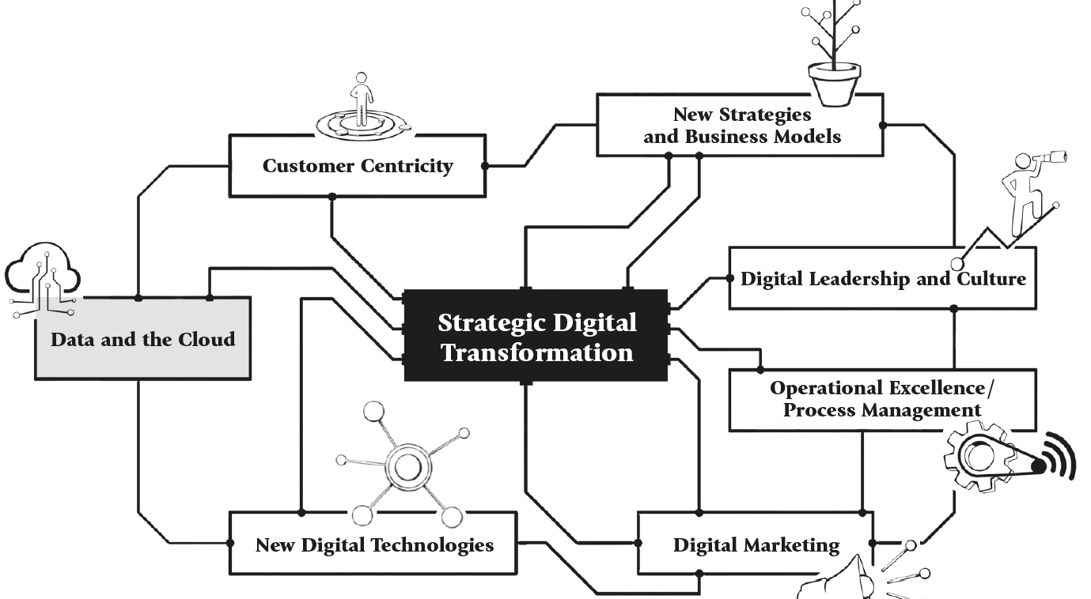
Strategic Action Fields

Slide 237



Opening Case: Cloud Services: Amazon AWS, Microsoft Azure
and Google Cloud

Slide 238

Opening Case: Cloud Services: Amazon AWS, Microsoft Azure and Google Cloud
Cloud computing offers “ubiquitous, convenient, on-demand network access to a shared pool of configurable computing resources that can be rapidly provisioned and released with minimal management effort or service provider interaction”
Leading global firms:
  Amazon Web Services: founded in 2006, holds largest market share at 32%
  Microsoft Azure: established in 2010, market share around 23%
  Google Cloud Platform: established in 2010, market share about 10%
  have the strongest ability and vision to execute compared to competitors
  leveraged own used ICT infrastructure for cloud services businesses
  also lead in GenAI market with large datasets and computing infrastructure
  played an important part in enabling digital transition to cloud of other businesses, currently focus on infrastructure for proprietary and open-source Gen AI models (primary concern in development)
  focused on delivery of public cloud infrastructures which contributed to hybrid cloud strategies

Slide 239
6.0 Introduction
Primary output of this digital transition is data.
Data is argued to be the “new black gold” to create significant value to the growing availability, access to data and ability to process it.
Unprocessed data has long been understood as lass valuable than information, knowledge (information in context) was seen as the ultimate source of value creation.
GenAI showed how strong the relationship between collection and processing of data in relation to knowledge is affected by hybrid systems of human cognition and machine computing power.
Firms with large datasets, access to user generated content and cloud computing or data centre infrastructure took a lead in bringing new GenAI products.
Established products are critical sources of data, but data, information and knowledge are critical drivers of new innovations.
Customer information and knowledge about customer journey is central in customer centricity, but data on the use of products is an important source as well.

Slide 240

6.1 Information Systems: Data, Information and Knowledge
Basic building block of information systems and the practical realisation of the digital transformation: Data, information and knowledge.
Hierarchical understanding of the relationship:
Chapter 04 discussed a four-phase process with to customer centricity:
  Development of ICT, infrastructure for a central customer data repository
  Development of necessary capabilities for analysis of data
  Retrospective and predictive analytics capability is developed
  Intensive approach is incorporated in all day-to-day operations
  Understanding of the relationship between

Slide 241
Developing a Data Overview
Important to understand and process the available data and know what gaps may exist in terms of data.
First step: map the different kinds of data that should be integrated into decision-making
  Customer data: demographic data, purchasing history, contact data etc.
  Purchasing and supplier data: raw materials purchases, goods / products delivered, services consumed, input delivery times, service quality etc.
  Financial data: financial performance indicators, cashflow, etc.
  HR data: recruitment data, employee development data, etc.
  Production and distribution: inventory data, production data, finished goods data, orders and delivers data etc.
  Technical data: Equipment rental costs, storage costs, ITC maintenance costs, cybersecurity monitoring etc.
  Geodata: transportation data, branch network data, etc.

Slide 242
6.1 Information Systems: Data, Information and Knowledge
Other understanding of definitions and relationship between data, information and knowledge as core information systems, different in
  degree to which knowledge is tacit (implicit) or explicit,
  held by individuals or shared by a group,
  nature of knowledge in relation to the activities of a business organisation.
Newer approach to relationship argues that prior knowledge is needed in the interpretation of new data.
  Knowledge is then information possessed in the mind of individuals as personalized information and preexisting to determine the identification and collection of data needed to crate information.
  Tacit knowledge when articulated, verbalised and structures becomes information.
  Information becomes knowledge when it is internalised by the mind of an individual (a knower).
  This cycle has been central to GenAI as a non-human knower.

Slide 243
Evaluating Data Quality
In the data economy it is essential that the data is of high quality (operational and legal requirement)
Qualities of high-quality data:
  Completeness: a record must include all the required details
  Unambiguity: the interpretation of the data must be clear and easy
  Correctness: The data must accurately reflect reality
  Timeliness: All data must be up-to-date
  Accuracy: data reflects reality at the correct level of accuracy
  Redundancy Free: Duplication in the dataset should be avoided
  Relevance: Collected and stored data are relevant to the activities of firm
  Uniformity: The data should adhere to a uniform structure
  Reliability: The original data sources should be traceable
  Comprehensibility: The data is structured and labelled so that recipients (users) are able to interpret it.

Slide 244

Importance of Data Management Plans
Quality of data can be supported through a data management plan (overview)
Data will then be stored in a data management system (software) like:
  Enterprise Resource Planning (ERP): stores logistical / technical product information, manages all operational processes in real time, provides access to high-quality data for employees
  Customer Relationship Management (CRM): used by go-to-market team, manages all data related to current/ prospective customers, enables multichannel customer journeys, supports customer experience and retention, links with product information
  Product Information Management (PIM): centralized information for product and marketing teams, provides access to complete, reliable and up-to-date product information.

Slide 245
6.2 Hybrid Systems of Human and Machine-based Knowledge Creation
AI is mostly associated with ML that requires very large data sets (Big Data) to train models for different application domains.
Two alternative, complementary approaches in AI techniques:
  Sub-symbolic learning systems require computing power and large data sets like ML.
  Symbolic knowledge-based reasoning systems require access to and the ability to formally represent expert knowledge.
Importance of integrating human knowledge into hybrid systems for
  shaping initial knowledge that precedes ML,
  providing input to guide training,
  correcting potential errors in ML outcomes.
Hybrid systems compose of systems of humans (Human), machine learning systems (ML), knowledge representation (KR), data (data), and human interpretable symbols (sym).

Slide 246

6.2 Hybrid Systems of Human and Machine-based Knowledge Creation
Human cognition knowledge and ML computation can lead to symbolic representations (sym) of knowledge (Box 1)
Applying symbolic technique to a dataset (case) produces new data (Box 2) which can be interpreted by a human expert giving feedback to the ML technique (Box 3).
Key enabling trends for AI is the adoption of cloud computing services (CCS).

Slide 247
6.3 Cloud Computing Services
Defined by the US Department of Commerce National Institute of Standards and Technology (NIST) as a “a model for enabling ubiquitous, convenient, on-demand network access to a shared pool of configurable computing resources that can be rapidly provisioned and released with minimal management effort or service provider interaction.”
In the EU, 77% of large, 59% of medium-sized, and 41% of small firms have purchased cloud computing services in 2023.
Types of services used: e-mail (82.7%), storage of files (68.0%), office software (66.3%), security software applications (61.0%), financial or accounting software applications (51.6%), hosting enterprise database(s) (43%), platform(s) for application development, testing or deployment (26.1%), ERP software applications (25.9%), computing power for enterprise’s own software (25.4%) and CRM software applications (25.0%)
Leading companies: Finland (78.3%), Sweden (71.6%), Norway (71.3%), Denmark (69.5%), Malta (66.7%), Ireland (63.1%), Italy (61.4%), and the Netherlands (61.2%).

Slide 248

NIST Description of Cloud Infrastructure
“A cloud infrastructure is the collection of hardware and software that enables the five essential characteristics of cloud computing:
on-demand self-service;
broad network access;
resource pooling;
rapid elasticity;
measured service.
The cloud infrastructure can be viewed as containing both a physical layer and an abstraction layer. The physical layer consists of the hardware resources that are necessary to support the cloud services being provided, and typically includes server, storage and network components. The abstraction layer consists of the software deployed across the physical layer, which manifests the essential cloud characteristics. Conceptually the abstraction layer sits above the physical layer.”

Slide 249
6.3 Cloud Computing Services
Cloud computing as clear shift from inhouse, firm specific provision of IT infrastructure and management to infrastructure over the internet.
Initial expectations: firm have preferences for building inhouse private clouds, owning and managing the IT infrastructure and the access to the cloud.
Primary growth seen in public cloud computing services, greater reliance on external suppliers, often with hybrid cloud solutions.
Community clouds: intension for shares resources for an exclusive group of organisations with shared interests, concerns.
Cloud computing “offers dynamic and scalable resources using internet-based services like Software as a Service (SaaS), Infrastructure as a Service (IaaS) and Platform as a Service (Paas)”.

Slide 250

NIST Definitions of Cloud Service Models

Slide 251
6.4 Products and Services in the Data Economy
Analogue products and services create data through customer loyalty schemes or like digital products in the online phases of the journey on platforms or search engines.
Collected data is then commoditised and sold as a product or service.
Loyalty schemes paired with payment systems capture customer behaviour and provide deep insights about customers in a very big dataset over time.
IoT represents the integration of digital sensing, storage and communication technologies into physical products into national, regional or global digital network of data transfer and communication.
Edge computing: addition of computing capabilities to products, transforming data into information on the device before communication.
IoT and edge computing are expected to contribute to the expansion of data by transforming devices into local data collection and communication devices that offer insights into product usage and customer preferences.

Slide 252
Evolution of Cloud Computing: Internet of Things, Blockchain and AI
Cloud Computing changed significantly with IoT due to greater number of devices and computing capacities.
Blockchain may play a critical role in ensuring traceability and data integrity in a world featured by the IoT.
AI transformed cloud computer due to larger, longitudinal datasets as critical enabler of AI developments and their commercialization.
AI algorithms control IoT devices or are in new products.

Slide 253
6.5 Business Ecosystems and the Data Economy
Data economy is enabled by digital technologies and an ecosystem of different actors that implement technologies to collect, store and process data to generate insights (knowledge).
Ecosystems include government and regulatory bodies at national or regional level like the EU.
EU Data Strategy 2020 incentivises the creation of European data spaces so that more data becomes available while keeping the control.

Slide 254
6.5.1 Data Protection and Legal Aspects of the Data Economy
Data economy can positively affect society and customers may benefit from better products, an improved overall customer journey.
Clear and urgent need to develop the data economy in a responsible and ethical manner addressing privacy concerns
Answers of EU: GDPR to ensure privacy and security of personal data, seen as Broader minimalist approach that individuals and organisations retain ownership of their data.
Other jurisdictions like the US have different approaches to the data market and privacy protection, essential for firms to know laws and regulations.
Legal frameworks need understanding of where data is, usage and protection.
Data governance requires development of processes, role specification, the development of guidelines, standards, indicators and high data quality.
Data protection obligations are ensured by managing access and treatment of data, depending on type and intended use case.

Slide 255







Examples of Data Protection Laws Around the World
UK
Data Protection Act
India
Digital Personal Data Protection Act
China
Data Security Law / Personal Information Protection Law
Canada
Federal Personal Information Protection and Electronic Documents Act
EU
General Data Protection Regulation (GDPR)
Australia
Privacy Act
US
Various State and Federal Laws

Slide 256
6.5.2 Data Security and the Data Economy
(Trust in) Data security is key concern in creation of data economy.
Goal of data security: ensure only authorised employees have access to data they are authorised to view at all times, authenticity and trustworthiness of data, high degrees of integrity to protect data from manipulation.
Data security is also “the measures and protocols put in place to protect sensitive and confidential data collected, stored and shared by organizations from cyber-attacks that are becoming more complex and raising complicated security problem”
Important aspect of data protection and security in relation to crimes:
  Governments need reasons for access to firm-held personal data.
  Laws vary across countries, firms must act accordingly with jurisdiction
  Strongest position: secure and high-quality data, allowing to respond to legal requests as required

Slide 257

General Data Protection Regulation (GDPR) Framework
137 of 194 country have introduced legislation with minimum requirements to protect data and privacy, introduced in 2016 in the EU
https://gdpr.eu/data-processing-agreement/

Slide 258
6.6 Data, Information and Knowledge and Competitive Advantage
Two important themes in strategy literature:
  How data is transformed into information, role of knowledge, importance of focusing on relation products, data creation, capture (Chapter 02).
  Relationship between digital technology adoption, products/ services, data creation and capture: increasingly technology adoption decisions are integral to competitive strategizing in the data economy.
Firm perspective: data, information and knowledge are key resources to gain ownership or control.
Knowledge-based view of the firm as extension of resource-based and capabilities perspective on competitive advantage
  Internal knowledge resources to process data into proprietary information allows effective orchestration of resources as core competences of a firm
  Sourcing of knowledge and its application provides basis for coordination, strategic decision-making and organisational design

Slide 259
6.6 Data, Information and Knowledge and Competitive Advantage
Open system perspective reflected in creation and capture of data, information processing, need for firms to co-evolve with its context in the data economy:
  Embedded ecosystem, product or services, market positioning strategies determine potential of participation in the data economy.
  Legitimacy of digital technologies, potential for data collection and transmission depend on generic strategies of firm.
Perspectives also seen in the generic strategies typologies, for example in
  Tesla: highly associated with technology, data collection, transmission and analysis to improve performance of capabilities to improve experience
  Apple: positioning strategy with servitisation of product value proposition, data-driven value creation, customers control own data and privacy
  Hoppstar: product leadership value discipline, product offering around technology, design choices due to parental concerns limiting data creation.
Strategic choice in product/ service leadership strategy: understand how technology contributes to innovation, given customer segments and preferences in relation to the data economy

Slide 260
6.7 Data, the Cloud and Sustainability
Relationship digital transformation, sustainability transition is complex but highly interconnected.
Role of ICT and demand of ICT equipment has variety of negative impacts on sustainability, like e-waste, energy demand, CO2 emissions through production.
Cloud computing more efficient compared to proprietary infrastructure but creates greater pressure on resources for infrastructure and energy.
Cloud solutions reduce energy use associated with positive impact on CO2.
Complexity and tension unlikely to dissipate soon with data economy growing, products and services increasing, profiting from data generation, processing and leveraging for value creation.

Slide 261
6.8 Conclusion
Digital technologies are intertwined with the emergence of the data economy, impacting how we think about integration of data and technology into products and services.
AWS, Microsoft Azure and Google Cloud dominate market of cloud services providers due to extensive infrastructure and capabilities, enabling firms to access scalable computing resources, facilitating adoption of AI and other advanced technologies.
Cloud computing services are categorized into IaaS, PaaS, SaaS.
Benefits of cloud adoption: cost savings, scalability, enhanced data processing.
Challenges: data security, privacy concerns, need for robust data governance.
Data, processed into information and knowledge are valuable assets.
Human cognition, ML in hybrid systems show synergy in knowledge creation.
Digital technology producing more data change value creation and affect competitive strategies of firms.

Slide 262
Case Studies
You will find a collection of case studies for Strategic Digital Transformation in the appendix and additional cases online at www.strategic-digital-transformation.com.
Step 1: Selection of a case organization
Students can complete the following tasks either based on the focal case study, or work on the recommended case study for this chapter (BRUGG Lifting and its Industrial Internet of Things (IIoT) asset management solution ‘PVS’) and answer below questions.
Step 2: Case questions linked to this chapter
What is the value of data in an organisation; and how important are customer, product, and usage/transaction data (and why)?
What data can BRUGG collect wits its sensors? Provide an overview of data categories with examples for each category (see also Box 6.1).
Should this data be stored and made available via an IaaS, PaaS or SaaS Cloud solution (see Box 6.5)? Describe the reasons for your choice.
How can BRUGG use this data for process improvements, including automation/digitalisation, efficiency increase and cost reduction?
How can BRUGG use this data strategically to build, for instance, new service offerings, strategic partnerships with other organisations (e.g., an ecosystem or digital platform) or expand into new industries (see also Chapter 6.5)?

Slide 263
Case Studies
You will find a collection of case studies for Strategic Digital Transformation in the appendix and additional cases online at www.strategic-digital-transformation.com.
How can BRUGG protect this data from unauthorised access or use from an organisational and technological point of view?
What skills are required for BRUGG or any other organisation to use data operationally (for e.g., automation) and strategically (e.g., to build new services)?
Alternatively, students can work on the supplementary case study (available online) for this chapter (CRM and Sales Automation at Transgourmet Switzerland) and answer below questions.
What is the value of data in an organisation; and how important is customer data (and why)?
What is a possible CRM (customer relationship management) software vision and project scope for a small business (like for example, a bikeshop)?
Which internal teams (human resources) have the potential and the ability to plan and implement a CRM project?
What skills are required to implement a CRM project?
How can/should senior management support a CRM project?
Into which other IT systems/platforms will a CRM integrate with, and why?

Slide 264
Case Studies
You will find a collection of case studies for Strategic Digital Transformation in the appendix and additional cases online at www.strategic-digital-transformation.com.
What processed can be automated via a CRM platform?
How can an organisation protect its data from unauthorised access or use?
How and why could a mobile version of the CRM system support your employees?
Additional cases with student questions for the strategic digital action field of Data and the Cloud are covered in:
• Action fields of digital transformation at Synchrony Financial (USA)
(available online).

Slide 265
Exercises
Discuss the following questions in your class, in your group or assignment:
Review the features (product offering) and prices of Cloud services such as Amazon AWS, Microsoft Azure and Google Cloud (see opening case) using online information and prepare an overview regarding their capabilities and advantages.
Based on a selected industry/business, identify various types of data, information and knowledge which the organisation likely currently has in operation (for each level, define at least 3 types) (see Figure 6.2).
Review Table 6.1 (Knowledge Taxonomy) and define/describe for the selected organisation in Exercise 2 what tacit and explicit knowledge is available to managers and employees.
For your selected organisation in exercise 2, create a data management plan (see Figure 6.3) that provides an overview of available data for strategic and operational use. Make assumptions, if required.
Forming two small groups (2-4 students in each group), assign a pro and contra position to each group and debate to which degree humans (e.g. employees and managers) are still required (and why), or not required anymore (and why), to build AI-driven knowledge management systems (see also Figure 6.4).

Slide 266
Exercises
Based on the organisation from exercise 2, explain for what processes/use cases they would use Infrastructure as a Service (IaaS), Platform as a Service (PaaS) and Software as a Service (SaaS) cloud service models.
Finally, explain how the organisation selected in exercise 2 can fulfil the General Data Protection Regulation (GDPR) framework (as described in Box 6.7). How can the organisation fulfil the legal requirements; what policies, resources, systems and processes are required?

Slide 267
Further Reading List
European Commission (2022). European data strategy, https://commission.europa.eu/strategy-and-policy/priorities-2019-2024/europe-fit-digital-age/european-data-strategy_en.
Hogan, M., Liu, F., Sokol, A., & Tong, J. (2011). NIST Cloud Computing Standards Roadmap. NIST Special Publication, 35(6), 11, https://csrc.nist.rip/library/NIST%20SP%20500-291%20Cloud%20Computing%20Standards%20Roadmap,%202011-07-05.pdf.
Sestino, A., Kahlawi, A., & De Mauro, A. (2025). Decoding the data economy: a literature review of its impact on business, society and digital transformation. European Journal of Innovation Management, 28(2), 298-323.
UNCTAD (2023). Data Protection and Privacy Legislation Worldwide. United Nations Conference on Trade and Development, Geneva, Switzerland, https://unctad.org/page/data-protection-andprivacy-legislation-worldwide.

Slide 268
References
Amazon Web Services (2024). Home Page. Last Accessed from https://aws.amazon.com on 06 August 2024.
Ambrozio, S., Lindeque, J.P., Peter, M.K. (2025). Navigating Uncertainty: Isomorphic Pressures in Cloud Computing Adoption. In: Moussa, M., McMurray, A. (eds) The Palgrave Handbook of Breakthrough Technologies in Contemporary Organisations. Palgrave Macmillan, Singapore. https://doi.org/10.1007/978-981-96-2516-1_18.
Apple (2024). Control is yours. Last accessed from https://www.apple.com/privacy/control on 12 August 2024.
Borra, P. (2024). An Overview of Cloud Computing and Leading Cloud Service Providers, International Journal of Computer Engineering and Technology (IJCET), 15(3),122-133.
Etsy (2024) Etsy Home Page. Last accessed from https://www.etsy.com on 12 August 2024.
European Commission (2022). European data strategy, https://commission.europa.eu/strategy-and-policy/priorities-2019-2024/europe-fit-digital-age/european-data-strategy_en.
General Data Protection Regulation (GDPR) (2016). Regulation (EU) 2016/679 of the European Parliament and of the Council of 27 April 2016 on the protection of natural persons with regard to the processing of personal data and on the free movement of such data. Available from https://eur-lex.europa.eu/eli/reg/2016/679/oj
Gill, S. S., Tuli, S., Xu, M., Singh, I., Singh, K. V., Lindsay, D., ... & Garraghan, P. (2019). Transformative effects of IoT, Blockchain and Artificial Intelligence on cloud computing: Evolution, vision, trends and open challenges. Internet of Things, 8, 100118.
Google Cloud (2024). Last Accessed from https://cloud.google.com/ on 06 August 2024.
Grant, R., & Phene, A. (2022). The knowledge based view and global strategy: Past impact and future potential. Global Strategy Journal, 12(1), 3-30.
Gulati, R., & Oldroyd, J. B. (2005). The quest for customer focus. Harvard Business Review, 83(4), 92-101.
Hoppstar (2024). What is Important to Us. Last accessed from https://www.hoppstar.com/en/was-uns-wichtig-ist on 12 August 2024.
Kumar, V., & Vidhyalakshmi, P. (2012). Cloud computing for business sustainability. Asia-Pacific Journal of Management Research and Innovation, 8(4), 461-474.
Mell, P. & Grance, T. (2011). The NIST Definition of Cloud Computing. Last accessed from http://faculty.winthrop.edu/domanm/csci411/Handouts/NIST.pdf on 10 August 2024.
Microsoft Azure (2024). Home Page. Last Accessed from https://azure.microsoft.com on 06 August 2024.
Peter, M.K. (Hrsg.) (2017). KMU-Transformation: Als KMU die Digitale Transformation erfolgreich umsetzen. Forschungsresultate und Praxisleitfaden. FHNW Hochschule für Wirtschaft, Olten/Schweiz, www.kmu-transformation.ch.
Peter, M.K. (Hrsg.) (2021). Strategieentwicklung im digitalen Zeitalter: Planung und Umsetzung der Digitalen Transformation. FHNW Hochschule für Wirtschaft und Strategylab, Olten/Schweiz, www.strategische-transformation.ch.
Peter, M.K. (2023). Digitaler Masterplan für KMU. So gelingt die digitale Transformation in Ihrem Unternehmen. Verlag Beobachter Edition & Handelszeitung. Zürich/Schweiz, www.digitaler-masterplan.ch.
Peter, M.K. (2024). The Digital Transformation Canvas. Develop and implement your digital strategy. FT Publishing/Pearson, London/UK, www.the-digital-transformation-canvas.com.
Peter, M. K., Kraft, C., & Lindeque, J. (2020). Strategic Action Fields of Digital Transformation: An exploration of the strategic action fields of Swiss SMEs and large enterprises. Journal of Strategy and Management, 13(1), 160-180.
Robuck, M. (2024). Analysis: Google, Amazon, Microsoft fight for AI dominance. Last accessed from https://www.mobileworldlive.com/google/analysis-google-amazon-microsoft-fight-for-ai-dominance on 10 August 2024.
Sestino, A., Kahlawi, A., & De Mauro, A. (2025). Decoding the data economy: a literature review of its impact on business, society and digital transformation. European Journal of Innovation Management, 28(2), 298-323.
Tesla (2024). Home Page. Last accessed from https://www.tesla.com/ on 12 August 2024.
van Harmelen, F., & ten Teije, A. (2019). A boxology of design patterns for hybrid learning and reasoning systems. Journal of Web Engineering, 18(1-3), 97-123.
UNCTAD (2023). Data Protection and Privacy Legislation Worldwide. United Nations Conference on Trade and Development, Geneva, Switzerland, https://unctad.org/page/data-protection-andprivacy-legislation-worldwide.
Witschel, H. F., Pande, C., Martin, A., Laurenzi, E., & Hinkelmann, K. (2020). Visualization of patterns for hybrid learning and reasoning with human involvement. In New Trends in Business Information Systems and Technology: Digital Innovation and Digital Business Transformation (pp. 193-204). Cham: Springer International Publishing.
Wright, D., Smith, D., Ji, K., Borrega, M.A., Galimberti, A., & Bauman, S. (2023). Magic Quadrant for Strategic Cloud Platform Services. Last Accessed from https://www.gartner.com/doc/reprints?id=1-2FTDYPQN&ct=231204&st=sb on 06 August 2024.
Zins, C. (2007). Conceptual approaches for defining data, information, and knowledge. Journal of the American Society for Information Science and Technology, 58(4), 479-493.

Slide 269
Case Study Collection
Each book chapter has an opening case and suggested case work,
and additional cases are available online as separate documents.
The authors would like to express their gratitude to all participating organisations
and to the contributors (authors and interview partners) of the case studies:

Slide 270
Digital Transformation Textbook
Visit www.strategic-digital-transformation.com
for case studies, videos and workshop templates.
Prof. Dr. Marc K. Peter
Dr. Johan P. Lindeque

Slide 271
07 Strategic Action Field of New Strategies and Business Models for Value Creation
Chapter 07 of 12
© Marc K. Peter & Johan P. Lindeque (2026): Strategic Digital Transformation. Theory and Practice. Sage Publications, London/UK
271

Slide 272
Digital Transformation Textbook
This cutting-edge textbook takes a unique approach to digital transformation which aligns theory and practice and is supported by the authors’ own research with over 4,000 organisations. Covering key topics such as emerging technologies, AI, cybersecurity, customer orientation, operational excellence, marketing automation, innovation and leadership and culture, it offers a learning experience which prepares students for the practical realisation of digital transformation for competitive advantage.
With individual and group exercises and case studies from a range of organisations, Strategic Digital Transformation prepares students to apply the knowledge and experience gained from the book in their future careers. It is suitable for undergraduate and postgraduate digital transformation and digital business courses.
We wish you lots of success and hope that
you will benefit from this textbook!
This cutting-edge textbook takes a unique approach to digital transformation which aligns theory and practice and is supported by the authors’ own research with over 4,000 organisations. Covering key topics such as emerging technologies, AI, cybersecurity, customer orientation, operational excellence, marketing automation, innovation and leadership and culture, it offers a learning experience which prepares students for the practical realisation of digital transformation for competitive advantage.
With individual and group exercises and case studies from a range of organisations, Strategic Digital Transformation prepares students to apply the knowledge and experience gained from the book in their future careers. It is suitable for undergraduate and postgraduate digital transformation and digital business courses.
Marc K. Peter & Johan P. Lindeque
Strategic Digital Transformation
Theory and Practice
2026, 408 pages
Sage Publications, London/UK
www.strategic-digital-transformation.com
Prof. Dr. Marc K. Peter
Dr. Johan P. Lindeque

Slide 273
Foreword
Modern advancements in the economy are characterised by a series of transformative industrial revolutions over the past three hundred years, each driven by groundbreaking technological innovations that reshaped societies, industries, businesses, and the way we live and work. The first industrial revolution, which began in the late 18th century, was driven by the mechanisation of production through steam power and the advent of factories. This era saw a dramatic increase in productivity and the rise of urban centres, fundamentally altering the social and economic landscape. The second industrial revolution in the late 19th and early 20th centuries introduced mass production and assembly lines, powered by electricity. Innovations such as the telegraph, telephone, and internal combustion engine further accelerated industrial growth and global connectivity, resulting in consumer markets.
The third industrial revolution, starting in the mid-20th century, brought automation and the digitalisation of manufacturing processes. The development of computers and the internet revolutionised industries, enabling unprecedented levels of precision and efficiency. This era laid the groundwork for the interconnected world we live in today. We are currently in the midst of the fourth industrial revolution, characterised by the fusion of digital and physical dimensions, creating smart factories and shipping digital societies. As we stand on the brink of the fifth industrial revolution, the focus shifts towards human-machine symbiosis, ethical AI, and sustainable practices. This emerging era emphasises the integration of advanced technologies with human capabilities, fostering collaboration between humans and robots, and prioritising ecological sustainability and social well-being.
In this rapidly evolving landscape, strategic digital transformation is not just an option but a necessity for organisations to remain competitive and relevant. It involves a holistic renewal of business models, processes, and organisational structures, leveraging digital technologies to create new value and drive innovation. This new textbook describes the components and provides a toolkit for strategic digital transformation, which requires a clear vision, a comprehensive digital strategy, a robust implementation plan and a commitment to continuous learning and adaptation.
Organisations that embrace this transformation will be better positioned to navigate the complexities of the digital age, capitalise on new opportunities, and contribute to a more sustainable and inclusive future. It is an exciting time to be part of this journey, and I am confident that the insights and strategies presented in this textbook will provide valuable guidance for young leaders and innovators seeking to thrive in the digital era.
Alois Zwinggi
Managing Director, World Economic Forum
www.weforum.org
© World Economic Forum/Pascal Bitz (Flickr, 2023)

Slide 274
Case Study Collection
Each book chapter has an opening case and suggested case work,
and additional cases are available online as separate documents.
Visit www.strategic-digital-transformation.com for:
  Slide decks for each case (case summaries and illustrations).
  Videos from case organisations (case introductions, promotional clips and interviews).
  The Digital Transformation Toolkit with workshop templates and checklists.
The authors would like to express their gratitude to all participating organisations
and to the contributors (authors and interview partners) of the case studies:

Slide 275
Book Structure
PART 1
FOUNDATIONS
OF DIGITAL
TRANSFORMATION
Chapter 01: Strategic Digital Transformation: Background and Terminology
Chapter 02: Business Strategy in the Digital Age
Chapter 03: Digital Transformation
in Context: Innovation
and Sustainability
PART 2
STRATEGIC ACTION FIELDS (SAF) OF
DIGITAL TRANSFORMATION
Chapter 04: SAF Customer Centricity
Chapter 05: SAF New Digital Technologies
Chapter 06: SAF Data and the Cloud
Chapter 07: SAF New Strategies and Business Models
Chapter 08: SAF Operational Excellence / Process Management
Chapter 09: SAF Digital Leadership and Culture
Chapter 10: SAF Digital Marketing
PART 3
DIGITAL TRANSFORMATION IN PRACTICE
Chapter 11: Success Factors and Metrics for Digital Transformation Implementation
Chapter 12: Transformation in Practice - Digital Transformation Toolkit
PART 4
DIGITAL TRANSFORMATION CASE STUDIES
BRUGG Lifting
City of Lucerne
Switzerland Tourism
Valuu (PostFinance)
With many other case studies (including videos and interviews) available online.

Slide 276
Learning Goals Chapter 07
Be able to identify and articulate a value proposition in the digital age for a specific organisation.
Be able to elaborate the difference on sustaining innovations versus disruptive innovations.
Be able to critically evaluate a firm's business strategy in light of the three generic digital strategies of the digitally enhanced business, digitally expanded business and new digital business.
Be able to analyse and evaluate a firm regarding their competitive strategy, business models and tactics in the digital age.
Be able to describe different business models and evaluate them for enabling a specific organisation to compete in the fourth/fifth industrial revolutions.
Be able to articulate how digital value chains, driven by data and technology, are providing insights for future digital innovation and value capture.

Slide 277

Strategic Action Fields

Slide 278

Opening Case: The Evolving Netflix Value Proposition
https://brand.netflix.com/en/assets/logos/
was founded by Marc Randolf and Reed Hastings in August 1997.
employs 13,000 people globally.
offers video streaming on demand globally.
has diversified, including into the production of in-house content.

Slide 279
Opening Case: The Evolving Netflix Value Proposition
Changing digital technologies allowed a value proposition of variety and convenience by seeking to address the practices in the market customers disliked.
Initial innovation: single store concept with full video inventory that could be accessed over internet and movies delivered by post.
Enabling of online store by digital technologies allowed an even easier search and allowed movies to be categorized into multiple categories.
Collection and analysis of customer preferences was an integral aspect of the business, including rapid testing of ideas for new features.
Focus on improving the product-market fit, Netflix adopted a subscription model
Initial idea:
Rental of VHS,
but too bulky, heavy and expensive
Development of DVD:
Next-day delivery of a full movie by post for the cost of a stamp
Online streaming:
Digitisation of delivery of the movies, increasing accessibility and convenience
High-speed internet:
Full digitalisation of on-demand service and digital platform business model

Slide 280
7.0 Introduction
Digital technology driven innovation is at the heart of the emergence of new strategies and business models, as well as innovation within established strategies and business models.
Challenges associated with transformation of existing businesses / business units have become know as the innovator’s dilemma.
Traditionally, innovation and transformation processes have been discussed in terms of corporate and competitive strategies.
Increasingly, concepts of corporate business models and other business models are being used to capture technology driven change processes.
Senior management teams play a critical role in enabling of ambidextrous strategies and the exploration of the opportunities by digital technologies / transformation.
Emerging trends, new strategies and business models as well as differences between multi-business and single business firms are discussed in this chapter.

Slide 281
7.1 Digital Transformation and the Innovator’s Dilemma
The digital transformation of firms is fundamentally driven by the adoption of digital technologies and the associated new ways of creating value.
Firms are required to consider their corporate strategy / business models and the technologies that could be incorporated to enhance competitiveness (competitive strategy).
“Innovator’s dilemma” (Christensen, 1997) explains why the emergence of new technologies can lead to previously very successful incumbent firms to fail when needing to transform their value creation.
  Sustaining technology innovations: enable firms to execute value creating strategies more effectively.
  Disruptive technology innovations: reduce performance by enabling value propositions that had not previously been possible.
Assessing and responding to such technological changes are the responsibility of senior management teams (see Chapter 09).
New entrants often take stronger advantage of disruptive technologies.

Slide 282
The Innovator’s Dilemma
Established companies focus on sustaining innovations to meet demands of current customers and maintain profitability but are then vulnerable to disruptive innovations.
Disruptive innovations often start as lower-quality, cheaper alternatives that initially appeal to a niche market, but eventually capture the mainstream market.
Innovator’s dilemma because disruptive innovations
  requires a shift in resources and attention away from the core business.
  can be risky and unpopular with stakeholders.
  potentially serve a small and uncertain market.
Difficulty of balancing need to innovate with need to sustain existing operations.
Companies that successfully navigate this dilemma recognize potentials early and are willing to take calculated risks to invest.

Slide 283
7.1 Digital Transformation and the Innovator’s Dilemma
Core idea of innovator’s dilemma: failure to effectively respond to technological change due to the inability of senior managers to effectively perceive technology changes and decide how to respond.
Alternative explanation: deeply embedded and complex organizational competences make it difficult for a firm to change the value creation, so firms are ill-equipped to build necessary resources and capabilities.
O’Reilly and Tushman (2008) argue that dynamic capabilities by enabling organizational ambidexterity allow to overcome the innovator’s dilemma.
  Dynamic capabilities: ability of senior managers to seize opportunities through the orchestration and integration of both new and existing assets to overcome inertia and path dependencies
  Dynamic capabilities enable ambidexterity when they support firms to exploit existing assets in a profit producing way and simultaneously to explore new technologies and markets.

Slide 284
7.1 Digital Transformation and the Innovator’s Dilemma
Successful response is more likely when senior management
  communicates “a compelling strategic intent that justifies the importance of both exploitation and exploration”,
  articulates of “a common vision and values that provide for a common identity”,
  establishes a “clear consensus among the senior team about [the ambidextrous] strategy, relentless communication of this strategy, and a common-fate incentive system” for the senior management team,
  establishes temporal, organizational, physical “separate [but] aligned organizational architectures for explor[ative] and exploit[ative] subunits, [implements] targeted integration” of the resulting business units,
  tolerates “the contradictions of multiple alignments and is able to resolve the tensions that ensue”.
Orchestration of resources, decisions about business portfolio should be at the heart of corporate strategy and corporate business models.

Slide 285
7.2 Digital Transformation, Corporate Strategy and Corporate Business Models
Corporate Strategies
  specify the businesses a firm currently serves and intends to serve in the future.
  determine the degree to which resulting business units should be related.
  have the potential to lead to corporate advantage built on strategic choices about the optimal combination and coordination of resources and capabilities for the entire organisation.
  are a critical aspect of value creation in larger multi-business organisations.
Business model thinking shifts the focus from competitive advantage to value creation.
Corporate business model is the corporate top manager’s perceived logic of value creation, especially regarding the value-creating links between the corporation’s portfolio of businesses.

Slide 286

Corporate Strategizing and Corporate Business Model Development at Nokia
Nokia
  has become famous for its radical divestment strategy during the 1990s.
  was leading in mobile phone devices but failed to maintain its competitive advantage with the shift to smartphones in the early 2000s.
  was active in six major businesses along less important businesses,
Senior management
  recognized need for new corporate business model, but micro-politics made it challenging.
  assessed all businesses for profitability, competitiveness, legitimacy for corporate reputation, national status and employment attractiveness.
  assessed all businesses for shared complementary products and customers, possessed attributes that led to previous lack of competitiveness.
In 2024, Nokia is active in in highly related fixed and IP networks, mobile networks, cloud and network services, and others, relying on intellectual property from the late 1990s.

Slide 287
7.2 Digital Transformation, Corporate Strategy and Corporate Business Models
Corporate Strategy should be understood as the driver, pacer and framer of firms (co)evolution with its external environment.
In the digital age, Corporate Strategy is tasked to adapt resources and bundles of the firm, design organisational coordination mechanism and control systems, breadth of the scope of the portfolio of businesses a firm participates in.
Corporate management does this by
  developing a representation of the fitness of a firm in the evolving external socio-technical systems, firm is embedded in (drive needed co-evolution).
  deciding on a desirable positioning of the firm, related degree of incremental, radical or recombination change needed (pace of needed co-evolution).
  Deciding on the ideal organisation of the firm to manage resources, capabilities bundles and portfolio (frame the co-evolution) – foundation of corporate business model.

Slide 288
7.2 Digital Transformation, Corporate Strategy and Corporate Business Models
One of the most critical barriers to effective response to digital transformation: need for a shift in corporate and business managerial cognition to accurately represent the changing external competitive environment (see Chapter 09).
Corporate business model transformation is about
  senior managerial cognition related to changing external conditions.
  perceiving and understanding the inter-organisational linkages of existing strategic business units, called inter-organisational cognition of senior managers.

Slide 289
Three Generic Digital Strategies
Aligned to the digital maturity levels to be implemented sequentially.
Digitally Enhanced Business (digital enablement)
  Simplifying and digitising existing processes and functions (agile practices, new digital skills developed), offering enhanced products and services.
  Focus on revised functional strategies.
Digitally Expanded Business (digital optimisation/ digitalisation)
  Digital expansion of business model or reinvention of existing business
  Focus on revised business strategy.
New Digital Business (strategic digital transformation)
  Creating new sources of revenue by new markets, new sales channels, new digital value creation systems, new business areas.
  Focus on revised corporate strategy.

Slide 290
7.3 Digital Transformation, Competitive Strategies and Business Models
Business unit business models:
  are focused on logics of value creation and capture realised in daily managerial practice.
  can be expected to be aligned with a higher-level competitive strategy, in terms of orchestration resources and capabilities and market positioning.
  are a reflection of the business’ realised competitive strategy.
Porter (1996) views that competitive strategy is concerned with selecting between alternative activity systems to fit a preferred market positioning, with the specific activity systems adopted being the business model of the firm.
Resources and capabilities of a firm and those of external partner enable the activity bundles of a specific business model to be realised.

Slide 291

Competitive Strategy, Business Models and Tactics
Competitive Strategy:
  Choice of business model is determined by classic strategic analyses of the competitive environment (positional strategy), the resource and capability endowments of the firm (resource-based and capabilities view), to identify opportunities for realising a competitive advantage
  Decision to either compete based on planned execution of a business model or by offering a new value proposition that leverages digital technologies.
Business Models
  Logic of the firm, the way it operates, how it creates value
  Nine elements of decision making (business model canvas)
Tactics
  Decision on how to deliver the nine elements of a business model.

Slide 292
7.4 Digital Transformation and Business (Unit) Model Innovation
The firms that have grown most quickly are the ones that were able to take advantages of changing socio-technical systems to innovate their business model.
Firms are required to innovate their business models, understood as the activity systems, for the digital age.
Activity systems allowed by different business models used at the same time can lead to different value creation and capture outcomes, strategic competitive advantage for same value proposition, idea or technology.
Economic value of general-purpose digital technologies remain latent until technology is commercialised via a business model.
“Lean Startup” approach:
  start of innovation process, experimentation of alternative possibilities to stimulate feedback about ideal business model.
  can be applied along entire value chain of firm or new ventures.

Slide 293
Overview of Business Models for the Digital Age
Auction Model: market determines price of the product (eBay, Sotheby’s)
Bundle/ package prices: individual prices of several products as package deal
Cross-selling: a company sells offers from other product categories (Aldi)
Crowdfunding: new product financed through donations and loans (Indiegogo)
Crowdsourcing: product or service created with the help of the crowd
Direct sales: organisations sell through retailers and directly (Levi’s Jeans)
Dynamic prices: prices change over time to maximise profit (Booking.com)
E-commerce: sale and trade of goods only on the internet (Alibaba, Amazon)
Ecosystem model / digital ecosystem: lock-in process to a service or technology to lock customer in an ecosystem long-term (Apple)
Franchising: company offers products via a network of partners (franchisees)
Free model: products and services offered free of charge for rights on data

Slide 294
Overview of Business Models for the Digital Age
Freemium model: basic functions in free version, premium features to be paid
Guaranteed maximum price (GMP): maximum price set, billed on a per item or hourly basis up to the maximum price of the contract
Licensing: right to use a company’s product in another market or as a component for a new product for a fee
On-demand model: immediate access to service or product, “time is money”
Open source: often software used free of charge, earnings from added services
Pay-per-use model: customer pays per use (car rental, co-working renting)
Platforms / platform economy: several market players link up (Amazon, Airbnb)
Sharing economy: systematic lending of objects or provision of spaces
Subscription model: service is billed periodically to retain customers over long-term, continuous benefits like service improvements or extensions.

Slide 295
Digital Technologies and Value Chain-based Business Model Innovation
Digital technologies and digital transformation are not disruptive by nature.
Careful analysis of value chains identify opportunities for digital technologies to be adopted and integrated to optimise activities for effectiveness or efficiency.
Value chain analysis is widely adopted in the Business Model Canvas of Osterwalder and Pigneur (2010):
  encourages managers from left to right to consider external and internal resources and activities for value creation and delivery.
  misses after sales services and customer relationship management for long-term value creation.

Slide 296

Digital Technologies and Value Chain-based Business Model Innovation
Value chain transformation is highly related to data creation and analysis potential.
Digital transformation of the value chain seeks to reduce cost and increase willingness-to-pay.
Analysis of the digital value chain helps to identify future opportunities for digital innovation and value capture through technology and data layers.

Slide 297
7.5 Web 2.0 and the Platform Economy: New Competitive Strategies and Business Models
Web 2.0 business models
  leverage customer self-service and algorithmic data management to reach out to the entire web, to the long tail.
  create value by leveraging networks and collective intelligence of users on the web and related user generated content.
  often relate to the meta data describing user activity online.
  Examples: Google Search, eBay, Amazon, YouTube, LinkedIn
Web 2.0 is commonly referred to as the platform economy which
  incorporates different types of platform-based business models like sharing economy, collaborative economy, gig economy, on-demand economy.
  includes B2B, B2C and one-sided platforms.
Firms developing a digital platform business model need to consider the type of revenue stream, the pricing mechanism, price discrimination and who is paying.

Slide 298
7.6 New Strategies, Business Models and Competitive Advantage
Firms within the same industry can have different corporate strategies, mixed evidence for dominant corporate strategy.
  Bowman and Helfat (2001): excluding single business firms, effects of corporate strategies on firm performance are clear.
  Critics: limited evidence for corporate strategies driving value creation because decision-makers focus on individual elements of the strategy.
The competitive advantage of a given business model is likely to be sustained once implemented because successful business models become best practice.
A business model leads to sustained competitive advantage
  when the firm has unique, rare, difficult to imitate and non-substitutable resources and capabilities.
  when firms can pursue a market positioning strategy that attracts people.
Competitive strategy analysis identifies “isolating” mechanisms which are difficult to observe but essential for implementing the business model, revealing the firm’s “moat”.

Slide 299
7.7 New Strategies, Business Models and Sustainability
Sustainable business models = business models that integrate sustainability concerns into companies as source of competitive advantage in economic, social and environmental value.
Business model innovations reducing the negative impact of a firm on the environment and society are (more) sustainable.
Digital technologies support the realisation of more sustainable business models by increasing efficiency, optimising resource consumption, scaling and replicating across different regions and industries and therefore driving long-term value creation and resilience.

Slide 300

7.8 Conclusion
Through analysis, exploration and debate, the identification of customers expectations, new digital technology and the understanding of data lead to a new digital strategy or business model (Chapter 04 to summary in 07).
Digital technology-driven innovation is central to the development of new or transformed strategies and business models.
Key challenge: Overcoming innovator’s dilemma with dynamic capabilities and organizational ambidexterity.
Clear distinctions between strategy (three generic digital strategies), business model and tactics needed.
Business model innovation needs a digital value chain, experimentation and feedback to discover the ideal for new technologies.

Slide 301
Case Studies
You will find a collection of case studies for Strategic Digital Transformation in the appendix and additional cases online at www.strategic-digital-transformation.com.
Step 1: Selection of a case organization
Students can complete the following tasks either based on the focal case study, or work on the recommended case study for this chapter (Valuu: a corporate start-up for digital business model innovation) and answer below questions.
Step 2: Case questions linked to this chapter
Document and analyse an industry’s (use the mortgage industry for the Valuu case) digital value chain and identify data and technology components as per Chapter 07 (Box 7.6).
Evaluate if the organisation currently covers all digital value chain components (with a focus on data and technology): Which digital opportunities did the organisation capture successfully, and what are the future opportunities (make assumptions, if required)?
From a board member’s perspective, what are the success factors for a digital business model innovation (a digital ecosystem as part of platform economies like Valuu, see Chapter 07, Box 7.5)?
From the perspective of the project team (the business model innovation project team), what are the success factors for digital strategy innovation? Refer to Chapter 11 for the success factors of digital transformation implementation).
What skills are required in a project team to drive a successful digital business initiative?

Slide 302
Case Studies
You will find a collection of case studies for Strategic Digital Transformation in the appendix and additional cases online at www.strategic-digital-transformation.com.
What ‘lessons learned’ would you consider for your own digital start-up/business venture?
Additional cases with student questions for the strategic digital action field of New Strategies and Business Models are covered in:
• BRUGG Lifting and its Industrial Internet of Things (IIoT) asset management
solution ‘PVS’ (available in the Appendix).
• Digital transformation of the city of Lucerne (available in the Appendix).
• Action fields of digital transformation at Synchrony Financial (USA)
(available online).

Slide 303
Exercises
Discuss the following questions in your class, in your group or assignment:
Based on a selected industry/business which is active in the digital space (i.e., provides a digital product or service), identify their value proposition (also see the opening case "Evolving Netflix Value Proposition").
Based on your selected firm from Exercise 1, identify how the innovator's dilemma (see Box 7.1.) could impact their strategy/business, and explain the difference on sustaining innovations versus disruptive innovations based on their current situation.
Review the case study firm's business strategy (from Exercise 1) in light of the three generic digital strategies (see Box 7.3) of digitally enhanced business, digitally expanded business, and new digital business. Identify at least three concrete suggestions how they could improve their strategy under each generic digital strategy.
Analyse the firm from Exercise 1 regarding their competitive strategy, business model and tactics (see Box 7.4): in what areas could the firm improve on each level to foster digital transformation?

Slide 304
Exercises
Forming two small groups (2-4 students in each group), each group should select a business model from Box 7.5 and discuss the pros and cons. In a debate, convince the other group that your business model is the more successful choice/option to compete in the digital age.
Analyse the digital value chain (with a focus on data and technology) based on the organisation from Exercise 1 and identify how the firm could capture future value and develop digital innovations (see Box 7.6).

Slide 305
Further Reading List
Aspara, J., Lamberg, J. A., Laukia, A., & Tikkanen, H. (2013). Corporate business model transformation and inter-organizational cognition: The case of Nokia. Long Range Planning, 46(6), 459-474.
Christensen, C. M. (1997). The innovator's dilemma: When new technologies cause great firms to fail. Boston: Harvard Business Review Press.
Osterwalder, A. and Pigneur, Y. (2010). Business Model Generation: A Handbook for Visionaries, Game Changers, and Challengers. New Jersey: Wiley.
Rayport, J.F. and Sviokla, J.J. (1996). Exploiting the Virtual Value Chain. McKinsey Quarterly, No. 1, pp. 20–36.

Slide 306
References
Aspara, J., Lamberg, J. A., Laukia, A., & Tikkanen, H. (2013). Corporate business model transformation and inter-organizational cognition: The case of Nokia. Long Range Planning, 46(6), 459-474.
Bartlett, S. (Host) & Randolf, M. (Guest). (2024, August 01). Former Netflix CEO: “Hard Work Does Not Matter!” A $278 Billion Company Wasn’t Built On Hard Work! [Video podcast episode]. In The Diary Of A CEO. Youtube. https://youtu.be/HSVbD7RhOHU?si=T2cGKbTTUhRV_3Oj
Bartlett, S. (Host). (2019 - present). The Diary Of A CEO [Video podcast]. Youtube. https://www.youtube.com/c/thediaryofaceo
Bowman, E. H., & Helfat, C. E. (2001). Does corporate strategy matter? Strategic Management Journal, 22(1), 1-23.
Broccardo, L., Zicari, A., Jabeen, F., & Bhatti, Z. A. (2023). How digitalization supports a sustainable business model: A literature review. Technological Forecasting and Social Change, 187, 122146.
Caldart, A. A., & Ricart, J. E. (2004). Corporate strategy revisited: a view from complexity theory. European Management Review, 1(1), 96-104.
Casadesus-Masanell, R., & Ricart, J. E. (2010). From strategy to business models and onto tactics. Long Range Planning, 43(2-3), 195-215.
Chesbrough, H. (2010). Business model innovation: opportunities and barriers. Long Range Planning, 43(2-3), 354-363.
Christensen, C. M. (1997). The innovator's dilemma: When new technologies cause great firms to fail. Boston: Harvard Business Review Press.
Collis, D. J., & Montgomery, C. A. (1998). Creating corporate advantage. Harvard Business Review, 76(3), 71-83.
Derave, T., Prince Sales, T., Gailly, F., & Poels, G. (2021, June). Comparing digital platform types in the platform economy. In International Conference on advanced information systems engineering (pp. 417-431). Cham: Springer International Publishing.
Gambardella, A., & McGahan, A. M. (2010). Business-model innovation: General purpose technologies and their implications for industry structure. Long Range Planning, 43(2-3), 262-271.
Henderson, R. (2006). The Innovator's Dilemma as a Problem of Organizational Competence. Journal of Product Innovation Management, 23(1), 5-11.
Kaltenrieder, B., Peter, K.P., & Reinhardt, K. (2024). Digitale Wettbewerbsvorteile in der Praxis: Wie Sie erfolgreich digitale Strategien planen, umsetzen und verankern. Stuttgart, DE: Schäffer-Poeschel.
Kraft, C., Lindeque, J. P., & Peter, M. K. (2022). The digital transformation of Swiss small and medium-sized enterprises: insights from digital tool adoption. Journal of Strategy and Management, 15(3), 468-494.
Netflix. (2024). Netflix Home Page. https://www.netflix.com
Nokia (2024a) Q3 2024 Financial results, 17 October 2024. Last accessed from https://www.nokia.com/system/files/2024-10/nokia_slides_2024_q3.pdf on 02 November 2024.
Nokia (2024b) Nokia licensed products: Support information for Nokia licensed products. Last accessed from https://www.nokia.com/support/licensed-products/ on 02 November 2024.
O'Reilly, T. (2007). What is Web 2.0: Design Patterns and Business Models for the Next Generation of Software. Communications & Strategies, 65, 17-37.
O’Reilly III, C. A., & Tushman, M. L. (2008). Ambidexterity as a dynamic capability: Resolving the innovator's dilemma. Research in Organizational Behavior, 28, 185-206.
Osterwalder, A. and Pigneur, Y. (2010). Business Model Generation: A Handbook for Visionaries, Game Changers, and Challengers. New Jersey: Wiley.
Peter, M.K. (2019): The evolving approach to strategic corporate foresight at Swiss bank PostFinance in the age of digital transformation, in: D.A. Schreiber & Z.L. Berge (eds.), Futures thinking and organizational policy. Palgrave Macmillan, New York, pp. 113-132.
Peter, M.K. (Hrsg.) (2017). KMU-Transformation: Als KMU die Digitale Transformation erfolgreich umsetzen. Forschungsresultate und Praxisleitfaden. FHNW Hochschule für Wirtschaft, Olten/Schweiz, www.kmu-transformation.ch.
Peter, M.K. (Hrsg.) (2021). Strategieentwicklung im digitalen Zeitalter: Planung und Umsetzung der Digitalen Transformation. FHNW Hochschule für Wirtschaft und Strategylab, Olten/Schweiz, www.strategische-transformation.ch.
Peter, M.K. (2023). Digitaler Masterplan für KMU. So gelingt die digitale Transformation in Ihrem Unternehmen. Verlag Beobachter Edition & Handelszeitung. Zürich/Schweiz, www.digitaler-masterplan.ch.
Peter, M.K. (2024). The Digital Transformation Canvas. Develop and implement your digital strategy. FT Publishing/Pearson, London/UK, www.the-digital-transformation-canvas.com.
Peter, M. K., Kraft, C., & Lindeque, J. (2020). Strategic Action Fields of Digital Transformation: An exploration of the strategic action fields of Swiss SMEs and large enterprises. Journal of Strategy and Management, 13(1), 160-180.

Slide 307
References
Porter, M. E. (1996). What is strategy? Harvard Business Review, 74(6), 37-55.
Rayport, J.F. and Sviokla, J.J. (1996). Exploiting the Virtual Value Chain. McKinsey Quarterly, No. 1, pp. 20–36.
Ries, E. (2011). The Lean Startup: How Today's Entrepreneurs Use Continuous Innovation to Create Radically Successful Businesses. New York, Crown Currency.
Täuscher, K., & Laudien, S. M. (2018). Understanding platform business models: A mixed methods study of marketplaces. European Management Journal, 36(3), 319-329.
Teece, D. J. (2010). Business models, business strategy and innovation. Long Range Planning, 43(2-3), 172-194.
Wang, C., Fang, Y., & Zhang, C. (2022). Mechanisms and countermeasures of “The Innovator’s Dilemma” in business model. Journal of Innovation & Knowledge, 7(2), 100169.
Zott, C., & Amit, R. (2010). Business model design: An activity system perspective. Long Range Planning, 43(2-3), 216-226.

Slide 308
Case Study Collection
Each book chapter has an opening case and suggested case work,
and additional cases are available online as separate documents.
The authors would like to express their gratitude to all participating organisations
and to the contributors (authors and interview partners) of the case studies:

Slide 309
Digital Transformation Textbook
Visit www.strategic-digital-transformation.com
for case studies, videos and workshop templates.
Prof. Dr. Marc K. Peter
Dr. Johan P. Lindeque

Slide 310
08 Strategic Action Field of Operational Excellence / Process Management
Chapter 08 of 12
© Marc K. Peter & Johan P. Lindeque (2026): Strategic Digital Transformation. Theory and Practice. Sage Publications, London/UK
310

Slide 311
Digital Transformation Textbook
This cutting-edge textbook takes a unique approach to digital transformation which aligns theory and practice and is supported by the authors’ own research with over 4,000 organisations. Covering key topics such as emerging technologies, AI, cybersecurity, customer orientation, operational excellence, marketing automation, innovation and leadership and culture, it offers a learning experience which prepares students for the practical realisation of digital transformation for competitive advantage.
With individual and group exercises and case studies from a range of organisations, Strategic Digital Transformation prepares students to apply the knowledge and experience gained from the book in their future careers. It is suitable for undergraduate and postgraduate digital transformation and digital business courses.
Marc K. Peter & Johan P. Lindeque
Strategic Digital Transformation
Theory and Practice
2026, 408 pages
Sage Publications, London/UK
www.strategic-digital-transformation.com
Prof. Dr. Marc K. Peter
Dr. Johan P. Lindeque

Slide 312
Foreword
Modern advancements in the economy are characterised by a series of transformative industrial revolutions over the past three hundred years, each driven by groundbreaking technological innovations that reshaped societies, industries, businesses, and the way we live and work. The first industrial revolution, which began in the late 18th century, was driven by the mechanisation of production through steam power and the advent of factories. This era saw a dramatic increase in productivity and the rise of urban centres, fundamentally altering the social and economic landscape. The second industrial revolution in the late 19th and early 20th centuries introduced mass production and assembly lines, powered by electricity. Innovations such as the telegraph, telephone, and internal combustion engine further accelerated industrial growth and global connectivity, resulting in consumer markets.
The third industrial revolution, starting in the mid-20th century, brought automation and the digitalisation of manufacturing processes. The development of computers and the internet revolutionised industries, enabling unprecedented levels of precision and efficiency. This era laid the groundwork for the interconnected world we live in today. We are currently in the midst of the fourth industrial revolution, characterised by the fusion of digital and physical dimensions, creating smart factories and shipping digital societies. As we stand on the brink of the fifth industrial revolution, the focus shifts towards human-machine symbiosis, ethical AI, and sustainable practices. This emerging era emphasises the integration of advanced technologies with human capabilities, fostering collaboration between humans and robots, and prioritising ecological sustainability and social well-being.
In this rapidly evolving landscape, strategic digital transformation is not just an option but a necessity for organisations to remain competitive and relevant. It involves a holistic renewal of business models, processes, and organisational structures, leveraging digital technologies to create new value and drive innovation. This new textbook describes the components and provides a toolkit for strategic digital transformation, which requires a clear vision, a comprehensive digital strategy, a robust implementation plan and a commitment to continuous learning and adaptation.
Organisations that embrace this transformation will be better positioned to navigate the complexities of the digital age, capitalise on new opportunities, and contribute to a more sustainable and inclusive future. It is an exciting time to be part of this journey, and I am confident that the insights and strategies presented in this textbook will provide valuable guidance for young leaders and innovators seeking to thrive in the digital era.
Alois Zwinggi
Managing Director, World Economic Forum
www.weforum.org
© World Economic Forum/Pascal Bitz (Flickr, 2023)

Slide 313
Case Study Collection
Each book chapter has an opening case and suggested case work,
and additional cases are available online as separate documents.
Visit www.strategic-digital-transformation.com for:
  Slide decks for each case (case summaries and illustrations).
  Videos from case organisations (case introductions, promotional clips and interviews).
  The Digital Transformation Toolkit with workshop templates and checklists.
The authors would like to express their gratitude to all participating organisations
and to the contributors (authors and interview partners) of the case studies:

Slide 314
Book Structure
PART 1
FOUNDATIONS
OF DIGITAL
TRANSFORMATION
Chapter 01: Strategic Digital Transformation: Background and Terminology
Chapter 02: Business Strategy in the Digital Age
Chapter 03: Digital Transformation
in Context: Innovation
and Sustainability
PART 2
STRATEGIC ACTION FIELDS (SAF) OF
DIGITAL TRANSFORMATION
Chapter 04: SAF Customer Centricity
Chapter 05: SAF New Digital Technologies
Chapter 06: SAF Data and the Cloud
Chapter 07: SAF New Strategies and Business Models
Chapter 08: SAF Operational Excellence / Process Management
Chapter 09: SAF Digital Leadership and Culture
Chapter 10: SAF Digital Marketing
PART 3
DIGITAL TRANSFORMATION IN PRACTICE
Chapter 11: Success Factors and Metrics for Digital Transformation Implementation
Chapter 12: Transformation in Practice - Digital Transformation Toolkit
PART 4
DIGITAL TRANSFORMATION CASE STUDIES
BRUGG Lifting
City of Lucerne
Switzerland Tourism
Valuu (PostFinance)
With many other case studies (including videos and interviews) available online.

Slide 315
Learning Goals Chapter 08
Be able to understand and describe how digital technology supports operational excellence / process management.
Be able to analyse a firm's operational framework from a process-based view of firm operations across management, core and support processes.
Be able to critically analyse the current use and future opportunities of digital technology in both manufacturing and services firms (Industry 4.0).
Be able to analyse a firm's business process management framework for business process creation, monitoring, and improvement.
Be able to describe the differences between Total Quality Management (TQM) and Six Sigma, and use them to identify operational excellence potential for a specific business.
Be able to describe the process/management standards of the International Organization for Standardization (ISO).
Be able to analyse and describe the link between operational excellence and sustainability as part of Industry 5.0 advancements.
Be able to identify strategic AI opportunities for operational excellence and building competitive advantages.

Slide 316

Strategic Action Fields

Slide 317

Opening Case: Agriculture 4.0 and Precision Livestock Farming

Slide 318
Opening Case: Agriculture 4.0 and Precision Livestock Farming
Agriculture 4.0: integration of digital technologies into the agriculture sector.
Precision Livestock Farming (PLF): example of how technology impacts biological systems and life forms that humans may relate to more directly.
Agriculture 4.0 and PLF
  are integral to realising a more sustainable future.
  are featured by active integration of sensing and controlling (IoT), information and communication technologies (ICT) like 5G and LoRaWAN.
  lead to a data intensive approach (Big Data) to farming enabling process optimizations.
PLF offers the prospect of an individualised animal management (identification, tracking, illness detection, feeding, drinking monitoring, animal behaviour and performance), enabling farm process automation and greater efficiencies.
Digital technologies contribute to operational excellence through uninterrupted monitoring, analysis of the data and automation of repetitive processes.

Slide 319
Opening Case: Agriculture 4.0 and Precision Livestock Farming
Digital transformation of livestock farming shows inherent tensions in the process:
  More effective and efficient livestock and supply chain management.
  Risk associated with perceptions of industrialization and commodification.
  Associated loss of legitimacy with consumers seeking sustainable products.
Case of PLF shows how digital transformation contributes to operational excellence in industrialised and sustainable value creation.
  Industrial farming: support for original conceptualisation of operational excellence as the pursue of value creation strategies of absolute low prices.
  Sustainable approaches: enables the necessary traceability needed for sustainable farming practices and contributes to management of costs for a best-in-class pricing strategy.

Slide 320
8.0 Introduction
One of the value disciplines of highly successful firms: operational excellence.
Digital transformation of business processes relates to the operational delivery of products/ goods and services, allowing to realise operational excellence.
This chapter adopts a process management perspective on realising operational excellence as part of the strategic digital transformation.
Process-based understanding of firm operations: all firm operations are composed of processes, which are designed and need their performance measured and improved.
Digital transformation promises significant opportunities for improved process (re)design and performance measurement.

Slide 321
8.1 Process-based View of Firm Operations
Business processes
  are a series of interrelated activities, crossing functional boundaries with inputs and outputs, focused on conversion of inputs to outputs.
  are constituted by people, processes, technology and other resources needed to produce goods/ services (operations management perspective).
Process management
  is critically important for efficiency, effectiveness, flexibility of production, quality of the final product/ service.
  includes design, monitoring, improvement of processes sourcing the inputs (resources and capital), transforming (adding value) them and distributing the outputs (products/ services).

Slide 322

Processes in Practice

Slide 323
8.1 Process-based View of Firm Operations
Focus on operational activities allows to move beyond the artificial distinction between manufacturing and services activities (Chapter differentiates cases).
Managed processes can be internal, boundary spanning or external processes, so process management needs to consider the entire value chain.
Operations of a firm require a range of resources (inputs)
  in different forms and modes of delivery, externally (materials), internally (labour) and different relevance that changes over time.
  like generic resources (energy, working capital).
  that are of equal importance for the functioning of the operations.
Inputs are turned into work-in-processes, through transformation processes into final products/ services (outputs/ inputs for next value creation step).
Management system is the “control unit” of operational processes (planning, organising, monitoring) and of the alignment with external context of the firm in geographical levels and industry or business ecosystems.

Slide 324
Digital Technologies Impact on Business Operations
Effectiveness:
  the degree to which a goal or objective is achieved
  focus on the outcome and whether the desired result is attained
Efficiency:
  how well resources are utilised to achieve a goal.
  emphasis on process and minimizing waste

Slide 325
8.2 Information Management, Process Management and Operational Performance
Information management
  is prerequisite for process management.
  Includes collection of data internally and externally, processing into information and management of information flows.
As discussed in Chapter 06, implicit and explicit knowledge play a key role in processing of data and making use of available information.
Subchapters below show that digital technologies are central to creation, capture and processing of data and information management.
Processes are fundamentally socio-technical systems that enable digital transformation and the need for understanding not only the technical, but also the organisational culture and leadership transformation for successful digital transformation.

Slide 326
8.3 Industry 4.0
draws attention to the integration of ICT and SCT into manufacturing and service delivery processes, also includes creation of cyber-physical systems, IoT, smart manufacturing.
is fundamentally about seeking to understand the consequences of the integration of physical and cyber systems, the generation and availability of data, and the access to data and computing power for its analysis.
Resulting transformation process not only impacts physical and cyber domains, but also biological domains. Example: farmer attaches smart tag via an ear tag in PLF, makes biological animal visible in cyber domain as a sensed, located and interacted “thing”.
Service 4.0 remains at the initial stages in its development and understanding of the potential for digital transformation of services delivery.
Impact of Industry 4.0 determined by strategic goals, organizations equipment and people, broader ecosystems: e.g. more standardisation and automation or greater personalisation and customization of products / services.

Slide 327
Industry 4.0 in Historic Perspective
First articulated by the German Government at the 2011 Hannover Trade Fair
  as an initiative to ensure long-term competitiveness of the German manufacturing industry.
  to communicate importance of cyber-physical systems, emphasis on IoT and the servitisation of manufacturing business models.
Similar contemporaneous articulations from
  2011 US Advanced Manufacturing Partnership (AMP) and later 2012 Advanced Manufacturing National Program Office (AMNPO)
  2013 French “La Nouvelle France Industrielle” and “Industrie du future”
  UK 2013 Future of Manufacturing initiatives
  European Commission factories of the future programme
  South Korea (2014), China (2015), Japan (2015), Singapore (2016), and Italy (2017)
Support through industry initiatives launched by major corporate actors.

Slide 328
Industry 4.0 Technologies
Large number of different technologies, expected to increase.
All technologies serve to increasingly digitalise value creation process by developing interconnected cyber-physical systems, support human decision-making and enable decentralised or autonomous machine decision-making.
Data and information generation and processing as central activity.
Artificial intelligence
Augmented reality
Big Data
Big Data Analysis
Cloud Services (including data storage and computing)
Computer-Aided Design and Manufacturing (CAD)
Cybersecurity
Digital automation with sensors
Digital Product-Service Systems
Flexible manufacturing lines (automation with sensors)
Horizontal and vertical (IT) integration systems for data and information exchange
Industrial Internet of Things (IioT)
(Autonomous) Robotics
Simulations

Slide 329
8.3.1 Industry 4.0 and Manufacturing Firms
Nature of manufacturing processes often distinguished by the degree of production variety and the volume of production (five-part typology).
Digital technologies help realize operational excellence in all types with shifting emphasis on the degree to which effectiveness and / or efficiency is the goal.
Digital transformation, specifically Industry 4.0
  offers opportunity to integrate digital technology to improve processes, develop digital services to complement products, enable servitisation.
  seeks to realise the potential of automation, flexibility, customisation by creating highly connected cyber-physical systems.
  is associated with high levels of data generation, analysis and resulting decision-making by humans and machines.
  needs network of sensors for making physical environment “visible” to machines, which is the heart of cyber-physical or socio-technical descriptions of Industry 4.0 manufacturing.
  has the potential to support competitiveness of firms.

Slide 330
Manufacturing Process Typology
Complex Production (Projects):
Focus on single unique product that requires large scale inputs
Relies on general purpose technologies and highly skilled professionals
Jobbing Production:
Focused on producing a wide variety of products most efficiently.
Key aspects: Equipment with different degrees of specialisation and organisation of flow of materials.
Routing and scheduling of processing activities, reliant on information
Mass Production:
Line flow processes, assembly line production, controlled customisation, large volume of production
Continuous Production:
High volumes of standardised products and significant automation
featured by uninterrupted processing by capital intensive equipment.

Slide 331

8.3.2 Industry 4.0 and Service Firms
Nature of service delivery processes distinguished by degree of service customisation (variety) and volume of production (four-part typology).
Digital technologies help realize operational excellence in all types with shifting emphasis on the degree to which effectiveness and / or efficiency is the goal.
Industry 4.0 in service industries
  has received rather little systematic attention.
  is multidimensional, including internal firm service and support functions, digital service delivery to customers, integration of digital services and product offerings for servitisation.
Three dominant forms of servitisation emerge in Industry 4.0 in service industry (differ in ownership and control of underlying products / equipment).

Slide 332

Service Processes Typology
Professional Services:
  High levels of highly skilled labour, general-purpose equipment to deliver services with high levels of interaction. People play a central role.
Service Shop:
  Less intensive labour and interaction, services are specialised and specific to customer, specialisation in distinct process steps. People and equipment play a role.
Service Factory:
  High volume standardised services, limited interaction. People and equipment play a role.
Mass Services:
  High labour intensity, short interactions, limited to no discretion. Equipment may play a greater role.

Slide 333
8.4 Business Process Management
Armisted and Machin (1997) identified six groups of activities associated with business process management:
creation and implementation of business processes (Chapter 8.4.1)
  organisational co-ordination
  process definition,
  the organisation and structuring of business processes,
  ensuring business processes fit an organisational culture
the monitoring and maintenance of business processes (Chapter 8.4.2)
  the measurement of business processes
the improvement of business processes (Chapter 8.4.3)
  business process improvement

Slide 334
8.4.1 Business Process Creation and Implementation
Business processes are argued to have an end-to-end nature: start with inputs that enter from externally, enable processing of inputs, pass the resulting products as outputs back out into external ecosystem.
Business operational processes that enable resource transformation to create value must be defined, organised and embedded in organisational structures as part of their implementation.
Once operational processes are implemented, new coordinating processes (managerial work) must be implemented, organised and embedded in organisational structures.
All need to be aligned with the overall organisational culture, the social dimension of the larger socio-technical system as the firm.

Slide 335
8.4.2 Business Process Monitoring (Measurement) and Maintenance
Managerial processes typically undertake monitoring and maintenance work in relation to customer expectations and satisfaction.
Simultaneously, critical need to ensure necessary efficiency in the processes as economic understanding of value creation, where
willingness-to-pay of a customer per unit – cost per unit = margin per unit
margin per unit * number of units produced (volume) = economic value.
Monitoring and ensuring the maintenance of process efficiency and effectiveness are key managerial activities.
Important international standard for the documentation, monitoring, management and maintenance of process frameworks are the ISO (International Organization for Standardization) standards (ISO, 2025) for process quality management (ISO 9001), environmental management (ISO 14001), and information security management (ISO 27001).

Slide 336
Process/ Management Standards of the International Organization for Standardization (ISO)
hi
 | ISO 9001 | ISO 14001 | ISO 27001
 | Quality Management Systems (QMS) | Environmental Management Systems (EMS) | Information Security Management Systems (ISMS)
Focus of framework | Ensuring meeting customer and regulatory requirements through operational excellence and process management | Managing environmental responsibilities systematically | Managing sensitive company data / information, ensuring confidentiality, integrity and availability; establishing, implementing, maintaining, and continually improving an ISMS.
Key Principles | Strong customer focus, involvement of top management, process approach, continual improvement | Environmental footprint, applicable laws, improve environmental performance | Reduce risk of cyber-attacks, protect data, comply with legal requirements, build trust with stakeholders
Current version: 2015 | Risk-based thinking to identify and address potential issues | Proactive approach to environmental management, integrated in business strategy | Addresses information security, cybersecurity and privacy protection

Slide 337
8.4.3 Business Process Improvement
is sometimes referred to as business process re-engineering (BPR), ensuring the adaptability of the business organisation.
can be undertaken in operational processes, in the supporting processes and in direction setting managerial activities.
tends to focus on operational and support processes in digital transformation initiatives.
is most visible in the philosophies of Total Quality Management (TQM) and (Lean) Six Sigma.

Slide 338
Top Quality Management and (Lean) Six Sigma
Top Quality Management (TQM)
  Broad set of management and control processes designed to ensure quality standards are attained and continually improved, not limited to large firms.
  Six steps are arguably essential to realizing TQM:
  The commitment of all employees to quality and customer satisfaction.
  The commitment of all employees to improving quality and customer satisfaction.
  The TQM philosophy must be incorporated into all activities of the firm.
  Prioritise quality and customer satisfaction in such a manner that it is done effectively and efficiently, it does not need to cost more to do.
  Be open to making significant changes, redesigning processes, to improve quality and customer satisfaction.
  Do not overlook the significant impact that small advantages across company functions can have on its overall competitive advantage in the marketplace.

Slide 339
Top Quality Management and (Lean) Six Sigma
Six Sigma
  refers to a data-driven methodology (statistical tools and techniques) to improve process quality based on DMAIC (Define, Measure, Analyse, Improve, Control) framework.
  seeks to improve quality of processes by identifying and removing the causes of defects and minimising variability with primary goal to achieve near-perfect quality.
Lean Six Sigma
  combines lean principles with Six Sigma to enhance efficiency and quality.
  focuses on eliminating waste and improving flow in processes.
  aims to deliver maximum value to customer with minimal resources by streamlining processes and reducing non-value-added activities.

Slide 340
8.5 Operational Excellence and Competitive Advantage
Treacy and Wiersema (1995)
  see operational excellence as the pursuit of value creation strategy emphasizing low or lowest prices compared to competitors with holistic understanding of costs across entire customer journey (price, convenience, cost of product ownership, hassle-free customer service).
  align with Porter’s pure cost leadership and cost focus generic strategies.
  emphasize importance of cooperation with partner and third parties along the value chain.
  understand the importance of discipline related to product portfolio and the associated processes management to avoid complexity and inefficiencies, aligning with process-based view of operations management.
  arguably focused too exclusively on efficiency in terms of cost.
Operationally excellent firms do not seek performance improvements from raising prices, they rather work to assure a constant, steady volume of business, find new ways to use their assets and replicate their formula in other markets.

Slide 341

Identification of AI Opportunities for Operational Excellence
Documenting processes, organisations can identify areas where AI can be applied to automate tasks, reduce errors and improve decision-making.
New technology like advances in computing power, cloud infrastructure, and machine learning algorithms AI solutions possible.
Internet of Things (IoT), big data analytics and edge computing generate vast amount of data and provide the computational resources.
High-quality, relevant data used for training AI models and making predictions.
Data-driven approach uncovers patterns, trends, insights, so AI can add value.
Important to review current/available IT infrastructure and highlight any gaps for successful implementation of AI opportunities.

Slide 342
8.6 Operational Excellence and Sustainability: Industry 5.0
Industry 5.0 as extension of Industry 4.0 by the European Commission (2021).
Industry 5.0
  emphasizes on sustainability goals through development of a human-centric, sustainable, and resilient manufacturing system with responsibility of firms for entire value chain.
  emphasizes need to develop indicators for industrial ecosystems to monitor progress towards Industry 5.0.
  clearly intended to address some challenges exposed by Industry 4.0 and the emergence of human-caber-physical systems.
  focuses on human-centric integration of machines and humans into collaborative human-cyber-physical systems of production.
  is challenged to address the challenges of cybersecurity, privacy and societal impact.

Slide 343
8.6 Operational Excellence and Sustainability: Industry 5.0
Technological enablers are congruous with Industry 4.0: IoE, big data analytics, blockchain, edge computing, AI, digital twins, collaborative robots (hard and software-based co-bots), 6G and wireless communication standards.
Co-evolution with Society 5.0: a vision of a future human-centric society guided by scientific and technological innovation, so all citizens can access high quality lives.
Industry 5.0 moves to a focus on resilience at the level of the workforce (self-resilience) and at the human-cyber-physical system level (system resilience).
This reflects societal (human) and economic sustainability goals within the context of a human-centric society that is knowledge-intensive and data-driven.
Industry 5.0 and Society 5.0 transformations offer significant opportunity for minimizing the impact of industry and society on the natural environment by enabling circular principles in production and consumption and thereby reducing the impact on environmental stocks.

Slide 344
8.7 Conclusion
Digital transformation has significant opportunities for realising operational excellence in firms of all sizes.
Digital technologies can be implemented to create or re-engineer very different operational, support and managerial business processes.
Understanding the overall value creation strategy of a firm by considering how the different business processes contribute to operational excellence is the first step to implementing digital technologies accordingly.
Process-based view of firm operations emphasizes the importance of designing, measuring and improving processes.
Industry 4.0 and 5.0 integrate ICT into manufacturing and service delivery to create cyber-physical systems that enhance operational efficiency and customization across all processes.
Total Quality Management and (Lean) Six Sigma are well known tools to improve processes, ISO provide framework for ensuring process quality, environmental management and information security.

Slide 345
Case Studies
You will find a collection of case studies for Strategic Digital Transformation in the appendix and additional cases online at www.strategic-digital-transformation.com.
Step 1: Selection of a case organization
Students can complete the following tasks either based on the focal case study, or work on the recommended case study for this chapter (Valuu: a corporate start-up for digital business model innovation) and answer below questions.
Step 2: Case questions linked to this chapter
Which management, core and support processes would Valuu need to run its business (see Box 8.1)? Please provide an overview (process map) with at least ten processes.
What technologies could Valuu use/implement to optimise/streamline its processes towards digitisation (see Box 8.4)? Please link your answer to your process map from question 1.
What type of software solution/s could be used in each process (see also Chapter 6, Box 6.3)? Please link your answer to your process map from question 1.
Would you recommend to Valuu to document and certify its process and quality management systems according to an ISO standard (see Box 8.7)? Describe the reasons for your decision.
Which business process improvement method would you recommend for Valuu (see Box 8.8)? Select one or both and describe how and why it should be used.
What strategies can be employed to ensure that all employees are prepared for the adoption of new digital systems and processes?

Slide 346
Case Studies
You will find a collection of case studies for Strategic Digital Transformation in the appendix and additional cases online at www.strategic-digital-transformation.com.
Alternatively, students can work on the supplementary case study (available online) for this chapter (From Limited Budget to Limitless Potential: The Digital Journey of OSHE@UTMKL) and answer below questions.
How can an organisation with limited resources effectively undergo digital transformation and streamline/digitise processes?
What role does ISO 45001 certification play in supporting an organization’s health and safety (OH&S) objectives?
How can free or open-source tools contribute to the early stages of digital transformation in a cost-conscious environment?
What are the potential challenges in scaling up from basic digital systems to more integrated digital platforms?
How can organisations measure the success of their digital transformation in terms of employee engagement and safety performance?
In what ways can IT tools support both the development of digital skills and the cultural shift toward safety awareness among staff?
What strategies can be employed to ensure that all employees are prepared for the adoption of new digital systems and processes?

Slide 347
Case Studies
You will find a collection of case studies for Strategic Digital Transformation in the appendix and additional cases online at www.strategic-digital-transformation.com.
Additional cases with student questions for the strategic digital action field of Operational Excellence / Process Management are covered in:
IT portfolio management and corporate knowledge – Colloquial enterprise architecture management (available online).
Action fields of digital transformation at Synchrony Financial (USA) (available online).
CRM and Sales Automation at Transgourmet Switzerland (available online).

Slide 348
Exercises
Discuss the following questions in your class, in your group or assignment:
How can technology from Industry 4.0/5.0 - in this exercise the Internet of Things (IoT) or Industrial Internet of Things (IIoT) - streamline business processes (see the opening case on Agriculture 4.0 and Precision Livestock Farming)? Describe at least three possible applications.
Based on a selected industry/business, define which processes across management, core and support processes are central (and/or have the most potential) for digital transformation (see Box 8.1)?
Select a business that is manufacturing products and describe the core manufacturing process. In a second step, identify what tasks in the process should be supported by Industry 4.0 technologies (see Box 8.4) and across the five types of manufacturing processes (see Box 8.5).
Select a business in the services industry (which provides services instead of manufacturing products) and identify digital process improvement opportunities in its core process (see Box 8.6 and Figure 8.6).

Slide 349
Exercises
Forming two small groups (2-4 students in each group), each group should pick one digital service operational model (digital services economy, sharing economy or product-services economy as per Figure 8.6), and debate which model is the most successful in the fifth Industrial revolution in light of strategic AI opportunities.
Based on the selected firm in Exercise 2, describe the success factors for business process management across the three areas of (1) creation and implementation of business processes, (2) the monitoring and maintenance of business processes, and (3) the improvement of business processes (see Chapter 8.4).
For your selected firm in Exercise 2, explain how Total Quality Management (TQM) and Six Sigma (see Box 8.8) could support business process improvement together with new digital technologies.
For your selected firm in Exercise 2, identify where AI can be applied in business processes (Chapter 8.5 and Box 8.9) for operational excellence and to build competitive advantages.

Slide 350
Further Reading List
Armistead, C., & Machin, S. (1997). Implications of business process management for operations management. International Journal of Operations & Production Management, 17(9), 886-898.
EFQM (2025). The EFQM Model (European Foundation for Quality Management). https://efqm.org/the-efqm-model/ (accessed on 8 March 2025).
ISO (2025): ISO 9000 Family Quality Management (popular standards), https://www.iso.org/standards/popular/iso-9000-family (accessed on 8 March 2025).
ISO (2025): ISO 14000 Family Environmental Management (popular standards), https://www.iso.org/standards/popular/iso-14000-family (accessed on 8 March 2025).
ISO (2025): ISO/IEC 27000 Family Information Security Management (popular standards), https://www.iso.org/standard/iso-iec-27000-family (accessed on 8 March 2025).

Slide 351
References
Armistead, C., & Machin, S. (1997). Implications of business process management for operations management. International Journal of Operations & Production Management, 17(9), 886-898.
Capello, R., & Lenzi, C. (2021). Industry 4.0 and servitisation: Regional patterns of 4.0 technological transformations in Europe. Technological Forecasting and Social Change, 173, 121164.
Dalenogare, L. S., Benitez, G. B., Ayala, N. F., & Frank, A. G. (2018). The expected contribution of Industry 4.0 technologies for industrial performance. International Journal of Production Economics, 204, 383-394.
Eastwood, C. R., Edwards, J. P., & Turner, J. A. (2021). Anticipating alternative trajectories for responsible Agriculture 4.0 innovation in livestock systems. Animal, 15, 100296.
European Commission (2021). Industry 5.0, a transformative vision for Europe: Governing systemic transformations towards a sustainable industry. Last accessed on 28 August 2024 from https://op.europa.eu/publication-detail/-/publication/38a2fa08-728e-11ec-9136-01aa75ed71a1
Hayes, R. H., & Wheelwright, S. C. (1979). Link manufacturing process and product life cycles. Harvard Business Review, 133-140.
Holweg, M., Davies, J., De Meyer, A., Lawson, B., & Schmenner, R. W. (2018). Process Theory: The principles of operations management. Oxford University Press.
Huang, S., Wang, B., Li, X., Zheng, P., Mourtzis, D., & Wang, L. (2022). Industry 5.0 and Society 5.0—Comparison, complementation and co-evolution. Journal of Manufacturing Systems, 64, 424-428.
ISO (International Organization for Standardization) (2025). ISO Popular Standards, https://www.iso.org/popular-standards.html (accessed on 8 March 2025).
Klassen, R. D., & Menor, L. J. (2007). The process management triangle: An empirical investigation of process trade-offs. Journal of Operations Management, 25(5), 1015-1034.
Leng, J., Sha, W., Wang, B., Zheng, P., Zhuang, C., Liu, Q., ... & Wang, L. (2022). Industry 5.0: Prospect and retrospect. Journal of Manufacturing Systems, 65, 279-295.
Maddikunta, P. K. R., Pham, Q. V., Prabadevi, B., Deepa, N., Dev, K., Gadekallu, T. R., ... & Liyanage, M. (2022). Industry 5.0: A survey on enabling technologies and potential applications. Journal of Industrial Information Integration, 26, 100257.
Mariani, M., & Borghi, M. (2019). Industry 4.0: A bibliometric review of its managerial intellectual structure and potential evolution in the service industries. Technological Forecasting and Social Change, 149, 119752.
Montgomery, D. C., & Woodall, W. H. (2008). An overview of six sigma. International Statistical Review/Revue Internationale de Statistique, 329-346.
Morrone, S., Dimauro, C., Gambella, F., & Cappai, M. G. (2022). Industry 4.0 and precision livestock farming (PLF): an up to date overview across animal productions. Sensors, 22(12), 4319.
Peter, M.K. (Hrsg.) (2017). KMU-Transformation: Als KMU die Digitale Transformation erfolgreich umsetzen. Forschungsresultate und Praxisleitfaden. FHNW Hochschule für Wirtschaft, Olten/Schweiz, www.kmu-transformation.ch.
Peter, M.K. (Hrsg.) (2021). Strategieentwicklung im digitalen Zeitalter: Planung und Umsetzung der Digitalen Transformation. FHNW Hochschule für Wirtschaft und Strategylab, Olten/Schweiz, www.strategische-transformation.ch.
Peter, M.K. (2023). Digitaler Masterplan für KMU. So gelingt die digitale Transformation in Ihrem Unternehmen. Verlag Beobachter Edition & Handelszeitung. Zürich/Schweiz, www.digitaler-masterplan.ch.
Peter, M.K. (2024). The Digital Transformation Canvas. Develop and implement your digital strategy. FT Publishing/Pearson, London/UK, www.the-digital-transformation-canvas.com.
Peter, M. K., Kraft, C., & Lindeque, J. (2020). Strategic Action Fields of Digital Transformation: An exploration of the strategic action fields of Swiss SMEs and large enterprises. Journal of Strategy and Management, 13(1), 160-180.
Porter, K., Little, D., Peck, M., & Rollins, R. (1999). Manufacturing classifications: relationships with production control systems. Integrated Manufacturing Systems, 10(4), 189-199.
Prajogo, D., Toy, J., Bhattacharya, A., Oke, A., & Cheng, T. C. E. (2018). The relationships between information management, process management and operational performance: Internal and external contexts. International Journal of Production Economics, 199, 95-103.
Schmenner, R. W. (1986). How can service businesses survive and prosper. Sloan Management Review, 27(3), 21-32.
Silvestro, R., Fitzgerald, L., Johnston, R., & Voss, C. (1992). Towards a classification of service processes. International Journal of Service Industry Management, 3(3), 62-75.
Talha, M. (2004). Total quality management (TQM): an overview. The Bottom Line, 17(1), 15-19.
Treacy, M., & Wiersema, F. (1995). The Discipline of Market Leaders. Reading, MA: Persus Books.
Williams, L. R., Fox, D. R., Bishop-Hurley, G. J., & Swain, D. L. (2019). Use of radio frequency identification (RFID) technology to record grazing beef cattle water point use. Computers and Electronics in Agriculture, 156, 193-202.
Zaki, M. (2019). Digital transformation: harnessing digital technologies for the next generation of services. Journal of Services Marketing, 33(4), 429-435.
Zobair, K.M., & Peter, M.K. (2025). A Meta-Analysis of AI-Driven Digital Platforms for Optimising Real-Time Value Chains in Logistics for Competitive Advantage. Working Paper, Olten/Switzerland and Brisbane/Australia.

Slide 352
Case Study Collection
Each book chapter has an opening case and suggested case work,
and additional cases are available online as separate documents.
The authors would like to express their gratitude to all participating organisations
and to the contributors (authors and interview partners) of the case studies:

Slide 353
Digital Transformation Textbook
Visit www.strategic-digital-transformation.com
for case studies, videos and workshop templates.
Prof. Dr. Marc K. Peter
Dr. Johan P. Lindeque

Slide 354
09 Strategic Action Field of
Digital Leadership and Culture
Chapter 09 of 12
© Marc K. Peter & Johan P. Lindeque (2026): Strategic Digital Transformation. Theory and Practice. Sage Publications, London/UK
354

Slide 355
Digital Transformation Textbook
This cutting-edge textbook takes a unique approach to digital transformation which aligns theory and practice and is supported by the authors’ own research with over 4,000 organisations. Covering key topics such as emerging technologies, AI, cybersecurity, customer orientation, operational excellence, marketing automation, innovation and leadership and culture, it offers a learning experience which prepares students for the practical realisation of digital transformation for competitive advantage.
With individual and group exercises and case studies from a range of organisations, Strategic Digital Transformation prepares students to apply the knowledge and experience gained from the book in their future careers. It is suitable for undergraduate and postgraduate digital transformation and digital business courses.
Marc K. Peter & Johan P. Lindeque
Strategic Digital Transformation
Theory and Practice
2026, 408 pages
Sage Publications, London/UK
www.strategic-digital-transformation.com
Prof. Dr. Marc K. Peter
Dr. Johan P. Lindeque

Slide 356
Foreword
Modern advancements in the economy are characterised by a series of transformative industrial revolutions over the past three hundred years, each driven by groundbreaking technological innovations that reshaped societies, industries, businesses, and the way we live and work. The first industrial revolution, which began in the late 18th century, was driven by the mechanisation of production through steam power and the advent of factories. This era saw a dramatic increase in productivity and the rise of urban centres, fundamentally altering the social and economic landscape. The second industrial revolution in the late 19th and early 20th centuries introduced mass production and assembly lines, powered by electricity. Innovations such as the telegraph, telephone, and internal combustion engine further accelerated industrial growth and global connectivity, resulting in consumer markets.
The third industrial revolution, starting in the mid-20th century, brought automation and the digitalisation of manufacturing processes. The development of computers and the internet revolutionised industries, enabling unprecedented levels of precision and efficiency. This era laid the groundwork for the interconnected world we live in today. We are currently in the midst of the fourth industrial revolution, characterised by the fusion of digital and physical dimensions, creating smart factories and shipping digital societies. As we stand on the brink of the fifth industrial revolution, the focus shifts towards human-machine symbiosis, ethical AI, and sustainable practices. This emerging era emphasises the integration of advanced technologies with human capabilities, fostering collaboration between humans and robots, and prioritising ecological sustainability and social well-being.
In this rapidly evolving landscape, strategic digital transformation is not just an option but a necessity for organisations to remain competitive and relevant. It involves a holistic renewal of business models, processes, and organisational structures, leveraging digital technologies to create new value and drive innovation. This new textbook describes the components and provides a toolkit for strategic digital transformation, which requires a clear vision, a comprehensive digital strategy, a robust implementation plan and a commitment to continuous learning and adaptation.
Organisations that embrace this transformation will be better positioned to navigate the complexities of the digital age, capitalise on new opportunities, and contribute to a more sustainable and inclusive future. It is an exciting time to be part of this journey, and I am confident that the insights and strategies presented in this textbook will provide valuable guidance for young leaders and innovators seeking to thrive in the digital era.
Alois Zwinggi
Managing Director, World Economic Forum
www.weforum.org
© World Economic Forum/Pascal Bitz (Flickr, 2023)

Slide 357
Case Study Collection
Each book chapter has an opening case and suggested case work,
and additional cases are available online as separate documents.
Visit www.strategic-digital-transformation.com for:
  Slide decks for each case (case summaries and illustrations).
  Videos from case organisations (case introductions, promotional clips and interviews).
  The Digital Transformation Toolkit with workshop templates and checklists.
The authors would like to express their gratitude to all participating organisations
and to the contributors (authors and interview partners) of the case studies:

Slide 358
Book Structure
PART 1
FOUNDATIONS
OF DIGITAL
TRANSFORMATION
Chapter 01: Strategic Digital Transformation: Background and Terminology
Chapter 02: Business Strategy in the Digital Age
Chapter 03: Digital Transformation
in Context: Innovation
and Sustainability
PART 2
STRATEGIC ACTION FIELDS (SAF) OF
DIGITAL TRANSFORMATION
Chapter 04: SAF Customer Centricity
Chapter 05: SAF New Digital Technologies
Chapter 06: SAF Data and the Cloud
Chapter 07: SAF New Strategies and Business Models
Chapter 08: SAF Operational Excellence / Process Management
Chapter 09: SAF Digital Leadership and Culture
Chapter 10: SAF Digital Marketing
PART 3
DIGITAL TRANSFORMATION IN PRACTICE
Chapter 11: Success Factors and Metrics for Digital Transformation Implementation
Chapter 12: Transformation in Practice - Digital Transformation Toolkit
PART 4
DIGITAL TRANSFORMATION CASE STUDIES
BRUGG Lifting
City of Lucerne
Switzerland Tourism
Valuu (PostFinance)
With many other case studies (including videos and interviews) available online.

Slide 359
Learning Goals Chapter 09
Be able to describe and explain the importance of digital leadership during a digital transformation process.
Be able to reflect and describe how and why transformational leadership supports digital transformation.
Be able to describe and explain the importance of digital culture during a digital transformation process.
Be able to explain why it is important that digital leadership enables the emergence of a digital culture.
Be able to describe the relationship between social, spatial and technical dimensions during a digital transformation of the way work is done.
Be able to analyse and describe the changing characteristics of employees in the course of the emergence of new ways of working as a result of digital transformation.

Slide 360

Strategic Action Fields

Slide 361

Working-from-Home at Spotify

Slide 362
Working-from-Home at Spotify
Spotify Technology S.A.,
  founded in 2006, is a Swedish audio streaming and media services provider
  shifted the music world from a transaction-based model of buying and owning audio content to an access-based model that allows users to stream music on demand.
  is the world’s most popular audio streaming subscription service.
  has become famous as a great employer – a pioneer for digital leadership and culture
  has the “Work From Anywhere” programme where employees have the freedom to choose where they work best maintaining a healthy work-life-balance according to personal needs and preferences.
  reached global fame with its large billboard in response to many corporations insisting on to return back to the office after the COVID-19 pandemic.

Slide 363
Working-from-Home at Spotify
Other components to the unique workplace digital culture:
  Dedicated team GreenHouse which ensures support and guidance for learning and professional development opportunities
  Inclusive and diverse organizational culture where everyone feels valued and included, regardless of their background or identity
  Comprehensive benefits package like global parental leave (6 months of fully paid leave), flexible public holidays (swap days off according to their beliefs).
  Assistance programm “All The Feels” which offers resources and support for mental health and self-care
  Commitment to social responsibility and sustainability: lower emissions and advocating for fair competition in the marketplace
  “Process-light” approach as collaborative and innovative work culture, allowing for agility and quick decision-making

Slide 364

9.0 Introduction
Socio-technical nature of digital transformation requires employee commitment, know-how, time and motivation for the process to be successful.
Digital leadership is essential for preparing, supporting, and helping individuals, teams, and the entire organisation transform the firm and as a result how employees work.
Effective change management by leadership to transition employees from current state to a desired future state.
In the medium or longer-term a digital culture is required for the integration of digital technologies: new ways of working, digital skills
Digital transformation in socio-technical understanding:
  Technical aspects: organizational structures, digital technologies
  Social: employee work, organizational culture
  Spatial: flexibilization of where, when and how to work

Slide 365
9.1 Digital Leadership
Focus of digital leadership concerning managers and employees to realise full potential of digital technologies and competitive advantage
  Sustained unlearning of established beliefs about what is effective and likely to lead to success
  Willingness to accept uncertainty and risk
Digital leadership: long-term, people focused leadership orientation that emphasises personal ethics and adaptability with the purpose of ensuring the realisation of a digital culture that supports new ways of working enabled by digital technologies integration.
Digital leadership tasks: core leadership capabilities (process of transformation, ownership of process, empowerment of employees), vision of future digitally transformed firm, strategic goals, digital literacy, change orientation, motivation of employees, management of teams and internal business communication

Slide 366
Digital Transformation in Large and Small and Medium-sized Enterprises
Research by Zoppelletto et al. (2023) reveals:
  Approaches to organisational setup and nature of the management differ in SME and large enterprises.
Peter et al. (2024) found evidence that owner-manager in SMEs can act as a veto holder in digital workplace transformation processes to e.g. a modern working environment.
Small businesses
“digital transformation peer-tutor (digital coach or mentor)”
- informal, persuasive and empathic approach
- bottom-up strategy implementation
Large enterprise
“digital transformation conductor (chief digital officer”
- Oversees digital transformation
- top-down strategy implementation

Slide 367
9.1 Digital Leadership
Digital leadership associated with transformational leadership:
  Decentralisation, delegation of responsibility and transparency.
  Motivation of employees to look beyond self-interests through charisma, inspiration, intellectual stimulation, individualized consideration.
  Elevation of employees' level of maturity and ideals, concerns for achievement, self-actualization and the well-being of others, organisation and society.
Digital leadership enables an open-minded, adaptable and innovative mindset required.
Associated transformational leadership enables necessary trust-building also through high levels of transparency required for employees to accept uncertainty and risk

Slide 368
E-Leadership vs Digital Leadership
Origins of digital leadership are in e-leadership thinking that emphasised leadership effectiveness in virtual spaces during the initial digitalisation of work and team collaboration, e.g. virtual team effectiveness
Digital leadership incorporates e-leadership but changes the focus to a more strategic in nature with emphasis on adaptation and competitive advantage
Digital leadership provides understanding of changes, shared goal setting and employee motivation, experimentations and provides necessary working conditions to enable experimentations.

Slide 369

9.1 Digital Leadership
Digital leadership should enable stablished practices for successful change management, e.g. suggested by Kotter (2012):
Individual digital leader’s understanding of the human dimension places significant demands on leadership teams and employees.
Digital leadership needs to sustain digital mindset in the medium and long-term to establish digital culture.

Slide 370
9.2 Digital Culture
Digital culture cultivates willingness to take risks and experiment with digital technologies.
  Requires changes in human resource management and culture of openness and innovation through learning and development initiatives.
  Requires activities around modified / updated organisational structures and processes.
Digital culture becomes manifest in daily practices of agile ways of working that emphasise adaptation and flexibility in the short-term to realise the longer-term goal of the digital transformation and a more agile project management approach of scrum (see next slide).
Organisations muse adopt a digital culture and mindset to realise full potential of digitally transforming business models, processes and ways of working.
Value creation realised by the firm is associated with business models, processes, ways of working and value propositions.

Slide 371

Agility and Scrum
Agile: effectively responding to changing external conditions with speed and surprise, key capability for digital transformation enabled by digital technologies
Scrum technique (aligned with digital culture):
  Technique to enable agile responses: Learning through small, incremental and iterative changes while maintaining the ability to adapt long-term plans based of the outcomes and changes in the environment.
  was originally developed for software development
  involves 5 to 20 employees, “sprints” are typically 2 weeks for completing tasks or goals
  Progress is actively documented; team discusses solutions and prioritisation daily to find solutions

Slide 372
9.2 Digital Culture
Organisational culture is critical in social processes where the way employees behave is driven by their beliefs, norms and values as it shapes employee behaviour.
Fundamental understanding of organisational culture:
  Shared values and basic assumptions by a group that tend to persist over time even when group membership changes
  Values and basic assumptions are learned through group experiences of what works to solve problems
  Behaviour patterns or style of an organisation that new employees are automatically encouraged to follow as the correct way
Recalling strategies for realising ambidexterity (Chapter 03): response to tensions between different organisational cultures
Easy to change visible behaviours, symbols, rules and regulations to reflect digital culture, but difficult to sustainably change norms, values and beliefs to reflect digital mindset

Slide 373
Getting Stuck at the Digitisation of the Established Business
Kraft et al. (2022) draws attention to an unevenly integration of digital technologies across different kinds of work, suggesting change at different speeds.
Evidence that operative work was far more actively affected than managerial work.
This would hinder the potential for a digital culture to be developed.
Therefore, the digital transformation process is getting stuck at the level of digitalisation of processes and tasks.

Slide 374
9.2 Digital Culture
Ability of employees to articulate norms and values associated with a digital culture could be a signal of deeper culture change, but behaviour could still differ.
Professionalisation associated with different functional roles in a larger firm can result in subgroups within a firm, so accepted norms, values and beliefs can vary across functional areas.
Some groups can therefore find a transition easier, others more challenging.
Responsible managers need to engage in self-reflection, seek to initiate reflection in other employees about norms and values and seek to collectively develop a shared understanding of digital culture.
Managers can influence this process through adaptation of symbols, the physical working environment and leading in the adoption of a digital mindset.

Slide 375

9.3 The Changing Workspace
“New work” or “new ways of working:
  term to describe flexible and self-guided ways and the changed understanding of where and when work can and should be done emerge as digital transformation progresses (workplace transformation).
  “New” is relative and integrates spatiotemporal, technological and socio-cultural dimensions of life and organizing)
  Emergence of new concepts: Open spaces (see below)

Slide 376

Office Space (1999)
Satirical comedy written and directed by Mike Judge, staring Ron Livingston (as Peter) and Jennifer Aniston (as Joanna).
Documents ) the search for meaning by Peter a worker in a 1990s software company, where he and other employees work in office cubicles completing meaningless tasks in front of generic grey desktop computers for multiple micro-managing corporate bosses, while battling with a non-cooperative printer.
Work experience is epitomized with the tagline
“Work Sucks”.
Initial limited success has in time been replaced by the film achieving cult status for its portrait of the relationships between people and technology shortly before the Internet boom.

Slide 377
9.3 The Changing Workspace
Further new concepts:
  Desk sharing: employees work at desks that are available at that time, flexibly used as the office infrastructure most suitable to the work.
  Home offices: spaces in the home of employees dedicated to work, may include equipment provided by an employer
  Co-working: shared infrastructure that individuals share access to
  Mobile working: work is done independent of a specific location
New ways of working are closely associated with integrating spatial, technological and social/ cultural dimension.
Different benefits: work life balance, cost savings, greater autonomy, flexibility
Risks and concerns: mixing of private and work life, IT and data security, precarity, surveillance, control, deskilling, generally changed power dynamics.
Employees need new skills for managing challenges to avoid self-exploitation.

Slide 378

9.4 The Changing Employee
Employees required to develop digital skills, complete tasks with greater flexibility and autonomy, challenged to undertake “digital configuration work”.
Caputo et al. (2023) describe ideal employee as a T-shaped professional (deep focused technical competences with contextual awareness):
  Technical: knowledge and skills
  Methodological: problem solving, decision-making
  Social: cooperation, communication, personal competences related to values, motivation and attitude
Competences would ideally be aligned with digital culture.

Slide 379
9.4 The Changing Employee
Caputo et al. (2023) builds on earlier work by Leonard-Barton (1995):
  T-shaped is required across different deep functional knowledge bases or at the juncture of such deep knowledge with an application area.
  People possessing these skills can shape their knowledge to fit the problem and are capable of convergent, synergistic thinking.
Leadership/ executive teams, operative management, employees should develop T-shaped profiles, seen in the emergence of Chief Digital Officer role:
  role in executive management but not widely present.
  associated with companywide digital transformation agenda, system integration through digital technologies, leadership and development of a digital culture (wide integrative perspective), symbolising firm’s commitment.
  tends to adopt roles and undertake activities more actively in functional areas most suitable to rapid digital transformation (digital experience, marketing, innovation, product development).

Slide 380
9.5 Digital Leadership and Culture and Competitive Advantage
Khaw et al. (2022) found support that digital leaderships positively impact firm performance, Martínez-Caro et al. (2020) showed same with digital culture.
Wei et al. (2024) suggest that CDOs contribute to digital transformation related change and create value.
  Best when appointed externally and generally responsible for company-wide digital tasks
  CDOs boost digital transformation, through increasing the likelihood of development of T-shaped profiles in the executive team and through the development of a culture of collaboration and continuous improvement.
Bhatti et al. (2024) argue that performance of SME is dependent on presence of a digital culture.
Caro et al. (2020) provide evidence that digital culture enables digitalisation and organisational learning associated with insights and knowledge form the organisational knowledge (separate and complementary process of the integration of digital technologies).

Slide 381
9.6 Digital Leadership and Culture and Sustainability
Digital leadership and culture can drive environmental sustainability by
  implementing data analytical capabilities,
  technologies and processes which reduce energy consumption, minimize waste, optimize resource use
Digital culture promotes transparency, ethical practices and social responsibility.
Challenging to proof a clear uncontrovertible relationship between development of digital leadership and culture and sustainability performance, limited availability of insights from research.
Khaw et al. (2022) suggest that digital leadership and culture may be associated with greater sustainability of the firm itself.

Slide 382
9.7 Conclusion
Digital leadership is essential by enabling emergence of digital culture, developing employees into T-shaped professional, creating opportunities for new ways of working, enabling to achieve positive performance effects.
Digital leadership
  involves preparing, supporting, and helping individuals and teams adapt to new ways of working enabled by digital technologies.
  requires a long-term, people-focused approach that emphasises personal ethics, adaptability, and the establishment of a digital culture.
  envisions the future, sets strategic goals, demonstrates digital literacy, motivates employees, manages teams effectively.
Transformational leadership motivates to look beyond self-interests, embrace change, fosters trust, transparency and collaboration.
Digital culture encourages risk-taking and experimentation, is characterized by openness, innovation and continuous learning, agile and new ways of working.

Slide 383
Case Studies
You will find a collection of case studies for Strategic Digital Transformation in the appendix and additional cases online at www.strategic-digital-transformation.com.
Step 1: Selection of a case organization
Students can complete the following tasks either based on the focal case study, or work on the recommended case study for this chapter (Digital transformation of the city of Lucerne) and answer below questions.
Step 2: Case questions linked to this chapter
What are the challenges and barriers (including cultural ones) for digital transformation in an organisation; and specifically, in a government organisation?
How would you describe the city of Lucerne’s effort and progress regarding digital transformation?
How could an organisation (such as the city of Lucerne) modify/enrich its technical, social and spatial dimensions to foster digital transformation (see Chapter 9.0)? Provide five ideas/recommendations for each dimension.
Identify two government stakeholder groups and describe three digital services for each group that might provide value and efficiency gains. What digital skills are required to provide these digital services?
Would you recommend Scrum (see Box 9.3) as an agile project and work method to the city of Lucerne? Describe why you would (or would not) recommend Scrum.
Overall, what are the digital skills which employees require (refer to Chapter 9.4 and Figure 9.8) for successful digital transformation in an organisation? Define at least 8 skills and provide a rationale for your choice.

Slide 384
Case Studies
You will find a collection of case studies for Strategic Digital Transformation in the appendix and additional cases online at www.strategic-digital-transformation.com.
What are your takeaways from this case regarding digital culture and leadership? What were the key activities at the City of Lucerne that enabled cultural and leadership change?
Additional cases with student questions for the strategic digital action field of Digital Leadership and Culture are covered in:
Action fields of digital transformation at Synchrony Financial (USA) (available online).
From Limited Budget to Limitless Potential: The Digital Journey of OSHE@UTMKL (available online).

Slide 385
Exercises
Discuss the following questions in your class, in your group or assignment:
Review the three dimensions of new work (social, spatial and technical dimension) in light of the opening case (Working-from-Home at Spotify): what investments (make assumptions, if required) do you believe does Spotify make in these three dimensions to provide a contemporary working environment (see also Table 9.1)?
Discuss how transformational leadership (Chapter 9.1 and Box 9.2) is linked to digital transformation: identify and describe at least three important leadership characteristics which support digital transformation.
Based on a selected industry/business, describe how they could embed the Scrum methodology (see Box 9.3) in the way the company develops products or services.
For the business selected in Exercise 3, develop a culture framework with organisational values, reflecting the dimensions in Figure 9.5. Develop at least three suggestions for each dimension.

Slide 386
Exercises
Forming two small groups (2-4 students in each group), assign a pro and contra position to each group and debate if modern working environments are important (group 1), or if they are overvalued and not that important (group 2) for successfully competing in the digital age.
For the business selected in Exercise 3, describe the impact on the employees as a result of the 4th/5th industrial revolutions (see Chapter 9.4 and Figure 9.8). Use the concept of the T-shaped employee and describe the impact on both the strong narrow technical competences (deep discipline expertise) and broad cognitive competences (cross-discipline expertise).

Slide 387
Further Reading List
Peter, M.K., Wuersch, L., Neher, A., Lindeque, J. & Mändli Lerch, K. (2024): The workplace of the future: the COVID-19 pandemic and working from home in Swiss small businesses, Journal of Strategy & Management, Vol. 17, No. 4, pp. 707-729.
WEF (2025): The Future of Jobs Report 2025. World Economic Forum, 7 January, https://www.weforum.org/publications/the-future-of-jobs-report-2025/.
WHO (2022): Healthy and Safe Telework: Technical Brief. World Health Organization, 2 February, https://www.who.int/publications/i/item/9789240040977.
Zoppelletto, A., Orlandi, L. B., Zardini, A., Rossignoli, C., & Kraus, S. (2023). Organizational roles in the context of digital transformation: A micro-level perspective. Journal of Business Research, 157, 113563.

Slide 388
References
Albannai, N. A., Raziq, M. M., Malik, M., Scott-Kennel, J., & Igoe, J. (2024). Unraveling the role of digital leadership in developing digital dynamic capabilities for the digital transformation of firms. Benchmarking: An International Journal, early online.
Aroles, J., Cecez-Kecmanovic, D., Dale, K., Kingma, S. F., & Mitev, N. (2021). New ways of working (NWW): Workplace transformation in the digital age. Information and Organization, 31(4), 100378.
Bhatti, S. H., Sumbal, M. S., Ahmed, A., & Golgeci, I. (2024). Digital strategy for firm performance-mediating role of digital platform capabilities and digital culture in manufacturing SMEs. Technology Analysis & Strategic Management, 1-15.
Balakrishnan, R., & Das, S. (2020). How do firms reorganize to implement digital transformation? Strategic Change, 29(5), 531-541.
Bass, B. M. (1999). Two decades of research and development in transformational leadership. European Journal of Work and Organizational Psychology, 8(1), 9-32.
Bloom, B. S., Engelhart, M. D., Furst, E. J., Hill, W. H., & Krathwohl, D. R. (1956). Taxonomy of educational objectives. Cognitive domain. New York: Mc Kay.
Dent, E.B. and Goldberg, S.G. (1999). Challenging ‘resistance to change. The Journal of Applied Behavioral Science, 35(1), 25-41.
Forsythe, J., & Rafoth, J. (2022). Being Digital: Why Addressing Culture and Creating a Digital Mindset are Critical to Successful Transformation. INSIGHT, 25(1), 25-28.
Hackl, B., Wagner, M., Attmer, L. and Baumann, D. (2017), New work: Auf dem Weg zur neuen Arbeitswelt: Management-Impulse, Praxisbeispiele, Studien. Springer, Wiesbaden.Hofstede, G. (2012). Culture is the collective programming of the mind which distinguishes the members of one group from another. Journal of Professional Exercise Physiology, 10(12).
Hogg, Ryan (2024): Spotify’s HR chief says remote staff aren’t ‘children’ as company reaffirms work-from-anywhere policy. Yahoo!Finance, 8 October, https://finance.yahoo.com/news/spotify-hr-chief-says-remote-100021103.html.
Hubble (2025): The Official List of Every Company’s Back-to-Office Strategy, 4 February, https://hubblehq.com/blog/famous-companies-workplace-strategies.
IMDb (1999). Office Space. Last accessed from https://www.imdb.com/title/tt0151804 on 24 February 2025.
Jöhnk, J., Röglinger, M., Thimmel, M., Urbach, N. (2017). How to implement agile IT setups: a taxonomy of design options. In European Conference of Information Systems, Guimaraes, Portugal, pp. 1521–1535.
Kane, G. C., Phillips, A. N., Copulsky, J., & Andrus, G. (2019). How digital leadership is(n’t) different. MIT Sloan Management Review, 60(3), 34-39.
Khaw, T. Y., Teoh, A. P., Khalid, S. N. A., & Letchmunan, S. (2022). The impact of digital leadership on sustainable performance: a systematic literature review. Journal of Management Development, 41(9/10), 514-534.
King, Ashley (2024): Spotify Says Its Employees Aren’t Children — No Return to Office Mandate as ‘Work-From-Anywhere’ Plan Remains. Digital Music News, 8 October, https://www.digitalmusicnews.com/2024/10/08/spotify-return-to-office-mandate-comments/.
Kotter, J.P. (2012): Leading Change. Harvard Business Review Press, Boston/USA.
Kotter, J.P. and Heskett, J.L. (1992). Corporate Culture and Performance, Free Press, New York, NY.
Kraft, C., Lindeque, J. P., & Peter, M. K. (2022). The digital transformation of Swiss small and medium-sized enterprises: insights from digital tool adoption. Journal of Strategy and Management, 15(3), 468-494.
Krättli, N., & Peter, M.K. (2021). Arbeitswelt 4.0 – Das KMU der Zukunft: Führung, Arbeitsplatzgestaltung und Technologieeinsatz im digitalen Zeitalter. Beobachter Edition & Handelszeitung, www.kmu-arbeitswelt.ch.
Kunisch, S., Menz, M., & Langan, R. (2022). Chief digital officers: An exploratory analysis of their emergence, nature, and determinants. Long Range Planning, 55(2), 101999.
Leonard-Barton, D. (1995). Wellsprings of knowledge: Building and sustaining the sources of innovation. Cambridge, MA: Harvard Business Press.
Loonam, J., Eaves, S., Kumar, V., & Parry, G. (2018). Towards digital transformation: Lessons learned from traditional organizations. Strategic Change, 27(2), 101-109.
Lyu, J. (2024). How does digital leadership improve organizational sustainability: Theory and evidence. Journal of Cleaner Production, 434, 140148.
Macdonald, S. (1995). Learning to change: an information perspective on learning in the Organization. Organization Science, 6(5), 557-568.
Martignoni, D. and Keil, T. (2021). It did not work? Unlearn and try again - unlearning success and failure beliefs in changing environments. Strategic Management Journal, 42(6), 1057-1082.
Martínez-Caro, E., Cegarra-Navarro, J. G., & Alfonso-Ruiz, F. J. (2020). Digital technologies and firm performance: The role of digital organisational culture. Technological Forecasting and Social Change, 154, 119962.
Messenger, J.C. (2019), Telework in the 21st Century: an Evolutionary Perspective. Edward Elgar, Cheltenham.
Peter, M.K. (Hrsg.) (2017). KMU-Transformation: Als KMU die Digitale Transformation erfolgreich umsetzen. Forschungsresultate und Praxisleitfaden. FHNW Hochschule für Wirtschaft, Olten/Schweiz, www.kmu-transformation.ch.
Peter, M.K. (2019). Arbeitswelt 4.0. Als KMU die Arbeitswelt der Zukunft erfolgreich gestalten. Forschungsresultate und Praxisleitfaden. Hochschule für Wirtschaft FHNW, Olten/Schweiz.

Slide 389
References
Peter, M.K. (Hrsg.) (2021). Strategieentwicklung im digitalen Zeitalter: Planung und Umsetzung der Digitalen Transformation. FHNW Hochschule für Wirtschaft und Strategylab, Olten/Schweiz, www.strategische-transformation.ch.
Peter, M.K. (2023). Digitaler Masterplan für KMU. So gelingt die digitale Transformation in Ihrem Unternehmen. Verlag Beobachter Edition & Handelszeitung. Zürich/Schweiz, www.digitaler-masterplan.ch.
Peter, M.K. (2024). The Digital Transformation Canvas. Develop and implement your digital strategy. FT Publishing/Pearson, London/UK, www.the-digital-transformation-canvas.com.
Peter, M. K., Kraft, C., & Lindeque, J. (2020). Strategic Action Fields of Digital Transformation: An exploration of the strategic action fields of Swiss SMEs and large enterprises. Journal of Strategy and Management, 13(1), 160-180.
Peter, M. K., Wuersch, L., Neher, A., Lindeque, J. P., & Mändli Lerch, K. (2024a). The workplace of the future: the COVID-19 pandemic and working from home in Swiss small businesses. Journal of Strategy and Management, 17(4), 707-729.
Peter, M.K., Wuersch, L., Wong, A. & Neher, A. (2024b): Digital transformation of work: Swiss MSEs working from home behaviour during COVID-19 – pioneers leading the pack, European Business Review, Vol. 36, No. 2, pp. 249-270.
Rancord Society. (2021). Spotify’s Organizational Culture & Strategic Considerations, https://www.rancord.org/spotify-organizational-culture-strategic-cultural-characteristics (accessed 17 February 2025).
Sambamurthy, V., Bharadwaj, A., Grover, V. (2003). Shaping agility through digital options: reconceptualizing the role of information technology in contemporary firms. MIS Quarterly, 27(2), 237–263.
Schein, E.H. (2010). Organisational Culture and Leadership, 4th ed., Jossey-Bass, San Francisco, CA.
Spotify. (2025a). About Spotify, https://newsroom.spotify.com/company-info/ (accessed 17 February 2025).
Spotify. (2025b). Work isn’t somewhere you go, it’s something you do, https://www.lifeatspotify.com/being-here/work-from-anywhere (accessed 17 February 2025).
Spotify. (2025c). Here at Spotify, we like to think of ourselves as a band, https://www.lifeatspotify.com/being-here/the-band-manifesto (accessed 17 February 2025).
Tigre, F. B., Curado, C., & Henriques, P. L. (2023). Digital leadership: A bibliometric analysis. Journal of Leadership & Organizational Studies, 30(1), 40-70.
Van Laar, E., Van Deursen, A. J., Van Dijk, J. A., & De Haan, J. (2017). The relation between 21st-century skills and digital skills: A systematic literature review. Computers in Human Behavior, 72, 577-588.
Vial, G. (2019). Understanding digital transformation: A review and a research Agenda. Journal of Strategic Information Systems, 28, 118-144.
Warner, K. S., & Wäger, M. (2019). Building dynamic capabilities for digital transformation: An ongoing process of strategic renewal. Long Range Planning, 52(3), 326-349.
Wei, Y., Zhu, M., Lam, H. K., Liu, F., Yeung, A. C., Cheng, T. C. E., & Zhou, H. (2024). Protagonists in digital transformation: the impact of chief digital officers on firms’ financial performance. Journal of Industrial Information Integration, 41, 100678.
Wilson, A. M. (2001). Understanding organisational culture and the implications for corporate marketing. European Journal of Marketing, 35(3/4), 353-367.
Wuersch, L., Neher, A., & Peter, M. K. (2023). Digital internal communication: an interplay of socio‐technical elements. International Journal of Management Reviews, 25(3), 614-639.
Wuersch, L., Neher, A., Maley, J. F., & Peter, M.K. (2024). Using a digital internal communication strategy for digital capability development. International Journal of Strategic Communication, 18(3), 167-188.
Yahoo Finance. (2024). Spotify’s HR chief says remote staff aren’t ‘children’ as company reaffirms work-from-anywhere policy, https://finance.yahoo.com/news/spotify-hr-chief-says-remote-100021103.html, 8 October.
Yahoo Finance. (2025). Spotify Technology S.A. (SPOT), https://finance.yahoo.com/quote/SPOT/profile/ (accessed 17 February 2025).
Zoppelletto, A., Orlandi, L. B., Zardini, A., Rossignoli, C., & Kraus, S. (2023). Organizational roles in the context of digital transformation: A micro-level perspective. Journal of Business Research, 157, 113563.

Slide 390
Case Study Collection
Each book chapter has an opening case and suggested case work,
and additional cases are available online as separate documents.
The authors would like to express their gratitude to all participating organisations
and to the contributors (authors and interview partners) of the case studies:

Slide 391
Digital Transformation Textbook
Visit www.strategic-digital-transformation.com
for case studies, videos and workshop templates.
Prof. Dr. Marc K. Peter
Dr. Johan P. Lindeque

Slide 392
10 Strategic Action Field of Digital Marketing
Chapter 10 of 12
© Marc K. Peter & Johan P. Lindeque (2026): Strategic Digital Transformation. Theory and Practice. Sage Publications, London/UK
392

Slide 393
Digital Transformation Textbook
This cutting-edge textbook takes a unique approach to digital transformation which aligns theory and practice and is supported by the authors’ own research with over 4,000 organisations. Covering key topics such as emerging technologies, AI, cybersecurity, customer orientation, operational excellence, marketing automation, innovation and leadership and culture, it offers a learning experience which prepares students for the practical realisation of digital transformation for competitive advantage.
With individual and group exercises and case studies from a range of organisations, Strategic Digital Transformation prepares students to apply the knowledge and experience gained from the book in their future careers. It is suitable for undergraduate and postgraduate digital transformation and digital business courses.
Marc K. Peter & Johan P. Lindeque
Strategic Digital Transformation
Theory and Practice
2026, 408 pages
Sage Publications, London/UK
www.strategic-digital-transformation.com
Prof. Dr. Marc K. Peter
Dr. Johan P. Lindeque

Slide 394
Foreword
Modern advancements in the economy are characterised by a series of transformative industrial revolutions over the past three hundred years, each driven by groundbreaking technological innovations that reshaped societies, industries, businesses, and the way we live and work. The first industrial revolution, which began in the late 18th century, was driven by the mechanisation of production through steam power and the advent of factories. This era saw a dramatic increase in productivity and the rise of urban centres, fundamentally altering the social and economic landscape. The second industrial revolution in the late 19th and early 20th centuries introduced mass production and assembly lines, powered by electricity. Innovations such as the telegraph, telephone, and internal combustion engine further accelerated industrial growth and global connectivity, resulting in consumer markets.
The third industrial revolution, starting in the mid-20th century, brought automation and the digitalisation of manufacturing processes. The development of computers and the internet revolutionised industries, enabling unprecedented levels of precision and efficiency. This era laid the groundwork for the interconnected world we live in today. We are currently in the midst of the fourth industrial revolution, characterised by the fusion of digital and physical dimensions, creating smart factories and shipping digital societies. As we stand on the brink of the fifth industrial revolution, the focus shifts towards human-machine symbiosis, ethical AI, and sustainable practices. This emerging era emphasises the integration of advanced technologies with human capabilities, fostering collaboration between humans and robots, and prioritising ecological sustainability and social well-being.
In this rapidly evolving landscape, strategic digital transformation is not just an option but a necessity for organisations to remain competitive and relevant. It involves a holistic renewal of business models, processes, and organisational structures, leveraging digital technologies to create new value and drive innovation. This new textbook describes the components and provides a toolkit for strategic digital transformation, which requires a clear vision, a comprehensive digital strategy, a robust implementation plan and a commitment to continuous learning and adaptation.
Organisations that embrace this transformation will be better positioned to navigate the complexities of the digital age, capitalise on new opportunities, and contribute to a more sustainable and inclusive future. It is an exciting time to be part of this journey, and I am confident that the insights and strategies presented in this textbook will provide valuable guidance for young leaders and innovators seeking to thrive in the digital era.
Alois Zwinggi
Managing Director, World Economic Forum
www.weforum.org
© World Economic Forum/Pascal Bitz (Flickr, 2023)

Slide 395
Case Study Collection
Each book chapter has an opening case and suggested case work,
and additional cases are available online as separate documents.
Visit www.strategic-digital-transformation.com for:
  Slide decks for each case (case summaries and illustrations).
  Videos from case organisations (case introductions, promotional clips and interviews).
  The Digital Transformation Toolkit with workshop templates and checklists.
The authors would like to express their gratitude to all participating organisations
and to the contributors (authors and interview partners) of the case studies:

Slide 396
Book Structure
PART 1
FOUNDATIONS
OF DIGITAL
TRANSFORMATION
Chapter 01: Strategic Digital Transformation: Background and Terminology
Chapter 02: Business Strategy in the Digital Age
Chapter 03: Digital Transformation
in Context: Innovation
and Sustainability
PART 2
STRATEGIC ACTION FIELDS (SAF) OF
DIGITAL TRANSFORMATION
Chapter 04: SAF Customer Centricity
Chapter 05: SAF New Digital Technologies
Chapter 06: SAF Data and the Cloud
Chapter 07: SAF New Strategies and Business Models
Chapter 08: SAF Operational Excellence / Process Management
Chapter 09: SAF Digital Leadership and Culture
Chapter 10: SAF Digital Marketing
PART 3
DIGITAL TRANSFORMATION IN PRACTICE
Chapter 11: Success Factors and Metrics for Digital Transformation Implementation
Chapter 12: Transformation in Practice - Digital Transformation Toolkit
PART 4
DIGITAL TRANSFORMATION CASE STUDIES
BRUGG Lifting
City of Lucerne
Switzerland Tourism
Valuu (PostFinance)
With many other case studies (including videos and interviews) available online.

Slide 397
Learning Goals Chapter 10
Be able to apply the marketing and sales funnel as a basis to manage and analyse customer flows and metrics for lead/revenue generation.
Be able to describe the challenges and benefits, as well as project steps, of pursuing marketing automation.
Be able to explain how specific digital technologies contribute to digital marketing strategies over time.
Be able to critically evaluate a firm’s digital marketing strategy across the four areas of technology platforms, digital marketing technology, digital marketing channels and digital marketing competencies.
Be able to identify the value of content marketing and online communities, and apply the content marketing framework to a business.
Be able to discuss and define opportunities for Web 3.0 digital marketing technologies.

Slide 398

Strategic Action Fields

Slide 399





Opening Case: Ryan Reynolds’ Multi-Brand Social Media
Marketing Strategy on X
Ryan Reynolds (2024) is a part-time actor and business owner that has emerged as one of the most effective digital marketers on social media through his ability to leverage his celebrity status and networks to generate attention for his brands.
The digital marketing strategy for the profiles by Reynolds on the social media platform X reflect different combinations of a limited number of main building blocks: (i) accessible celebrity, (ii) humour, (iii) influencer marketing, (iv) brand partnering and (v) product placement.
Ryan Reynolds has ownership of Aviation American Gin, Mint Mobile, Maximum Effort, Wrexham AFC, his personal domain for acting, Maximum Effort X profiles.
https://sco.wikipedia.org/wiki/Ryan_Reynolds

Slide 400
Opening Case: Ryan Reynolds’ Multi-Brand Social Media
Marketing Strategy on X
Maximum Effort (catchphrase from Deadpool):
  social media advertising venture that “makes movies, TV series, content, ads and cocktails for the personal amusement of Ryan Reynolds.”
  Film production company and digital marketing agency founded by him and former senior vice president of digital marketing at 20th Century Fox/ president of digital marketing at Annapurna Pictures, George Dewey
  plays a significant role in the social media strategies of his companies.
Mint Mobile and Aviation Gin both use Ryan Reynolds on screen with a comedic tone to promote product or service.
Wrexham AFC, football club in Wales, focuses on community building with club, fans and its players.
Reynolds pursues a brand alliance strategy for promoting films he plays in, e.g. most recent campaign involved his co-star Hugh Jackman from the film Deadpool & Wolverine, forming a powerful “brand alliance” for marketing impact.

Slide 401
10.0 Introduction
The first six SAF primarily addressed the impact of digital technologies on firms and their sociotechnical systems, and how this requires a strategic response from firms.
This chapter is the second of two focusing on the relationship of firms with their two primary human stakeholder: employees (Chapter 09) and the market/ customers (this Chapter 10).
Digital marketing
  focuses on how firms communicate with customers to generate sales in alignment with one or more the generic value creation strategies: customer centricity (see Chapter 04), product/service competitive leadership (see Chapter 07), and operational excellence (see Chapter 08).
  is concerned with understanding the opportunities and challenges that digital technologies create for communicating value propositions and capturing value through sales.

Slide 402
10.1 Digital Marketing Toolkit
Digital marketing is focused on “grabbing customers’ attention, securing patronage, and ultimately, loyalty” of current and potential customers over new channels.
Digital marketing reflects on traditional marketing activities with new channels and new capabilities created by digital technologies.
Digital technologies generate data about customer behaviour and preferences along the customer journey, while ideally traditional channels enable unprecedented tracking to enable multi- or even omnichannel customer relationship management (consumers and business customers).
Value creation strategy of a firm determines which specific platform, channels or activities firms will employ.
A central management tool of digital marketing is the marketing and sales funnel.

Slide 403

Marketing and Sales Funnel
Two Models that represent the customer journey from initial awareness to purchase.
Different purposes and focus on distinct stages of the buyer’s process, can be combined or separated.
Marketing funnel: guides potential customers from brand awareness to consideration, with success often measured by return on marketing investment and number of generated marketing qualified leads.
Sales funnel: converting qualified prospects (sales qualified leads) into customers.
Objective: constantly monitor and improve funnel, increase conversion rate to deliver additional revenue and profit.

Slide 404
10.1.1 Technology Platforms
All digital marketing channels are access over an IT hardware platform, each has unique characteristics and optimal use cases.
Relevant attributes of each hardware platform: degree of mobility, cost, internet connectivity, application availability, screen size, data storage and data processing capacity.
Insights on customer preferences in the EU:
  clear importance of hardware attributed, but price is constantly ranked as the first or second most important consideration.
  Three of the five devices addressed are mobile devices (laptops, smartphones and tablets), followed by smart TVs (main stationary device for consuming media) and gaming consoles.
  Most important sustainability related attributes: expected lifetime, energy label class, ease to repair, availability of replacement parts.
Device preferences of consumers/ customers set technical boundary conditions for digital channels available for marketing activities.

Slide 405
10.1.2 Digital Marketing Technology
Important digital marketing technology: customer analytics (Chapter 10.3),
e-commerce and marketing automation.
E-Commerce:
  infrastructure to build and operate digital marketplaces (B2C, B2B, C2C)
  Secure payment gateways, efficient logistics, and customer service has further enhanced the user experience, making online shopping an important technology and go-to-market channel for businesses.
Marketing automation uses software and technology to streamline, automate repetitive tasks and measure marketing to increase efficiency and revenue.
Marketing automation tools help businesses segment their audience, personalise communications, track customer interactions to optimize conversion rates, leads and increase customer-life-time value.
E-commerce automation is the convergence of both technologies.

Slide 406

10.1.3 Digital Marketing Channels
Usage data for channels:
Website: increases with size of the firm, mainly used for description of goods and services provided.
Social Media: 61% of all EU firms, 59% focus on social networks, 32% use content sharing channels and only 10% blogs or microblogging.

Slide 407
10.1.4 Digital Marketing Competencies
Ever-growing number of digital marketing competencies and activities with different degrees of success of the channels.
Digital competencies should be developed to enable a specific digital marketing strategy aligned with overall value creation strategy of the firm.
Eight most important digital marketing competencies to follow:
Search Engine Optimization (SEO):
Recognizes the importance for companies to be findable online through web search engines / services like Google Search or Bing within their algorithm.
Free source of engagement with a company’s online presence.
SEO seeks to optimise the displayed content and meta data with keywords to improve the chances of being recognised as relevant and interesting.
Criteria can change due to algorithm updates: keywords, link building, online community building, richness and value of content.

Slide 408
10.1.4 Digital Marketing Competencies
Search Engine Advertising (SEA), also called paid search:
Essentially: Digital marketers pay for the website to be linked to specific keywords or combinations on the near monopoly of Google Search / Google Ads) with cost determined in an auction (degree to which others want to buy the keywords).
SEO (organic, natural search) and SEA (paid search) are summarised as SEM (search engine marketing).
Display Advertising:
made possible by ecosystem of three types of players, guaranteed and non-guaranteed digital channels, two-sided display ad market.
Two-sided digital display advertising market is facilitated by intermediaries (Facebook Ads, Google Ads Display Network) which provide a market for advertisers seeking impressions for a given price (advertising publishers). Intermediaries and advertising publisher may be owned by the same company.

Slide 409
10.1.4 Digital Marketing Competencies
Channels are distinguished by guaranteed selling: specific number of impressions agreed (when, where and how for a fixed price) and non- guaranteed selling: buying and selling impressions in real time.
Unique ecosystem of intermediaries enabling this exchange like DoubleClick Ad Exchange and Open X which rely on auctions for digital impressions.
Content Marketing
strategic marketing approach for creating and distributing valuable, consistent and relevant content to attract and retain customers across platforms
Goal: deliver engaging relationships, customer value and measurable success
Can be a variety of digital content types across channels: textual, visual and audiovisual content or a combination.

Slide 410

Content Marketing Framework
Very effective means for engaging the right customer at the right time with the relevant content, creating value for the customer and building a relationship.

Slide 411
10.1.4 Digital Marketing Competencies
Email Marketing
Oldest of the digital marketing competencies: One-to-many and / or one-to-one email communication sending messages with a variety of purposes.
Effective due to platform / software independence, ability to reach customers at local, national, regional or even global scales almost instantaneously.
Prevention of spam emails, regulatory emphasis on customer privacy rights affect reach of email marketing.
Most effective when customers have granted permissions, get personalised content and value which is made possible by marketing automation and AI.
Affiliate Marketing
Partnerships (transactional, personal or aligned) with other organisations to increase the reach of company’s marketing coverage
Social media influencers will often promote products or services paid to do so a specific number of times or earn a commission on resulting sales.

Slide 412
10.1.4 Digital Marketing Competencies
Viral Marketing
is similar to word-of-mouth communication
takes place in a digital environment and seeks to encourages the sharing of content for exponential distribution
has an inherent natural selection of the recipients, leading to a targeted communication
E-Coupons / Promotions Marketing
Longstanding tactic issued by a merchant to attract new customers or encourage repeat purchases by offering a benefit (volume or monetary).
All processing is done electronically.
requires excellent customer segmentation.
are still faced by challenges like consumer privacy and security concerns related to issuing and redeeming of e-coupons.

Slide 413
10.2 Company Website and Social Media
Important channels on the Web 1.0 and 2.0 are company websites and social media platforms.
Next to other channels like portals, emails, mobile apps (e.g. games), digital platforms / intermediaries, streaming/ video apps / services.
10.2.1 Identity and Branding – Importance of Company Websites
Company websites are the foundation of digital presence of companies.
Represent the online identity and brand.
First digital point of contact with customer or stakeholders.
Websites allow other digital channels to be found, but also other channels lead customers back to the website.
Branding on websites is largely in the hand of the company.
Presenting products and services is increasingly regulated in jurisdictions like the EU concerning product descriptions or price communication.

Slide 414

10.2.2 Marketing on Social Media
Social media platforms
  are very attractive for the large number of users, the rich data available to the operators and the advertising solutions.
  are suited to digital advertising (organic and paid, including affiliate marketing with influencers or brand ambassadors) and viral campaigns
  offer a unique environment to engage stakeholders with content marketing campaigns, especially with two-way communication.
  requires a highly responsive engagement from companies seeking to build communities.
Each platform has its unique strengths and weaknesses, form of communities and norms of behaviour – all should match the identity and brand of the company.
https://de.freepik.com/vektoren-premium/set-von-beliebten-social-media-icons-logos-netzwerkplattformen-aufkleber_15125575.htm

Slide 415
Community Building
Critical activity in the digital age, mostly associated with social media platforms or websites.
Online communities are featured by free association (to join or leave) and two-way communication between member and community founder(s).
Community founders are a single or small group of content creators for a specific topic, theme or issue that attract others.
No end to the variety and specific nature of online communities, but looking at the digital transformation of a company a digital community would be associated with the brand, products or activities of a company.
Communities need to be maintained and developed with active effort like meaningful investments.
Companies get stable/ positive relationships, deeper insights through exchange, co-creation opportunities and therefore better product market fit and improved performance.

Slide 416
10.2.3 Additional Marketing Concepts
A/B testing: improving performance by testing version A or B of campaigns.
AI for data collection, natural language processing, machine learning and analytics to drive better insights and automation.
Ambassador marketing: engage individuals to act as representatives of a brand.
Content Distribution (or Delivery) Network: system of interconnected services in different regions to deliver web content quickly, personalised and efficiently.
Go-To-Market (GTM) plan: document to summarise all marketing activities including, channels, target segments, goals/ metrics, milestones, budgets.
Marketing technology stack: collection of technologies and tools used to plan, execute, analyse and optimise all marketing activities including software.
Search Generative Experience (SGE): experimental search future by Google using AI to enhance search results (since 2024).
Video Search Optimisation (VSO): improving ranking and visibility of videos.
Voice commerce: technology to interact and purchase using voice commands.

Slide 417
10.3 Digital Marketing Data Analysis
AI, machine learning and data analytics have the potential to makes digital marketing more efficient and effective.
ML algorithms enable optimising e-commerce activities like pricing.
AI enables automation, customer engagement and building brand loyalty.
AI supports personalisation through data analytics and algorithmic decision-making using segmentation, personalized content delivery, behaviour prediction, cross-channel optimization.
All data analytic techniques rely on high data quality and digital technologies.
Effectiveness of AI/ ML adoption is influenced by a range of internal and external factors like internal management support (attitude), understanding of new technologies, external competitive pressures, perceived ease of use, usefulness and benefits.

Slide 418
Digital Marketing Metrics
Bounce rate: Number of user visiting a website and leaving without clicking or doing anything.
Click-through rate (CTR): number of clicks a paid ad receives per impression (%).
Cost per acquisition (CPA): cost to secure a paying customer.
Cost per click (CPC): how much a firm paid when someone clicks the add.
Cost per lead (CPL): cost to capture a lead that converts into MQLs/ SQLs.
Cost per mille (CPM): cost a firm pays for every 1000 impressions of ad.
Conversion rate (CR): percentage of users who complete a desired action.
Customer lifetime value (CLV): amount a customer is likely to spend during their lifetime with the firm.
Customer retention rate (CRR): share of customers who return for repeated purchases.
Exit rate: similar to bounce rate, but from a specific page.

Slide 419
Digital Marketing Metrics
Marketing qualified lead (MQLs): number of leads interested before purchasing.
Page views: how many page users have visited the website.
Page views per session: how many pages a user visits in a website visit (session).
Return on marketing investment (MROI): (number of leads x conversation rate x average sales price : cost for marketing) x 100.
Sales qualified leads (SQLs): number of leads that are deemed ready to purchase.
Session (or visits) on website:
  Direct: access by typing the URL in the browser.
  Organic: access via an unpaid search engine traffic.
  Reffered: from another site that links to website
  Email: from a marketing email.
  Social media: via social media platform.
  Paid: resulting from paid ads.

Slide 420
10.4 Web 3.0: Digital Marketing and Novel Digital Technologies
This chapter takes a prospective approach looking at what can be expected in the next development of digital space: Web 3.0.
Digital channels and digital marketing activities are expected to remain unchanged.
The three driving technologies as underlying enablers are Big Data, Blockchain and ML (algorithms).
  Are expected to facilitate key trends like decentralised, metamodern customer experiences and automation.
Web 3.0 envisions a web where users have greater control over their data and digital identities promoting privacy and security.
Web 3.0 will lead to extended or new peer-to-peer business models (see Chapter 07).

Slide 421

Web 3.0: Digital Worlds and the Metaverse
Virtual environment (digital world) reduces the friction of human experience and hardware in digital environments.
Digital experiences and activities depend on gaming consoles, mobile devices, television screens, desktop and laptop computers, virtual reality headsets, …
Metaverse is such an environment made by Meta.
Web 3.0 (represents necessary decentralisation of data and infrastructure) and block chain technology enable realisation of metaverse.
Metaverse offers a new digital space for brand building using a unique digital only and augmented consumer experiences.
Opportunities were especially seen in fashion and experience-based service industries as digital fashion led the way.
Non-fungible tokens (NFT) created a new digital product category that has allowed brands opportunities for brand building with new generations.

Slide 422
10.5 Digital Marketing and Competitive Advantage
Growing evidence that use of digital technologies enhance efficiency and effectiveness of targeted marketing leading to a competitive advantage.
Fundamental level of resource-based view: digital marketing competencies/ capabilities enable using digital technologies a competitive advance.
Digital marketing capabilities (DMC)
  can be defined as the firm’s ability to use digital technology-enabled processes to interact with customers and partners in a targeted, measurable and integrated ways to create new forms of value.
  Differ to conventional marketing capabilities (CMC) in terms of (1) scalability, (2) measurability, (3) interconnectivity, and (4) adaptability.
  adds value to firm in addition to CMC creating value (empirically shown).
Likelihood of contribution of DMCs and CMCs to value creation is dependent on specific organizational or external environmental conditions.
No evidence to suggest that interaction of DMCs and CMCs contributes to improved performance under degrees of inter-functional coordination.

Slide 423
10.6 Digital Marketing and Sustainability
Inherent data generating potential, data proliferation and associated data privacy issues have emerged as a critical ethical concern from the transformation of marketing.
There is tension between the attempt to monetise data for greater profitability and consumer data protection, often answered with a regulatory response to protect the rights of consumers like EU GDPR.
Firms’ managers need to manage these kinds of tensions to ensure a sustainable digital transformation.

Slide 424
10.7 Conclusion
Digital marketing competencies/ capabilities offer new ways for firms to gain customer attention and convert it into sales and customer loyalty.
Digital marketing = communication of value propositions and value capturing through marketing and sales.
Digital marketing toolkit includes technologies and platforms which streamline tasks and operational efficiency with key channels and competencies.
Key digital marketing channels: company websites, social media, email, search engines
Digital marketing competencies: SEO, SEA, display advertising, content marketing, email marketing, affiliate marketing, viral marketing, and e-coupons.
Data analytics supports a more successful marketing and sales funnel based on various matrics.
New digital technology from the Web 3.0 emphasis decentralisation, blockchain, and AI, resulting in e.g., new digital worlds.

Slide 425
Case Studies
You will find a collection of case studies for Strategic Digital Transformation in the appendix and additional cases online at www.strategic-digital-transformation.com.
Step 1: Selection of a case organization
Students can complete the following tasks either based on the focal case study (adapt accordingly), or work on the recommended case study for this chapter (Switzerland Tourism – cross-media campaign "The ride of a lifetime") and answer below questions.
Step 2: Case questions linked to this chapter
Which activities were particularly successful in improving the perception of Switzerland as a holiday destination? How could these activities be further optimised?
Was the campaign executed using Web 1.0, Web 2.0 or Web 3.0 digital technologies?
How could virtual reality add-ons (e.g. virtual tours of Switzerland) be developed to improve the user experience?
What are the success factors of influencer marketing with stars (ambassador marketing), and how could this marketing approach be used in the future?
What recommendations do you have to other organisations in utilising influencer marketing / ambassador marketing?
How could specific target groups be addressed even better in order to take cultural and regional differences into account?

Slide 426
Case Studies
You will find a collection of case studies for Strategic Digital Transformation in the appendix and additional cases online at www.strategic-digital-transformation.com.
What other digital approaches could be used to strengthen public transport as part of the travel experience?
What does a possible marketing and sales funnel (see Box 10.1) look like, and what are the key online metrics which Switzerland Tourism should use (see Box 10.4.)?
Which technologies (also see Chapter 10.1.2) could help to personalise the travel experience and further increase Switzerland's attractiveness as a travel destination?
Additional cases with student questions for the strategic digital action field of Digital Marketing are covered in:
Autodesk Asia-Pacific – Customer Lifecycle Management and Marketing Automation (available online).
BRUGG Lifting and its Industrial Internet of Things (IIoT) asset management solution ‘PVS’ (available in the Appendix).
Action fields of digital transformation at Synchrony Financial (USA) (available online).
CRM and Sales Automation at Transgourmet Switzerland (available online).

Slide 427
Exercises
Discuss the following questions in your class, in your group or assignment:
Reflect on the importance of social media in a firm's digital marketing strategy, for instance in the example of the opening case "Ryan Reynolds’ Multi-Brand Social Media Marketing Strategy on X".
Based on a selected industry/business, develop a marketing and sales funnel for the firm (see Figure 10.2).
Explain the dominance of "gatekeeper firms" as per the EU definition, and why this is important in the context of digital marketing (see Figure 10.4).
Forming two small groups (2-4 students in each group), assign a pro and contra position to each group and debate whether influencer marketing/brand ambassadors is an important/successful marketing tactic (group 1), or overrated and not necessary (group 2).
For the firm selected in Exercise 2, evaluate their digital marketing strategy (make assumptions, if required) across the four areas of technology platforms, digital marketing technology, digital marketing channels and digital marketing competencies (see Chapter 10.1).

Slide 428
Exercises
For your select firm in Exercise 2, develop a content marketing strategy based on the framework presented in Box 10.2.
Describe how you would build and nurture an online community (see Box 10.3) for the firm selected in Exercise 2.
For your selected firm in exercise 2, ideate how Web 3.0 (focus virtual worlds/the Metaverse) could benefit the firm (see Box 10.5). Provide at least 3 ideas.

Slide 429
Further Reading List
Brinker, S. (2024). 2024 Marketing Technology Landscape Supergraphic. Chiefmartec, May, The State of Martech 2024, https://chiefmartec.com/2024/05/2024-marketing-technology-landscape-supergraphic-14106-martech-products-27-8-growth-yoy/.
Checa, A., Heller, C., Stein, E. & Wilkie, J. (2023). Modern marketing: Six capabilities for multidisciplinary teams. McKinsey & Company, 05 April 2023. Last accessed on 23 January 2025 from https://www.mckinsey.com/capabilities/growth-marketing-and-sales/our-insights/modern-marketing-six-capabilities-for-multidisciplinary-teams
Field, D., Patel, S. & Leon, H. (2018). Mastering Digital Marketing Maturity. BCG, 20 February 2018. Last accessed on 23 January 2025 from https://www.bcg.com/publications/2018/mastering-digital-marketing-maturity
Halim, J., Lin, J., Sutisna,E., Zhang, B. & Menon, L. (2023). Reimagining Marketing During Recessionary Times: How top brands are using marketing data and experimentation to stay connected to consumers. Bain & Company. Last accessed on 23 January 2025 from https://www.bain.com/insights/reimagining-marketing-during-recessionary-times
Meyer, M. & Peter, M.K. (2024): Evolving marketing strategies for Swiss SMEs in the ICT sector: a marketing strategy canvas in support of digital transformation, International Journal of Technology Marketing, Vol. 18, No. 1, pp. 91-112.

Slide 430
References
Adobe (2023). Digital marketing metrics your business should be using. Adobe Experience Cloud, 10 August, https://business.adobe.com/blog/basics/digital-marketing-metrics.
Andzulis, J.M., N.G. Panagopoulos, and A. Rapp. 2012. A review of social media and implications for the sales process. Journal of Personal Selling & Sales Management, 32(3), 305–316.
Bampo, M., Ewing, M. T., Mather, D. R., Stewart, D., & Wallace, M. (2008). The effects of the social structure of digital networks on viral marketing performance. Information Systems Research, 19(3), 273-290.
Basu, R., Aktar, M. N., & Kumar, S. (2024). The interplay of artificial intelligence, machine learning, and data analytics in digital marketing and promotions: a review and research agenda. Journal of Marketing Analytics, early online, 1-21.
Carmi, E. (2017). Regulating behaviours on the European Union internet, the case of spam versus cookies. International Review of Law, Computers & Technology, 31(3), 289-307.
Choi, H., Mela, C. F., Balseiro, S. R., & Leary, A. (2020). Online display advertising markets: A literature review and future directions. Information Systems Research, 31(2), 556-575.
Colicev, A., Kumar, A., & O'Connor, P. (2019). Modeling the relationship between firm and user generated content and the stages of the marketing funnel. International Journal of Research in Marketing, 36(1), 100-116.
Content Marketing Association (2017). About the content marketing association - definition of content marketing, available at: http://the-cma.com/about-us/
Content Marketing Institute (2017). What is content marketing?, available at: http://contentmarketinginstitute.com/what-is-content-marketing/
Dalla Vecchia, M. , & Peter, M. K. (2018). Marketing automation: A project framework in support of digital transformation. Business Information Systems and Technology 4.0: New Trends in the Age of Digital Change, 117-130.
European Commission (2024). Gatekeepers. Last accessed on 14 December 2024 from https://digital-markets-act.ec.europa.eu/gatekeepers_en
Eurostat (2024). Digital economy and society statistics – enterprises. Last accessed on 14 December 2024 from https://ec.europa.eu/eurostat/statistics-explained/index.php?title=Digital_economy_and_society_statistics_-_enterprises#Access_to_the_internet
EY Americas (2022). How metaverse and Web 3 can create real value for your organization. Last accessed on 13 December 2024 from https://go.ey.com/3KZziVa
Ferrer-Gomila, J. L., Hinarejos, M. F., & Huguet-Rotger, L. (2018). A survey on electronic coupons. Computers & Security, 77, 106-127.
Ghorbani, Z., Kargaran, S., Saberi, A., Haghighinasab, M., Jamali, S. M., & Ale Ebrahim, N. (2021). Trends and patterns in digital marketing research: bibliometric analysis. Journal of Marketing Analytics, 1-15.
Hahn, T., Pinkse, J., Preuss, L., & Figge, F. (2015). Tensions in corporate sustainability: Towards an integrative framework. Journal of Business Ethics, 127, 297-316.
Ho, J., Pang, C., & Choy, C. (2020). Content marketing capability building: a conceptual framework. Journal of Research in Interactive Marketing, 14(1), 133-151.
Homburg, C., & Wielgos, D. M. (2022). The value relevance of digital marketing capabilities to firm performance. Journal of the Academy of Marketing Science, 50(4), 666-688.
Ipsos (2022). ICT User Behaviour Study: Intermediate Report for European Commission Joint Research Centre (JCR). Ipsos European Public Affairs, last accessed on 14 December 2024 from https://susproc.jrc.ec.europa.eu/product-bureau/sites/default/files/2022-08/Task%207%20-%20JRC%20ICT%20user%20behaviour%20study%20-%20intermediate%20report.pdf
Kannan, P. K. (2017). Digital marketing: A framework, review and research agenda. International Journal of Research in Marketing, 34(1), 22-45.
Kupfer, A. K., Pähler Vor der Holte, N., Kübler, R. V., & Hennig-Thurau, T. (2018). The role of the partner brand's social media power in brand alliances. Journal of Marketing, 82(3), 25-44.
Maximum Effort (2024a). Home Page. Last accessed on 12 December 2024 from https://www.maximumeffort.com
Maximum Effort (2024b). LinkedIn Profile. Last accessed on 12 December 2024 from https://www.linkedin.com/company/maximumeffort/
Meyer, M. & Peter, M.K. (2024): Evolving marketing strategies for Swiss SMEs in the ICT sector: a marketing strategy canvas in support of digital transformation, International Journal of Technology Marketing, Vol. 18, No. 1, pp. 91-112.
Ngai, E. W. (2003). Internet marketing research (1987‐2000): a literature review and classification. European Journal of Marketing, 37(1/2), 24-49.
Peter, M.K. (Hrsg.) (2017). KMU-Transformation: Als KMU die Digitale Transformation erfolgreich umsetzen. Forschungsresultate und Praxisleitfaden. FHNW Hochschule für Wirtschaft, Olten/Schweiz, www.kmu-transformation.ch.
Peter, M.K. (Hrsg.) (2021). Strategieentwicklung im digitalen Zeitalter: Planung und Umsetzung der Digitalen Transformation. FHNW Hochschule für Wirtschaft und Strategylab, Olten/Schweiz, www.strategische-transformation.ch.
Peter, M.K. (2023). Digitaler Masterplan für KMU. So gelingt die digitale Transformation in Ihrem Unternehmen. Verlag Beobachter Edition & Handelszeitung. Zürich/Schweiz, www.digitaler-masterplan.ch.
Peter, M.K. (2024). The Digital Transformation Canvas. Develop and implement your digital strategy. FT Publishing/Pearson, London/UK, www.the-digital-transformation-canvas.com.

Slide 431
References
Peter, M. K., Kraft, C., & Lindeque, J. (2020). Strategic Action Fields of Digital Transformation: An exploration of the strategic action fields of Swiss SMEs and large enterprises. Journal of Strategy and Management, 13(1), 160-180.
Peter, M.K., Baumgartner, R., Siscaro, D., & Neher, A. (2025). E-Commerce Automation: A Mixed-Method Investigation and Workshop Canvas for E-Commerce Roadmap Development, in: Reis, J.L., Peter, M.K., Reis, L.P., & Bogdanovic, Z., Marketing and Smart Technologies, Proceedings of ICMarkTech 2023, Volume 2, Springer, https://link.springer.com/book/9789819736973 (in print).
Peter, M. K., & Dalla Vecchia, M. (2021). The digital marketing toolkit: a literature review for the identification of digital marketing channels and platforms. New trends in business information systems and technology: Digital innovation and digital business transformation, 251-265.
Peter, M.K., & Niedermann, A. (Hrsg.) (2020). Digitales Marketing für KMU. Wie Unternehmen sich digital vermarkten und kommunizieren. Beobachter Edition & Handelszeitung, Zürich/Schweiz.
Plangger, K., Grewal, D., de Ruyter, K., & Tucker, C. (2022). The future of digital technologies in marketing: A conceptual framework and an overview. Journal of the Academy of Marketing Science, 50(6), 1125-1134.
Quach, S., Thaichon, P., Martin, K. D., Weaven, S., & Palmatier, R. W. (2022). Digital technologies: tensions in privacy and data. Journal of the Academy of Marketing Science, 50(6), 1299-1323.
Ren, X., Cao, J., & Xu, X. (2021). A two-stage model for forecasting consumers’ intention to purchase with e-coupons. Journal of Retailing and Consumer Services, 59, 102289.
Reynolds, R. (2024). LinkedIn Profile. Last accessed on 12 December 2025 from www.linkedin.com/in/vancityreynolds
Souchoroukof, A. (2020). History of Email Marketing. LinkedIn. Last accessed on 31 December 2024 from https://www.linkedin.com/pulse/history-email-marketing-alexis-souchoroukof
Schweidel, D. A., Bart, Y., Inman, J. J., Stephen, A. T., Libai, B., Andrews, M., ... & Thomaz, F. (2022). How consumer digital signals are reshaping the customer journey. Journal of the Academy of Marketing Science, 50(6), 1257-1276.
Wiraguna, R. T., & Aulia, D. (2024). The influence of sales funnel marketing on brand awareness through social media influencers. International Journal of Applied Management and Business, 2(1), 52-61.

Slide 432
Case Study Collection
Each book chapter has an opening case and suggested case work,
and additional cases are available online as separate documents.
The authors would like to express their gratitude to all participating organisations
and to the contributors (authors and interview partners) of the case studies:

Slide 433
Digital Transformation Textbook
Visit www.strategic-digital-transformation.com
for case studies, videos and workshop templates.
Prof. Dr. Marc K. Peter
Dr. Johan P. Lindeque

Slide 434
11 Success Factors and Metrics for Digital Transformation Implementation
Chapter 11 of 12
© Marc K. Peter & Johan P. Lindeque (2026): Strategic Digital Transformation. Theory and Practice. Sage Publications, London/UK
434

Slide 435
Digital Transformation Textbook
This cutting-edge textbook takes a unique approach to digital transformation which aligns theory and practice and is supported by the authors’ own research with over 4,000 organisations. Covering key topics such as emerging technologies, AI, cybersecurity, customer orientation, operational excellence, marketing automation, innovation and leadership and culture, it offers a learning experience which prepares students for the practical realisation of digital transformation for competitive advantage.
With individual and group exercises and case studies from a range of organisations, Strategic Digital Transformation prepares students to apply the knowledge and experience gained from the book in their future careers. It is suitable for undergraduate and postgraduate digital transformation and digital business courses.
Marc K. Peter & Johan P. Lindeque
Strategic Digital Transformation
Theory and Practice
2026, 408 pages
Sage Publications, London/UK
www.strategic-digital-transformation.com
Prof. Dr. Marc K. Peter
Dr. Johan P. Lindeque

Slide 436
Foreword
Modern advancements in the economy are characterised by a series of transformative industrial revolutions over the past three hundred years, each driven by groundbreaking technological innovations that reshaped societies, industries, businesses, and the way we live and work. The first industrial revolution, which began in the late 18th century, was driven by the mechanisation of production through steam power and the advent of factories. This era saw a dramatic increase in productivity and the rise of urban centres, fundamentally altering the social and economic landscape. The second industrial revolution in the late 19th and early 20th centuries introduced mass production and assembly lines, powered by electricity. Innovations such as the telegraph, telephone, and internal combustion engine further accelerated industrial growth and global connectivity, resulting in consumer markets.
The third industrial revolution, starting in the mid-20th century, brought automation and the digitalisation of manufacturing processes. The development of computers and the internet revolutionised industries, enabling unprecedented levels of precision and efficiency. This era laid the groundwork for the interconnected world we live in today. We are currently in the midst of the fourth industrial revolution, characterised by the fusion of digital and physical dimensions, creating smart factories and shipping digital societies. As we stand on the brink of the fifth industrial revolution, the focus shifts towards human-machine symbiosis, ethical AI, and sustainable practices. This emerging era emphasises the integration of advanced technologies with human capabilities, fostering collaboration between humans and robots, and prioritising ecological sustainability and social well-being.
In this rapidly evolving landscape, strategic digital transformation is not just an option but a necessity for organisations to remain competitive and relevant. It involves a holistic renewal of business models, processes, and organisational structures, leveraging digital technologies to create new value and drive innovation. This new textbook describes the components and provides a toolkit for strategic digital transformation, which requires a clear vision, a comprehensive digital strategy, a robust implementation plan and a commitment to continuous learning and adaptation.
Organisations that embrace this transformation will be better positioned to navigate the complexities of the digital age, capitalise on new opportunities, and contribute to a more sustainable and inclusive future. It is an exciting time to be part of this journey, and I am confident that the insights and strategies presented in this textbook will provide valuable guidance for young leaders and innovators seeking to thrive in the digital era.
Alois Zwinggi
Managing Director, World Economic Forum
www.weforum.org
© World Economic Forum/Pascal Bitz (Flickr, 2023)

Slide 437
Case Study Collection
Each book chapter has an opening case and suggested case work,
and additional cases are available online as separate documents.
Visit www.strategic-digital-transformation.com for:
  Slide decks for each case (case summaries and illustrations).
  Videos from case organisations (case introductions, promotional clips and interviews).
  The Digital Transformation Toolkit with workshop templates and checklists.
The authors would like to express their gratitude to all participating organisations
and to the contributors (authors and interview partners) of the case studies:

Slide 438
Book Structure
PART 1
FOUNDATIONS
OF DIGITAL
TRANSFORMATION
Chapter 01: Strategic Digital Transformation: Background and Terminology
Chapter 02: Business Strategy in the Digital Age
Chapter 03: Digital Transformation
in Context: Innovation
and Sustainability
PART 2
STRATEGIC ACTION FIELDS (SAF) OF
DIGITAL TRANSFORMATION
Chapter 04: SAF Customer Centricity
Chapter 05: SAF New Digital Technologies
Chapter 06: SAF Data and the Cloud
Chapter 07: SAF New Strategies and Business Models
Chapter 08: SAF Operational Excellence / Process Management
Chapter 09: SAF Digital Leadership and Culture
Chapter 10: SAF Digital Marketing
PART 3
DIGITAL TRANSFORMATION IN PRACTICE
Chapter 11: Success Factors and Metrics for Digital Transformation Implementation
Chapter 12: Transformation in Practice - Digital Transformation Toolkit
PART 4
DIGITAL TRANSFORMATION CASE STUDIES
BRUGG Lifting
City of Lucerne
Switzerland Tourism
Valuu (PostFinance)
With many other case studies (including videos and interviews) available online.

Slide 439
Learning Goals Chapter 11
Be able to describe the need for organisation-centric activities, based on identified barriers and risks, while implementing digital transformation.
Be able to articulate the importance of organisational anchoring of digital transformation and the role of a Chief Digital Officer in realising this anchoring.
Be able to critically evaluate the implementation of the three implementation success factors (project management, change management, digital leadership) for a specific case organisation.
Be able to describe the differences in strategic programmes, projects portfolios and projects for digital transformation implementation.
Be able to analyse implementation challenges and apply the change management process to support digital transformation and digital internal communication.
Be able to describe the need for digital capabilities and skills development measures.
Be able to apply the success metrics of digital transformation (financials, customers, and employees) in a business situation.

Slide 440

Opening Case: The LEGO Transformation Story
https://stock.adobe.com/de/search?k=%22lego+logo%22

Slide 441
Opening Case: The LEGO Transformation Story
In 2004: financial crisis due to a misapplication of digital transformation efforts and many unsuccessful strategic initiatives.
Turning point with appointment of new CEO in 2004, realigning the business model by combining physical products with digital experience.
Strategic initiatives:
  Organisational restructuring: fewer business units, cross-functional product-based teams.
  Enterprise platform development: central hub for resource planning, HR, IT, sourcing and other business function.
  Supply chain digitalisation: improved revenues by centralising information streams, collaborating with retail customers, breaking down silos.
CEO said, they constantly need to identify the next upcoming disruptive technology that could impact business and business model.

Slide 442
Opening Case: The LEGO Transformation Story
Key aspects of LEGO’s successful change management approach:
  Holistic approach: all aspects aligned with new digital strategy (technology, processes, structures, skills development).
  Gradual implementation: announcement in advance so employees and leaders can understand and adapt to the changes to mitigate resistance and allow smoother adoption.
Transformation fostered a more collaborative organisational culture: full responsibility for delivery to product teams and team collaboration is incentivised.
Focus on ongoing skill development through continuous learning and development opportunities.
Transformation improved operational efficiency, new product possibilities and revenue streams through physical and digital experiences, valuable insights into consumer preferences and a new culture of continuous improvement and collaboration.

Slide 443
11.0 Introduction
Careful planning of the implementation of digital transformation is crucial for all seven strategic action fields (Chapter 04 to 10).
Strategic and operational aspects need to be aligned with business goals, so disruptions are minimised, and benefits maximised.
Reasons and important considerations:
  Risk mitigation: significant changes can lead to disruptions, financial loss, quality issues, IT and data security vulnerabilities.
  Effective allocation of resources and investments.
  Management of human aspect of change (change management): address resistance ,build buy-in from stakeholders and support employees through the transition.
Chapter discusses success factors of digital transformation implementation and main metrics to measure success.

Slide 444
11.1 Implementing Digital Transformation
Three main categories of DT-related managerial activities for implementation (Balakrishnan & Das, 2020):
  Organisation-centric activities focused on employee engagement:
    Approach: recognizing the importance of fostering digital culture.
    Approach: clear understanding of key critical success factors required.
    Approach: focus on organization rather than technology.
  External stakeholder-centric activities related to partner engagement.
  Technology-centric activities aimed at achieving higher growth and economies of scale.
To implement change, processes and activities to guide them are implemented in a systematic and strategic approach.
Change management involves preparing (recognize and address barriers and risks), supporting and helping individuals, teams and the entire organization transition from their current state to a desired future state.

Slide 445

11.1.1 Proactively address Barriers and Risks
Knowing the various barriers is crucial to prepare strategic initiatives.
Strategies and projects require a great deal of employee commitment, know-how, time and motivation.
Results for the biggest barriers to successful digital in small Swiss businesses:
Organisations should also involve employees in strategic discussions to gather their knowledge of day-today business.

Slide 446
11.1.2 Organisational Anchoring of Digital Transformation
For development and implementation of digital transformation, resources must be provided and organisationally anchored in the organisation. Reasons:
  Clarity and accountability: everyone understand their part in the process.
  Effective communication: formal channels and protocols.
  Resource allocation: necessary resources are available when most needed.
  Change management: minimising resistance, ensuring a smooth transition.
  Measurement and evaluation: accountabilities and adjustments.
Anchoring / setup depends on company size and desired organisational level of anchoring (see difference on next slide).
Effective organisational anchoring and setup provides structural foundation for a cohesive and coordinated digital transformation.

Slide 447

11.1.2 Organisational Anchoring of Digital Transformation
Approaches in organisation setup differ in SMEs and large enterprises (Chapter 09):
  Macro level: organisation as a whole, position in broader industry / society.
  Meso level: intermediate structures within an organisation.
  Micro level: focus on individuals to understand personal interactions, behaviours and dynamics.

Slide 448

11.2 Success Factors for Digital Transformation Implementation
Project management: the planning, monitoring and execution of the entire digital transformation roadmap, including its individual programmes/initiatives and projects.
Change management: actively guiding, communicating and supporting organisations and their employees in the change process of digital transformation.
Digital leadership: inspiring employees in the digital age with a people-centred leadership and rewarding corporate culture.
Study of Vogelsang et al., 2019 aligns with those three.
Morakanyane et al. (2020): determine drivers and impacts, cultivate a digital culture, vision and organization.
Recognising the success factors help organisations to navigate complexity by providing a clear framework and ensure all aspects are addressed.

Slide 449
11.3 Project Management for Digital Transformation
serves as the backbone of digital transformation implementation by providing a structured approach to planning, executing and monitoring the various involved components.
structures into strategic programmes, portfolios, projects.
requires project management functions including programme and project governance, risk management with the ongoing measurement and monitoring of implementation progress.

Slide 450

11.3.1 Organising the Transformation and Project Planning
Project plan outlines objectives, scope, timelines, resources required – a roadmap for the entire transformation journey.
Depending on factors like organisational size, resource and scope of the roadmap an organisation might choose to implement activities as programme, project portfolio or projects.
Planning procedure at the project level:
  Create work packages,
  Create a breakdown of the work structure,
  Identify project activities,
  Create a schedule,
  Allocate resources and costs,
  Set milestones as control points.

Slide 451

Projects and Programmes
Gotthard Base Tunnel in Switzerland:
  longest and deepest train tunnel in the world digging a massive hole through the alps with new technology.
  High cost, lasted more than 10 years, endless decisions made.
  Still a project: clear objective and clear to be achieved results.
Rhine-Alpine Corrido:
  Organise the flow of train traffic from Rotterdam and the industry centres in Germany through the alps to Italy.
  Many topics traffic flow with neighbouring countries, even higher cost, upskilling of employees needed while maintaining current operations.
  Programme: set up to achieve strategic goals (unclear outcomes, multitude of stakeholders, unclear timeline).

Slide 452

11.3.1 Organising the Transformation and Project Planning
Today, projects are planned and completed via a hybrid project management approach:
  Waterfall planning method: linear and sequential step-by-step process.
  Agile method: design thinking method, SCRUM including sprints and iterations.
Visualisations for smaller and less complex projects to maintain a chronological overview: Gantt charts; for agile project management: Kanban.
Software tools available at low cost for project planning and management.

Slide 453
Features in Software Tools/Apps to Support Project Management
Planning: plan and assign tasks, define deadlines, set priorities, creates notifications.
Communication and collaboration: dashboard to track team and progress, access to each other’s work, status sharing, commenting, tracking of edits and version history.
Documentation: store project information, make it accessible to stakeholders.
Resource management: complete overview of total project costs (who, how and at what rate was worked, other costs).
Risk assessment: calculation and mapping of risks – marked, described and likelihood is calculated.
Project management tools: Jira, Microsoft Project, Monday, Padlet, Trello, Zoho

Slide 454
11.3.2 Programme and Project Portfolio Governance
Framework that guides the management and control of a programme/ portfolio
  Strategic alignment: programme’s goals and objective align with strategy.
  Stakeholder management: identify and involve all relevant stakeholders.
  Leadership and decision-making: establish a clear structure with defined roles, responsibilities, and authorities to be transparent, efficient, and accountable.
  Monitoring and resource management: continuously monitor and adjust the programme to maintain alignment with external and internal changes, to allocate resources to the changing nature of a strategic programme.
  Communication and collaboration: address stakeholders’ needs, concerns.
  Risk management: identify and manage potential risks, develop and deploy contingency plans and mitigation strategies to address potential issues.
  Performance review and monitoring: Establish OKRs (objectives and key results) and KPIs (key performance indicators) to measure the programme's progress and success.

Slide 455
11.3.3 Conclusion
Project managers act as central point of contact, facilitation clear and consistent communication to build trust and buy-in from stakeholders.
Project management
  provides a framework for measuring and monitoring progress to identify areas of improvement, make data-driven decisions, stay aligned with organisational goals and adapt to changing circumstances.
  provides structure to navigate complexities and challenges by clear planning, effective communication, efficient resource management, continuous monitoring.
  helps organisations achieve their digital transformation goals and drive sustainable growth.

Slide 456
11.4 Change Management for Digital Transformation
Digital transformation involves significant changes to processes, technologies and organisational structures.
Changes can create uncertainty and resistance among employees.
Change management mitigates resistance by preparing and supporting employees through the transition as active participants in the journey.

Slide 457
11.4.1 The Change Management Process
Process for preparing and implementing organisational change involving stakeholders.
includes strategies to implement change step-by-step, to introduce a pilot project and to ensure support for key stakeholders.
Kurt Lewin (1947) theory:
  Change process goes through three stages unfreeze – change – refreeze.
  Change meaning from the present level to the desired one.
  Breaking the current state, movement and consolidating the newly achieved state.
Adaptation to digital transformation: unfreeze – transform – remain agile.
Digital transformation is therefore not just a change process but a new reality.

Slide 458

Kurt Lewin's Change Management Model
Unfreeze (preparation for change): breaking down the existing status quo, people need to recognise and accept that change is necessary.
Change (transformation / transition): period of confusion, learning and transition as managers and employees begin to learn and adapt to new processes, technology, structures and behaviours (operating model).
Refreeze (setting the new state and remain agile): making these changes stick while being able to adapt to changing circumstances.

Slide 459

11.4.1 The Change Management Process
Kotter’s change management method with step 1 = unfreeze, 2-7 = change,
8 = freeze.
https://www.bitesizelearning.co.uk/resources/kotters-8-step-change-model

Slide 460
11.4.2 Project Communication and Skills Development
Communication is the most important part of change management: align everyone around goal by understanding reasons behind change, benefits and roles to reduce uncertainty, build trust and embrace change.
Communication with management using training courses and workshops: awakening willingness to change, taking their fears seriously, preparing them for smoothing change for employees using consistent team messages.
Information to employees in a staff meeting: explain change, preparing for quick dissemination via suitable information channels to present understandable backgrounds, avoid speculations and rumours.
Communication must be maintained throughout change process.
Change leadership programme: principles that help management to prepare for challenges and increasing complexity of market requirements.
Change management involves training/ development of new skills/ competencies through targeted trainings programmes to boost productivity and confidence.

Slide 461
11.4.3 Conclusion
Change management helps to align transformation with organisation’s strategic intent, culture and values so a shared vision is embraced by everyone.
Cultural alignment is vital for sustaining and embedding changes into DNA.
Change management addresses the human aspects ensuring that employees are prepared, engaged and supported.
Effective communication, training, stakeholder engagement, cultural alignment and continuous improvement support smooth and successful digital transformation.
Change management is essential for achieving long-term success through gaining necessary buy-in and support from those most impacted by changes.

Slide 462
11.5 Digital Leadership
Digitalisation requires stronger focus on people and their needs to get employees excited about digital roadmap: collaborative leadership style with focus on networking and trust.
Digital leaders see themselves as facilitators, mediators and networkers.
Important to establish consistent corporate values and a corporate culture that offers trust and security, creating an environment that builds team spirit, shows a common goal and leaves room for self-development.

Slide 463
11.5.1 Developing Skills for the Digital Age
Digital leaders together with their employees need to identify the skills gap to plan and invest into training and development programmes.
Focus on capability building not only enhances individual performance but the overall organisational capacity to manage and leverage digital technologies.
Digital Leadership skills:
  Ability to manage heterogeneous and geographically dispersed teams through appropriate team-building measures.
  Being agile and flexible in adapting to change, build and expand networks, set directions and encourage employees, willingness to fail.
  Organisational level: availability of a company vision, values, cultures, governances, decisions and structure..
  Digital leader’s skills, roles and leadership style.
  Individual level of the organisation: how team member experiences people management, knowledge levels, collaboration and communication.
  Ability to take ownership, daring to take a step forward and try out.

Slide 464
11.5.1 Developing Skills for the Digital Age
Digital capabilities and skills development:
  Search for digital talent is intensifying, many existing jobs are changing.
  Investing in development of digital skills ensures competitiveness, retainment of talent long-term and successfully designing digital transformation.
  Most important skills: communication technologies, collaboration software and apps, data management and data security, software solutions to increase productivity.
  Focus of the training should support individual goals, needs and interests.
  Three top priorities in the area of AI, green (sustainability) and digital skills, digital resilience and cybersecurity skills.
  Skill assessment needed to identify gaps and provide input for programmes.
  Up-skilling and re-skilling through internal training, educational/ academic institutions, micro-credentials, on-the-job training, customised training.

Slide 465
World Economic Forum Future of Jobs Report
Skill gaps are the biggest barrier to business transformation: 63% of employers.
85% of employers prioritise upskilling, 70% expect to hire staff with new skills, 40% plan to reduce staff because their skills become less relevant and 50% plan to transition staff to growing roles.
The technology trends (2025-2030) that drive digital transformation: AI (86%), robotics and autonomous systems (58%).
Fastest growing jobs: Big Data Specialist, FinTech Engineers, AI and Machine Learning Specialists, Software and Applications Developers and Security Management Specialists.
Fastest declining jobs: Process-driven roles like Postal Service Clerks, Bank Tellers and Related Clerks, Data Entry Clerks, Cashiers and Ticket Clerks, and Administrative Assistants and Executive Secretaries.
Core skills for digital age: analytical thinking, resilience, agility, leadership, social influence, creative thinking, motivation and self-awareness, technological literacy.

Slide 466

11.5.2 Digital Internal Communication
refers to the use of digital tools and platforms to facilitate the exchange of information, ideas and collaboration within an organisation.
encompasses a wide range of activities with focus on trust building, development and implementation of digital competencies and skills.
designed to keep employees informed, engaged and connected to the strategic goals and values.
can be explained as socio-technical organisational system and as a people-focused phenomenon.

Slide 467
11.5.3 Conclusion
Digital leadership provides and articulates a clear vision and direction that aligns with strategic goals.
Digital leaders foster alignment and commitment across the organisation towards common objectives through exploring new ideas, testing technologies and learning from failures.
Digital transformation requires a shift in mindset, encouraging experimentation and embracing change through promoting values like creativity, risk-taking, continuous capabilities, skills development and organisational learning.
Digital leadership is essential to navigate through complex issues like data privacy, cybersecurity and the ethical use of AI.
Digital leaders set value framework for internal collaboration and communication, ethical behaviour, establish robust governance frameworks and ensure compliance with relevant regulations.
Commitment to digital, ethical leadership builds trust for long-term success.

Slide 468
11.6 Success Metrics of Digital Transformation
Massive budgets for digital transformation need continuous tracking, measuring and monitoring of progress to make necessary adjustments.
Difficulty to measure: holistic and strategic digital transformation takes several years, management changes, loses focus, energy or interest.
Transformation management in two ways:
  Based on the progress of the project: digital roadmap / strategy has several programmes and projects with progress being measured through project reports or a traffic-light system.
  Through key strategic success metrics:
    Financials: revenue, profit growth, profit margins, ROI metrics.
    Customer focus: customer surveys, reviews, net promoter score.
    Employee focus: employee opinion surveys.
    Sustainability focus.

Slide 469

11.6 Success Metrics of Digital Transformation
Concepts to measure these metrics:
Focus on linking corporate strategy with programmes using planning, agile implementation, measurement of goals and results of output-impact-outcome using these concepts.
Organisations should embed these metrics in their leadership principles and culture and use feedback form the market to improve and develop the digital transformation roadmap.

Slide 470
How long does a digital transformation strategy take to implement?
Depending on size of the organisation, industry, culture and maturity of organisations.
Business strategies and digital transformation are designed to last between two and six years.
Small business: digital roadmap planned and outlined for two-three years.
Large enterprise: Period of four to six years, although a sustainable digital transformation can take longer due to complexity of organisation and infrastructure.
Organisations should plan for the future (long-term) and think about how many projects they can and want to implement to achieve a competitive position in the market.

Slide 471
11.7 Conclusion
Across the seven SAF, resources, risks and change processes need to be considered to successfully and sustainably implement digital transformation strategies in the context of new digital technology.
First step: identify and address potential barriers and risks, second step: most suitable organisational anchoring of digital transformation.
Main success factors:
  Project management: structure strategy and monitor progress
  Change management: support employees through unfree – change – freeze
  Digital leadership: development of digital skills, new digital internal collaboration and communication framework
Key metrics: performance monitoring, risk management, customer and employee metrics, sustainability metrics.
Digital toolkit builds bridge from theory to practice (Chapter 12) for a successful implementation for the long run of the digital transformation.

Slide 472
Case Studies
You will find a collection of case studies for Strategic Digital Transformation in the appendix and additional cases online at www.strategic-digital-transformation.com.
Step 1: Selection of a case organization
Students can complete the following tasks either based on the focal case study (adapt the questions, as required), or work on the recommended case study for this chapter (Digital transformation of the city of Lucerne) and answer below questions.
Step 2: Case questions linked to this chapter
What risks and barriers can you identify when renewing (digitally transforming) a government organisation (also see Section 11.1.1)?
What are the differences between the digital transformation of a business and government (or not-for-profit) organisation?
How would you prepare the City of Lucerne for their digital transformation in the three areas of project management, change management, digital leadership (see Chapter 11.2)? How would you recommend the City of Lucerne invest into these three areas?
Is the Smart city Lucerne strategy map (2021) a strategic programme or a project portfolio (see Section 11.3.1)? Explain your rationale.

Slide 473
Case Studies
You will find a collection of case studies for Strategic Digital Transformation in the appendix and additional cases online at www.strategic-digital-transformation.com.
What are the benefits of the digital maturity assessments? Why would you recommend this approach to another organisation (see Chapter 12)?
What are the tasks of the Chief Digital Officer (CDO) at the city of Lucerne? Define at least ten tasks/deliverables (see also Chapter 11.1.2)?
What other activities could CDO Urs Truttmann initiate to advance digital transformation in the city’s administration?
Additional cases with student questions for the implementation of digital transformation are covered in:Autodesk Asia-Pacific – Customer Lifecycle Management and Marketing Automation (available online).
BRUGG Lifting and its Industrial Internet of Things (IIoT) asset management solution ‘PVS’ (available in the Appendix).
CRM and Sales Automation at Transgourmet Switzerland (available online).
From Limited Budget to Limitless Potential: The Digital Journey of OSHE@UTMKL (available online).
Valuu: a corporate start-up for digital business model innovation (available in the Appendix).

Slide 474
Exercises
Discuss the following questions in your class, in your group or assignment:
Discuss the barriers and risks associated with digital transformation in light of Lego's transformation story (see opening case and Section 11.1.1). Identify at least three barriers/risks and explain how to overcome these.
Discuss why Lego's VP of Finance said that digital transformation is a "(...) journey - not a destination" (see opening case). What does he mean with that?
Explain the role of Chief Digital Officer (CDO) (see Section 11.1.2). What are the deliverables (tasks) of a CDO in a large organisation? List and describe at least five tasks.
Based on a selected industry/business, try to define strategic activities of the firm to innovate and digitally transform, and categorise them into the following three groups: strategic programmes, projects portfolios and projects (see Section 11.3.1).
Forming two small groups (2-4 students in each group), assign a pro and contra position to each group and debate whether change management (and it's "unfreeze – change – refreeze/remain agile" process) is important (group 1), or overrates and not necessary (group 2) for the digital transformation of firms.

Slide 475
Exercises
For your firm selected in Exercise 4, develop a programme digital capabilities and skills building in the firm (make assumptions, where required). Define at least five potential activities.
For the firm selected in Exercise 4, define how it could measure digital transformation success with the three metrics of financials, customers, and employees (make assumptions, if required). Define at least three examples for each metric.

Slide 476
Further Reading List
El Sawy, O. A., Kræmmergaard, P., Amsinck, H., & Vinther, A. L. (2020). How LEGO built the foundations and enterprise capabilities for digital leadership. In Strategic Information Management (174-201). Routledge.
European Commission (2022). DigComp Framework. DigComp 2.2, https://joint-research-centre.ec.europa.eu/scientific-activities-z/education-and-training/digital-transformation-education/digital-competence-framework-citizens-digcomp/digcomp-framework_en.
Mahboub, H., Sadok, H., Chehri, A., & Saadane, R. (2023). Measuring the digital transformation: a key performance indicators literature review. Procedia Computer Science, 225, 4570-4579.
WEF (2025): The Future of Jobs Report 2025. World Economic Forum, 7 January, https://www.weforum.org/publications/the-future-of-jobs-report-2025/.
Wuersch, L., Neher, A. & Peter, M.K. (2023): Digital internal communication: an interplay of socio-technical elements, International Journal of Management Reviews, Vol. 25, No. 3, pp. 614-639, https://doi.org/10.1111/ijmr.12323.

Slide 477
References
Agrawal, P., Narain, R., & Ullah, I. (2020). Analysis of barriers in implementation of digital transformation of supply chain using interpretive structural modelling approach. Journal of Modelling in Management, 15(1), 297-317.
Andersen, P., & Ross, J. W. (2016, March). Transforming the LEGO Group for the Digital Economy. In ICIS. MIT Sloan Management, Center for Information Systems Research, CISR WP no. 407.
Balakrishnan, R., & Das, S. (2020). How do firms reorganize to implement digital transformation?. Strategic Change, 29(5), 531-541.
By, R. T. (2005). Organisational change management: A critical review. Journal of Change Management, 5(4), 369-380.
Eberl, J. K., & Drews, P. (2021). Digital Leadership‒Mountain or molehill? A literature review. Innovation through Information Systems. Volume III (A collection of latest research on management issues), 223-237.
El Sawy, O. A., Kræmmergaard, P., Amsinck, H., & Vinther, A. L. (2020). How LEGO built the foundations and enterprise capabilities for digital leadership. In Strategic Information Management (174-201). Routledge.
European Digital SME Alliance (2024): Skills for Digital Leadership. European DIGITAL SME Alliance, September.
Grundy, T. (1998). Strategy implementation and project management. International Journal of Project Management, 16(1), 43-50.
Haffke, I., Kalgovas, B. J., & Benlian, A. (2016). The Role of the CIO and the CDO in an Organization’s Digital Transformation. Thirty Seventh International Conference on Information Systems, Dublin.
Hussain, S. T., Lei, S., Akram, T., Haider, M. J., Hussain, S. H., & Ali, M. (2018). Kurt Lewin's change model: A critical review of the role of leadership and employee involvement in organizational change. Journal of Innovation & Knowledge, 3(3), 123-127.
IPMA (2018): IPMA Reference Guide. ICB4 in Agile World. Version 2.3. International Project Management Association (IMPA). Zurich, Switzerland.
Kotter, J.P. (2012): Leading Change, Harvard Business Review Press, Boston/USA.
Loonam, J., Eaves, S., Kumar, V., & Parry, G. (2018). Towards digital transformation: Lessons learned from traditional organizations. Strategic Change, 27(2), 101-109.
LEGO (2025): Lego Jobs, https://www.lego.com/en-us/careers, accessed 8 January 2025.
Lewin, K. (1947) ‘Frontiers in Group Dynamics: Concept, Method and Reality in Social Science; Social Equilibria and Social Change’. Human Relations, 1(5).
Mahboub, H., & Sadok, H. (2023). Implementing enterprise digital transformation: a contribution to conceptual framework design. Nankai Business Review International, 14(1), 35-50.
Morakanyane, R., O'Reilly, P., McAvoy, J., & Grace, A. (2020). Determining digital transformation success factors. Proceedings of the 53rd Hawaii International Conference on System Sciences (pp. 4356-4365). HICSS.
Peter, M.K. (Hrsg.) (2017). KMU-Transformation: Als KMU die Digitale Transformation erfolgreich umsetzen. Forschungsresultate und Praxisleitfaden. FHNW Hochschule für Wirtschaft, Olten/Schweiz, www.kmu-transformation.ch.
Peter, M.K. (Hrsg.) (2019): Arbeitswelt 4.0: Als KMU die Arbeitswelt der Zukunft erfolgreich gestalten. Forschungsresultate und Praxisleitfaden. FHNW Hochschule für Wirtschaft, Olten/Schweiz.
Peter, M.K. (Hrsg.) (2021). Strategieentwicklung im digitalen Zeitalter: Planung und Umsetzung der Digitalen Transformation. FHNW Hochschule für Wirtschaft und Strategylab, Olten/Schweiz, www.strategische-transformation.ch.
Peter, M.K. (2023). Digitaler Masterplan für KMU. So gelingt die digitale Transformation in Ihrem Unternehmen. Verlag Beobachter Edition & Handelszeitung. Zürich/Schweiz, www.digitaler-masterplan.ch.
Peter, M.K. (2024). The Digital Transformation Canvas. Develop and implement your digital strategy. FT Publishing/Pearson, London/UK, www.the-digital-transformation-canvas.com.
Peter, M.K., & Jarratt, D. G. (2015). The practice of foresight in long-term planning. Technological Forecasting and Social Change, 101, 49-61.
Peter, M. K., Kraft, C., & Lindeque, J. (2020). Strategic Action Fields of Digital Transformation: An exploration of the strategic action fields of Swiss SMEs and large enterprises. Journal of Strategy and Management, 13(1), 160-180.
Petzold, R. (2024): KPI und OKR in der digitalen Transformation. Strategien für die Planung, Umsetzung, Steuerung sowie Messung der Ergebnisse und Wirkung. FHNW Hochschule für Wirtschaft, Olten/Schweiz.
Sedlmayer, Martin R. (2017): Programmes are not just big projects, IPMA, 29 September, https://ipma.world/programme-not-just-big-projects/.
Ul Musawir, A., Abd-Karim, S. B., & Mohd-Danuri, M. S. (2020). Project governance and its role in enabling organizational strategy implementation: A systematic literature review. International Journal of Project Management, 38(1), 1-16.
Vogelsang, K., Liere-Netheler, K., Packmohr, S., & Hoppe, U. (2018). Success factors for fostering a digital transformation in manufacturing companies. Journal of Enterprise Transformation, 8(1-2), 121-142.

Slide 478
References
WEF (2025): Future of Jobs Report 2025. Insight Report, January. World Economic Forum, Geneva/Switzerland.
Wuersch, L., Neher, A., & Peter, M.K. (2023): Digital Internal Communication: An Interplay of Socio-Technical Elements. International Journal of Management Reviews, doi.org/10.1111/ijmr.12323.
Wuersch, L., Neher, A., Maley, J.F. & Peter, M.K. (2024): Using a digital internal communication strategy for digital capability development, International Journal of Strategic Communication, 18(3), 167-188.
Zoppelletto, A., Orlandi, L. B., Zardini, A., Rossignoli, C., & Kraus, S. (2023). Organizational roles in the context of digital transformation: A micro-level perspective. Journal of Business Research, 157, 113563.

Slide 479
Case Study Collection
Each book chapter has an opening case and suggested case work,
and additional cases are available online as separate documents.
The authors would like to express their gratitude to all participating organisations
and to the contributors (authors and interview partners) of the case studies:

Slide 480
Digital Transformation Textbook
Visit www.strategic-digital-transformation.com
for case studies, videos and workshop templates.
Prof. Dr. Marc K. Peter
Dr. Johan P. Lindeque

Slide 481
12 Transformation in Practice –
Digital Transformation Toolkit
Chapter 12 of 12
© Marc K. Peter & Johan P. Lindeque (2026): Strategic Digital Transformation. Theory and Practice. Sage Publications, London/UK
481

Slide 482
Digital Transformation Textbook
This cutting-edge textbook takes a unique approach to digital transformation which aligns theory and practice and is supported by the authors’ own research with over 4,000 organisations. Covering key topics such as emerging technologies, AI, cybersecurity, customer orientation, operational excellence, marketing automation, innovation and leadership and culture, it offers a learning experience which prepares students for the practical realisation of digital transformation for competitive advantage.
With individual and group exercises and case studies from a range of organisations, Strategic Digital Transformation prepares students to apply the knowledge and experience gained from the book in their future careers. It is suitable for undergraduate and postgraduate digital transformation and digital business courses.
Marc K. Peter & Johan P. Lindeque
Strategic Digital Transformation
Theory and Practice
2026, 408 pages
Sage Publications, London/UK
www.strategic-digital-transformation.com
Prof. Dr. Marc K. Peter
Dr. Johan P. Lindeque
482

Slide 483
Foreword
Modern advancements in the economy are characterised by a series of transformative industrial revolutions over the past three hundred years, each driven by groundbreaking technological innovations that reshaped societies, industries, businesses, and the way we live and work. The first industrial revolution, which began in the late 18th century, was driven by the mechanisation of production through steam power and the advent of factories. This era saw a dramatic increase in productivity and the rise of urban centres, fundamentally altering the social and economic landscape. The second industrial revolution in the late 19th and early 20th centuries introduced mass production and assembly lines, powered by electricity. Innovations such as the telegraph, telephone, and internal combustion engine further accelerated industrial growth and global connectivity, resulting in consumer markets.
The third industrial revolution, starting in the mid-20th century, brought automation and the digitalisation of manufacturing processes. The development of computers and the internet revolutionised industries, enabling unprecedented levels of precision and efficiency. This era laid the groundwork for the interconnected world we live in today. We are currently in the midst of the fourth industrial revolution, characterised by the fusion of digital and physical dimensions, creating smart factories and shipping digital societies. As we stand on the brink of the fifth industrial revolution, the focus shifts towards human-machine symbiosis, ethical AI, and sustainable practices. This emerging era emphasises the integration of advanced technologies with human capabilities, fostering collaboration between humans and robots, and prioritising ecological sustainability and social well-being.
In this rapidly evolving landscape, strategic digital transformation is not just an option but a necessity for organisations to remain competitive and relevant. It involves a holistic renewal of business models, processes, and organisational structures, leveraging digital technologies to create new value and drive innovation. This new textbook describes the components and provides a toolkit for strategic digital transformation, which requires a clear vision, a comprehensive digital strategy, a robust implementation plan and a commitment to continuous learning and adaptation.
Organisations that embrace this transformation will be better positioned to navigate the complexities of the digital age, capitalise on new opportunities, and contribute to a more sustainable and inclusive future. It is an exciting time to be part of this journey, and I am confident that the insights and strategies presented in this textbook will provide valuable guidance for young leaders and innovators seeking to thrive in the digital era.
Alois Zwinggi
Managing Director, World Economic Forum
www.weforum.org
© World Economic Forum/Pascal Bitz (Flickr, 2023)
483

Slide 484
Case Study Collection
Each book chapter has an opening case and suggested case work,
and additional cases are available online as separate documents.
Visit www.strategic-digital-transformation.com for:
  Slide decks for each case (case summaries and illustrations).
  Videos from case organisations (case introductions, promotional clips and interviews).
  The Digital Transformation Toolkit with workshop templates and checklists.
The authors would like to express their gratitude to all participating organisations
and to the contributors (authors and interview partners) of the case studies:
484

Slide 485
Book Structure
PART 1
FOUNDATIONS
OF DIGITAL
TRANSFORMATION
Chapter 01: Strategic Digital Transformation: Background and Terminology
Chapter 02: Business Strategy in the Digital Age
Chapter 03: Digital Transformation
in Context: Innovation
and Sustainability
PART 2
STRATEGIC ACTION FIELDS (SAF) OF
DIGITAL TRANSFORMATION
Chapter 04: SAF Customer Centricity
Chapter 05: SAF New Digital Technologies
Chapter 06: SAF Data and the Cloud
Chapter 07: SAF New Strategies and Business Models
Chapter 08: SAF Operational Excellence / Process Management
Chapter 09: SAF Digital Leadership and Culture
Chapter 10: SAF Digital Marketing
PART 3
DIGITAL TRANSFORMATION IN PRACTICE
Chapter 11: Success Factors and Metrics for Digital Transformation Implementation
Chapter 12: Transformation in Practice - Digital Transformation Toolkit
PART 4
DIGITAL TRANSFORMATION CASE STUDIES
BRUGG Lifting
City of Lucerne
Switzerland Tourism
Valuu (PostFinance)
With many other case studies (including videos and interviews) available online.
485

Slide 486
Learning Goals Chapter 12
Be able to apply theory into practice via the Digital Transformation Toolkit for implementation of digital transformation concepts.
Be able to describe the ten project steps for digital transformation and develop a digital transformation project plan for an organisation.
Be able to describe the activities in each of the ten project steps for digital transformation process for an organisation.
Be able to analyse and evaluate the ACT method (Analyse, Create, Transform) for a specific organisation.
Be able to evaluate and prioritise candidate digital projects.
Be able to document a digital roadmap/digital transformation strategy based on the inputs from managers, employees, investigations, and workshops.
Be able to critically evaluate the tools/templates from the Digital Transformation Toolkit.
486

Slide 487

Opening Case: Digital Transformation in Practice at Synchrony (USA)
Synchrony Financial, the leading consumer financial services company, offers a wide range of credit products (including credit cards).
Synchrony’s corporate strategy leverages deep industry expertise, advanced data analytics, a dynamic technology platform.
Key strategic initiatives: expansion of digital capabilities, partnership growth, innovation and technology, sustainability and social responsibility.
Projects across the seven SAF of digital transformation:
  Customer Centricity: priority on customer experience in B2B and B2C.
  New Digital Technologies: proprietary technology like SyPI for mobile apps.
  Data and the Cloud: data lake to leverage rich data sets for all purposes.
  New Strategies and Business Models: unified digital marketplace for B2B2C.
  Operational Excellence / Process management for efficiency and agility.
  Digital Leadership and Culture: hybrid work model, supportive environment.
  Digital Marketing: extensive MarTech stack and digital channels
Future: leveraging AI capabilities after identifying opportunities with hackathon.
487

Slide 488
12.0 Introduction
In a dynamic market environment, it is important to develop and optimise successful competitive strategies.
This chapter focuses on the traditional strategy development process of analysis, strategy formulation, implementation, monitoring and optimisation for all seven SAF.
Practical strategic digital transformation method with a practice-oriented structure:
  Analyse: understanding market and firm situation,
  Create: design strategic digital capabilities, competencies and innovations,
  Transform: implement, evaluate and optimise them.
Chapter is based on the practical digital transformation toolkit centred around the ACT method to plan and implement digital transformation in ten steps.
Method developed in Switzerland over the past five years.
488

Slide 489

ACT Method (Analyse, Create, Transform)
Analyse: market analysis with topics such as customer expectations, competitors, environmental factors, technology trends and the firm’s own digital maturity.
Create: developing and shaping the vision as well as strategic core competencies, business models, working environments and digital channels.
Transform: implementation of the strategy roadmap with a new market positioning, new ideas/products and ongoing evaluation, selection and optimisation of options to improve strategic flexibility.
489

Slide 490
12.1 ACT Method (Analyse, Create, Transform)
Most businesses use the traditional process of strategic development (analysis, formulation, implementation, monitoring and optimisation).
In light of the fourth/ fifth industrial revolutions, some organisations have used the seven SAF as a navigation-aid/ checklist for the development of a strategy.
Each phase of the ACT method is linked to a SAF (based on design science research) with four elements:
  Analysis of the environment or problem diagnosis (people, organisations, technologies),
  Development and construction (technology innovations, products, processes, systems),
  Justification and evaluation of the solution (field studies, surveys, experiments, simulations), and a
  Knowledge base (methods, models, instruments).
This method simplifies the traditional strategy development process with a focus on digital transformation topics and strategic questions.
490

Slide 491
12.1.1 Analyse – Obtaining and Using Data
Analysis tools support the groundwork of the process by understanding and discussing strategic issues based on internal and external information and analysis, so knowledge gaps and strategic uncertainty can be reduced.
Organisations can use their strengths to exploit opportunities and reduce weaknesses to cope with threats.
Topics in this phase include:
  Customer expectations,
  Competitive dynamics,
  Environmental factors,
  Technology trends,
  Data about and used in the current product and service portfolio.
491

Slide 492
12.1.2 Create – Building Capabilities and Creating Innovations
Findings from the Analyse phase are used in this process to develop (create) new strategies and innovations.
Innovations are vital to maintain competitive edge, but skills are needed to use technology and collaborate strategically.
Co-creation describes a concept that in dynamic markets, through interaction and experimentation, creates the link between strategic focus and strategic flexibility.
Co-Creation shapes and forms new markets based on needs and requirements.
Topics in this phase include:
  Ecosystems with customers and partners,
  Customer experience/journey,
  New work,
  New business processes/process automation,
  Digital marketing.
(Digital) Vision,
Market positioning,
Core capabilities,
Business models,
492

Slide 493
12.1.3 Transform – Implementing, Testing and Optimising Strategies
Strategy and its implementation plan must be continuously monitored, tested and adjusted, before and during implementation.
Assessments are carried out to test the changes and impact in the market and the organisation itself, for feasibility and efficiency.
This phase should test whether the strategy delivers the desired return, growth targets are achieved, the resources are available, and the plans (marketing, production, HR, finance and leadership concepts) are coordinated and realistic.
This phase includes:
  Ideas and products,
  Strategic flexibility,
  Process transparency and efficiency.
Concept of “stress testing” is used: new business models and innovations assessed regarding agility and strategic flexibility focusing on scenarios, crises, new laws and/ or technologies.
493

Slide 494

Empirical Studies Supporting the ACT Method
First foundational study from a survey of Swiss organisations with 2590 study participants identified the seven SAF of digital transformation (Chapter 04-10).
Second large study with 1812 study participants
  identified 35 strategic topics (5 most frequently mentioned for each SAF).
  validated that organisations are active in all seven SAF.
  identified the 24 most important strategic topics
    which are defined as “best practice” if half or more of the sampled organisations work on the topic.
    and are implemented in the ACT method.
494

Slide 495

12.2 Digital Transformation with ACT in 10 Steps
Using ACT an organisation ensures to cover the 24 most important strategic topics.
Development of the strategy in the three ACT phases (workshops) and in ten strategy steps as pre- and post-processing activities.
Ten step ACT strategy development process is the primary applied strategy design process.
495

Slide 496
12.2 Digital Transformation with ACT in 10 Steps
Step 1: Preliminary Discussion with Board of Directors/ Owners/ Executives
  Semi-structured discussion or mini-workshop.
  Person in charge of digital transformation programm elicits and outlines first important strategic questions and issues for the firm.
  Typical questions:
    What new digital technology is impacting your industry/business the most?
    What is not running optimally in terms of the business, processes, products and services?
    Which departments or product groups are often underperforming?
  Important for obtaining buy-in from senior management, scoping the program and identifying those team members for participation in kick-off workshop (step 3).
  Important first step toward realizing the “unfreeze” phase.
496

Slide 497
12.2 Digital Transformation with ACT in 10 Steps
Step 2: Determining the Degree of Digital Maturity
  Maturity analysis: assessment of how far the organisation has come in their digital achievements
    an online survey amongst management and employees covering the seven SAF.
    presentation of evaluation and discussion by the board of directors and management, individual project teams and departments.
  Establishes a common understanding of situation, topics and digital maturity supporting the “unfreeze” phase.
  Questions answered:
    How competitive is our organisation in the digital age?
    How far have we progressed with our digital transformation?
    Why do we assess our progress as low/medium/high?
    Have we started or already completed projects in all action fields, and where is potential present?
497

Slide 498

The “Digital Strategy Check”
based on the seven SAF of digital transformation.
helps to determine digital maturity with a maturity analysis based on 24 strategic questions of the ACT method.
can be done by several employees to take opinions into account (bottom-up approach).
Visit www.digital-strategy-check.com to complete a free digital strategy assessment.
498

Slide 499
12.2 Digital Transformation with ACT in 10 Steps
Step 3: Strategy Kick-Off and Project Management Framework
  First large workshop to present identified topics and discuss results of maturity analysis or the “Digital Strategy Check”.
  Participants develop and document goals, topics, tasks, project teams, deadline and process for strategy development.
  In the ACT method, steps 1-3 now lead to Gate 1, an initial project management framework.
Step 4: Preparation of Analyse Phase (Strategic Analysis):
  Some tasks defined in step 3 like updated competitor analysis, evaluation of customer experience, customer feedback (Chapter 04), identification of new technology based on the radar template (Chapter 05) and an overview of all data (Chapter 06) need to be completed in preparation for the first workshop.
499

Slide 500
The Power of Well-Designed Workshops for Strategic Innovation
Design thinking approaches to strategy innovation processes are strongly associated with business model innovation (digital, sustainable transformation processes).
Design thinking places reliance on emphasis on developing solutions that are tested in the market as quickly as possible to capture feedback on an ongoing basis.
Well-designed workshops serve as a tool for initiation of a design thinking strategic development process:
  Expert workshops with diverse participants (internal and external stakeholders, experience and knowledge).
  Iterative process.
  Allow workshop participants time within and across a series of workshops to contribute their insights.
  Subjectivity is counteracted and tools enable focus and useful insights.
500

Slide 501

12.2 Digital Transformation with ACT in 10 Steps
Step 5: Workshop I: Analyse (Strategic Discussion)
  All SAF, challenges and potential strategic projects will be discussed with all employees or a selected group of employees (bottom-up approach).
  Recommended tool: Workshop Canvas for Digital Transformation (see next slide), allowing engagement across all important topics of strategy.
  ACT method suggests four specific strategic topics to be discussed additionally: market analysis, customer expectations, technology trends and strategic data.
  Completion of step 5 leads to Gate 2, concluding the Analyse phase in a SWOT analysis.
501

Slide 502

Workshop Canvas for Digital Transformation
Delivers quick results in a one-day workshop.
Covers the seven SAF with help of predefined topics and questions to compile and describe challenges, opportunities and project ideas.
Uses the collective knowledge of the organisation and ensures the experiences, ideas and suggestions are incorporated in the strategy development process.
Results are documented and completed workshop canvas is recorded in a photo log or screenshot, then communicated within organisation and employees.
Including more stakeholders will require more time and coordination effort but diversifies the inputs.
502

Slide 503
12.2 Digital Transformation with ACT in 10 Steps
Step 6: Preparation of the Create Phase (Design and Elaboration of Strategies)
  First preliminary projects or quick-wins can be implemented.
  Task may arise from the Analyse phase in preparation for the Create workshop in step 7:
    Recording the current customer experience in detail to identify implementation opportunities / use cases,
    Ideation and development of possible business and pricing models,
    Overview of strategic partners and processes,
    Overview of digital marketing activities and their metrics.
  List of deliverables / tasks are a result of the SWOT analysis and automatically lead to activities for the project team.
503

Slide 504

12.2 Digital Transformation with ACT in 10 Steps
Step 7: Workshop II: Create (Digital Roadmap)
  All strategic topics (results of step 5 and 6) shall now be discussed, prioritised, added to roadmap.
    Categorization of ideas: seven SAF or new organisation-specific.
    Prioritisation discussing need for change, risks, implementation cost, available know-how, resources, business impact, etc.
  requires one or multiple workshops.
  All initiatives and project will be documented with goals (measurable success), responsibilities (lead and assignments), budgets (investment), deadlines (start, end, milestones).
  Final step: development of OKR/ KPI to control progress.
  leads to Gate 3, digital roadmap to monitor transformation
504

Slide 505
12.2 Digital Transformation with ACT in 10 Steps
Step 8: Project Initialisation and Quick Wins
  Digital strategy/ roadmap needs to be approved.
  Implementation starts with various project kick-offs to deliver quick results.
  In most cases, pre-approved strategy projects still require a separate business case including management/ board approval.
  A strategic project committee is convened to support and control progress.
  All success factors (project management, change management, digital leadership) must be established:
    Organisational anchoring (Section 11.1.2)
    Programme and project portfolio governance (Section 11.3.2)
    Skills development and training (Section 11.5.1)
    Digital internal communication (Section 11.5.2)
    Monitoring of digital transformation performance (Section 11.6)
  Dawn of the “change/ transform” phase in change management process.
505

Slide 506
Small Business Example of the ACT Method Implementation
Month 1:
  Step 1: need for digital strategy is main item on the agenda for the board.
  Step 2: all employees participate in digital maturity assessment (CEO writes email explaining digital roadmap and survey).
Month 2:
  Step 3: strategy kick-off discussing results and appointing project team.
  Step 4: preparatory tasks are outline to be worked on until end of month (competitor analysis, discussion with external IT provider), CEO hols individual team meetings to explain next steps and answer questions.
Month 3:
  Step 5: two-day ideation workshop based on workshop canvas, strategic questions from steps before are discussed, first project ideas emerge.
  Step 6: tasks for the project team to prepare next workshop to discuss strategy ideas within 2 weeks. CEO explains next steps and results in a video message.
506

Slide 507
Small Business Example of the ACT Method Implementation
Month 4:
  Step 7: Second workshop with various inputs from subsequent tasks, all project ideas are discussed, prioritised and allocated.
Month 5:
  Step 8: First projects start, quick-wins are implemented. CEO visits all departments, presents projects and makes sure everyone understands strategy and is motivated.
Month 8:
  Step 9: one-day Transform workshop
  Step 10: discuss progress, introduce corrective measures and explore improvement areas. CEO sents out a survey to all employees to see if they understand and are satisfied with strategy and projects, asking which new capabilities need to be covered in training programmes.
Even in small firms, digital transformation only starts to show results after a year.
507

Slide 508
12.2 Digital Transformation with ACT in 10 Steps
Step 9: Workshop III: Transform (Flexibility and Competitiveness)
  held after a few months with strategy team, board of directors, owners and management.
  Progress of strategy implementation is analysed on basis of project reports and defined success metrics.
  Further strategic topics (current state of strategic flexibility, additional ideas and products, data availability, transparency in business processes) are discussed.
  Start of the “refreeze/ remain agile” phase in the change management process.
508

Slide 509
12.2 Digital Transformation with ACT in 10 Steps
Step 10: Continuous Measurement and Optimisation
  of all initiatives in a type of control loop.
  In dynamic markets driven by new technologies, the Analyse phase is now reactivated and the findings flow into the current strategy stage as a basis for the next version.
  Depending on organisation, industry, competitive situation, need for innovation and projects, updated digital roadmap, organisations might restart process step 1, ideally at least once a year.
  In organisations with agile management and working methods, this is a continuous and parallel process.
The Digital Transformation Toolkit, presented next, provides tools and templates to success with the ACT method across these ten steps.
509

Slide 510

12.3 Digital Transformation Toolkit
Results from research projects with thousands of participants: five continuously developed, improved and practice-validated tools/ templates for strategic digital transformation:
1: The ACT Method – Overview:
ensures that the 24 most important strategic topics are covered in strategy.
has three phases completed as separate workshops in ten strategy steps.
can be used to discuss the 24 strategic questions, allowing to identify challenges, opportunities and project ideas for a holistic strategy.
Free download of PDF template: www.strategic-digital-transformation.com/ACT-method
510

Slide 511


12.3 Digital Transformation Toolkit
2: The ACT Method – Checklist
Detailed checklist to discuss all 24 strategic topics to develop a holistic digital strategy towards a digital roadmap.
Each question is explained with a description and practical tip (small business example included).
Free download of the PDF template: www.strategic-digital-transformation.com/ACT-checklist
3: The Digital Strategy Check – Free Online Tool
helps to determine digital maturity through 24 digital strategy questions of the ACT method.
Less then 10 minutes, results right away online and downloadable as free PDF.
Free assessment: www.digital-strategy-check.com
511

Slide 512

12.3 Digital Transformation Toolkit
4: The Workshop Canvas for Digital Transformation
delivers quick results via its bottom-up approach of collaboration to activate the collective knowledge.
One-day workshop, SAF are discussed step by step by answering questions to identify and debate challenges, opportunities and project ideas.
Free download of the PDF template: www.strategic-digital-transformation.com/workshop-canvas
512

Slide 513

12.3 Digital Transformation Toolkit
5: The Digital Roadmap – Template and Small Business Example
used to document and present all strategic initiatives and project.
helps to obtain an overview.
Strategic management tool as basis for internal communication, control/ monitoring instrument.
Every month (at least once a quarter), management should discuss progress and document successes and changes to the plan.
Example of a small business included.
Free download of the PDF template: www.strategic-digital-transformation.com/roadmap
513

Slide 514
12.4 Conclusion
Chapter 12 focuses on transforming the theoretical foundations into practical applications and tools using the ACT method.
ACT is designed to help businesses develop and implement digital transformation strategies that are holistic (academically rigorous, practically relevant, efficient and effective).
Three phases / workshops:
  Analyse: Conducting market analysis, understanding customer expectations, competitive situations, environmental factors, technology trends, and digital maturity.
  Create: Developing strategic capabilities, business models, digital channels, and innovations based on the findings from the Analysis phase.
  Transform: Implementing, testing, and optimising strategies to ensure flexibility and competitiveness.
This chapter presents ten steps for using the ACT method and the Digital Transformation Toolkit to support this process.
514

Slide 515
Case Studies
You will find a collection of case studies for Strategic Digital Transformation in the appendix and additional cases online at www.strategic-digital-transformation.com.
Step 1: Selection of a case organization
For this chapter, students should complete the following tasks based on the focal case study from week 1 / Chapters 01-03. Below tasks can be completed either individually or in a group of 3-5 students as the final project for the course/textbook.
Step 2: Case questions linked to this chapter
Develop a project plan that includes the ten project steps (see Chapter 12.2). For each step, define who is involved, what should be done, how long it will take, what the deadlines are, and what the critical success factors are to succeed with the digital transformation initiative.
As per above task no. 1, define how long it will take to develop the digital roadmap/digital transformation strategy before implementation can start. Analyse if – for the size and type of business and the current competitive market situation – this is too short, just right or too long.
Define the questions which you would ask during a preliminary discussion with the board of directors/owners/executives of the organisation (Step 1 as per Chapter 12.2): define at least ten questions which you would ask in order to identify the importance/scope of the digital transformation initiative of the business.
515

Slide 516
Case Studies
You will find a collection of case studies for Strategic Digital Transformation in the appendix and additional cases online at www.strategic-digital-transformation.com.
Complete the online digital maturity assessment (see Box 12.3) for the organisation on www.digital-strategy-check.com (make assumptions, if required). Critically analyse the findings and explain/describe where (in which strategic action field or for which topics) the organisation should prioritise digital transformation projects.
For the focal case organisation, review their website and social media profiles, the websites of competitors, collect documents online, and with the collected information, describe strategic opportunities, barriers/challenges and proposed steps to overcome these for each phase of the ACT method (Analyse, Create, Transform).
In your group, use the workshop canvas for digital transformation (see Box 12.5 and Chapter 12.3) to review 1) potential barriers/challenges and 2) identify strategic digital opportunities across the seven action fields of digital transformation. Document your findings.
Review your digital transformation ideas (digital project candidates) from task no. 6.2 regarding business impact and feasibility (see Figure 12.7). Which projects would you want to support?
With the input from tasks nos. 6 and 7, develop the digital roadmap for the case organisation based on the template in Chapter 12.3 (The Digital Roadmap, Figure 12.12).
516

Slide 517
Case Studies
You will find a collection of case studies for Strategic Digital Transformation in the appendix and additional cases online at www.strategic-digital-transformation.com.
Finally, critically review your work in tasks nos. 1-8: which activities were the most valuable/meaningful, and which activities did not result in great output? Please explain/describe why you made this evaluation.
Optionally, the final project could be documented and presented as a slide deck (or in any other professional form of an impactful presentation in an actual business situation).
517

Slide 518
Exercises
Discuss the following questions in your class, in your group or assignment:
Discuss the degree of digital transformation in the opening case (Digital Transformation in Practice at Synchrony (USA)): is Synchrony a digitally mature business? Critically review your evaluation/answers.
Visit www.digital-strategy-check.com to complete a free digital strategy assessment (see Box 12.3) for a company which you know (or are a customer of). How do you evaluate the results, and where should the business invest as part of their digital transformation endeavour?
Review the ten steps of a digital transformation project (see Chapter 12.2) and discuss if the suggested process is complete. Identify and describe at least three additional activities/steps that could be implemented.
Forming two small groups (2-4 students in each group), assign a pro and contra position to each group and debate the degree to which a bottom-up approach is important (group 1), or a top-down approach is more meaningful (group 2) in the context of digital transformation across the ten project steps as per Chapter 12.2.
Critically evaluate the five tools as presented in the Digital Transformation Toolkit (Chapter 12.3): describe which tool you would use, and why, but also identify at least 3 additional tools that you could use during a digital transformation project.
518

Slide 519
Further Reading List
Peter, M.K. (2024): The Digital Transformation Canvas. Develop and implement your digital strategy. FT Publishing/Pearson, London/UK, www.the-digital-transformation-canvas.com
Peter, M.K. (2024): Digital Strategy Check, www.digital-strategy-check.com
Peter, M.K., & Lindeque, J. (2026): The ACT Method – Overview, www.strategic-digital-transformation.com/ACT-method
Peter, M.K., & Lindeque, J. (2026): The ACT Method – Checklist, www.strategic-digital-transformation.com/ACT-checklist
Peter, M.K., & Lindeque, J. (2026): The Workshop Canvas for Digital Transformation, www.strategic-digital-transformation.com/workshop-canvas
Peter, M.K., & Lindeque, J. (2026): The Digital Roadmap – Template and Small Business Example, www.strategic-digital-transformation.com/roadmap
519

Slide 520
References
Barjak, F., Lindeque, J., Koch, J., & Soland, M. (2022). Segmenting household electricity customers with quantitative and qualitative approaches. Renewable and Sustainable Energy Reviews, 157, 112014.
Centobelli, P., Cerchione, R., Chiaroni, D., Del Vecchio, P., & Urbinati, A. (2020). Designing business models in circular economy: A systematic literature review and research agenda. Business Strategy and the Environment, 29(4), 1734-1749.
Cesnovar, T. (2006). The impact of strategic management on business outcomes – Empirical research, Journal of East European Management Studies, 11(3), 227–243.
Hevner, A. R., March, S. T., Park, J., & Ram, S. (2004). Design science in information systems research, MIS Quarterly, S. 75–105.
Kuechler, B. & Vaishnavi, V. (2008). On theory development in design science research: anatomy of a research project, European Journal of Information Systems, 17(5), 489–504.
Mintzberg, H. (1994). The Rise & Fall of Strategic Planning. Prentice Hall International, London.
Osterwalder, A., & Pigneur, Y. (2013). Designing business models and similar strategic objects: the contribution of IS. Journal of the Association for Information Systems, 14(5), 237.
Peter, M.K. (Hrsg.) (2017). KMU-Transformation: Als KMU die Digitale Transformation erfolgreich umsetzen. Forschungsresultate und Praxisleitfaden. FHNW Hochschule für Wirtschaft, Olten/Schweiz, www.kmu-transformation.ch.
Peter, M.K. (Hrsg.) (2021). Strategieentwicklung im digitalen Zeitalter: Planung und Umsetzung der Digitalen Transformation. FHNW Hochschule für Wirtschaft und Strategylab, Olten/Schweiz, www.strategische-transformation.ch.
Peter, M.K. (2023). Digitaler Masterplan für KMU. So gelingt die digitale Transformation in Ihrem Unternehmen. Verlag Beobachter Edition & Handelszeitung. Zürich/Schweiz, www.digitaler-masterplan.ch.
Peter, M.K. (2024). The Digital Transformation Canvas. Develop and implement your digital strategy. FT Publishing/Pearson, London/UK, www.the-digital-transformation-canvas.com.
Peter, M. K., Kraft, C., & Lindeque, J. (2020). Strategic action fields of digital transformation: An exploration of the strategic action fields of Swiss SMEs and large enterprises. Journal of Strategy and Management, 13(1), 160-180.
Peter, M.K., & Lindeque, J. (2026a): The ACT Method – Overview, www.strategic-digital-transformation.com/ACT-method
Peter, M.K., & Lindeque, J. (2026b): The ACT Method – Checklist, www.strategic-digital-transformation.com/ACT-checklist
Peter, M.K., & Lindeque, J. (2026c): The Workshop Canvas for Digital Transformation, www.strategic-digital-transformation.com/workshop-canvas
Peter, M.K., & Lindeque, J. (2026d): The Digital Roadmap – Template and Small Business Example, www.strategic-digital-transformation.com/roadmap
Peter, M.K., Lindeque, J., Savoy, V., & Tonazzi, M. (2021). Die digitale Toolbox – Prozess und Vorlagen zur Anwendung der «ACT-Methode», in: Peter, M.K. (Hrsg.), Strategieentwicklung im digitalen Zeitalter: Planung und Umsetzung der Digitalen Transformation. FHNW Hochschule für Wirtschaft und Strategylab, Olten/Schweiz.
Venable, J. (2006). A framework for design science research activities, Proceedings of the 2006 Information Resource Management Association Conference (KHOSROW-POUR M, Ed), Washington, DC, 24–26 May, IRMA, Hershey, PA.
Vendraminelli, L., Macchion, L., Nosella, A., & Vinelli, A. (2023). Design thinking: strategy for digital transformation. Journal of Business Strategy, 44(4), 200-210.
Zott, C., & Amit, R. (2010). Business model design: An activity system perspective. Long Range Planning, 43(2-3), 216-226.
520

Slide 521
Case Study Collection
Each book chapter has an opening case and suggested case work,
and additional cases are available online as separate documents.
The authors would like to express their gratitude to all participating organisations
and to the contributors (authors and interview partners) of the case studies:
521

Slide 522
Digital Transformation Textbook
Visit www.strategic-digital-transformation.com
for case studies, videos and workshop templates.
Prof. Dr. Marc K. Peter
Dr. Johan P. Lindeque
522

